Slide 1



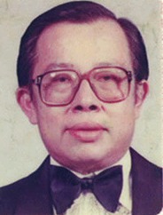
INAUGURAL CHIAM TEONG TEE
MEMORIAL LECTURE-CUM-LUNCH
The Abnormal becomes The New Normal
- Managing Water Hazards in the Context of Climate Change
Date: 10 March 2018
Venue: Ballroom 1, Sheraton Petaling Jaya, Selangor
Time: 12.00 pm – 2.00 pm

Slide 2
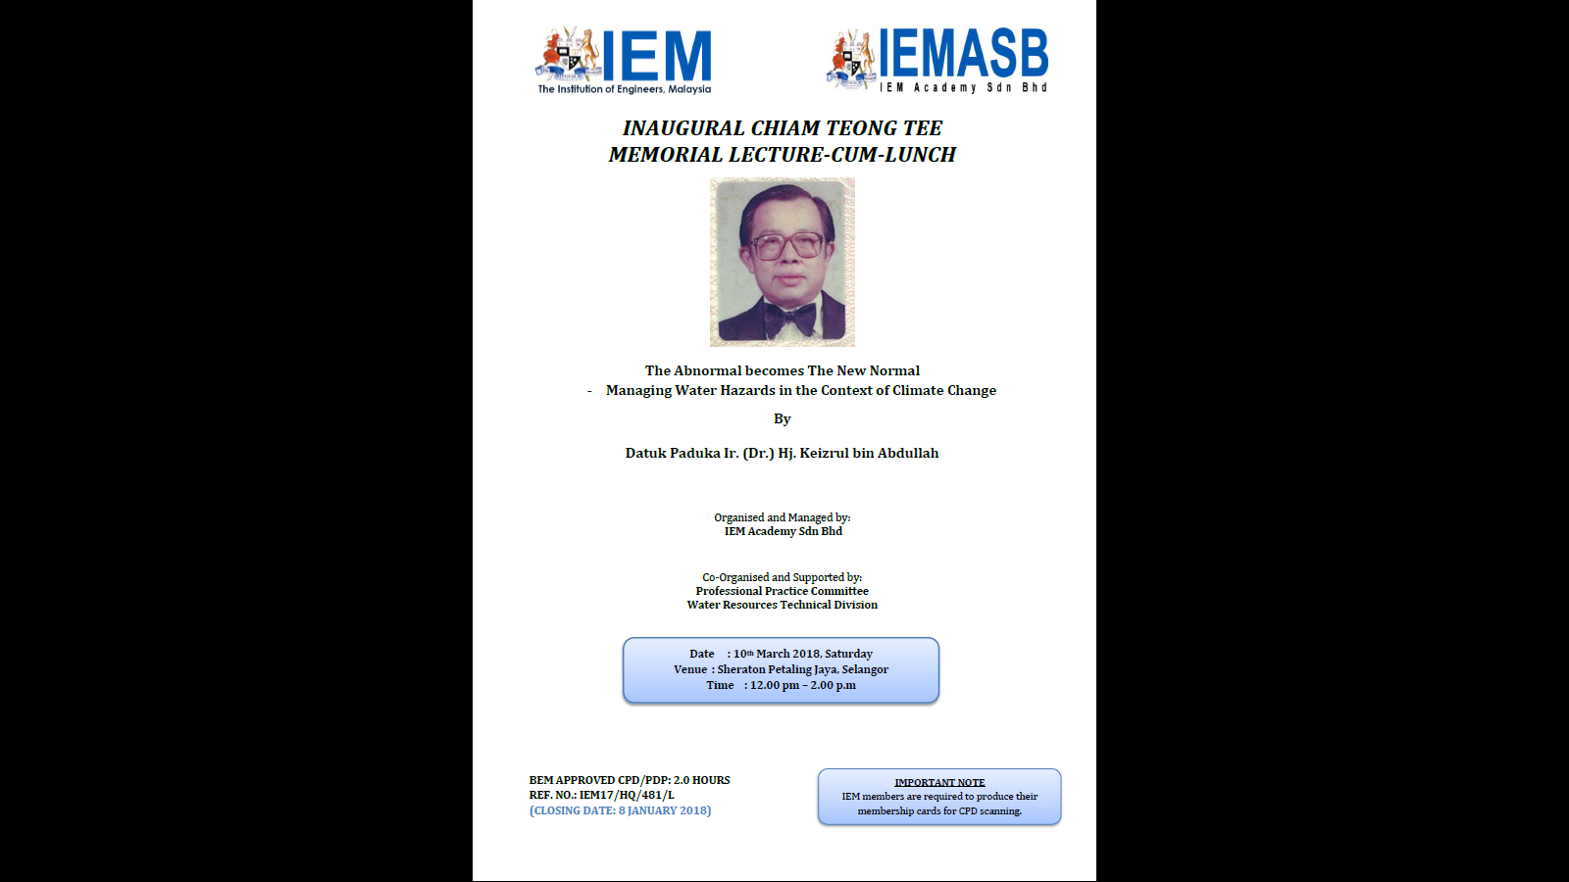
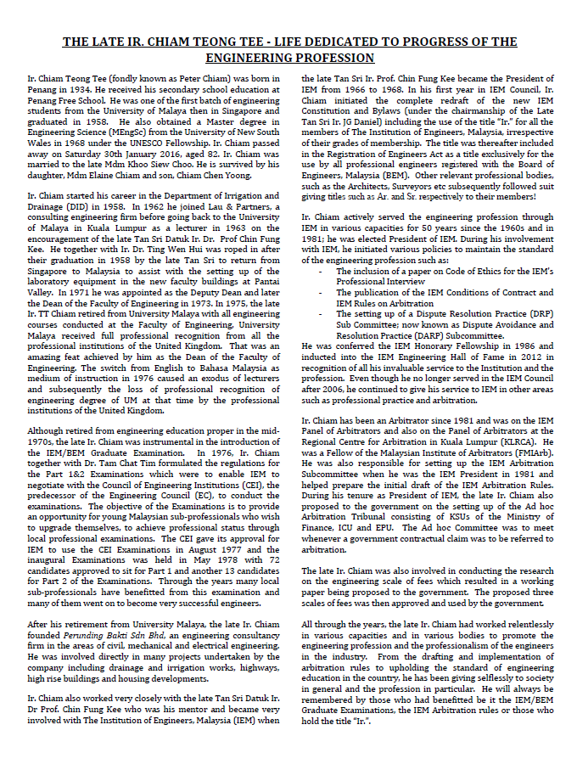
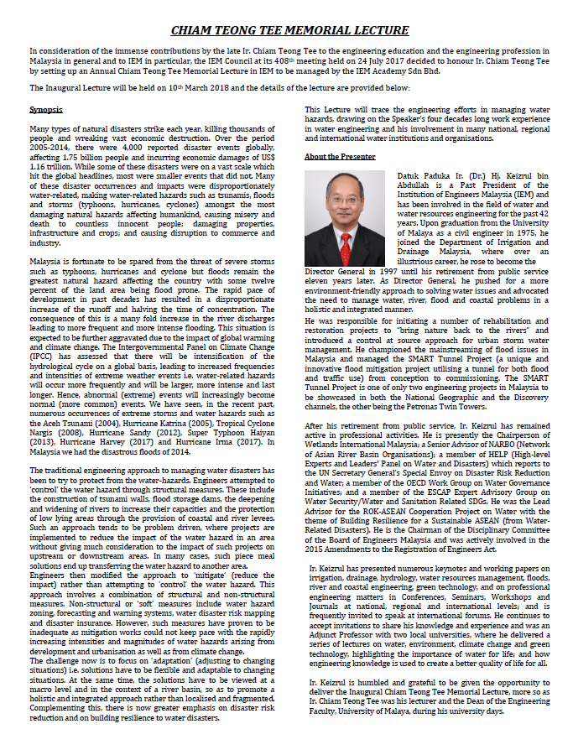

Slide 3

IEM PAST PRESIDENTS
No. | Name | Session
1 | Allahyarham Tan Sri Ir. (Dr) Haji Yusoff Bin Haji Ibrahim | 1959/62
2 | Allahyarham Raja Tan Sri Ir. Zainal Bin Raja Sulaiman | 1962/64
3 | Late Ir. Thean Lip Thong | 1964/66
4 | Late Tan Sri Datuk Ir. Prof. Chin Fung Kee | 1966/68
5 | Late Ir. Ow Yang Hong Chiew | 1968/69
6 | Late Ir. Chan Peng Khuen | 1969/70
7 | Y. Bhg. Tan Sri Dato’ Ir. (Dr) Abu Zarim Bin Haji Omar | 1970/72
8 | Late Y. Bhg. Academician Tan Sri Ir. (Dr) J. G. Daniel | 1972/74
9 | Allahyarham Tan Sri Datuk Ir. Haji Halaluddin Bin Mohd. Ishak | 1974/75
10 | Late Ir. Chan Khee Pok | 1975/77
11 | Allahyarham Tan Sri Datuk Ir. Mahfoz Bin Khalid | April - December 1977
12 | Allahyarham Ir. Tuan Haji Mohd. Razali Bin Bidin | 1977/79
13 | Late Ir. Wong Kin Hong | 1979/81
14 | Ir. Chiam Teong Tee | 1981/82
15 | Allahyarham Tan Sri Datuk Ir. Haji Mohd Hassan Bin Abdul Wahab | 1982/84
16 | Y. Bhg. Dato’ Ir. Pang Leong Hoon | 1984/86
17 | Ir. Tuan Haji Abdul Rahman Yaacob | 1986/88
18 | Y. Bhg. Academician Dato’ Ir. Lee Yee Cheong | 1988/90
19 | Allahyarham Dato’ Ir. Mustafa Bin Ahmad | 1990/92
20 | Ir. Chong Pick Eng (P.E. Chong) | 1992/93
21 | Y. Bhg. Dato’ Ir. Abdul Rashid Bin Ahmad | 1993/95
22 | Ir. Dr Ting Wen Hui | 1995/97
23 | Ir. Tuan Haji Mohd. Mazlan Bin Ismail Merican | 1997/99
24 | Y. Bhg. Academician Datuk Ir. (Dr) Haji Ahmad Zaidee Bin Laidin | 1999/01
25 | Ir. Dr Gue See Sew | 2001/03
26 | Y.Bhg Dato’ Ir. Prof. Abang Abdullah Bin Abang Ali | 2003/05
27 | Y. Bhg. Datuk Ir. Prof. Dr Ow Chee Sheng | 2005/07
28 | Y. Bhg. Dato' Paduka Ir. Prof. (Dr) Keizrul Bin Abdullah | 2008/09
29 | Y.Bhg Academician Dato’ Ir. Dr Chuah Hean Tiek | 2009/11
30 | Ir. Vincent Chen Kim Kieong | 2011/13
31 | Ir. Choo Kok Beng | 2013/14
32 | Y.Bhg Dato Ir. Lim Chow Hock | 2014 - Present

Slide 4

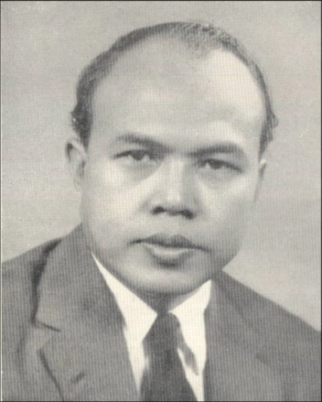
HALL OF FAME
Y. BHG. ALLAHYARHAM TAN SRI IR. HJ YUSOFF
Y.Bhg. Allahyarham Tan Sri Ir Hj Yusoff Ibrahim who graduated with a BSc in Engineering from University of London, served the Public Works Department for 25 years and was the first Malayan to be appointed Assistant Director of Administration and Development.
Y.Bhg. Allahyarham Tan Sri Ir Hj Yusoff mooted the idea of forming the IEM to oppose the effort of the British engineering institutions to use their membership as a deciding factor for promotion of engineers in the Civil service after the Independence.
Allahyarham Tan Sri was instrumental in IEM being admitted as a member of the Commonwealth Engineers Council in 1962 which enabled IEM to garner greater support from local engineers and thereby pave the way to IEM becoming the largest professional body in the country today.
During his service as Director of the PWD, Y. Bhg. Allahyarham Tan Sri was also appointed the Chairman of the “Jawatankuasa Istilah Kejuruteraan” of Dewan Bahasa dan Pustaka.

Slide 5

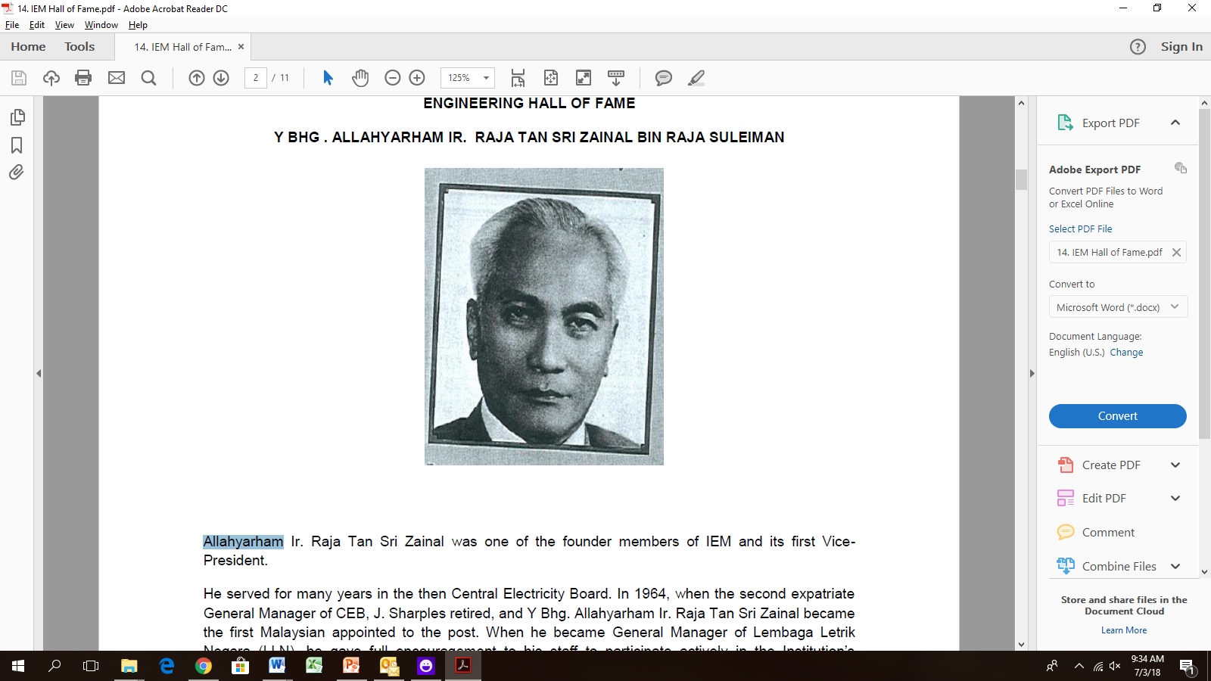
HALL OF FAME
Y. BHG . ALLAHYARHAM IR. RAJA TAN SRI ZAINAL BIN RAJA SULEIMAN
Allahyarham Ir. Raja Tan Sri Zainal was one of the founder members of IEM and its first Vice-President.
He served for many years in the then Central Electricity Board. In 1964, when the second expatriate General Manager of CEB, J. Sharples retired, and Y Bhg. Allahyarham Ir. Raja Tan Sri Zainal became the first Malaysian appointed to the post. When he became General Manager of Lembaga Letrik Negara (LLN), he gave full encouragement to his staff to participate actively in the Institution’s activities.
For his dedicated services to the nation, he was awarded the Panglima Setia Mahkota by DYMM Seri Paduka Baginda yang DiPertuan Agong in 1970.
In October 1970, through the good offices of Y Bhg. Allahyarham Ir. Raja Tan Sri Zainal, the IEM was offered an office space at Jalan Timur, NEB District Office. He was also made a Honorary Fellow of IEM for his services to the Institution.
For his effort IEM records this recognition by giving him this auspicious award and a place in the Engineering Hall of Fame.

Slide 6

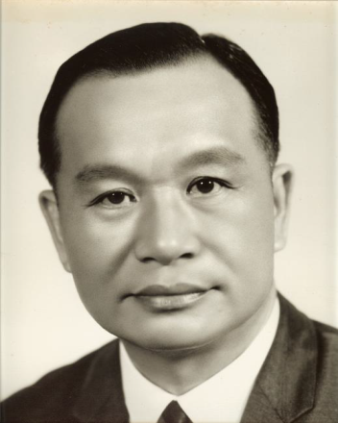
HALL OF FAME
THE LATE Y. BHG. TAN SRI IR PROFESSOR CHIN FUNG KEE
Y.Bhg. Tan Sri Datuk Ir. Dr Professor Chin Fung Kee, DSc (Belfast), FIE (Malaysia, S’pore, Ireland), FICE, FIStrutE, Hon FICE, Hon DSc (Glasgow, S’pore), was a man of outstanding qualities who distinguished himself in terms of his achievements and his contributions to society. In a long career lasting over 40 years he was well known as a brilliant research worker, a university lecturer and a practising engineer who was renowned not only in Malaysia but also in the international arena. He was an outstanding engineer in geotechnical, structural and hydraulic engineering. He is remembered for his leading role in the Penang Bridge project and other important projects such as the Maybank HQ building and the North-South Expressway.
Arising from his high professional standing, he was elected to serve in many key posts both nationally and internationally: Y.Bhg. Tan Sri was President of IEM, Chairman of the Commonwealth Engineers Council and Vice President for Asia in the International Society for Soil Mechanics and Foundation Engineering. Y.Bhg. Tan Sri was a man of high integrity and strong principles. He contributed immensely and selflessly to the engineering profession and to society at large. Above all, his lasting legacy which continues to this day is that he inspired a whole generation of engineers to engineering excellence which is crucial to the progress and advancement of the profession.

Slide 7
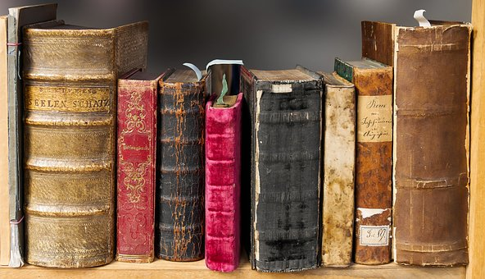
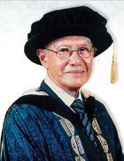
HALL OF FAME
Y. BHG. TAN SRI DATUK IR. (DR.) ABU ZARIM BIN HAJI OMAR
Y.Bhg Tan Sri Datuk Ir. (Dr.) Abu Zarim bin Haji Omar served as IEM’s President from 1970 to 1972. Y.Bhg Tan Sri served as the General Manager of Lembaga Letrik Negara (LLN) prior to his retirement after 40 years of service. He was responsible for the the reorganization of LLN in 1970, the development of all grades of human resource including the establishment of Institut Latihan Sultan Ahmad Shah. During his term of office, LLN expanded enormously in size and complexity. The aggressive implementation of Rural Electrification programmes including, the introduction of mini-hydro projects throughout the country are just a few.
Under his leadership, LLN had worked towards the exploration of other energy sources like coal, gas and hydro-power as replacement for oil and emerged as one of the leading employers of engineers in the country. During his tenure in IEM he participatedin thedevelopmentof the Engineers, Act. YBhg Tan Sri had assisted to provide facilities to house the IEM Secretariat office at the LLN premises at Jalan Timur. His dedicated and unselfish services to the nation and the Institution had earned him numerous awards including the IEM Honorary Fellow and the nation’s Panglima Setia Mahkota.
IEM Council at its meeting on 19 March 2012 therefore proud to honour Y.Bhg Tan Sri Datuk Ir. (Dr.) Abu Zarim bin Haji Omar a place in its Engineering Hall of Fame for all his contributions.

Slide 8

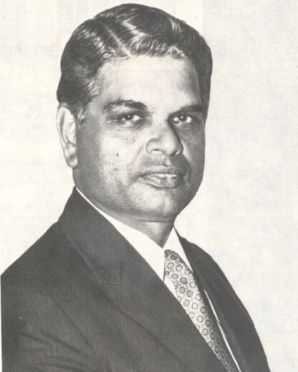
HALL OF FAME
THE LATE Y. BHG. TAN SRI J. G. DANIEL
One of the founding members of IEM, he had been elected a Member of IEM in 1958. The longest serving member of the IEM Council since 1961, Y. Bhg. Tan Sri had held the office of Honorary Treasurer (1965-1967) / (1971-1972), Vice President (1967-1971) and President (1972-1974). Y.Bhg. Tan Sri was one of the original Committee members who drafted the IEM Constitution and Bye-Laws and had been the Chairman of the Ad-Hoc Committee on Amendments to the IEM Constitutions and By-laws from 1971. Tan Sri was the Director General of the Drainage and Irrigation Department (DID) (1972-1976) and served as member of the Board of Engineers Malaysia (1972-1977) and
BEM Investigation Committee Member (2000-2002).
As the Government’s expert advisor and consultant in the field of drainage, irrigation, hydrology, hydraulics, urban drainage and flood control, among his major contributions were the formulation of the West Johore Drainage Project, the publishing of Standard Urban Drainage, hydrology and Hydraulics and the introduction of glass reinforced polyester conduits for speedy construction of irrigation distribution systems. He was consultant to the World Bank on Drainage and Irrigation Projects in Indonesia and the International Fund for Agricultural Development in Rome. Y.Bhg. Tan Sri was a Foundation Fellow and a Council Member of the Academy of Sciences, Malaysia and the Chairman of Balai Ikhtisas Malaysia.

Slide 9


HALL OF FAME
IR. CHIAM TEONG TEE
Ir. TT Chiam was born in Penang in 1934. He received his secondary school education at Penang Free School. He was one of the first batch engineering students from the University of Malaya then in Singapore and graduated in 1958. He also obtained a Master in Engineering Science (MEngSc) from the University of New South Wales in 1968 under the UNESCO Fellowship.
Ir. TT Chiam started his career in the Department of Irrigation and Drainage (DID) in 1958. In 1962 he joined a Consulting Engineering firm before goingback to the University of Malaya in Kuala Lumpur as a lecturer in 1963. In 1971 he was the
Deputy Dean and was appointed the Dean of the Faculty of Engineering in 1973.
In 1975, he was a founding member and principal of Perunding Bakti Sdn Bhd, a firm in Engineering Consultancy service in areas of civil, mechanical and electrical engineering. He was then involved directly in many projects undertaken by the company including Drainage and Irrigation works, Highways, High Rise Buildings and Housing Developments.
Ir. TT Chiam has been an Arbitrator since 1981 and is on the IEM Arbitration Panel and also the Regional Centre for Arbitration in Kuala Lumpur (KLRCA). He was a Fellow of the Malaysian Institute of Arbitrators. He was also responsible for setting up the IEM Arbitration Committee when he was the IEM President in 1981 and helped prepare the initial draft of the IEM Arbitration Rules.
Ir. TT Chiam is still actively serving the engineering profession through IEM in various capacities. He had been conferred the IEM Honorary Fellowship in 1986 and Fellow Members of other Institutions such as the Institution of Civil Engineers United Kingdom (ICE,UK), Institution of Engineers Singapore (IES) and American Society of Civil Engineers (ASCE) just to name a few.

Slide 10

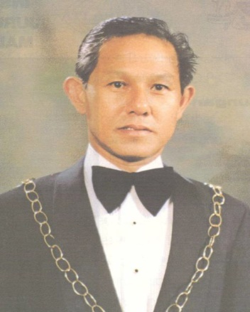
HALL OF FAME
Y. BHG. DATO’ IR. PANG LEONG HOON
Y.Bhg Dato’ Ir. Pang Leong Hoon received his Fellowship Diploma in Civil Engineering in 1957 from the Royal Melbourne Technical College, Australia. During his one-year service with the Commonwealth Department of Works Australia, Y.Bhg Dato’ Ir. Pang was involved with the multi-million pound Pukapunyal Military Camp Project.
Returning home in 1958, Y.Bhg Dato’ Ir. Pang joined the Drainage and Irrigation Department, Malaysia where he served for 29 years. His contribution
in various capacities with DID until his retirement in 1987, was instrumental in the development and management of drainage, irrigation and flood control projects throughout the country. After his retirement, Y.Bhg Dato’ Ir Pang served in the Panel of the Public Services Tribunal for five years.
Y.Bhg Dato’ Ir Pang Leong Hoon had also contributed tirelessly to the IEM especially during his presidency from 1984 to 1986. He is also IEM’s long standing Election Officer who is highly regarded for his impartiality and seriousness in conducting IEM’s annual elections.
His distinguished services had earned him various State and Federal awards.

Slide 11

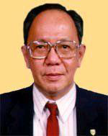
HALL OF FAME
Y.BHG. ACADEMICIAN DATO’ IR. LEE YEE CHEONG
Academician Dato’ Ir. Lee Yee Cheong, 68, studied in the University of Adelaide, South Australia and graduated with the degree of B.E. (Electrical) with first class honours in 1961.
On his return to Malaysia, he served with the National Electricity Board until 1980, primarily involved in real-time computer control of the power grid and in pioneering the use of computer in power system planning in Malaysia for the proposed ASEAN power grid. He was project manager of the National Load Despatch Centre and is still an ardent advocate of the ASEAN Power Grid, especially the stretch from South-westChina through Laos, Vietnam, Cambodia, Thailand, West Malaysia, Singapore and through Sumatra to Java.
In 1980, he joined Tenaga Ewbank Preece (M) Sdn Bhd as a Director and then Managing Director. TEP was the Malaysian company of the worldwide Ewbank Preece Group, a UK based engineering consultancy company. He eventually became a partner in the UK holding company, overseeing the expansion of the group in the Asia Pacific region. He was Managing Director of Ewbank Preece (Far East) Ltd, Hong Kong and Director of Ewbank Preece company in Australia, Singapore, Brunei, Indonesia and Thailand. He also was the CEO of KTA Tenaga Sdn Bhd, one of the top engineering consultancy companies in Malaysia from 1994 to 2003 before he retired. His business interests are independent power producer (IPP) and BOT projects in the power sector; and power and water projects in China.
Academician Dato’ Ir. Lee has been active in professional engineering institutions being the President of the IEM for the 1988/1990 sessions, Member of the Board of Engineers, Malaysia, Member of the Board of Architects Malaysia, Secretary General, the Federation of Engineering Institutions in Southeast Asia and the Pacific (FEISEAP), Chairman of the Commonwealth Engineers Council (CEC), the umbrella body of National Institutions of Engineers in the Commonwealth and President of the ASEAN Federation of Engineering Organisations (AFEO). Currently he is the President of the World Federation of Engineering Organisations (WFEO). He is also a National Congress delegate of the Institution of Engineers, Australia.

Slide 12
HALL OF FAME
Y.BHG. ACADEMICIAN DATO’ IR. LEE YEE CHEONG (CONT’D)
Academician Dato’ Ir. Lee was one of the key players in the initiative that resulted in the formation of the Academy of Sciences, Malaysia (ASM) in 1995. He was a Foundation Fellow and the first Secretary General. Currently he is a Senior Fellow of the ASM and the title “Academician” was conferred by the Academy of Sciences Act. He has been overseeing international affairs in ASM since its establishment and was instrumental in the establishment of the ASEAN Council of Academies of Science, Engineering and Technology and Similar National Organisations (ASEAN-CASE) in 1997.
He was a member of the Inter-Academy Panel of World Science Academies (IAP) Sustainability Transition Conference Coordinating Committee (STCC), responsible for the successful organisation of the IAP 2000 Conference in Tokyo in May 2000. He is also a
member of the Board of the newly established Inter-Academy Council (IAC) of World Science Academies. He coordinates International council for Science (ICSU) affairs at the ASM.
Academician Dato’ Ir. Lee was conferred the Malaysian state awards of DPMP and KMN for services to engineering. He was conferred the Honorary Officer in the Order of Australia for the services in Malaysia/Australia relations.
Academician Dato’ Ir. Lee Yee Cheong has shown outstanding greatness of spirit, selfless service, integrity and devotion to the humanity, technical professions and other professions, particularly the Institution of Engineers, Malaysia with no expectation of material rewards and without expecting public recognition.
Academician Dato’ Ir. Lee Yee Cheong has indeed made Malaysia proud during the recent World Engineering Conference in Shanghai, China. He has impressed upon the world engineering fraternity that the Malaysian Engineering Professional are a force to be reckoned with.
IEM Council at its meeting on 19 March 2012 is therefore proud to honour Y.Bhg Academician Dato’ Ir. Lee Yee Cheong a place in its Engineering Hall of Fame for all his contributions.

Slide 13

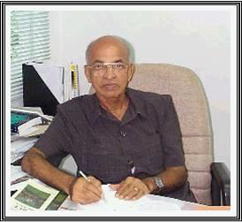
HALL OF FAME
THE LATE IR K. KUMARASIVAM
The late Ir. K. Kumarasivam joined IEM as a member in 1966 and elected as Fellow in 1981. He served in various Standing Committees and presented various papers at seminars and forums organised by IEM. He served a three-year term in the Council and Executive Committee of IEM in 1982; and represented IEM on the FEISEAP Environment Committee. He was the founder of Kumarasivam Tan & Ariffin Sdn Bhd (KTA) and was Chairman until the company’s merger with Tenaga Ewbank Preece (Malaysia) Sdn Bhd in 1993, after which he was the Deputy Chairman of KTA Tenaga Sdn Bhd. He had been involved in many aspects of engineering particularly Highway & Traffic Engineering and Environmental Engineering.
A humble gentleman and very much ahead of his time in both vision and philosophy, his love for engineering which he believed as a key contributing factor to the betterment of mankind and the environment was manifested by his selfless contributions to the Malaysian engineering and environmental fraternities.

Slide 14
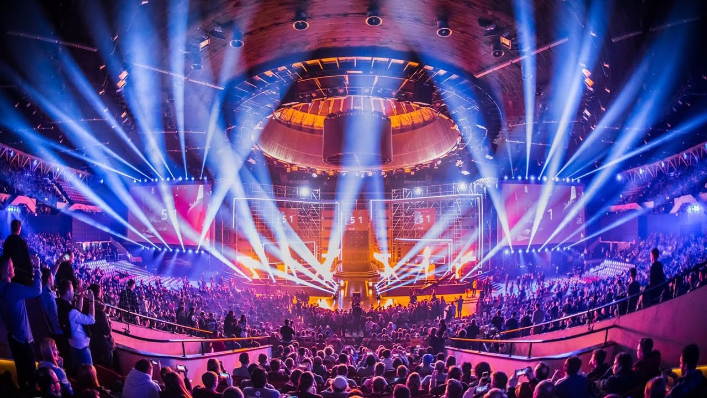
IEM DISTINGUISHED HONORARY FELLOW
Year | Name of Recipient
2003 | Y.A.Bhg. Tun Dr Mahathir bin Mohamed
2010 | Y.Bhg. Academician Dato’ Ir. Lee Yee Cheong

Slide 15
IEM HONORARY FELLOW
Year | Name of Recipient
1981 | Allahyarham Tan Sri Ir. (Dr) Haji Yusoff bin Haji Ibrahim
1981 | Allahyarham Raja Tan Sri Ir. Zainal bin Raja Sulaiman
1981 | Late Ir. Thean Lip Thong
1981 | Late Tan Sri Datuk Ir. Prof. Dr. Chin Fung Kee
1982 | Y.Bhg. Tan Sri Dato’ (Dr) Ir. Haji Abu Zarim bin Haji Omar
1982 | Late Academician Tan Sri Ir. (Dr) J. G. Daniel
1984 | Y.A.Bhg. Tun Dr Mahathir bin Mohamed (transferred to Grade of Distinguished Hon Fellow in 2004)
1986 | Ir. Chiam Teong Tee
1986 | Allahyarham Tan Sri Datuk Ir. Haji Mohd. Hassan bin Abdul Wahab
1988 | Allahyarham Tun Hussein Onn
1989 | Al-Marhum DYMM Paduka Seri Sultan Azlan Muhibbuddin Shah Ibni al-Marhum Sultan Yussuf Izzuddin Shah Ghafarullahu-Lah
1991 | Y.Bhg. Dato’ Ir. Pang Leong Hoon
1991 | Prof. Dr. Ing. B. J. Habibie
1993 | Allahyarham Dato’ Ir. Mustafa bin Ahmad (posthumous)
1993 | Y.Bhg. Tan Sri Dato’ Ir. (Dr) Shamsuddin bin Abdul Kadir
1993 | Y.Bhg. Academician Dato’ Ir. Lee Yee Cheong (transferred to Grade of Distinguished Hon Fellow in 2010)

Slide 16
IEM HONORARY FELLOW (CONT’D)
Year | Name of Recipient
1994 | Al-Marhum Tuanku Ja’afar Ibni al-Marhum Tuanku Abdul Rahman
1995 | Y.Bhg. Datuk Amar (Dr) Leo Moggie
1998 | Y.A.Bhg. Tun Daim Zainuddin
2001 | Y.A.B. Dato’ Seri Abdullah bin Haji Ahmad Badawi
2003 | Y.Bhg. Dato’ Seri Law Hieng Ding
2004 | Y.Bhg Datuk Tham Nyip Shen
2006 | Late Ir. Teoh Cheng Hock (Ir. C.H. Teoh) (posthumous)
2007 | Y.Bhg. Tan Sri Dato’ Ir. Haji Zaini bin Omar
2008 | YAB Pehin Seri Tan Sri Dr Haji Abdul Taib bin Mahmud
2008 | YAB Datuk Seri Panglima Musa bin Haji Aman
2008 | YAB Dato’ Seri Ir. Hj Mohammad Nizar bin Jamaluddin
2009 | Y.Bhg. Dato’ Sri Ir. Mohd Zin bin Mohamed
2012 | Y.B. Senator Dato’ Ir. Donald Lim Siang Chai
2012 | Ir. Dr Ooi Teik Aun
2012 | Late Ir. Ow Yang Hong Chiew (posthumous)
2012 | Late Ir. Chan Peng Khuen (posthumous)
2012 | Allahyarham Tan Sri Datuk Ir. Haji Halaluddin bin Mohd. Ishak (posthumous)
2012 | Late Ir. Chan Khee Pok (posthumous)

Slide 17
IEM HONORARY FELLOW (CONT’D)
Year | Name of Recipient
2012 | Allahyarham Tan Sri Datuk Ir. Mahfoz bin Khalid (posthumous)
2012 | Allahyarham Tuan Haji Mohd. Razali bin Bidin (posthumous)
2012 | Late Ir. Wong Kin Hong (posthumous)
2012 | Allahyarham Ir. Tuan Haji Abdul Rahman bin Yaacob
2012 | Ir. Chong Pick Eng (P.E. Chong)
2012 | Y.Bhg. Dato’ Ir. Abdul Rashid bin Ahmad
2012 | Ir. Dr Ting Wen Hui
2012 | Ir. Dr Ting Wen Hui
2012 | Ir. Tuan Haji Mohd. Mazlan bin Md. Ismail Merican
2012 | Y.Bhg. Academician Tan Sri Datuk Ir. (Dr) Haji Ahmad Zaidee bin Laidin
2012 | Y.Bhg. Dato’ Ir. Dr Gue See Sew
2012 | Y.Bhg Dato’ Ir. Prof. Abang Abdullah bin Abang Ali
2012 | Y.Bhg. Datuk Ir. Prof. Dr Ow Chee Sheng
2012 | Y.Bhg Dato’ Paduka Ir. Prof. (Dr) Haji Keizrul bin Abdullah
2013 | Y.Bhg. Ir. Academician Prof. Dato’ Dr Chuah Hean Teik
2014 | Ir. Vincent Chen Kim Kieong
2014 | Y. Bhg. Dato’ Sri Ir. Dr. Judin bin Abdul Karim
2014 | Y. Bhg. Tan Sri Dato’ Ir. Dr. Gan Thian Leong
2014 | Allahyarham Dato’ Ir. Prof. Dr. Radin Umar bin Radin Sohadi
2015 | Y. Bhg. Tan Sri Dato’ Seri Dr. Jeffrey Cheah Fook Ling, AO

Slide 18
IEM HONORARY MEMBER
Year | Name of Recipient
2009 | Late Master Yeoh Tong Eng
2012 | En. Mohd. Annuar bin Taib
2012 | Y. Bhg. Dato’ Hj. Abd. Halim bin Hj. Abd Latif
2012 | Y. Bhg. Dato’ Baharudin bin Sariman
2012 | Y. Bhg. Dato’ Gan Boon Khuay
2012 | Puan Salmah binti Mohd Taufik
2013 | Y.Bhg. Dato’ Prof. Dr Mohd Noh bin Dalimin
2013 | Y. Bhg. Tan Sri Dato’ Ir. Teo Chiang Kok
2013 | Y.Bhg. Dato’ Dr Mohamad bin Hashim
2014 | Y.Bhg. Dato’ Lau Siu Wai
2014 | Y.B. Datuk Dr. Abu Bakar bin Mohamad Diah
2015 | Professor Datuk Dr. Shahrin bin Sahib @ Sahibuddin

Slide 19

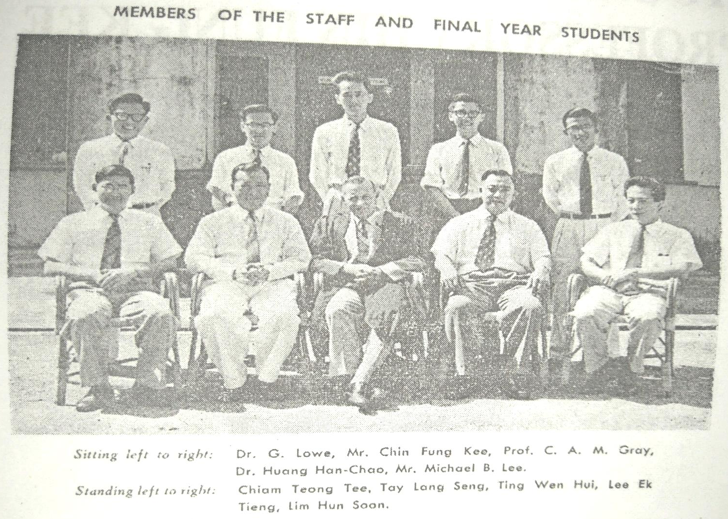
1958 FINAL YEAR STUDENTS OF
UNIVERSITY OF MALAYA ENGINEERING FACULTY

Slide 20
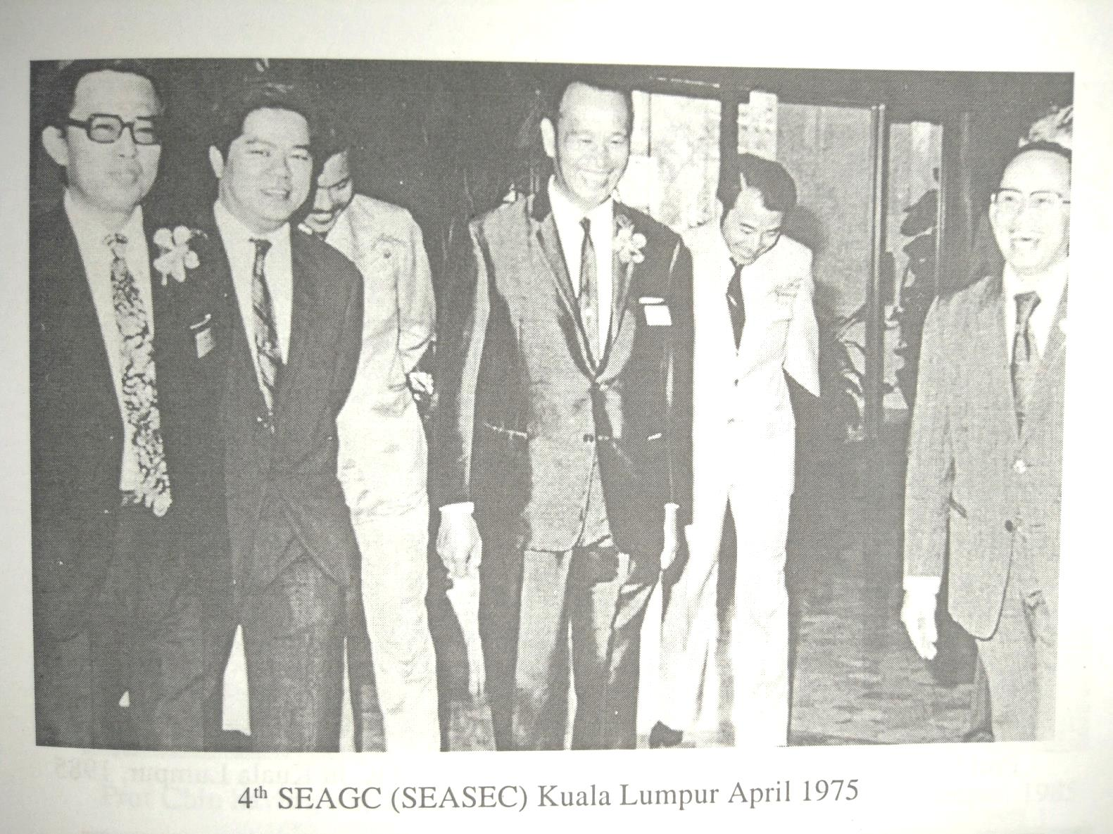
4SEAGC

Slide 21
PROF. CHIN LECTURE
FIRST PROF. CHIN LECTURE HELD IN BANGKOK AT THE 9TH ARC IN 1991
While glancing through my Archives, I found that the First Prof. Chin Lecture was held in Bangkok in 1991 during 9 ARC. Mr Chiam, a distinguished student of Prof. Chin and past-President of IEM, talked about the contributions of Prof. Chin. Dr. Ting chaired the first Lecture by Dr. Za Chieh Moh. Mrs. Chin was also invited to the Lecture with the daughter of Prof. Chin. Since then many lectures were given. It would be nice if the History of named Lectures Dr.Za Chieh Moh Lecture, Prof. Peter Lumb Lecture, Dr. Chai Mukhtabant Lecture, Prof. Seng Lip Lee Lecture and others can feature in the History of SEAGS-AGSSEA. Only the History of CTGS, and GeoSS were received now. We eagerly wait for others as well.
Peter Chiam delivering his Speech

Slide 22
BACKGROUND HISTORY
Geotechnical Engineering Technical Division of
The Institution of Engineers, Malaysia
(GETD, IEM)
The Geotechnical Engineering Technical Division of The Institution of Engineers, Malaysia has its root in the organizing committee formed by the late Tan Sri Ir. Dr. Prof. Chin Fung Kee in 1972 to organize the Fourth Southeast Asia Soil Engineering Conference (4SEASSEC). It was the first time for Malaysia to play host after the Third conference held in Hong Kong. Prof Chin was elected President (1972 – 1975) of the Southeast Asian Society for Soil Engineering (SEASSE) (later changed to Southeast Asian Geotechnical Engineering Society (SEAGS). After the 4SEASSEC conference the organizing committee became the Geotechnical Technical Division of IEM. Ir. Chiam Teong Tee was Deputy Chairman of the Organising Committee of 4SEASSEC.
Ir. Prof. Chin was Chairman from 1974 – 1982 after which Ir. Dr Ting Wen Hui took over as Chairman and served from 1982 – 1992. In 1992 Ir. Dr Ooi Teik Aun served as Chairman and in 1993 he was elected as President of Southeast Asian Geotechnical Society (SEAGS) (1993 – 1996) Ir. Dr. Ooi was elected again as President of SEAGS for two more terms in the difficult time of SEAGS (2010 – 2013, 2013 – 2016). Ir Dr Ooi served as Chairman for the term of 1992 – 1993. He was succeeded by Ir. Dr Chan Sin Fatt who served as Chairman from 1993 – 1995. Ir. Tang Tin Seng took over as Chairman from 1995 – 1996.
This was followed by Ir. Neoh Cheng Aik who served as Chairman from 1996 – 1999. Ir. Dr Gue See Sew took over as Chairman from 1999-2001. He was succeeded by Ir. Mun Kwai Peng who served from 2001 – 2003. Ir. Kenny Yee Kwong Sing served as Chairman from 2003-2005. Ir. Tan Yean Chin served as Chairman from 2005 – 2007. Ir. Yee Yew Weng served as Chairman from 2007 – 2010. He was succeeded by Ir. Lee Eng Choy as Chairman from 2010 – 2012. Ir. Liew Shaw Shong took over from 2012 – 2015 as Chairman before handing over the Chairmanship to Ir. Yee Thien Seng who serves from 2015 – present.

Slide 23
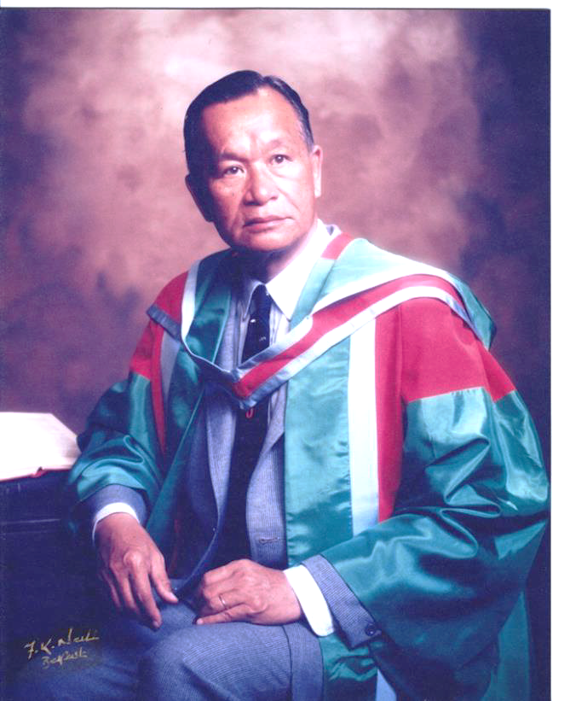
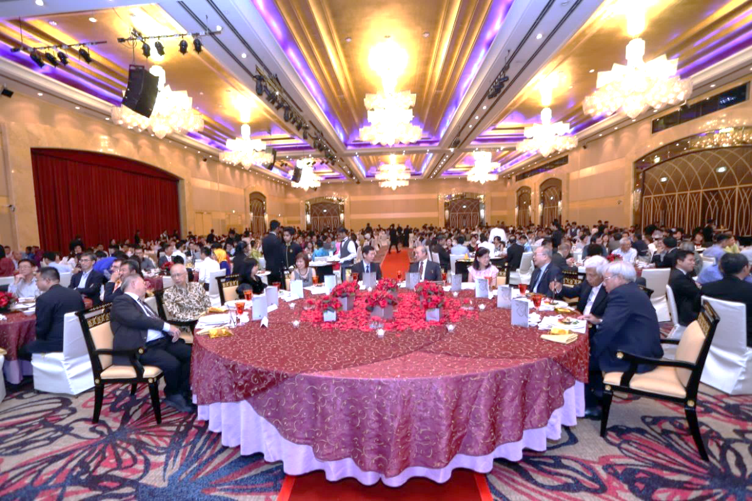
PROF CHIN COMMEMORATIVE DINNER HELD
ON 12TH SEPTEMBER 2016
Tan Sri Ir. Dr. Prof. Chin Fung Kee
Prof Chin Commemorative Dinner held on 12th September 2016
organised by Ir. Chiam Teong Tee

Slide 24

COMMITTEE MEMBERS
Ir. Dr Ooi Teik Aun
Dato’ Ir. Lim Chow Hock
Ir. Lai Sze Ching
Ir. Dr Tan Yean Guan
Ir. Tan Yean Leong
Ir. Chia Khoon Khean
Alex Pong Vui Wei

Slide 25

BANGUNAN INGENIEUR (THE IEM BUILDING)
BACKGROUND
In the early days, the Institution had no building of its own and it had to squat on borrowed premises – homes and offices of the various Hon. Secretaries and, later, Station Hotel (K.L) Malayan Railway. From 1st October, 1970, the NEB (now TNB) was generous enough to allow part of the NEB store in Jalan Timor, Petaling Jaya, Selangor, to be used as the IEM Secretariat office until the IEM Building was completed in May, 1976.
As early as 1961, the IEM Council realised there was a need to start a Building Fund with the aim for IEM to have its own building one day. During session 1962/1963, the Council set up a committee to consider ways and means to raise funds. Later, the committee’s function was extended to include the search for and to identify sites suitable for the proposed IEM Building.
When the site for proposed IEM Building was finalised, the Council, at its 140th meeting held on 13 July 1970, appointed the Institution Building Committee to come up with the design and planning of the building. The Committee Members comprised:
Encik Abu Zarim bin Haji Omar (Chairman)
Mr. Chan Weng Chu
Mr. Chan Kee Pok
Encik Mohd. Hassan bin Abd. Wahab
Mr. Chester Ho Hong
Mr. Thean Lip Thoung
Mr. Lee Boey Huay
Over the years, the composition of this Committee went through some changes.
After the contract of the Building was awarded, the Council appointed the Building Supervision and Management Committee for the proper supervision and management of the contract and construction of the building.
THE BUILDING SITE
During the search for sites suitable for the proposed IEM Building, the Council was informed that the Petaling Jaya Authority had earmarked a few pieces of land in the New Town area for such a purpose.
Accordingly, steps were taken to find out more details. After some delays, the Petaling Jaya Authority submitted IEM’s application to the State Government for consideration and approval. This was recorded in the Minutes of the 56th Council Meeting held on 16 March 1964. As reported by the President at the 5th Annual General Meeting on 11 May 1963, an application had been made to obtain and purchase two lots of land (Lot No. 60 & 62) at Jalan 52/4, Petaling Jaya, Selangor. These two lots (57ft x 75ft) covered 4,275sq ft of commercial land.
In mid-1964, the Petaling Jaya Authority informed IEM that the Selangor State Government had approved IEM’s application for the land and that the total cost was RM20,485.50. At its 64th Meeting held on 8 August, 1964, the Council considered and approved the payment of the quit rent and other fees in the form of a RM3,000 deposit. With the site and land settled in 1965, the next stage was the planning and design for the proposed IEM Building.
With the two lots of land in Petaling Jaya secured, the Council was informed in late 1966 that land was also available in Kuala Lumpur beside the new “Through Road”. Attempts to apply for the land was not successful or we might also have had a building in Kuala Lumpur today!

Slide 26
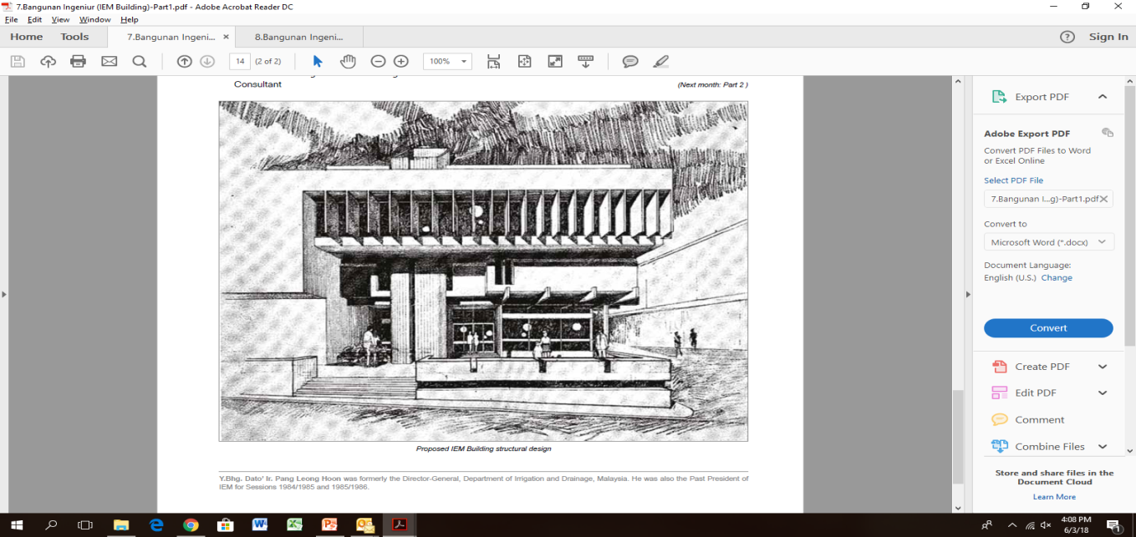
BANGUNAN INGENIEUR (THE IEM BUILDING)
THE EARLY DESIGN / TENDERINGS
For 5 years, from mid-1964 to mid-1969, the Council tried hard to get volunteers to do the design and drawings for the proposed building. The response was very good and a number of Council Members came forward to render their services in preparing the design and drawings for the approval of the PJ Authority. Tenders were called based on basic details available then. Fourteen contractors were invited to submit their bids and eight tenders were received, ranging from RM288,000 to RM321,000. The tender sums were considered too high and were rejected (Ref: 133th Council Meeting held on 8 December, 1969).
During Session 1970/1971, the design and drawing were refined and detailed Bills of Quantities were prepared. Tenders were invited in August 1970 and five tenders were received. Again, the tender sums were high and beyond the estimated cost. They were also rejected. (Ref: Report presented at the 12th Annual General Meeting held on 25 June, 1971).
After the two unsuccessful tendering processes, the Council decided to commission a well-known Malayan architect to design a building to serve the interests of the Institution. It would have a distinct character and stature both internally and externally as befitting a national body (Ref: Bulletin No.4 Nov 1970). At the 144th Council Meeting held on 9th November, 1970, the Council decided to commission Encik Baharuddin Abu Kasim of Architect Team 3 (Jurubena Bertiga) to redesign the proposed IEM Building. The Terms of Reference of the appointment were given in Bulletin 1970/1971 No. 5 of December, 1970.
Apart from the appointment of Architect Team 3 for the purpose, engineering consultancy service and design would also be required. IEM was very fortunate in that it had many dedicated members who were willing to volunteer their services. These were:
Ir. Chan Weng Chu – Structural Design
Ir. Wong Kon Nam – Supervision of Structural Construction
PCR dan Rakan-rakan – Acoustics and Electrical Consultant
Ir. Dr H.C. Huang – Air-conditioning and Mechanical Consultant
Ir. Dr Ting Wen Hui – Overall Project Supervisor and Co-ordinator
Following the appointment of Architect Team 3, various preliminary designs were prepared for the consideration of the Council. These were followed by several design sketches showing the perspective views of the proposed building. Eventually, it presented a design that was acceptable to the Council. The design sketches showing perspective views of the proposed building were displayed at the 12th Annual General Meeting of the Institution (25 June 1971) for members’ inspection. The proposed building had a basement, elevated ground floor, first floor, second floor, a penthouse and roof garden. The design gave the building character and strength that blended well with its immediate surroundings. Details of the proposed IEM Building were given in Bulletin Vol 1972 No. 2, February, 1972.
Proposed IEM building structural design

Slide 27
BANGUNAN INGENIEUR (THE IEM BUILDING)
CONSTRUCTION BEGAN
With the design finalised and drawings completed, the plans were submitted to the PJ Town Board (Lembaga Bandaraya PJ) for approval. The fine tuning of the drawings was done with valuable inputs from Mr. A.S. Bhatt and Mr. Lee Boay Huay, who were then P.J Town Board engineers. Accordingly, the building plans were approved by P.J Town Board in June 1972.
At the 164th Council Meeting held on 10 July 1972, the Council noted that the building plans had been approved and decided to call for tenders. Following discussions with the architect, the Council requested that arrangements be made for tenders to be invited as soon as possible.
After some minor amendments to the design and drawings, the architect was able to call for tenders in December 1972. The tender was closed on 30 January 1973 and 9 tenders were received. At its 172nd meeting held on 13 March 1973, the Council considered the Report on Tenders and agreed to accept the recommendation of the Building Committee. The contract was awarded to M/s. Ng Chye Heng. The contractor’s work as tendered was a total of RM219,450.00, not inclusive of PC items such as air conditioning, lifts, etc. It was estimated then that the cost of the contractor’s work for the building would eventually be around RM300,000.
The building site at Lots 60 & 62 Jalan 52/4 was handed over to the contractor on 14 April 1973 and accordingly, the targeted completion date would be 14 April 1974. However due to some problems and unforeseen circumstances, there were delays in construction work and the Council could not organise the launching ceremony as planned.
The ceremony for the laying of the foundation stone was delayed and was only held on 27 June 1974. Our Founder President, Tan Sri Hj. Yusoff bin Hj. Ibrahim, was given the honour of performing this function. During the ceremony, Tan Sri Hj. Yusoff donated RM1,000 to the Building Fund as “bunga tangan”. (The speeches given by the IEM President, Mr. JG Daniel, and Tan Sri Hj. Yusoff can be found in IEM Bulletin Vol. 1974 No.7, July 1974).
During the construction work, some modifications and changes were made to the original design and drawings to include the addition of a basement and the reconfiguration of the floor space.
At the time when the contract was awarded, it was expected that we could occupy the new building after one year. Unfortunately, the Institution and the contractor were caught in the woes of an unprecedented inflation in the country which also swept through the world from the latter part of 1973 to 1975. Like all other commodities, the price of building materials skyrocketed and as a result, the cost grew far more than the original estimated figure. To add to the problem, there was a shortage of steel, cement and other building materials. IEM was really in a dilemma. The Council suffered great anxiety, especially when construction work almost came to a standstill.
However, through the dedicated efforts and strong support of members, sourcing of building materials continued and various activities were organised to raise more funds. These really saved the day and the building was finally completed in May 1976 at the cost of RM671,780.00, including all the PC items.

Slide 28
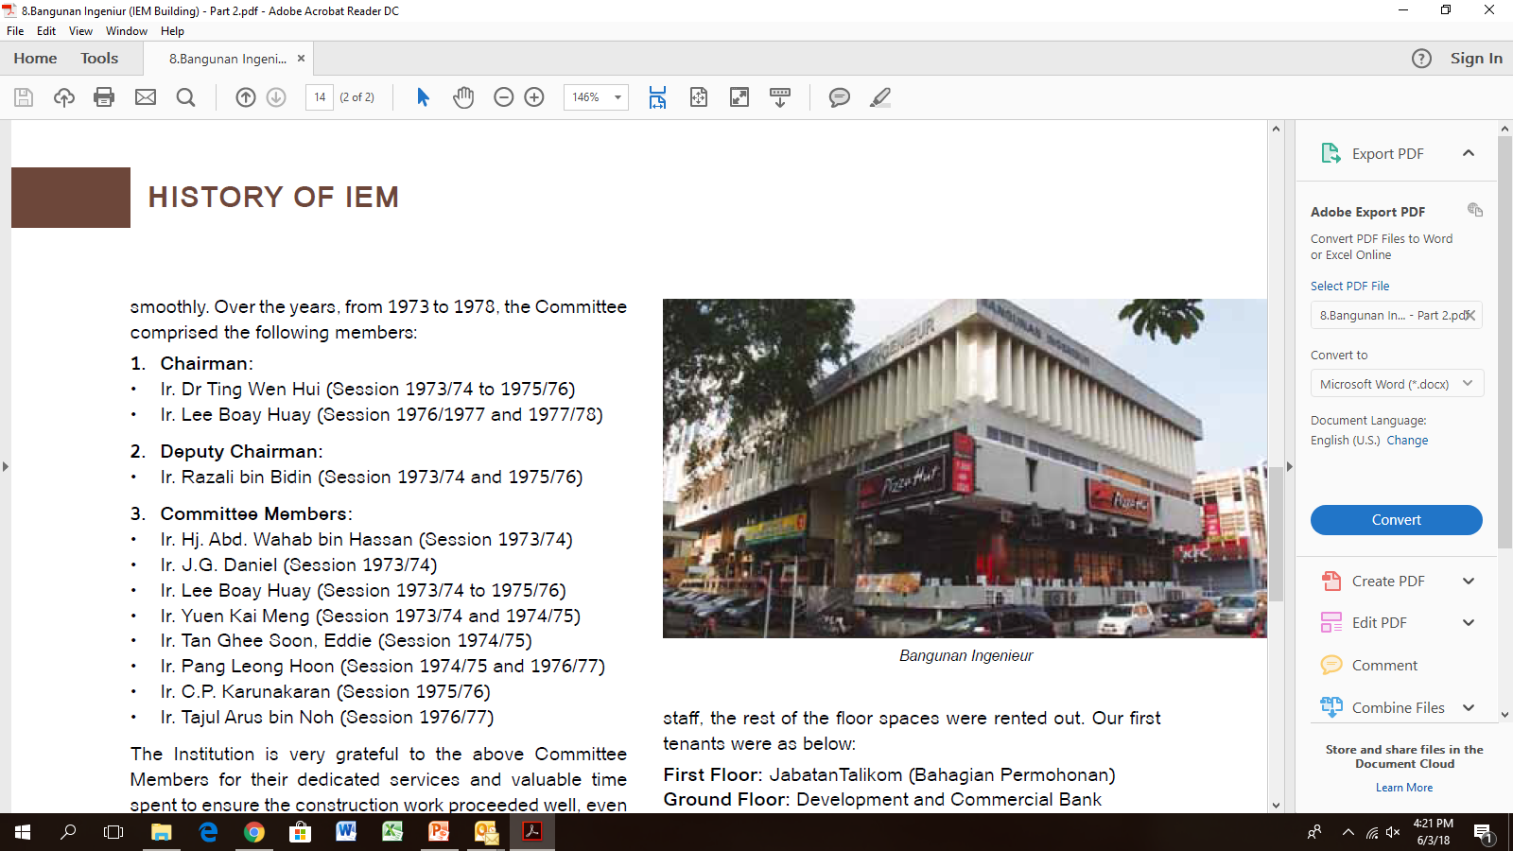
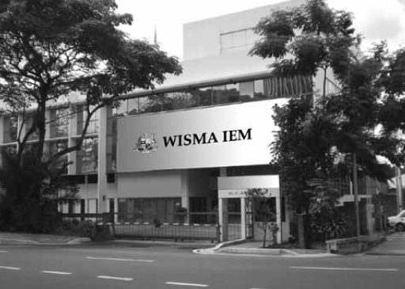
BANGUNAN INGENIEUR (THE IEM BUILDING)
It was very appropriate that our then President, Ir. Chan Kee Pok, in the Annual Report for the 17th AGM on 23 April 1976, gratefully thanked those who so generously donated both money and services to enable the Institution to have its own building. Below is an extract from the IEM Annual Report:
“I would like to record the thanks of the Institution to the Building Supervision and Management Committee headed by Ir. Lee Boay Huay for the good work carried out during the session. Our thanks also go to Architect Team Three (Jurubena Bertiga) for the design of the building, to Ir. Chan Weng Chiu, who was responsible for the structural design, to Ir. Wong Kon Nam for the supervision of the structural construction on site, to Ir. Dr Huang Han Chao for acting as mechanical and airconditioning consultant, to P.C.R & Rakan-Rakan for services asacoustic and electrical consultants and to Ir. Dr Ting Wen Hui for overall supervision and co-ordination.”
SUPERVISION AND MANAGEMENT COMMITTEE
Just before the contract was awarded, the Council at its 176th Meeting held on 30 July 1973, appointed the Building Supervision Committee. Later, the Committee was named Building Supervision and Management Committee. Its main function was to ensure that construction work proceeded smoothly. Over the years, from 1973 to 1978, the Committee comprised the following members:
1. Chairman:
Ir. Dr Ting Wen Hui (Session 1973/74 to 1975/76)
Ir. Lee Boay Huay (Session 1976/1977 and 1977/78)
2. Deputy Chairman:
Ir. Razali bin Bidin (Session 1973/74 and 1975/76)
3. Committee Members:
Ir. Hj. Abd. Wahab bin Hassan (Session 1973/74)
Ir. J.G. Daniel (Session 1973/74)
Ir. Lee Boay Huay (Session 1973/74 to 1975/76)
Ir. Yuen Kai Meng (Session 1973/74 and 1974/75)
Ir. Tan Ghee Soon, Eddie (Session 1974/75)
Ir. Pang Leong Hoon (Session 1974/75 and 1976/77)
Ir. C.P. Karunakaran (Session 1975/76)
Ir. Tajul Arus bin Noh (Session 1976/77)
Bangunan Ingenieur
The Institution is very grateful to the above Committee Members for their dedicated services and valuable time spent to ensure the construction work proceeded well, even during extremely trying times. Under proper supervision and directions, Bangunan Ingenieur was successfully completed.
Wisma IEM

Slide 29
BANGUNAN INGENIEUR (THE IEM BUILDING)
The Building is now 38 years old and is still standing strong as a testimony of good engineering design, construction and proper supervision! A job well done! From the 17th and 18th Annual Report Balance Sheets as at the 31st December 1975 and 31st December 1976, the following figures were given on the cost of Bangunan Ingenieur:
OFFICIAL OPENING
With the completion of Bangunan Ingenieur, arrangements were made for the official ceremony to commemorate the occasion. The date was 14th April 1977 and the venue was in front of the Building. The welcome address was made by our President, Mr. Chan Kee Pok. The guest of honour was Dr Mahathir Mohamad, the then Deputy Prime Minister, Malaysia. (Text of the speeches can be found in IEM Bulletin Vol. 1977 No. 4 April 1977).
Over 250 members and guests attended the ceremony held in front of Bangunan Ingenieur.
WHAT’S NEXT
In the Annual Report at the 17th AGM held on 23 April 1976, it was reported that the Building was completed and ready for occupation in May. The IEM Building was named Bangunan Ingenieur. The IEM Secretariat moved in on 28 May 1976. Apart from the space occupied by Secretariat staff, the rest of the floor spaces were rented out. Our first tenants were as below:
First Floor: JabatanTalikom (Bahagian Permohonan)
Ground Floor: Development and Commercial Bank
Basement:
i. M/s Oh & Associates
ii. M/s C.H William, Talhar & Wong Sdn. Bhd.
iii. M/s Drew Ameroid Sdn. Bhd.
iv. M/s Mayo, Fong & Yong Dental Surgeons
When Bangunan Ingenieur was completed in 1976, there were 1,804 IEM members and only 10 staff members. Today, IEM membership stands at 28,616 and there are 39 staff members. IEM activities have also increased over the years. As space was the main factor that was holding back the development of IEM, this warranted the need to consider office expansion and/or finding a new place. The Council and its members, after long deliberation, decided to purchase the building across the road in 2007 and it was named WISMA IEM!
Land | RM 20,485.50
Building Contract (Ng Chye Heng) | RM 325,169.28
PC items (air conditioning system, electrical, lift, etc) | RM 346,610.72
TOTAL | RM 692,265.50

Slide 30

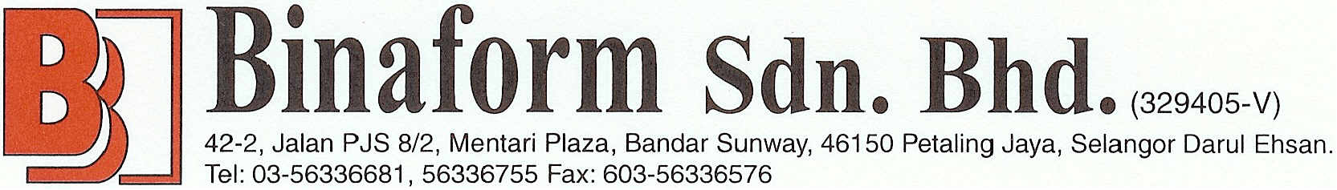





LIST OF PREMIER TABLE
Mr. Harry Chiam
GDS Intruments Sdn Bhd
Dynamic Pile Testing Sdn Bhd
Binaform Sdn Bhd
T & T Pacific Sdn Bhd
G-Pile System Sdn Bhd
G-Pile System Sdn Bhd
Jurutera Perunding Primareka Sdn Bhd
Econpile (M) Sdn Bhd
Dr YG Tan Jurutera Perunding Sdn Bhd

Slide 31












LIST OF STANDARD TABLE
Mechanical Engineering Technical Division (METD), IEM
The Consulting Engineering Special Interest Group (CESIG), IEM
Professional Practice Committee (PPC), IEM
Mega Geosolutions Sdn Bhd
Nestcon Infra Sdn Bhd
WD Infra Sdn Bhd
Advancecon Infra Sdn Bhd
Sandar Bina Sdn Bhd
Excelgenic Sdn Bhd
Kejuruteraan Kelancaran Jasa Sdn Bhd
Loo Sek Choy Plumbing Construction Sdn Bhd
Jurutera Perunding Wawasan Sdn Bhd
Industrial Concrete Products Sdn Bhd
Perunding Aziz, Azali & Tee Sdn Bhd
Econpile (M) Sdn Bhd

Slide 32
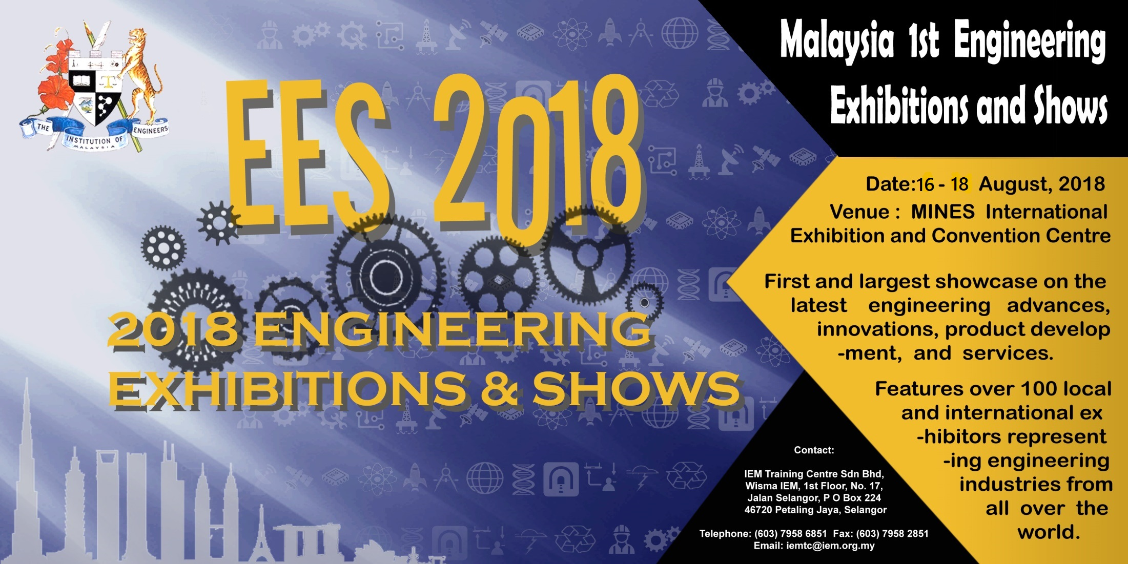
ENGINEERING EXHIBITIONS & SHOWS 2018 (EES2018)
16 – 18 August 2018
Contact:
Telephone: (603) 7958 6851 Fax: (603) 7958 2851
Website: iemtc.com Email: iemtc@iem.org.my

Slide 33

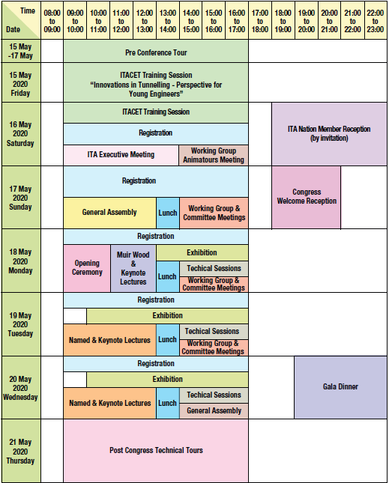
WORLD TUNNEL CONGRESS (WTC) 2020
Programme Outline
Innovation and Sustainable Underground
Serving Global Connectivity
ITA-AITES
World Tunnel Congress 2020
and 46th General Assembly
15th – 21st May 2020
Kuala Lumpur, Malaysia

Slide 34
WORLD TUNNEL CONGRESS (WTC) 2020
Sponsorship
Sponsorships Packages
No | METALLIC SPONSORS | MYR
1 | Platinum Package A Sponsorship | MYR 530,000
2 | Platinum Package B Sponsorship | MYR 318,000
3 | Platinum Package C Sponsorship | MYR 212,000
4 | Gold Sponsorship | MYR 106,000
5 | Silver Sponsorship | MYR 42,400
6 | Bronze Sponsorship | MYR 26,500
Other Sponsorships Item
No | ITEM PARTICULARS | MYR
1 | Gala Dinner | MYR 212,000
2 | Welcome Reception | MYR 106,000
3 | Conference Lunch (Per Session) | MYR 106,000
4 | Conference Bag ( Exclusive Sponsorship) | MYR 530,000
5 | WTC 2020 16 GB Pendrive (Exclusive Sponsorship) | MYR 318,000
6 | Lanyard 3 Sponsors @ Each | MYR 74,200
7 | One unit of Exhibition Booth (3m x 3m Shell Scheme) | MYR 31,800
8 | Mobile Apps Sponsorship | MYR 56,180
9 | Name Tag Sponsors @ Each | MYR 56,180
10 | Poster Session Area @ Each | MYR 10,600
11 | Table Top Sponsorship @ Each | MYR 10,600
12 | Advertisements in Programme Books | Refer to Secretariat

Slide 35
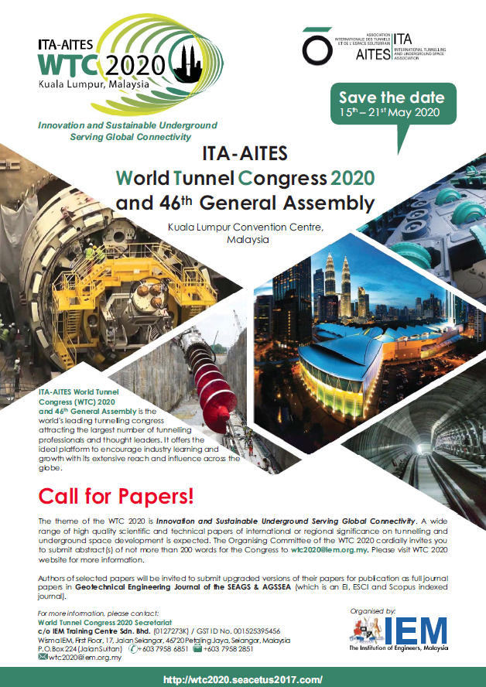
WORLD TUNNEL CONGRESS (WTC) 2020
Proposed Topics:
1. Innovation in tunnels and tunnelling technology
2. Innovation in rock support and water proofing technology
3. Sustainable and strategic use of underground space
4. Environment sustainability in underground construction
5. Urban dewatering and flood control with underground tunnels
6. Planning, design and construction of tunnels and underground structures
7. Risk, health and safety, contractual practices and project management of underground construction
8. Instrumentation and monitoring in underground construction
9. Conventional tunnelling, sprayed concrete use, drill and blast excavation
10. Mechanised tunnelling and excavation (hard rock, soft rock and soil)
11. Site investigation and ground characterisation
12. Geological and geotechnical aspects in underground construction
13. Stability assessment and ground stabilisation in underground construction
14. Operation, repair and maintenance of tunnels and underground structures
15. Design and installation of mechanical and electrical systems for underground structures
16. Information modelling in tunnelling and underground space development
17. Projects and case histories
18. Others (e.g. economics of tunnels and use of underground space, life cycle asset management, etc.)
Important Dates
The Organising Committee of the WTC 2020 cordially invites you to submit abstract(s) of not more than 200 words for the Congress to wtc2020@iem.org.my.
• Call for papers • Submission of abstracts • Acceptance of abstracts • Submission of papers • Acceptance of papers • Notification to speakers | : 01 January 2018 : 31 December 2018 : 31 March 2019 : 31 October 2019 : 31 January 2020 : 15 March 2020

Slide 36
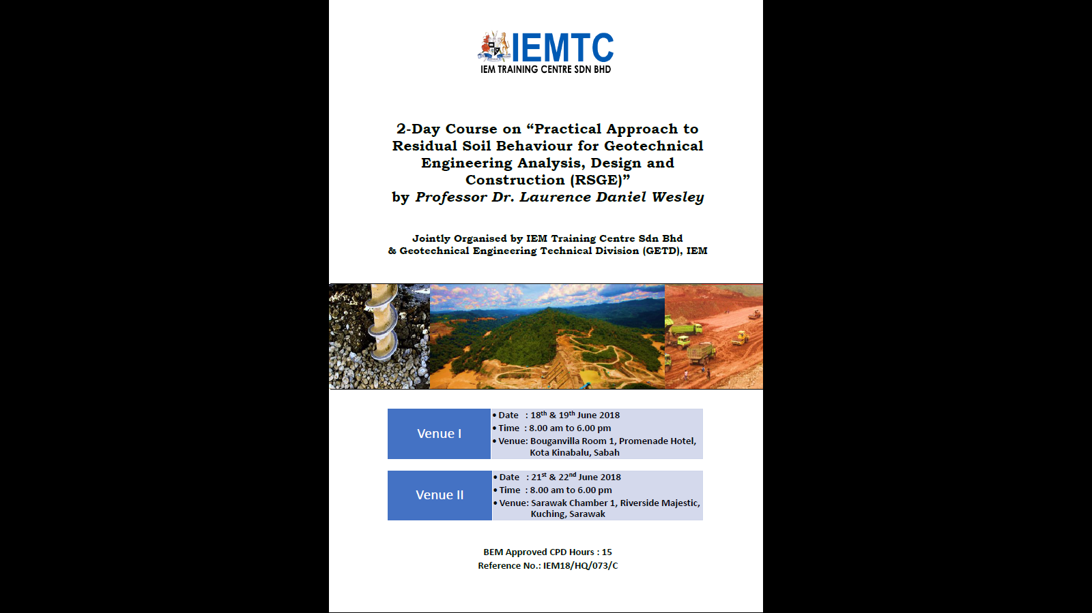
PRACTICAL APPROACH TO RESIDUAL SOIL BEHAVIOUR FOR GEOTECHNICAL ENGINEERING ANALYSIS, DESIGN AND CONSTRUCTION (RSGE)
By:
Professor Dr Laurence Daniel Wesley
Venue I
Date : 18th & 19th June 2018
Venue II
Date : 21st & 22nd June 2018
Venue: Bouganvilla Room 1, Promenade Hotel, Kota Kinabalu, Sabah
Time : 8.00 am to 6.00 pm
Venue: Sarawak Chamber 1, Riverside Majestic, Kuching, Sarawak
Time : 8.00 am to 6.00 pm

Slide 37
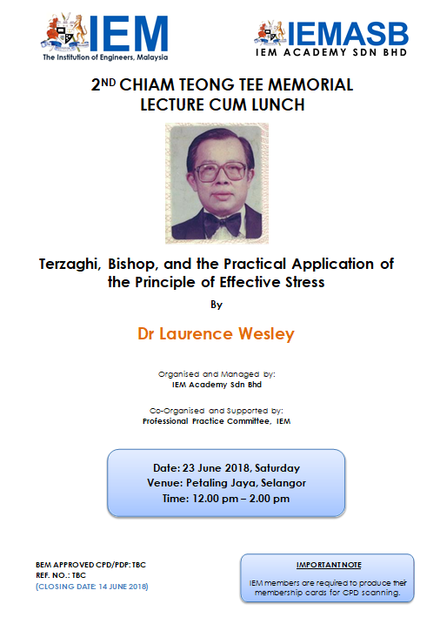
2ND CHIAM TEONG TEE MEMORIAL LECTURE CUM LUNCH
Terzaghi, Bishop, and the Practical Application of the Principle of Effective Stress
By
Dr Laurence Wesley
Date: 23 June 2018
Venue: Petaling Jaya, Selangor
Time: 12.00 pm – 2.00 pm

Slide 38

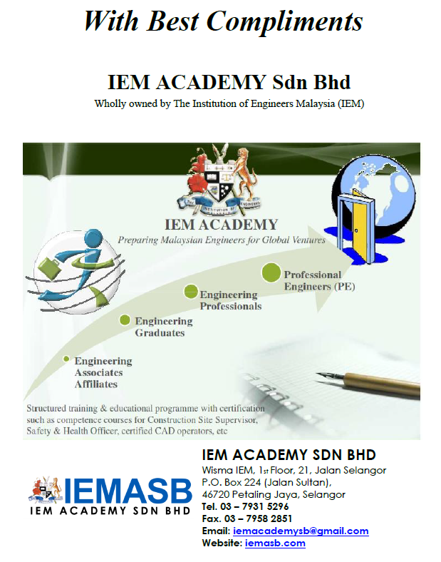
Kindly visit our website
www.iemtc.com & www.iemasb.com
for more interesting courses and events.

