Slide 1

Saturated soil modelling: Griffith University: February 2010
Constitutive modelling:
Concluding remarks
David Muir Wood
d.muirwood@dundee.ac.uk

Slide 2
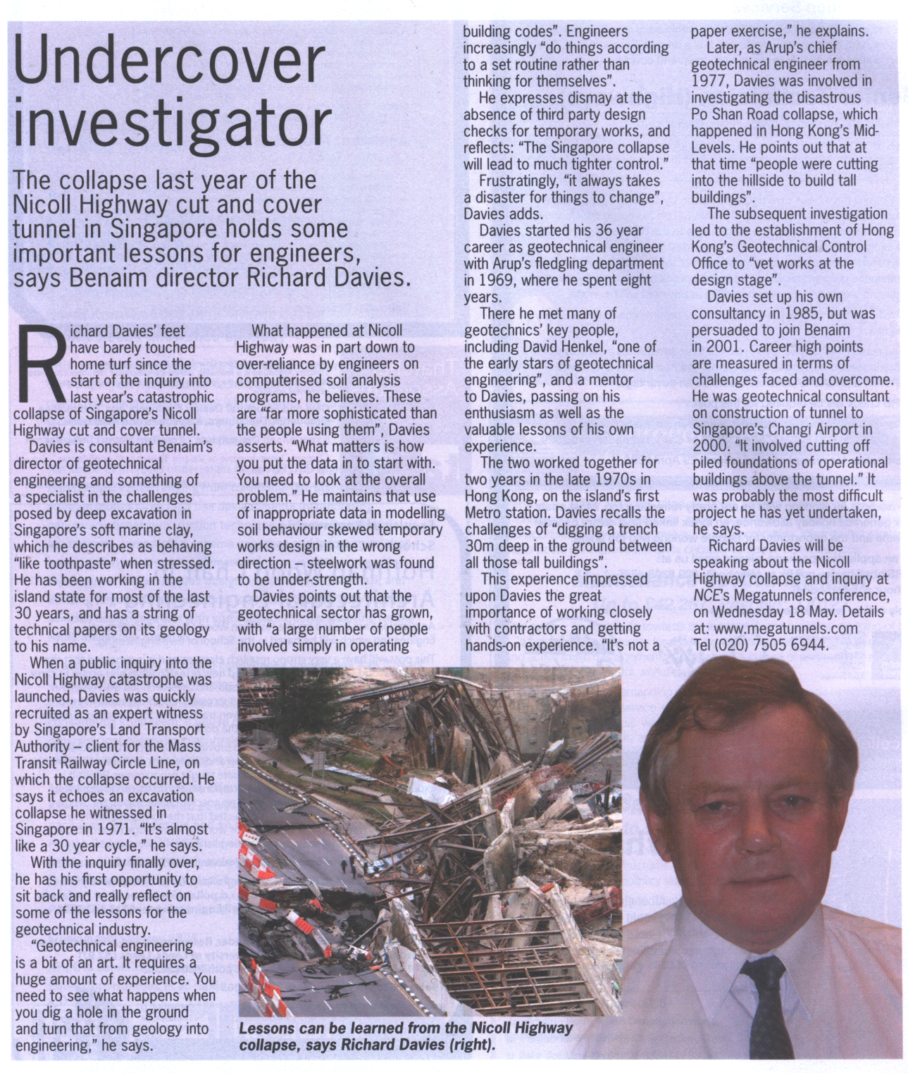


Slide 3
Modelling should be elegant?
‘It is more important to have beauty in one's equations than to have them fit experiment.’ (Dirac)
Those involved in modelling tend to become more interested in the process than its purpose:
the stimulation of simulation is greater than the pleasurement of measurement:
but it makes you go blind.
…but Ockham’s razor: Pluralitas non est ponenda sine neccesitate
(William of Ockham, ca 1285-1349)

Slide 4
difficulties with numerical modelling (Potts, 2003):
- because there is no standard numerical strategy for implementation of nonlinear models
- because some constitutive models seem to be unable to give reasonable predictions
- because, even for apparently simple problems, the results of numerical modelling can be very dependent on the decisions made by the user

Slide 5
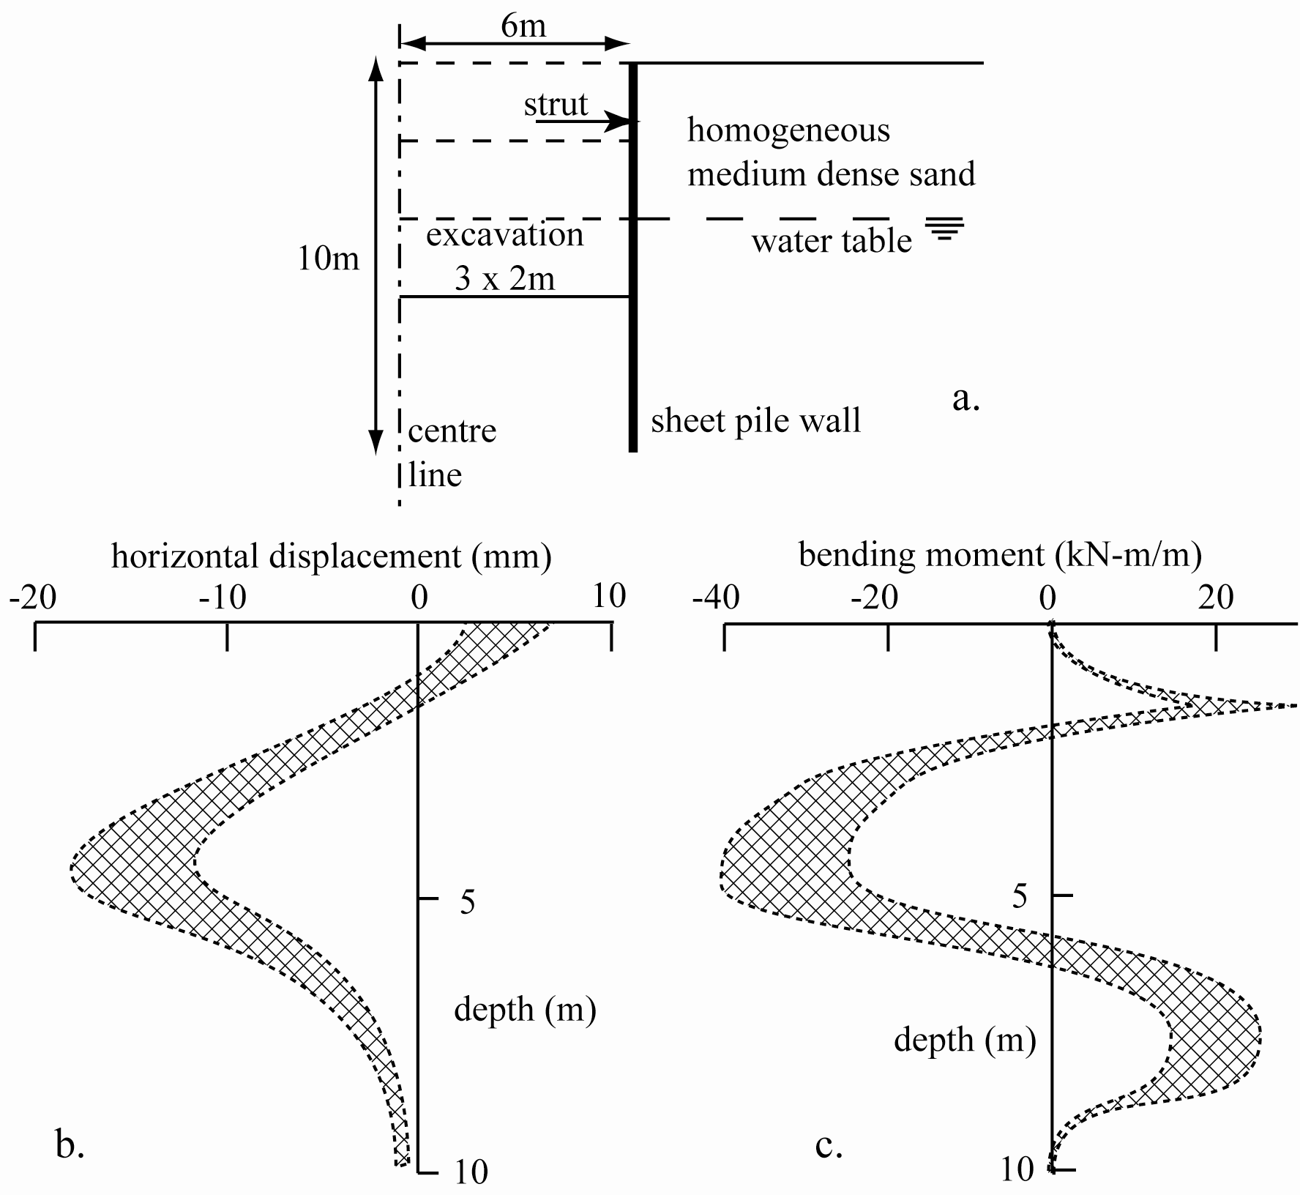
PLAXIS analyses
same problem – different modellers
spread of predictions
(Schweiger, 2003)

Slide 6
Modelling is personal
My modelling choices
Are founded in logic.
Can I convince you?

Slide 7
useful numerical modelling requires skilled operators who:
- have a detailed understanding of soil mechanics and the underpinning theory for the numerical algorithms
- understand the limitations of constitutive models
- are familiar with the software that is being used for the numerical modelling

Slide 8
Modelling should be justifiable
appropriate simplification of reality
Modelling must be auditable

Slide 9
Verification: is the program doing what it claims to be doing?
Are we getting the answers that we think we are getting?
Validation: are we getting the answers that we need?
Can we justify/understand the results using simple hand (back of the envelope) calculations?

Slide 10
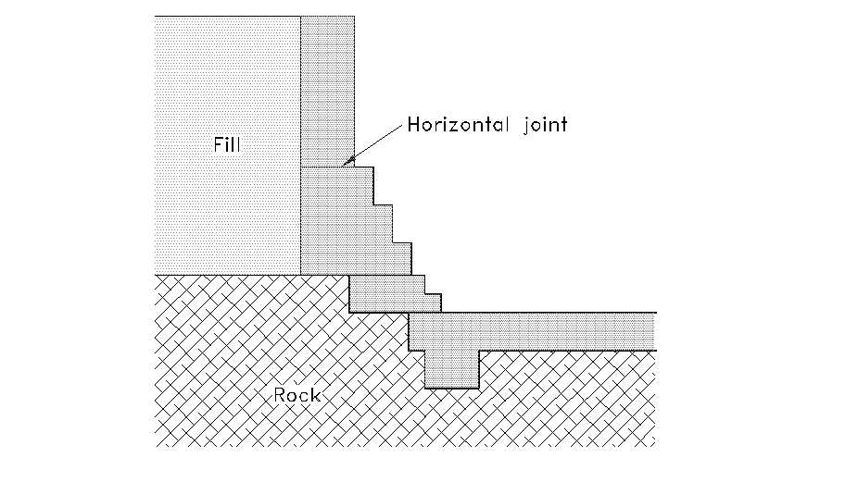
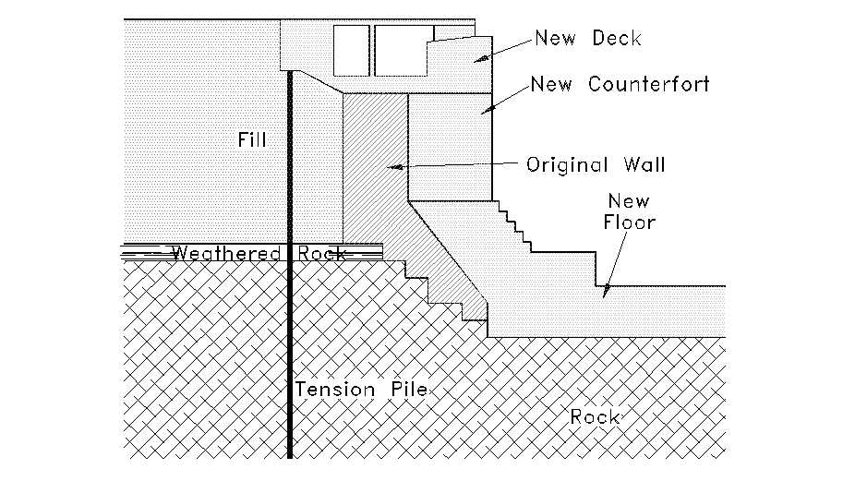
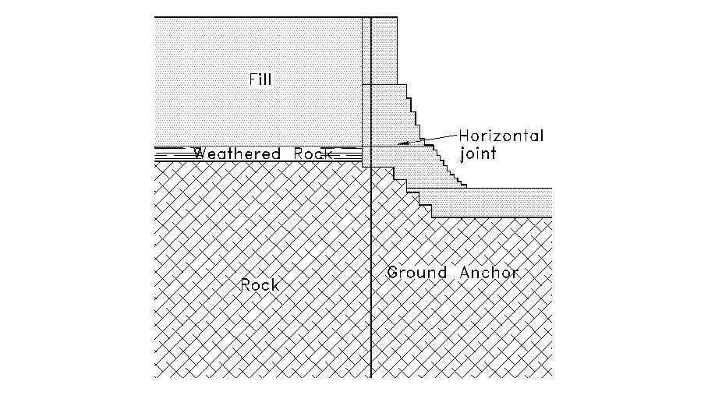
displacement (m)
no strengthening
ground anchors
Mair and Muir Wood (2001)
time (s)
counterforts and piles

Slide 11
displacement (m)
no strengthening
time history analyses (nonlinearity)
Mohr-Coulomb model (regulators)
limited number of histories
ground anchors
Mair and Muir Wood (2001)
time (s)
counterforts and piles

Slide 12
Concentration on constitutive modelling
- essential component of any numerical modelling
- finite element, finite difference
Similar messages apply to numerical modelling itself
- and to physical modelling and laboratory testing

Slide 13
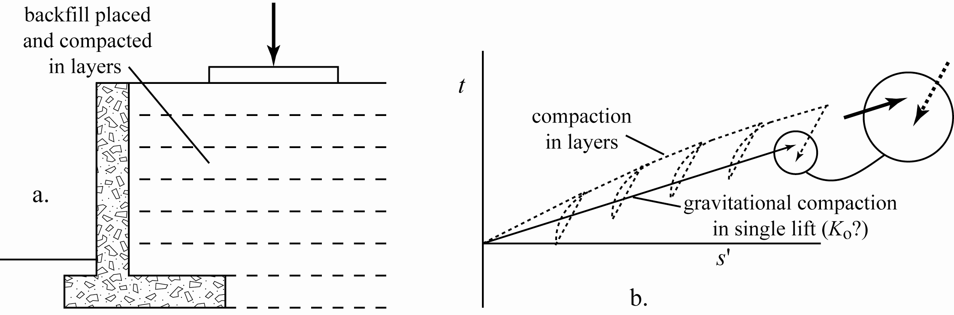
modelling of geotechnical processes (understand soil model)
(also important for physical modelling)
- kinematic soil stiffness – stiffness dependent on recent history
- centrifuge modelling

Slide 14
Modelling should be adequately complex
Show the trees in the wood:
but must we include
all the reeds on the muir?

Slide 15
Modelling is local – adequate complexity
The excellent map
misses no detail, but it is
as large as the world.
Complex models can distract and deceive

Slide 16
a good model test (element, numerical, physical) is one which surprises
- route to advance of scientific understanding
- design model tests with this in mind
rival hypotheses can be sifted using carefully chosen testing
scientific conjectures cannot be proved – only refuted
absence of evidence does not mean evidence of absence

Slide 17
Don’t just perform routine tests
The train keeps to the tracks
But the country around
Remains unexplored.
attempt to discover the shortcomings of the model!

Slide 18
Modelling should attempt to surprise
If you look down,
Are you surprised to see
Only your feet?
what about the uncalibrated parts of stress space?

Slide 19
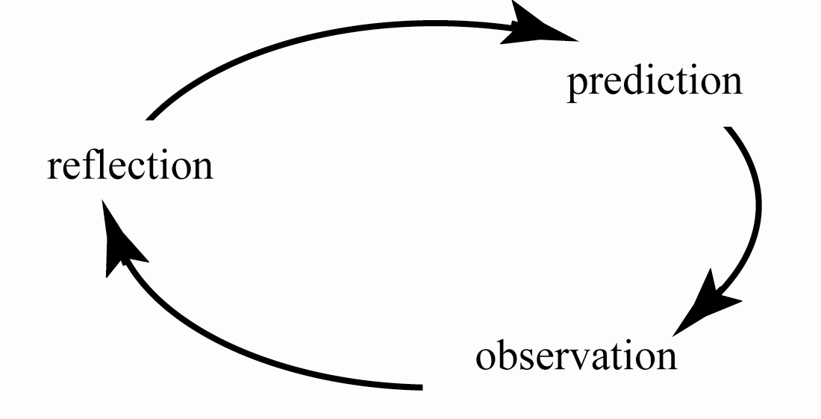
Reflective practice cycle…
always start with prediction of what you expect to happen
if observation unexpected, reflection required to improve predictions

