Slide 1

Saturated soil modelling: Griffith University: February 2010
Practical exercise: stress paths and laboratory
testing
David Muir Wood
d.muirwood@dundee.ac.uk

Slide 2
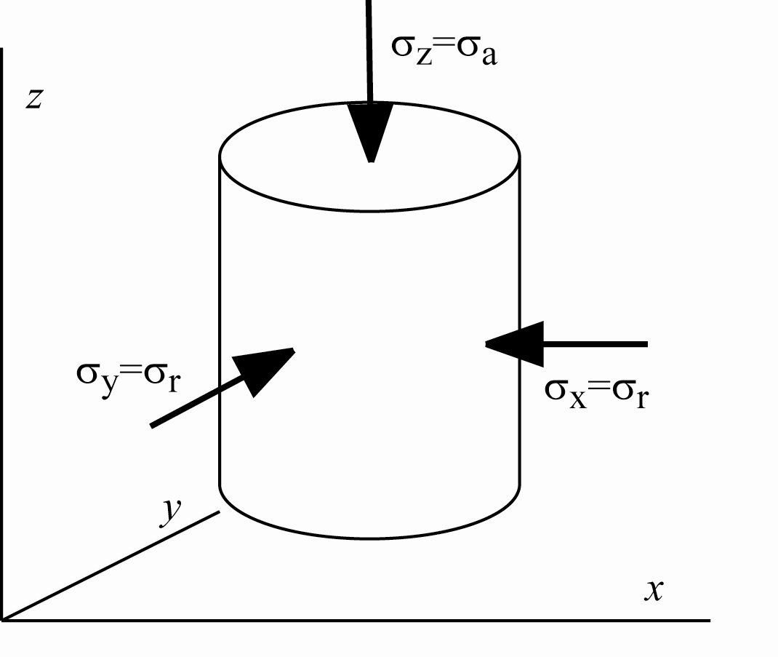
the triaxial apparatus is the mostly widely used apparatus for producing data concerning the deformation properties of soils
stress levels are usually chosen for convenience
tests will usually be drained/undrained conventional compression δσ_{r} = 0

Slide 3
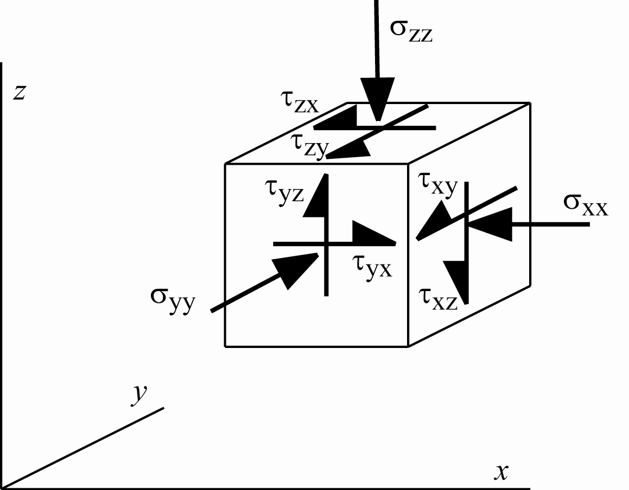
actual stress states and stress changes will not be axially symmetric
we know that the behaviour of soils is extremely nonlinear and history dependent
constitutive models are used to extrapolate from known data to unknown applications

Slide 4
can we make quantitative estimates about the stress paths relevant to various typical geotechnical systems?
aim to help in planning detail of triaxial test programme
note that even triaxial has two degrees of freedom – we are not restricted to conventional triaxial compression with δσ_{r} = 0, δq > 0
aim to help in understanding extent and nature of extrapolation from data to application
aim to ensure that models are calibrated using most useful experimental data
note that it may sometimes be possible to perform tests in apparatus other than triaxial
importance of engineering judgement!

Slide 5
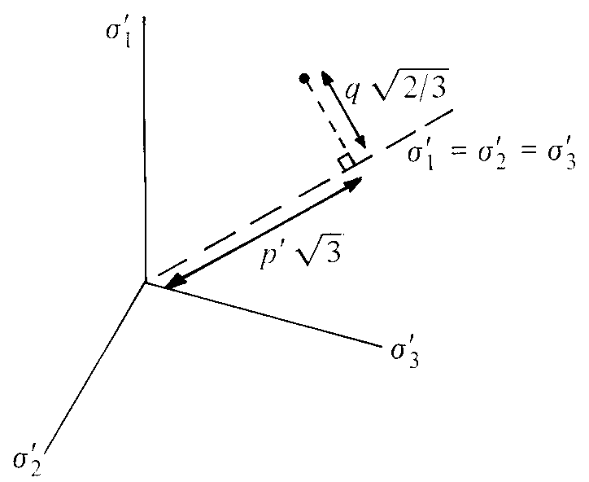
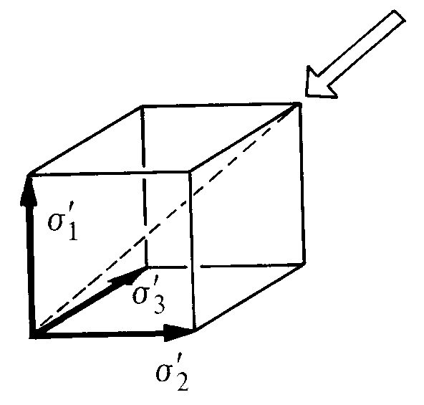
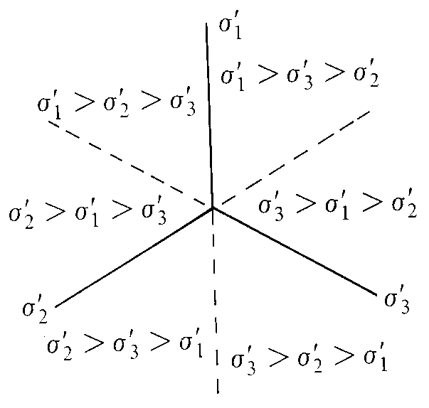
deviatoric view of principal stress space
π-plane
view into corner of cube with axes defined by principal stresses

Slide 6
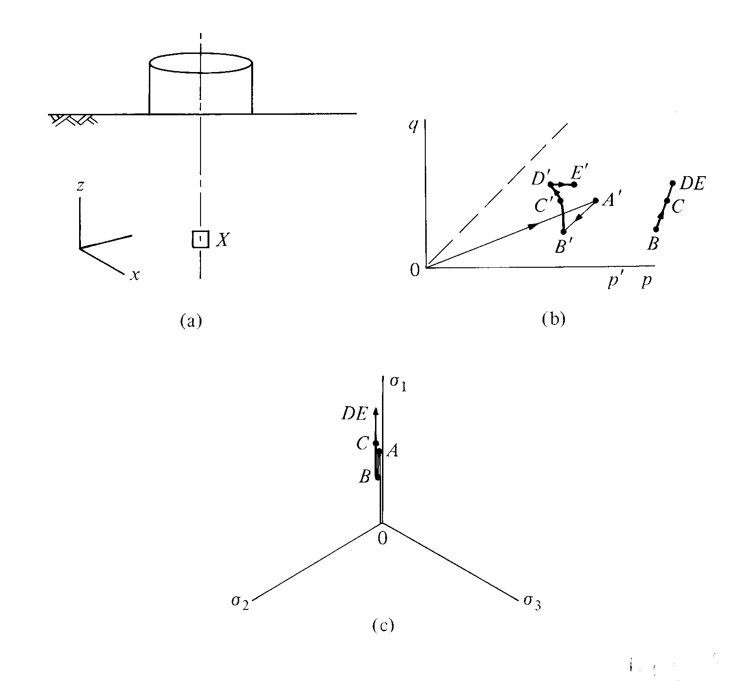
element on centreline beneath circular load
stress path can be followed in triaxial
(assume initial one-dimensional history: K_{o}?)
deviatoric view of principal stress space
axial symmetry
equal horizontal principal stresses
typical elements, down to depth 2D?
elements off centreline?

Slide 7
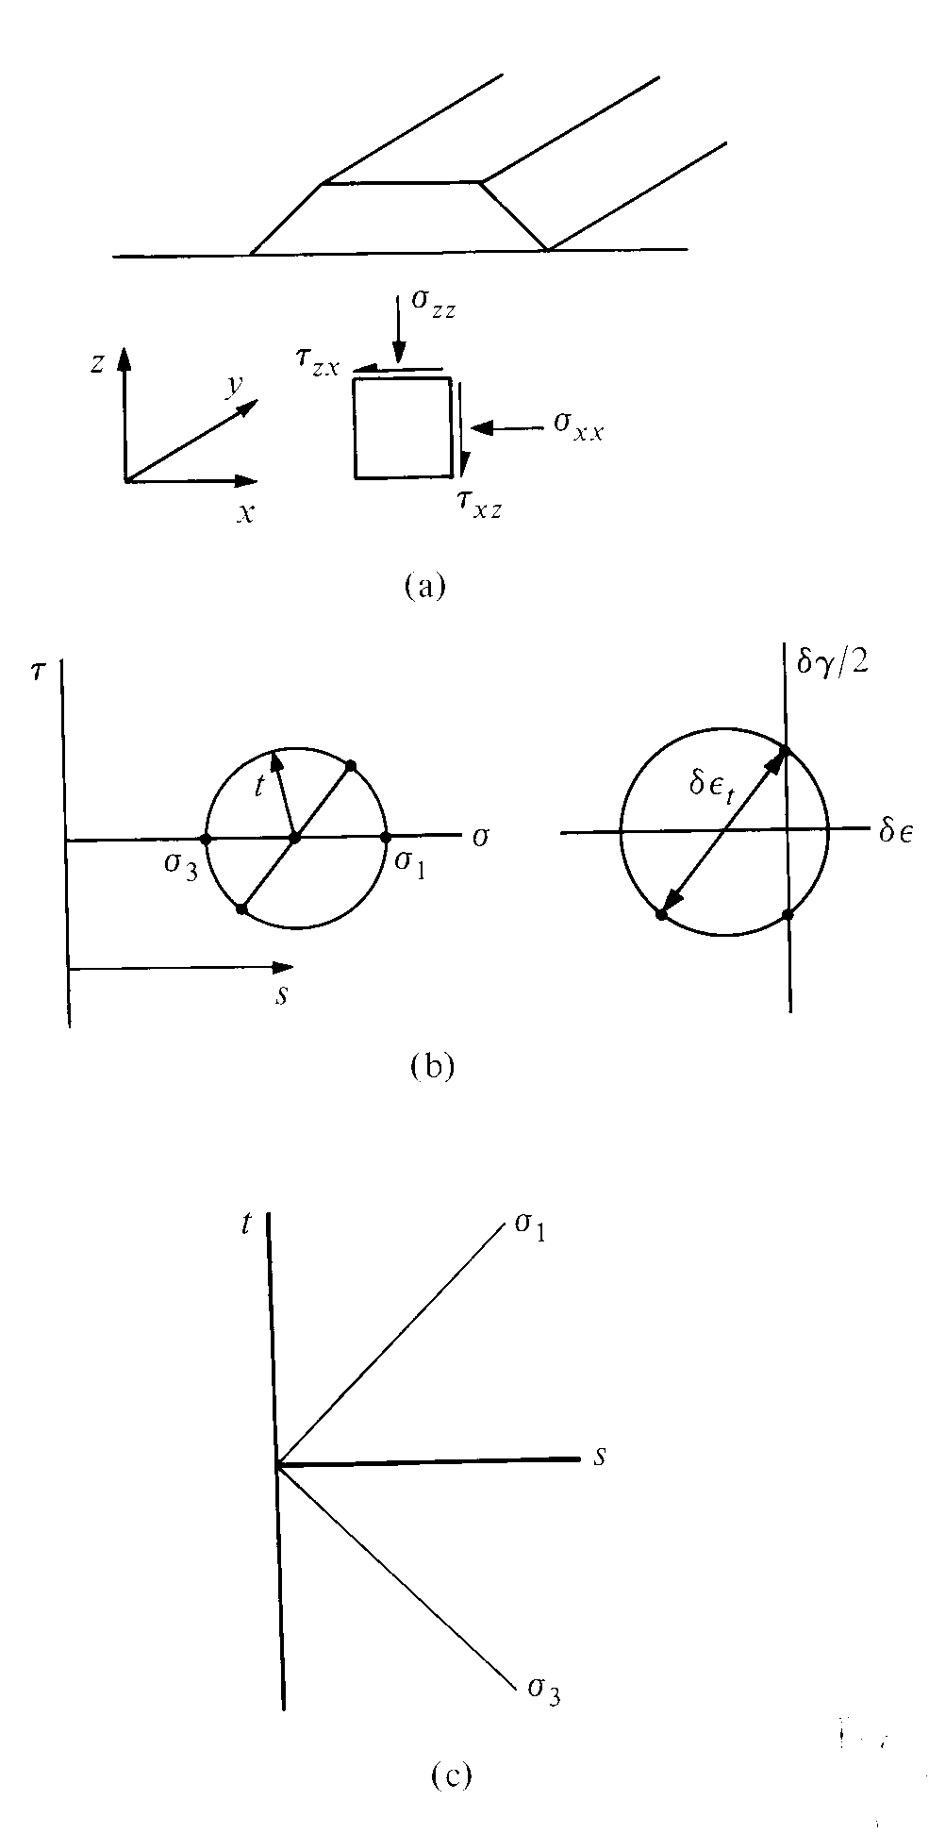
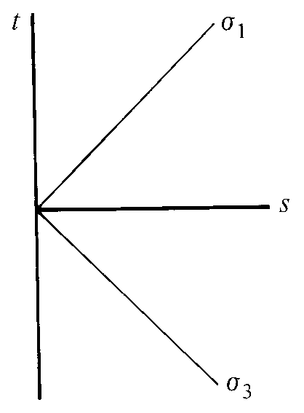
plane strain may be more common
long geotechnical structures
stress variables s, t
centre and radius of Mohr circle
s, t do not include rotation of principal axes
principal stress σ₂ = σ_{y} adjusts to keep δε_{y} = 0

Slide 8
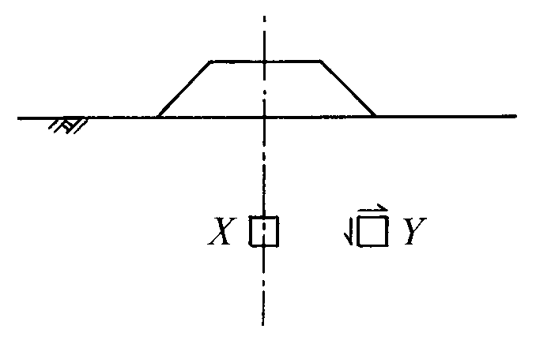
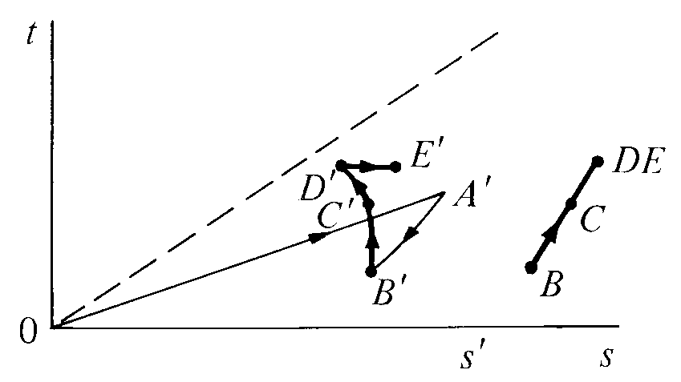
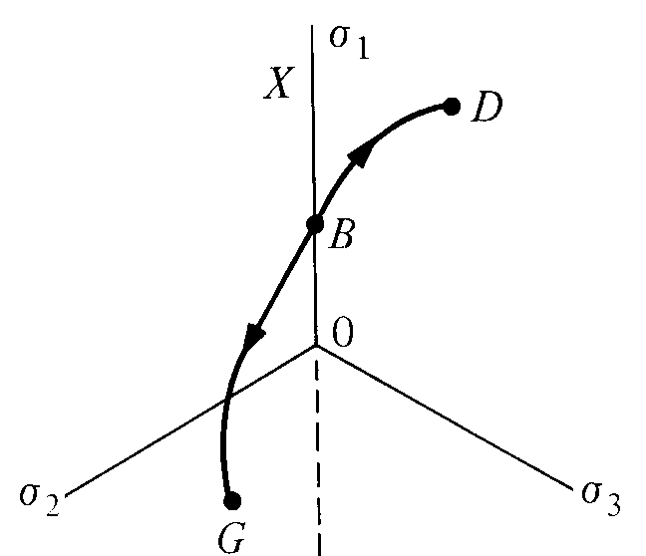
elements beneath embankment
t/s' = sin φ'
total and effective stress paths for element X
one-dimensional history (K_{o} = ?)
significant depth range 2B?
deviatoric view: plane strain ≠ axial symmetry
BD: plane strain active: element X
BG: plane strain passive
rotation of axes: element Y

Slide 9
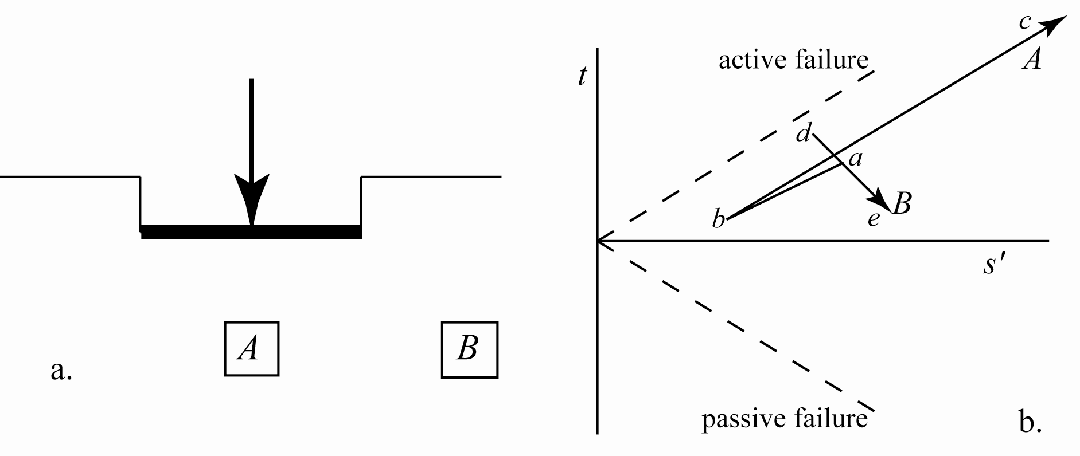
elements beneath shallow footing on sand
previous history? depth range 2B? unit weight 20kN/m³?
vertical stress at A, B: 30kPa? φ' = 40º? K_{o} = 1 – sin φ' = 0.35
stresses low – compare typical laboratory testing?
stress path for excavation: ab and ad
A: Δσ_{v} > 0 (active); Δσ_{h} > 0?
B: Δσ_{h} > 0 (passive); Δσ_{v} = 0

Slide 10
elements beneath shallow footing on sand
triaxial test? in situ stresses p'_{i} = 20kPa, q = 20kPa
A: compression with δq/δp' = 1.5-2 (steeper than K_{o})
B: constant cell pressure extension δq/δp' = -1.5
plane strain strength? 10% higher than triaxial?
kinematic stiffness – include unloading cycle to model excavation

Slide 11
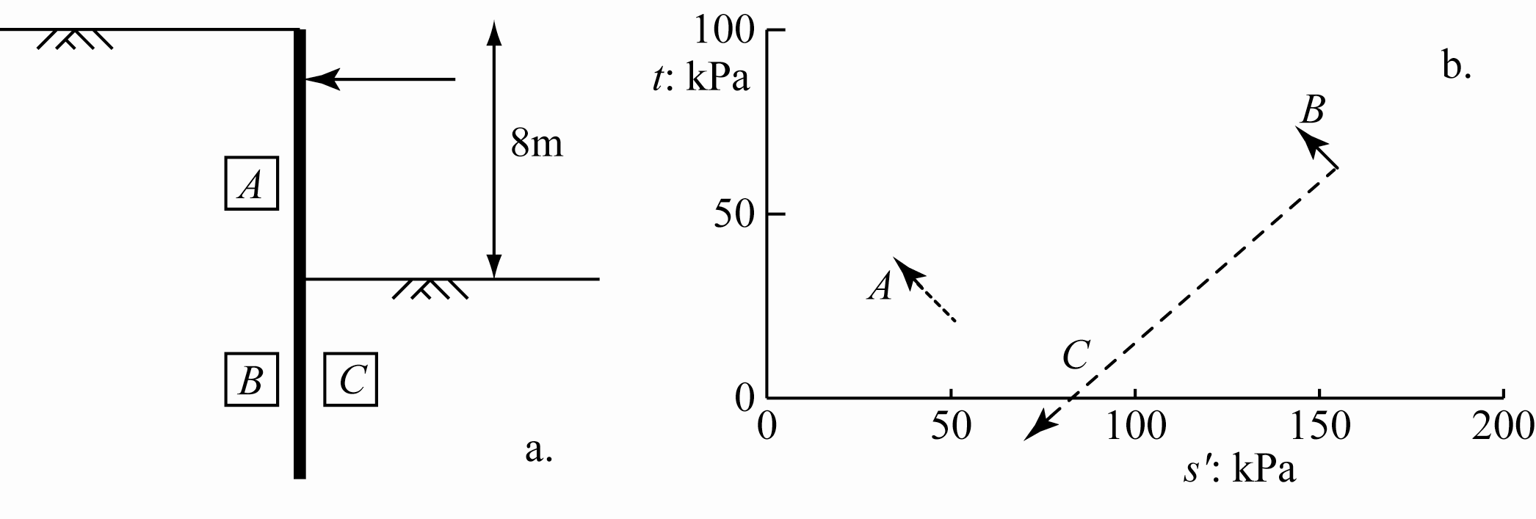
elements around flexible retaining wall
A: mid-height: γ = 18kN/m³? φ' = 35º? K_{o} = 0.43
σ'_{v} = 72kPa, σ'_{h} = 30kPa
Δσ_{v} ≈ 0; Δσ_{h} < 0: Δt/Δs' ≈ -1, Δt > 0

Slide 12
elements around flexible retaining wall
C: depth 12m? γ = 18kN/m³? φ' = 35º? K_{o} = 0.43
σ'_{v} = 216kPa, σ'_{h} = 92kPa
Δσ_{v} < 0; Δσ_{h} > 0?: Δt/Δs' ≈ +1 (in fact < 1), Δt < 0

Slide 13
elements around flexible retaining wall
B: depth 12m? γ = 18kN/m³? φ' = 35º? K_{o} = 0.43
σ'_{v} = 216kPa, σ'_{h} = 92kPa
Δσ_{v} ≈ 0; Δσ_{h} < 0 following C: Δt/Δs' ≈ -1, Δt > 0

Slide 14
elements around flexible retaining wall
triaxial tests?
cell pressure 30-90kPa; match initial K_{o}
conventional extension for C?
compression with constant axial stress for A, B
plane strain effect?

Slide 15
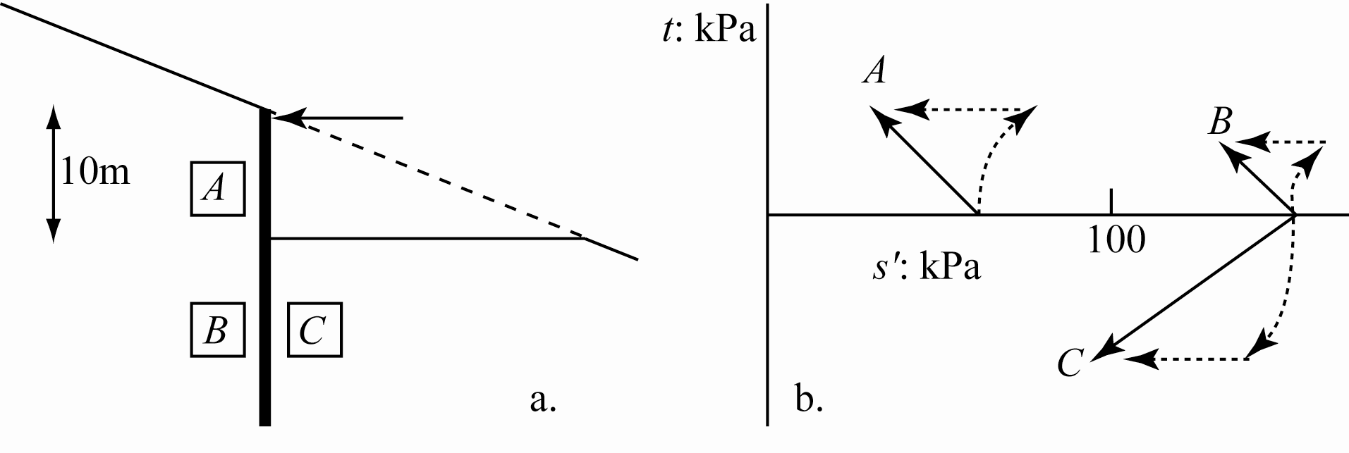
excavation in clay slope
first ignore slope! (directions of principal stresses?)
γ = 20kN/m³? overconsolidated? K_{o} = 1-1.5?
A: 5m; B, C: 15m
initial undrained response
A, B: Δt/Δs ≈ -1, Δt > 0
C: Δt/Δs ≈ +1, Δt < 0
total, effective stress paths – effect of drainage
triaxial tests: stress levels
stress paths: Δp < 0

Slide 16
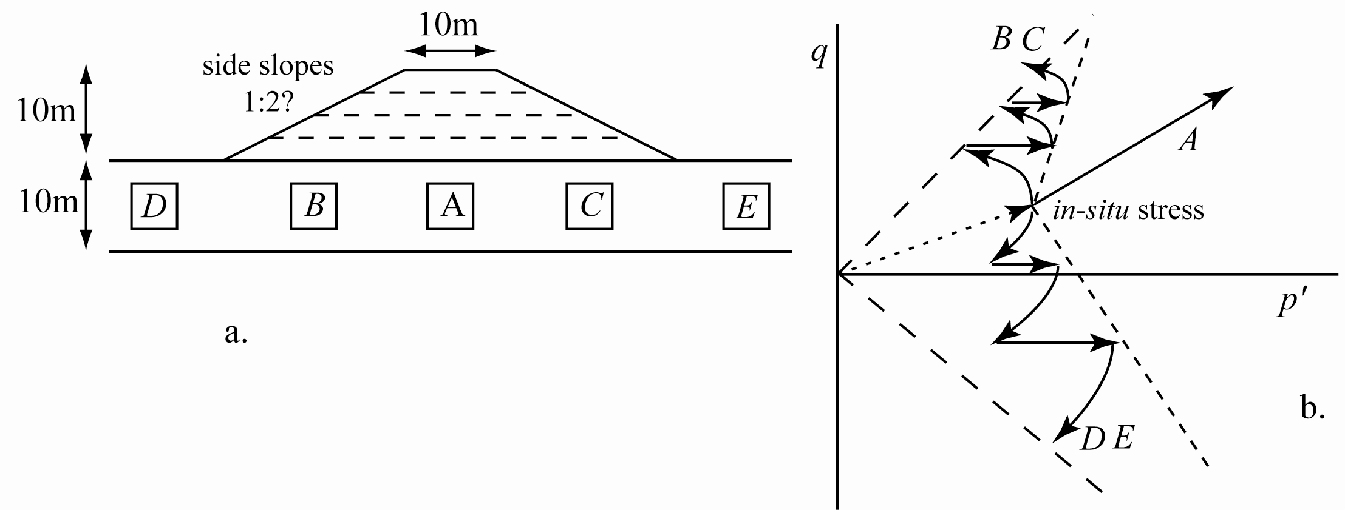
stage constructed embankment: 10m soft clay over sand/gravel
A: continuing confined compression ≈ 1-D compression?
eventual vertical stress increase Δσ_{v} ≈ 180kPa, K_{o} = 0.7, Δσ'_{h} ≈ 126kPa
D, E: Δσ_{v} ≈ 0, Δσ_{h} > 0: passive loading, extension
B, C: rotation of axes? undrained shearing towards failure – multistage tests: undrained/drained to total stress path Δσ_{h} ≈ 0?

Slide 17
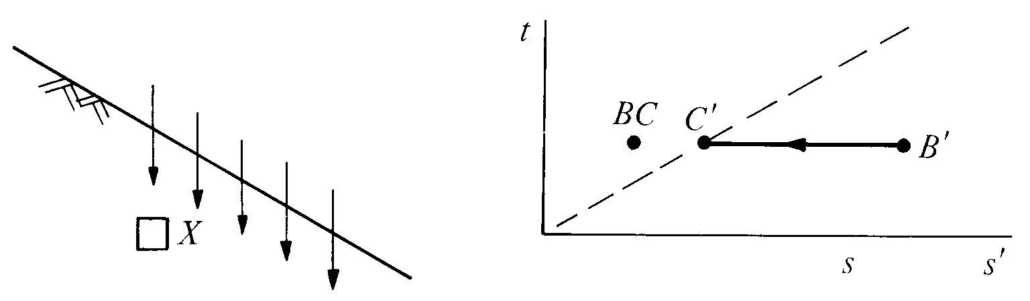
element in slope: effect of infiltration of rainfall
initial effective stresses? (principal directions?)
initial suction? (saturation?)
rainfall infiltration reduces suction with somewhat constant total stresses?
special compression test with δp' < 0, δq = 0
compare conventional compression test!

Slide 18
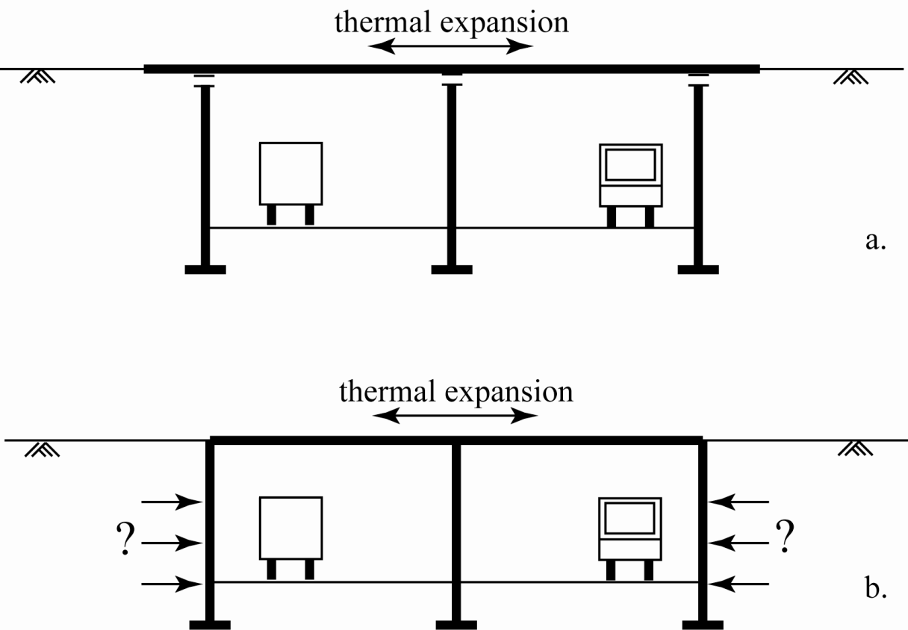
stress paths from numerical analysis
integral bridge abutment – remove need for bearings between deck and supports
but what are stresses on abutments?

Slide 19

thermal expansion of bridge deck
abutments move towards backfill
passive loading – governed by strength of backfill?
abutments can be flexible – vertical support for deck

Slide 20
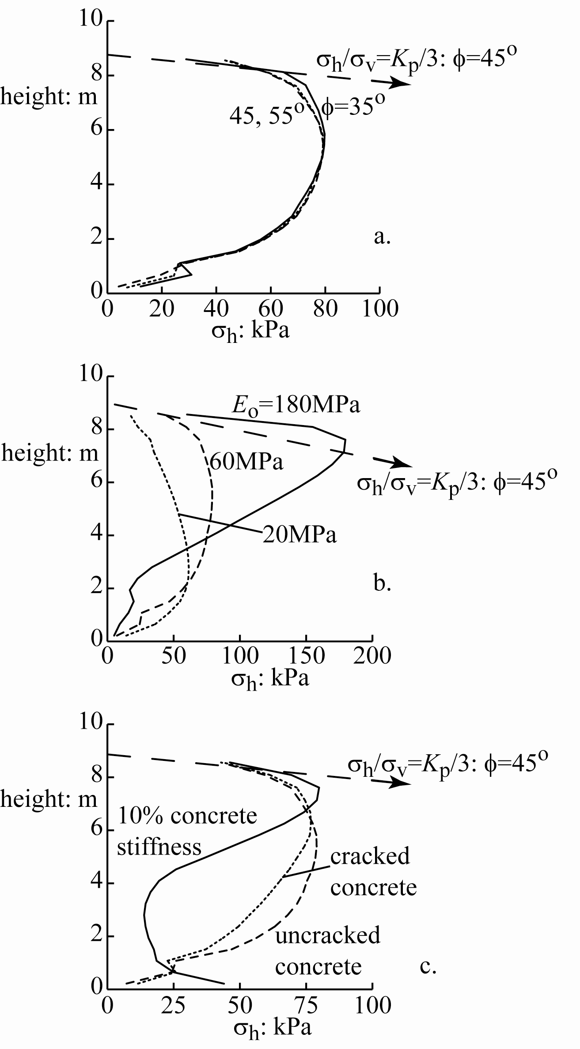
numerical studies of actual prototype show that strength of backfill has no effect on horizontal stresses on abutment!
relative stiffness of abutment and backfill is important
controls shape of stress distribution
soil-structure interaction
importance of characterising backfill stiffness (not easy)

Slide 21
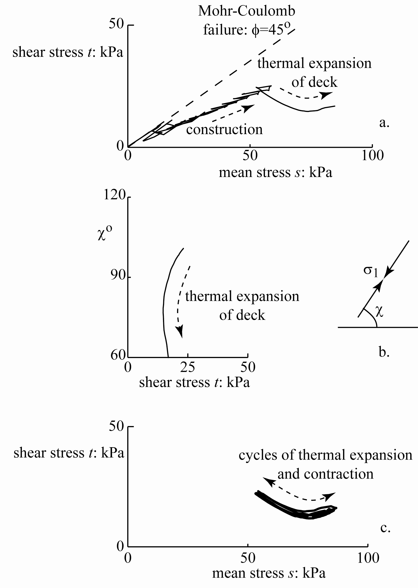
look at stress paths from numerical analysis
elastic-perfectly plastic Mohr-Coulomb model
dominant effect: increase in mean stress with little change in shear stress
not heading towards failure
stiffness of primary importance

Slide 22
messages:
we can (with engineering judgement) make estimates of stress paths that are likely to be relevant
then design laboratory test programmes with appropriate stress levels and appropriate stress paths
conscious thought about difficulties of reproducing detail of paths in triaxial apparatus can help us to understand necessary extrapolation
stress paths in unfamiliar situations may surprise – numerical modelling can help us to understand

Slide 23
Design of laboratory test programmes
numerical estimates of stress levels and stress changes
make rational guesses for any numbers that you do not know – soil properties, dimensions
probably you have access only to conventional triaxial apparatus – but are not restricted to conventional triaxial compression tests
think how you might interpret the results for your application – initial stress states, non-axisymmetric stress paths, rotation of principal axes
importance of auditable trail – you must be able to justify your proposals
many possible answers – great numerical precision not appropriate

Slide 24
1. Stresses around tunnel

Slide 25
2. Stresses around bored pile

Slide 26

3. Stresses around deep excavation

Slide 27
4. Stresses around backfilled retaining wall

Slide 28
5. Stresses around shallow foundation

Slide 29
6. Stresses around excavation in slope

Slide 30
7. ???
or choose your own problem!

Slide 31
Design of laboratory test programmes
numerical estimates of stress levels and stress changes
make rational guesses for any numbers that you do not know – soil properties, dimensions
probably you have access only to conventional triaxial apparatus – but are not restricted to conventional triaxial compression tests
think how you might interpret the results for your application – initial stress states, non-axisymmetric stress paths, rotation of principal axes
importance of auditable trail – you must be able to justify your proposals
many possible answers – great numerical precision not appropriate

