Slide 1

Saturated soil modelling: Griffith University: February 2010
Mohr-Coulomb improved: nonlinearity and
critical states
David Muir Wood
d.muirwood@dundee.ac.uk

Slide 2
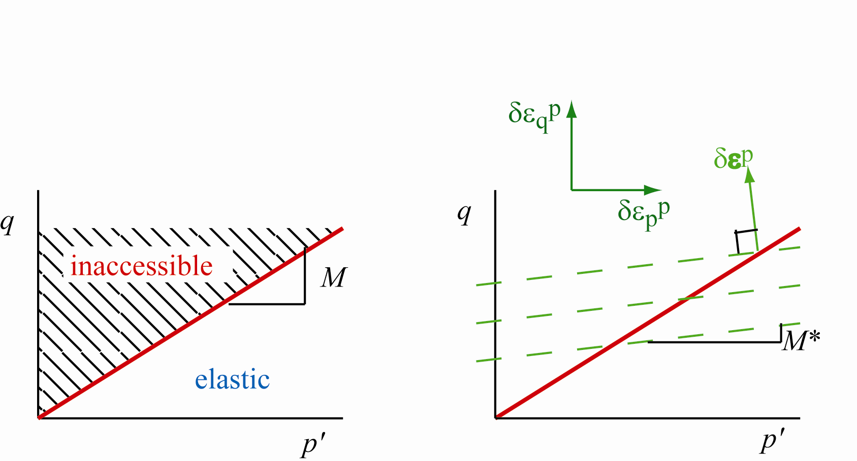
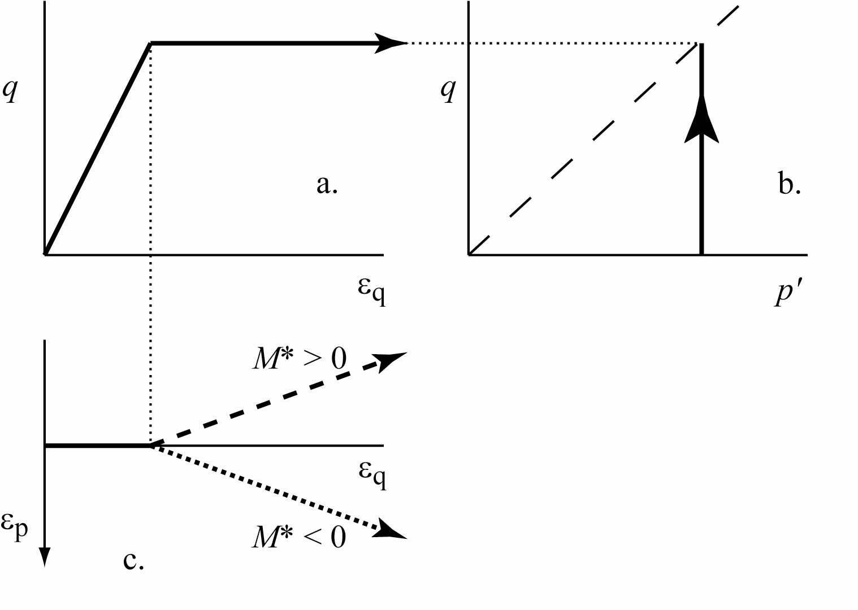
standard elastic-perfectly plastic Mohr-Coulomb model
non-associated plastic flow
simplicity
sharp stiffness changes
tangent stiffness either elastic or zero
continuing volume change

Slide 3
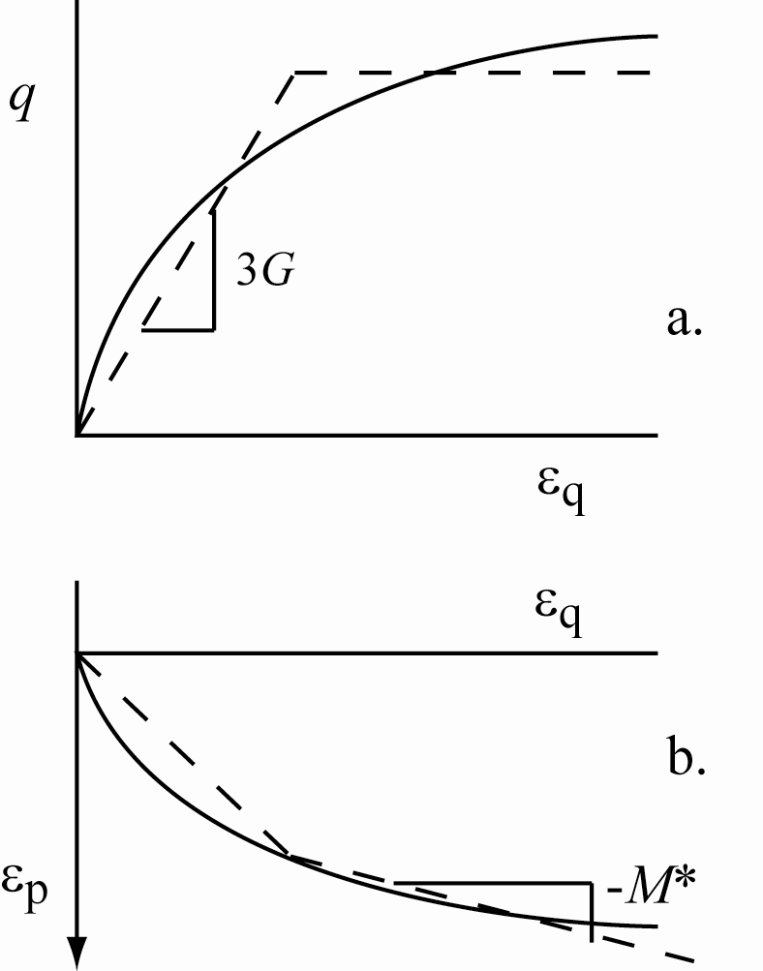
standard elastic-perfectly plastic Mohr-Coulomb model
available in all numerical analysis programs
subjectivity in selecting values of soil parameters – stiffness, strength, dilatancy

Slide 4
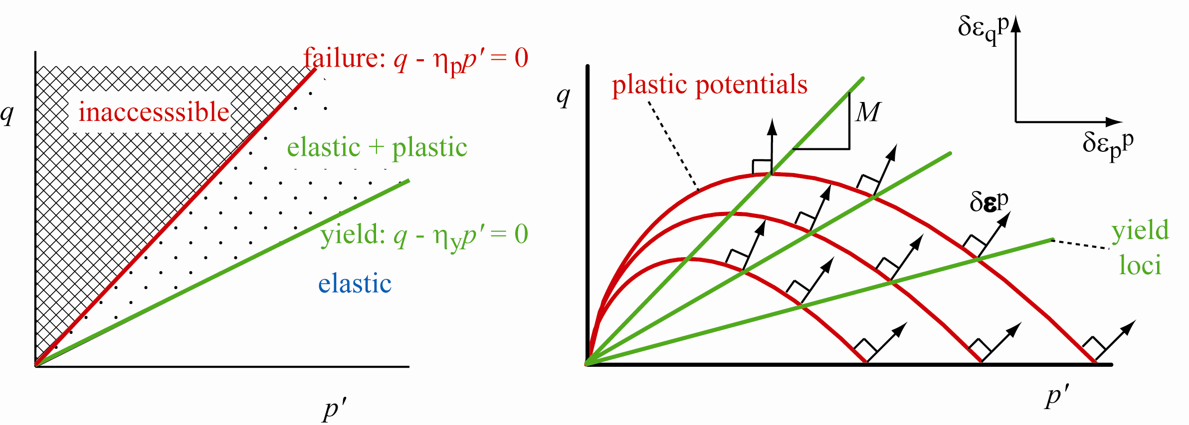
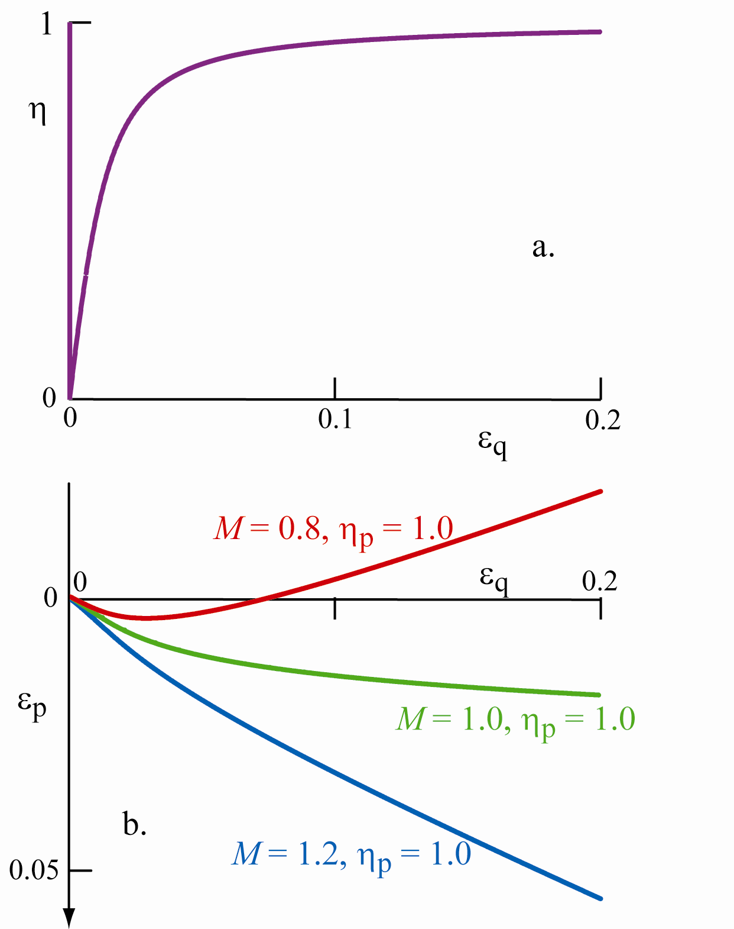
elastic-hardening plastic Mohr-Coulomb model
non-associated flow steady fall in stiffness continuing volume change

Slide 5
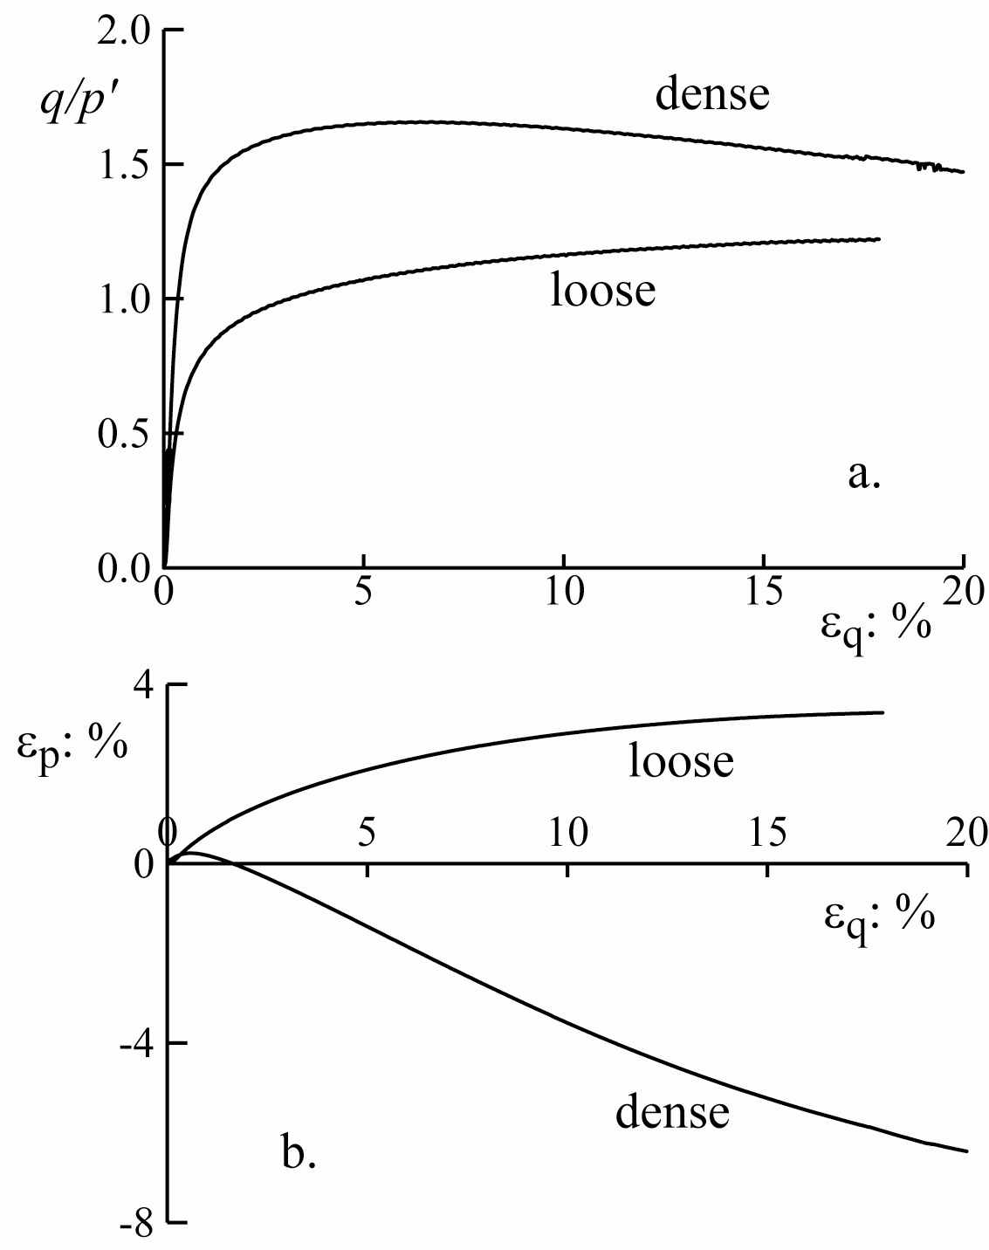
Severn-Trent sand
build on Mohr-Coulomb model
describe journey from initial elastic response to ultimate critical state
include nonlinearity, peak strength and softening
simplicity?
adequate complexity?

Slide 6
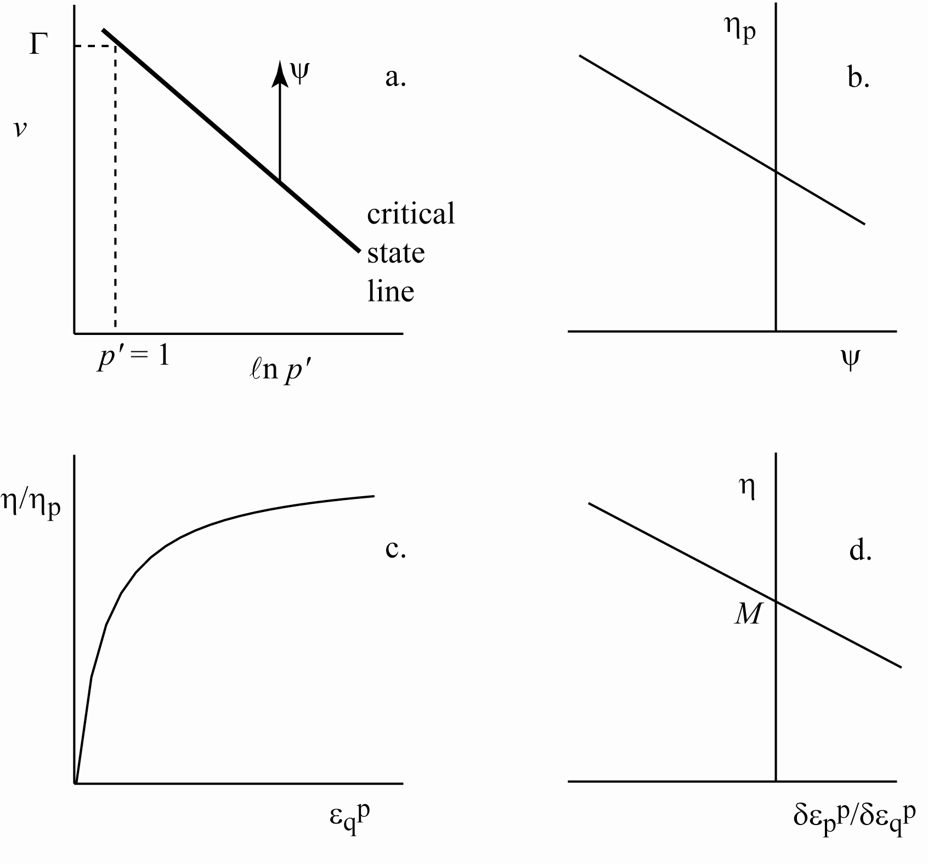
Severn-Trent sand: strength
critical state line
state parameter ψ = volume distance from critical state line
function of density and stress level
more useful than void ratio alone – indicating effect of density and stress
'loose'
specific volume
ψ
'dense'
mean stress
Been & Jefferies

Slide 7
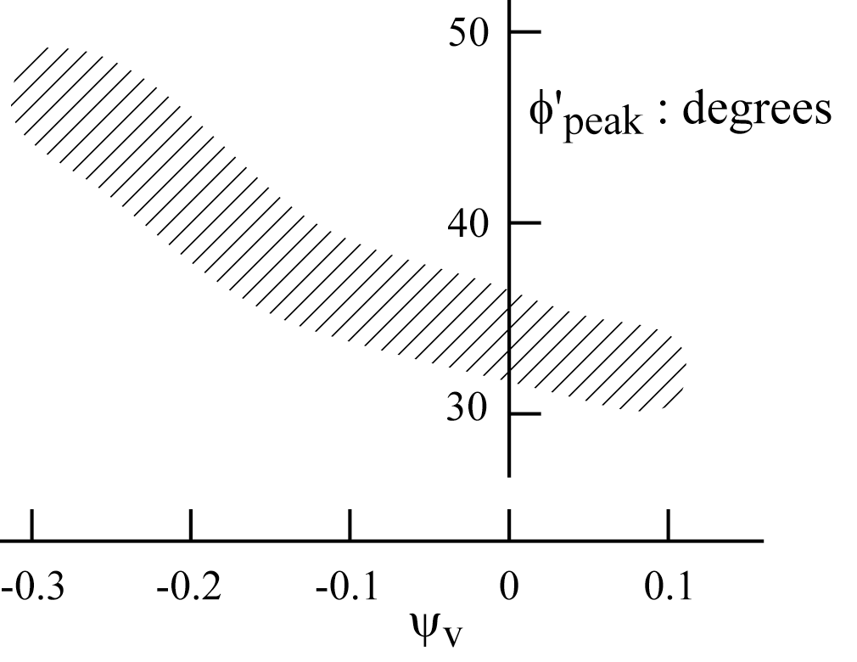
Severn-Trent sand: strength
peak strength
what is peak strength?
property of the soil which changes with stress level, density
data confirm link between strength and state parameter ψ
Mohr-Coulomb model with current strength dependent on current state parameter
state parameter ψ
'loose'
specific volume
ψ
'dense'
mean stress
Been & Jefferies

Slide 8
Severn-Trent sand: dilatancy
dilatancy: volume change during shearing
'dense' sand expands
'loose' sand contracts
dilatancy depends on density
dilatancy varies during test
what do we mean by 'dense' and 'loose'?
volume strain
shear strain
Benahmed

Slide 9
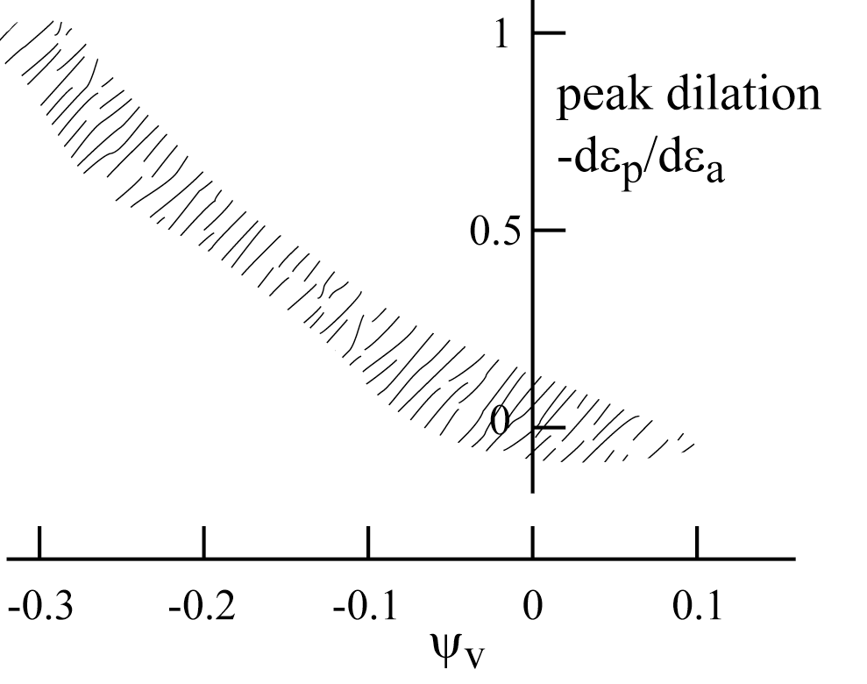
Severn-Trent sand: dilatancy
critical state line
dilatancy
'loose'
specific volume
ψ
'dense'
'loose'
'dense'
state parameter ψ
mean stress
data confirm link between dilatancy and state parameter ψ
if soil is not at critical state when it is being sheared (ψ ≠ 0):
then volume changes occur towards the critical state: dilatancy
'loose': ψ > 0: contraction
'dense': ψ < 0: dilation
Been & Jefferies

Slide 10
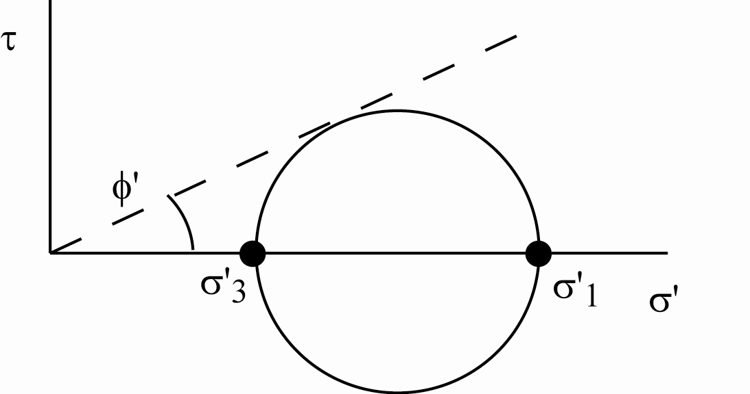
Mohr-Coulomb model with strength dependent on state variable
ratio
currently mobilised strength
1
currently available strength
distortional hardening
monotonic increase of ratio of mobilised to available strength (η/η_{p}) with distortional strain ε_{q}^{p}
hyperbolic hardening law: simple
monotonic relationship
shear strain
available strength φ':
varies with state parameter
mobilised strength φ'_{mob}

Slide 11
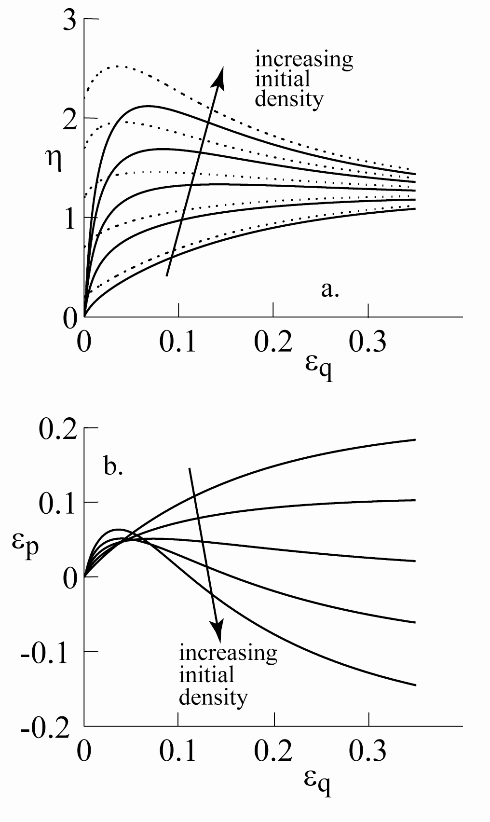
current peak strength
conventional drained triaxial compression tests
different initial density (state variable)
volume change accompanies shearing
hence change in state variable
hence change in available strength
model automatically homes in on critical state
softening emerges without being described mathematically
peak strength is moving target reached at infinite distortional strain – then identical with critical state strength

Slide 12
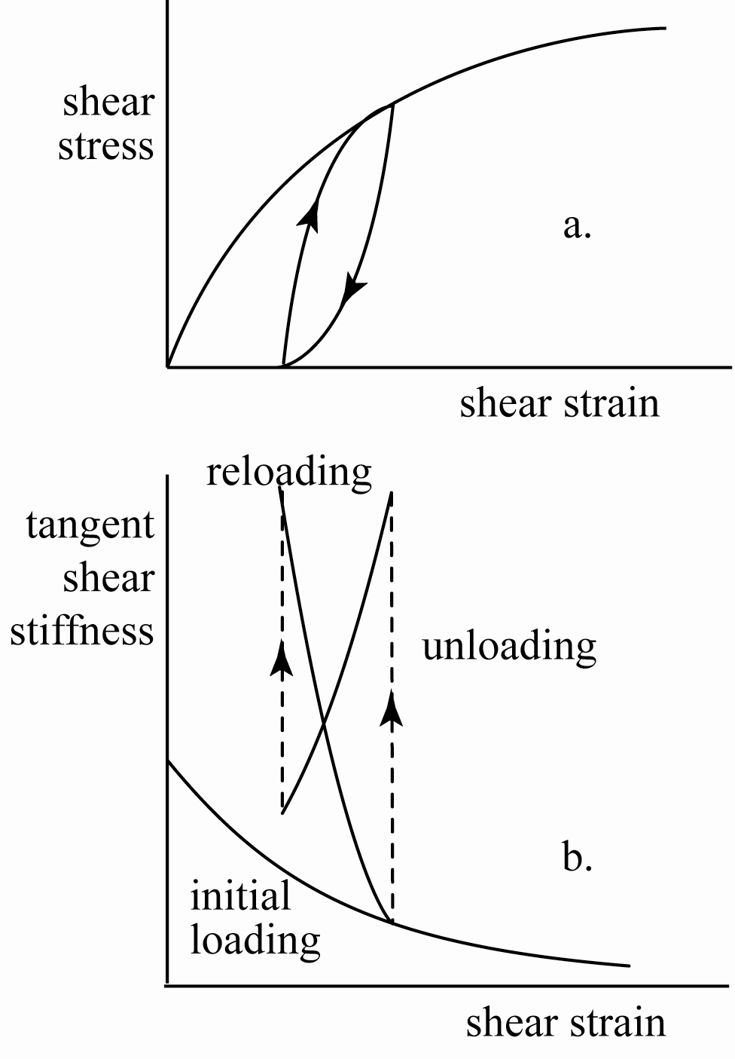
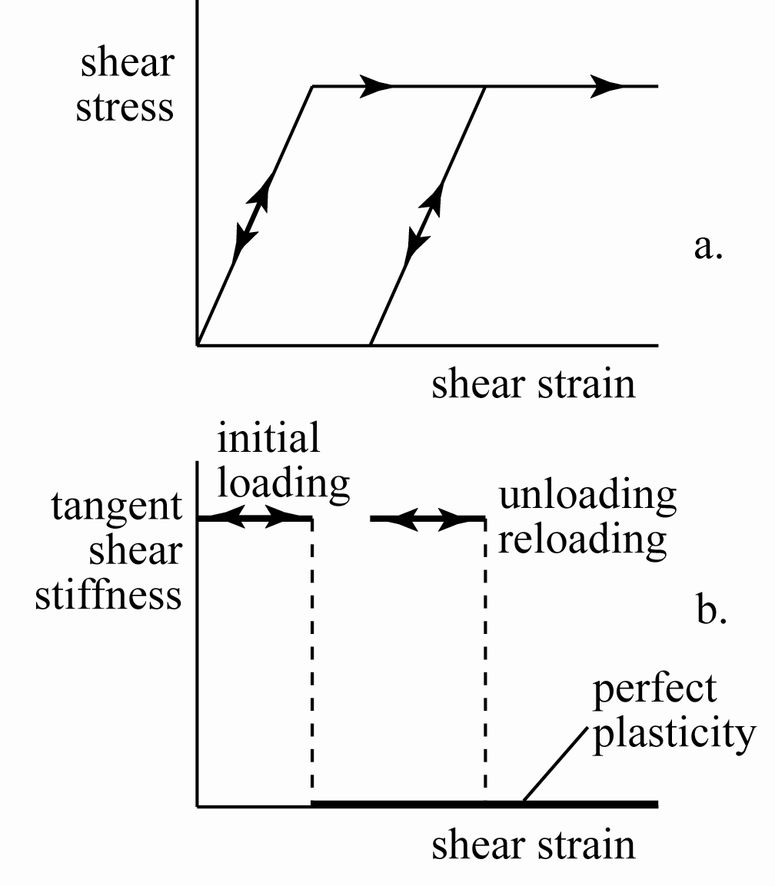
characterisation of variation of tangent stiffness
soil response perfectly plastic model

Slide 13
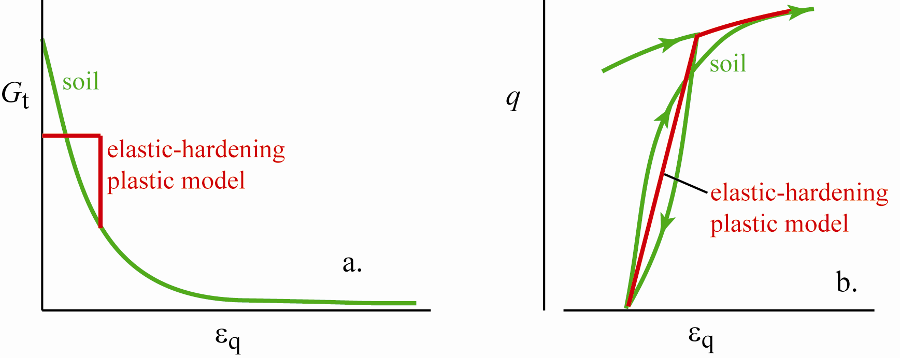
nonlinearity and reversed plasticity observed when direction of loading is reversed
elastic-hardening plastic model: behaviour purely elastic for stress ratios lower than the previous maximum stress ratio

Slide 14
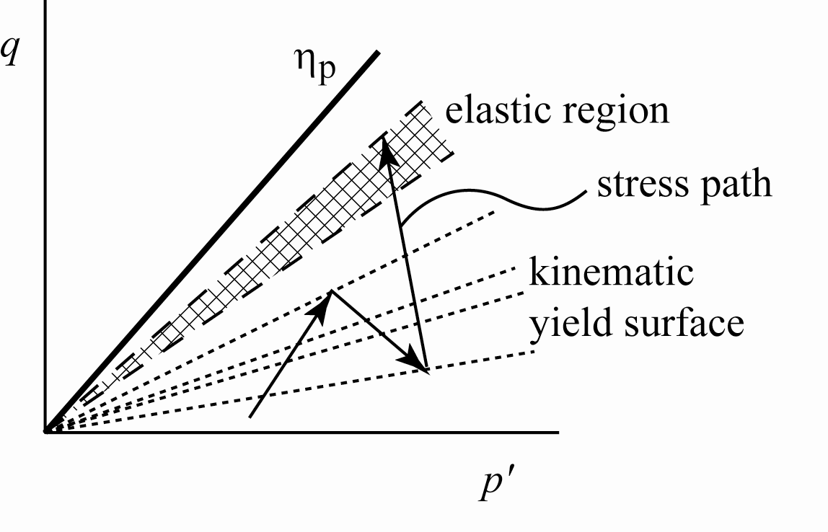
Severn-Trent sand
add kinematic hardening:
elastic region of high stiffness carried round with recent stress history
boundary of elastic region is the yield surface
use bounding surface plasticity:
plastic hardening stiffness depends on separation of the yield surface and bounding surface
kinematic hardening Mohr-Coulomb: strength dependent on state variable: hierarchical development

Slide 15
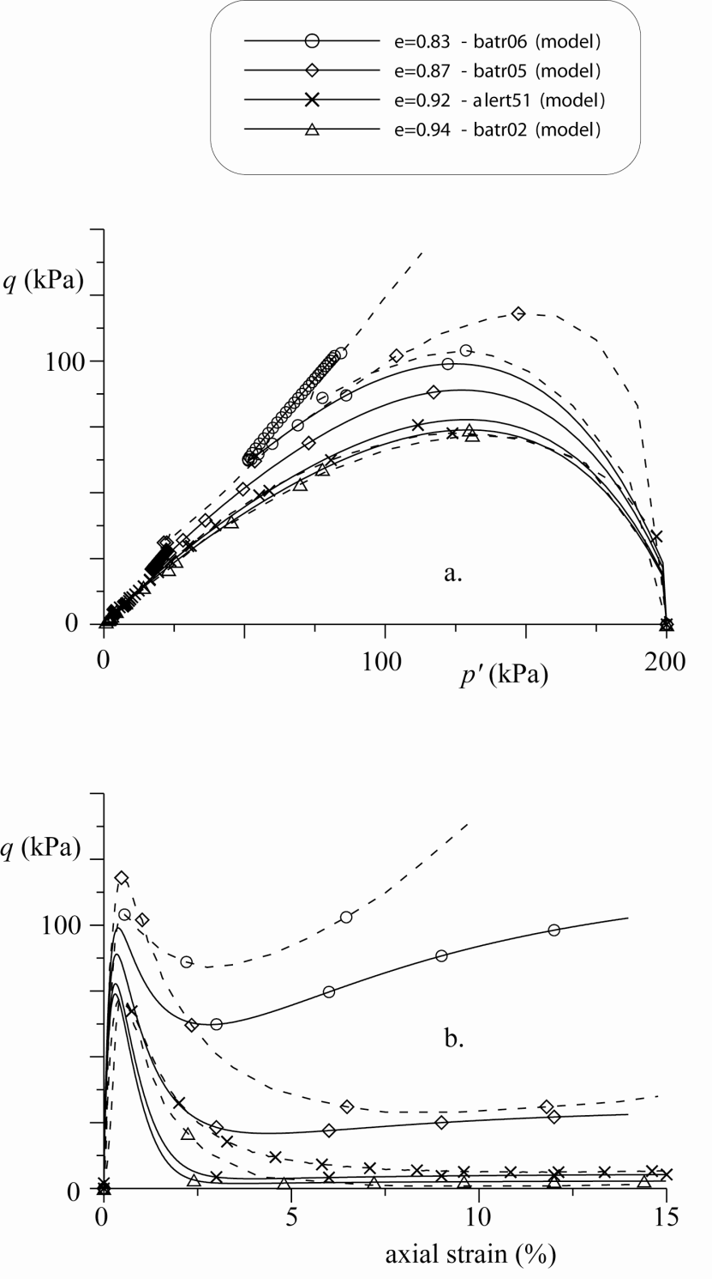
Severn-Trent sand
calibrated against triaxial test data for Hostun sand
effect of different density/stress level automatically described
ignore practical problem of maintaining homogeneity within softening sample
Gajo & Muir Wood, 1999

Slide 16
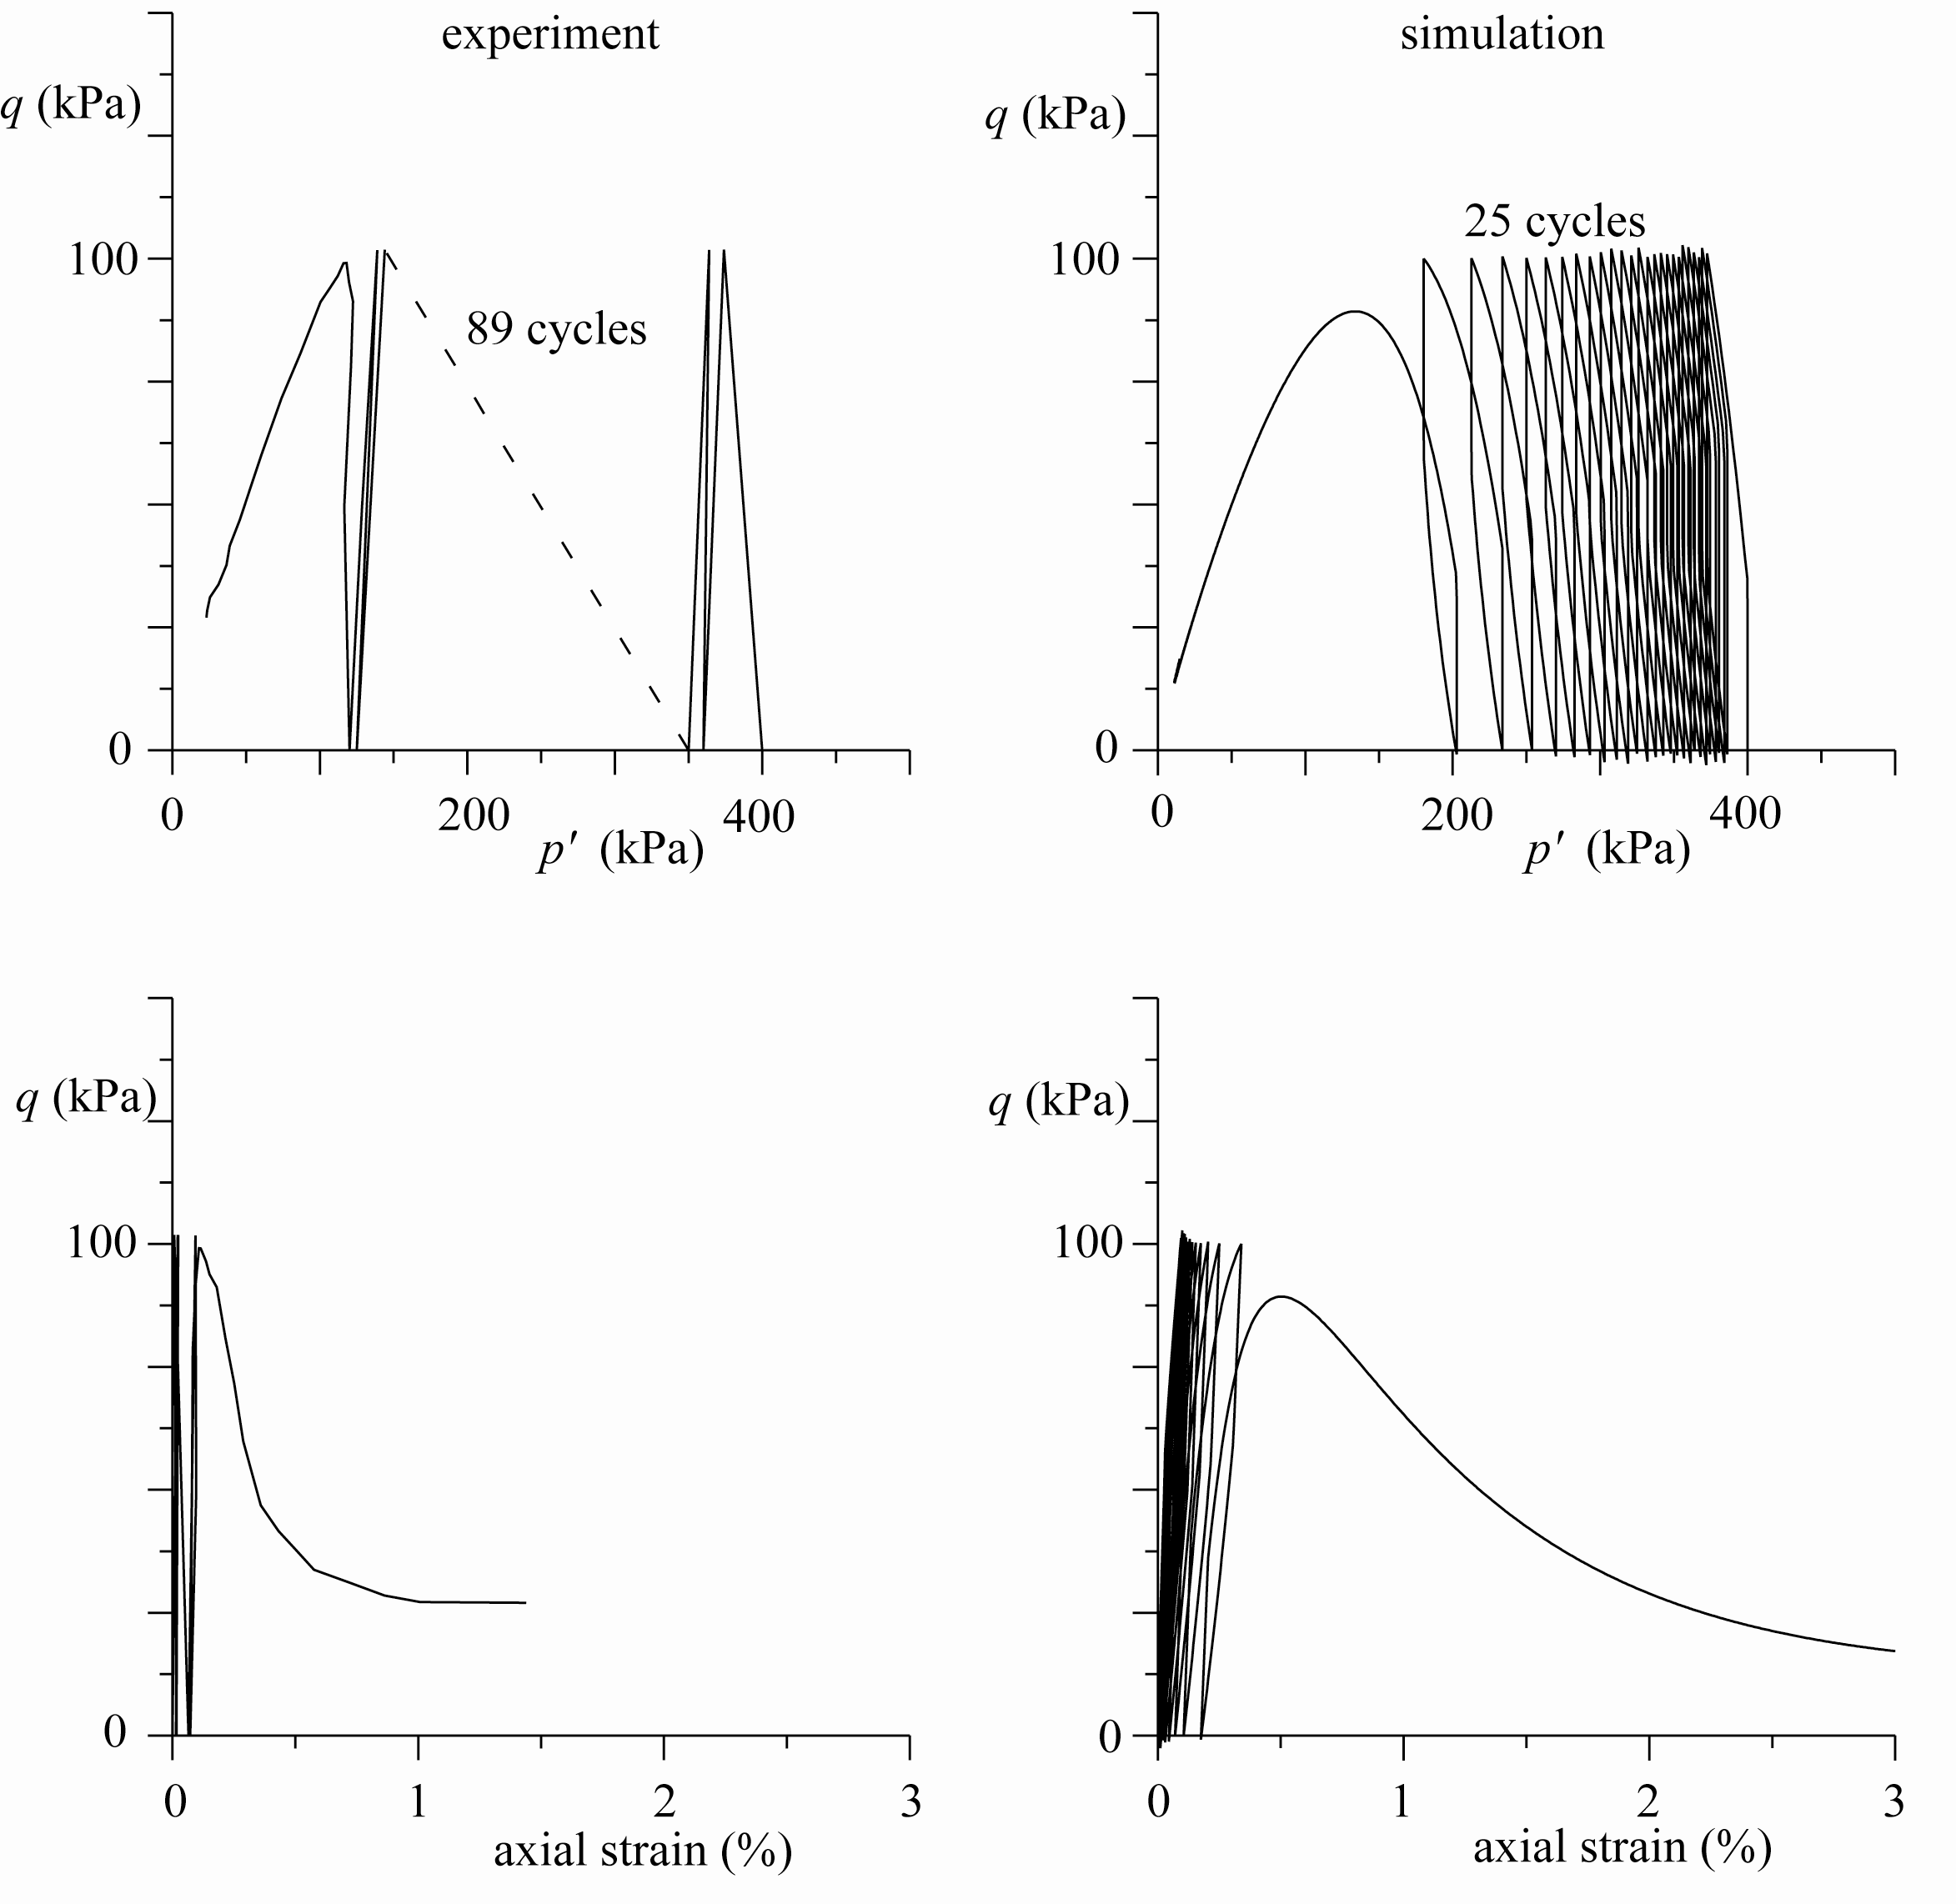

Slide 17
use model to simulate cyclic undrained loading leading to eventual liquefaction
model fails after 25 cycles
actual soil (Hostun sand) fails after 89 cycles
number of cycles to liquefaction is not a particularly reliable parameter to use for model calibration
obvious significant difference between samples which liquefy in one or two cycles and those which survive for many cycles
character of cyclic pore pressure build-up reproduced in model

Slide 18
messages:
possible to develop elegant models which reproduce desirable mechanical characteristics
especially effects of density and stress level
mathematical complexity not essential
build up from well known model – Mohr-Coulomb
next steps…
effect of particle crushing/change of grading
rate effects

