Slide 1

Saturated soil modelling: Griffith University: February 2010
Cam clay improved: nonlinearity and structure
David Muir Wood
d.muirwood@dundee.ac.uk

Slide 2
Designer models: addition of extra features
Kinematic yielding
2. Cam clay
3. Mohr-Coulomb

Slide 3
plastic – less stiff
shear stress
shear stress
elastic - stiff
mean stress
shear strain
classical elastic-plastic modelling of soil
for example, Cam clay (1963, 1968)

Slide 4
stress
yield?
classical identification of yield from stress:strain response
typical actual response
void ratio
strain
geometrical construction for estimation of preconsolidation pressure
preconsolidation pressure
vertical stress
(log scale)

Slide 5
Cam clay providing inspiration:
search for ‘Cam clay like’ yield loci
eg kaolin (Al-Tabbaa, 1984)

Slide 6
yield loci for natural clays
collected by Graham et al (1988)

Slide 7
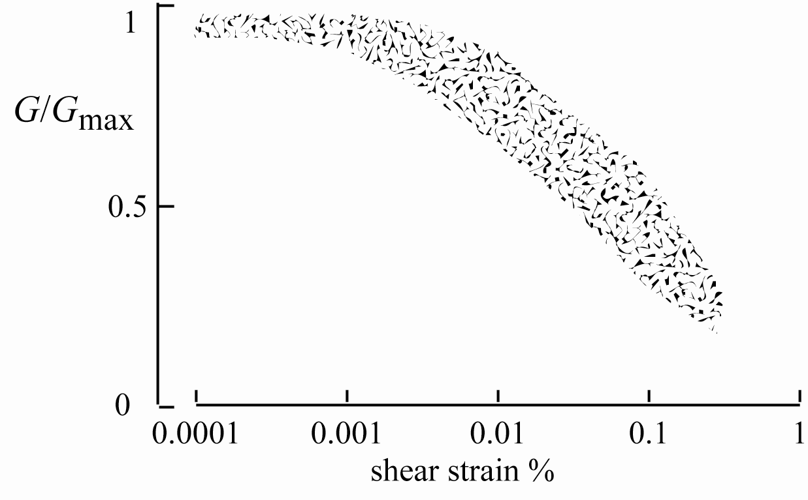
typical experimental observation: stiffness falls steadily with monotonic straining: is there an elastic region?
limit of elastic response??
shear stiffness degradation data for Quiou sand from resonant column and torsional shear tests (after LoPresti et al, 1997)

Slide 8
how do we objectively identify yielding? occurrence of irrecoverable strain? dissipation of energy in loading/unloading cycles? change in slope of stress:strain response?
stress
stress
a.
b.
strain
strain

Slide 9
yielding of Bothkennar clay:
boundaries deduced from inspection of stress:strain response
Y1 approximately centred on in situ stress state
Y3 reflects natural structure – damaged by any irrecoverable strain - evanescent
after Smith et al (1992)

Slide 10
kaolin revisited: isotropic consolidation histories
data from Al-Tabbaa (1987)

Slide 11
kaolin revisited: one-dimensional consolidation histories
data from Al-Tabbaa (1987)

Slide 12
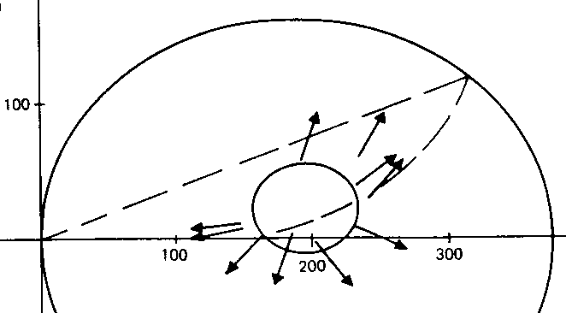
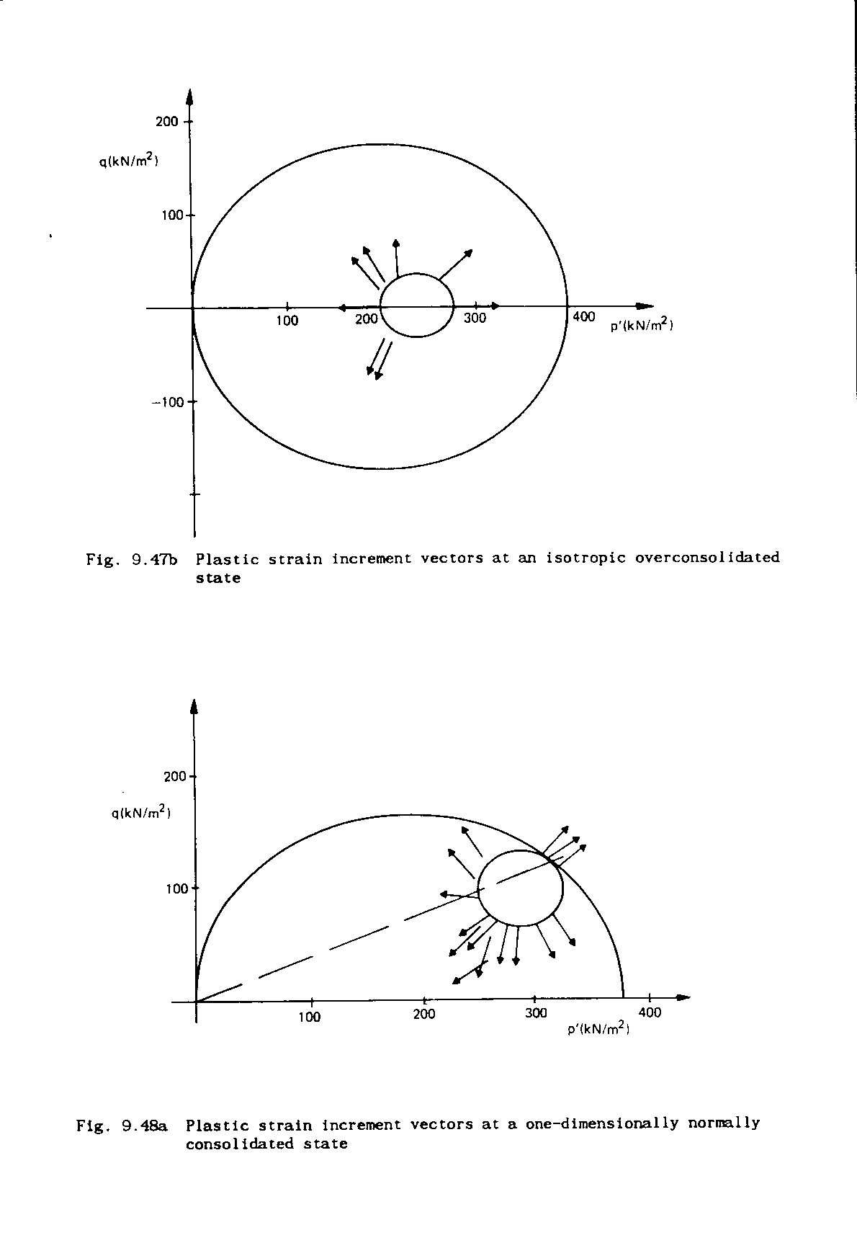
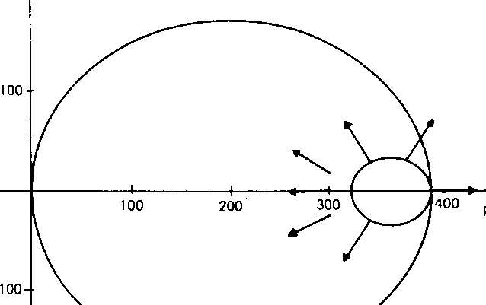
q kPa
q kPa
p' kPa
p' kPa
plastic strain increments: approximate normality to kinematic yield loci
q kPa
q kPa
p' kPa
p' kPa
kaolin: Al-Tabbaa, 1987

Slide 13
Deviatoric stress response envelopes
σ_{z}
σ_{z}
A: isotropic compression
σ_{x}
σ_{y}
σ_{x}
σ_{y}
ε_{d} = 0.05, 0.2, 0.4, 0.6, 0.8, 1, 1.2%
distortional stress probe rosettes
constant mean stress
cross anisotropy?
E_{v} > E_{h}
Hostun sand
Sadek, 2006

Slide 14
σ_{z}
distortional probing
constant mean stress
non-monotonic stress paths
stress probe rosettes
ABC … probe
σ_{x}
σ_{y}
σ_{z}
AB … probe
Sadek, 2006
σ_{x}
σ_{y}

Slide 15
Stress response envelopes: Hostun sand: small-medium strain
radial shearing AB
two corners ABC
ε_{d} = 0.05, 0.2, 0.4, 0.6, 0.8, 1, 1.2%
distortional strain
0.05%: history recalled
1%: history ‘forgotten’
Sadek, 2006

Slide 16
stress response envelopes
small/medium strain stiffness
kinematic hardening
centre as indicator of current fabric
but strain too large
comparison of 0.05% strain response envelopes for histories A, AB, ABC
Sadek, 2006

Slide 17
Designer models: addition of extra features
Kinematic yielding
2. Cam clay
3. Mohr-Coulomb

Slide 18
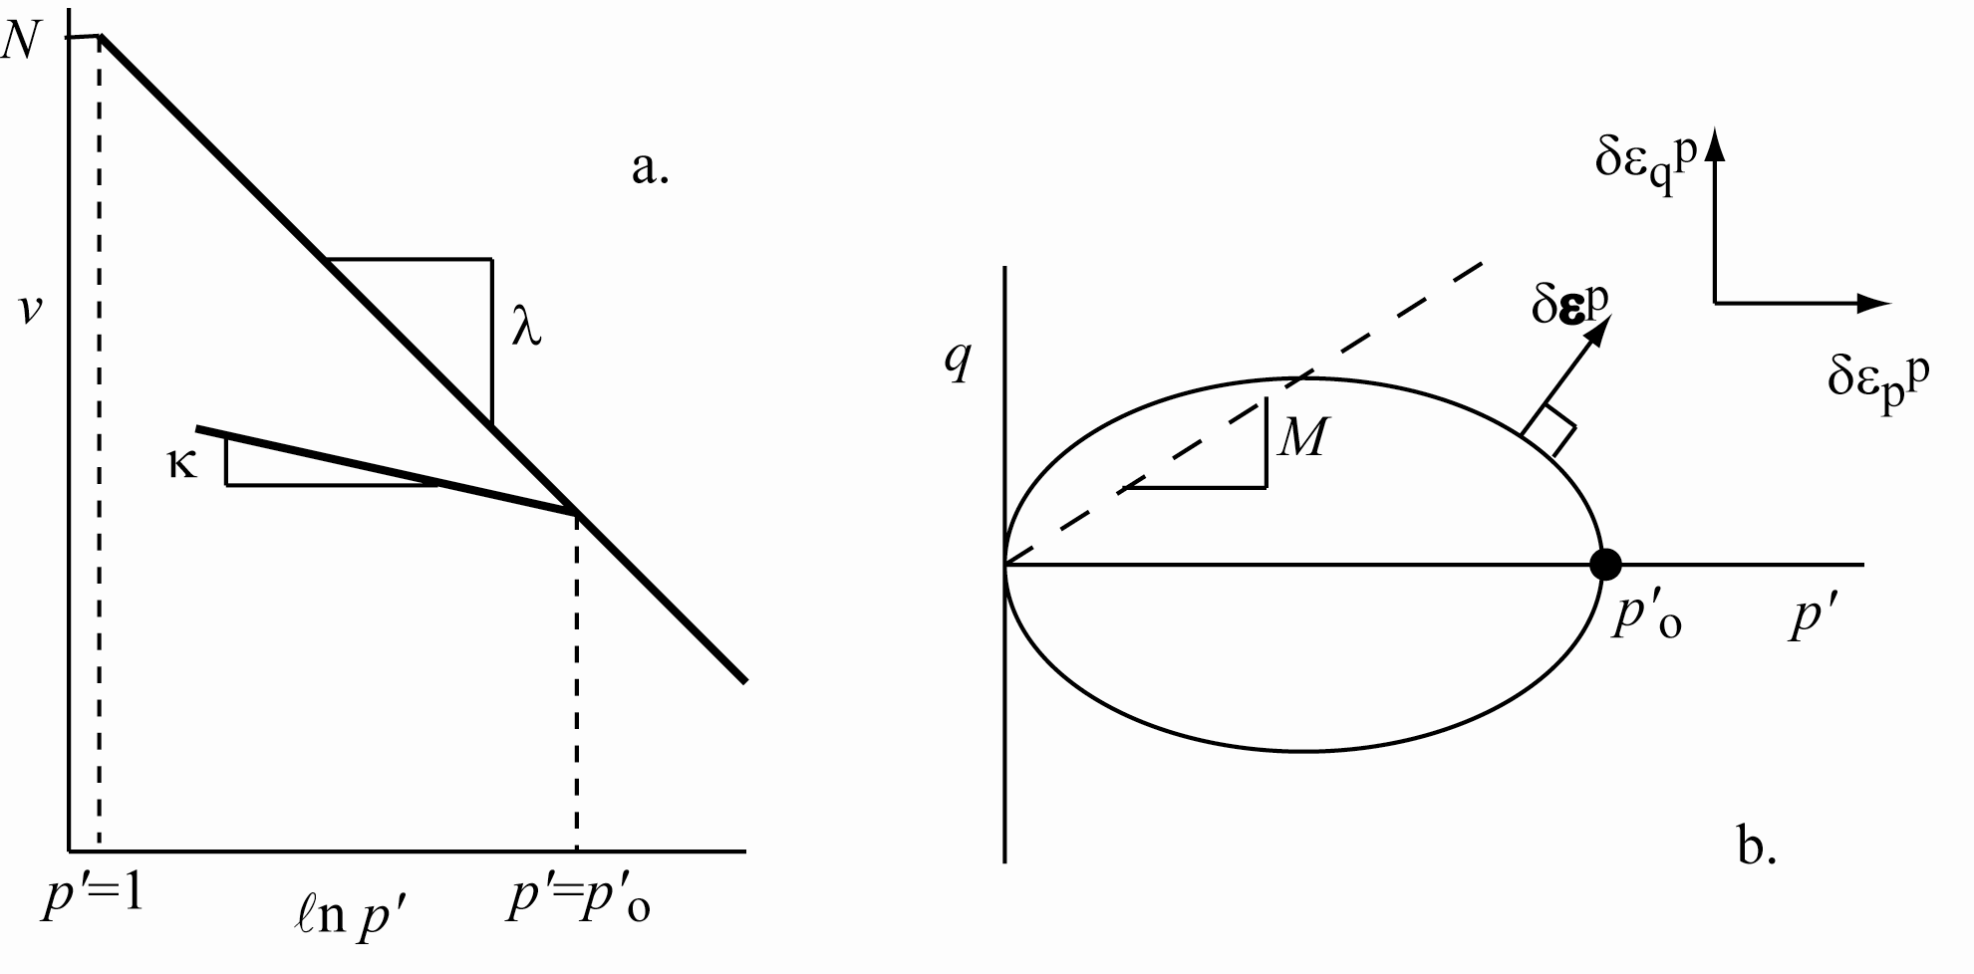
Cam clay
elastic-hardening plastic model
volumetric hardening
associated flow – normality

Slide 19
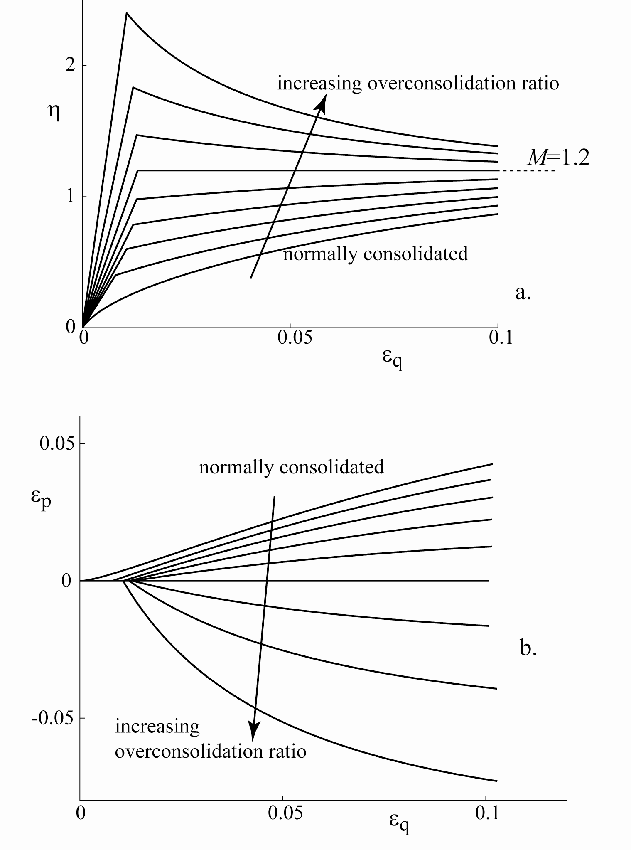
Cam clay
response in drained triaxial compression tests with constant p'
asymptotic approach to critical state
effect of overconsolidation ratio
sharp division between elastic and plastic response

Slide 20
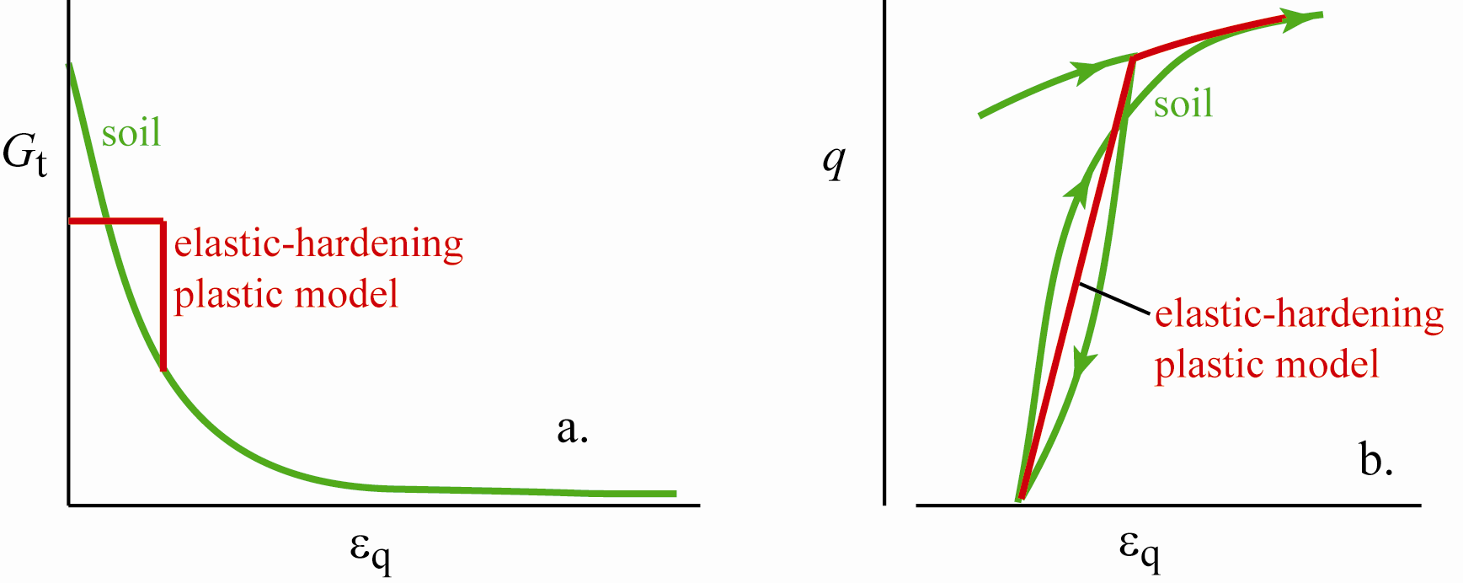
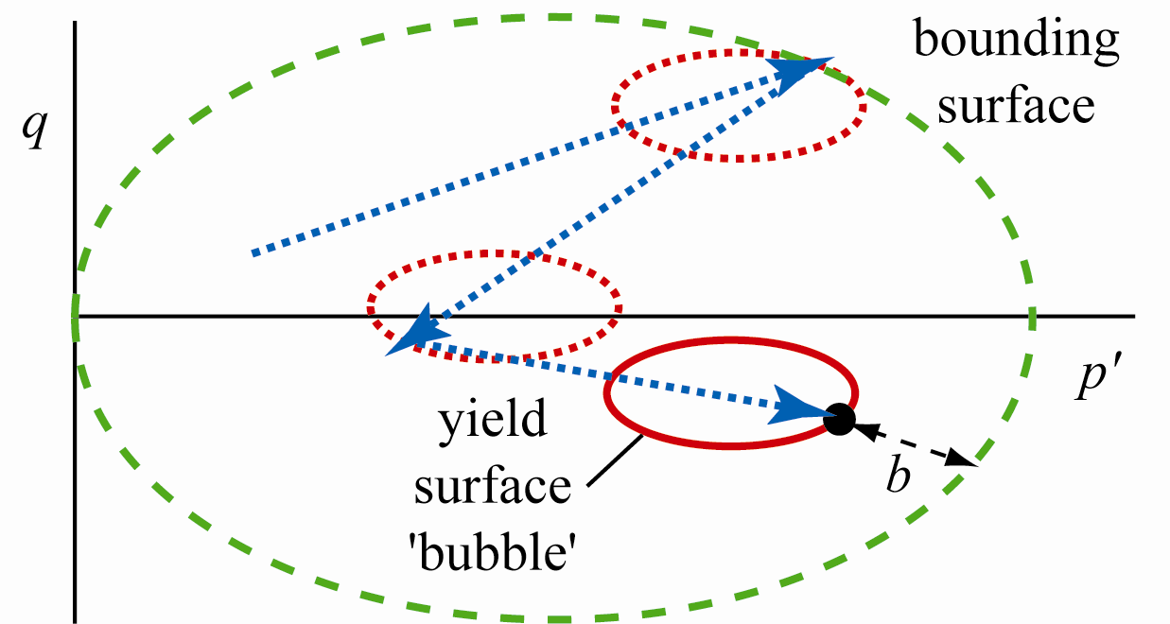
compare response of soil on nonmonotonic loading
with capability of single yield surface model
extension to simple models using kinematic hardening
and bounding surface plasticity

Slide 21
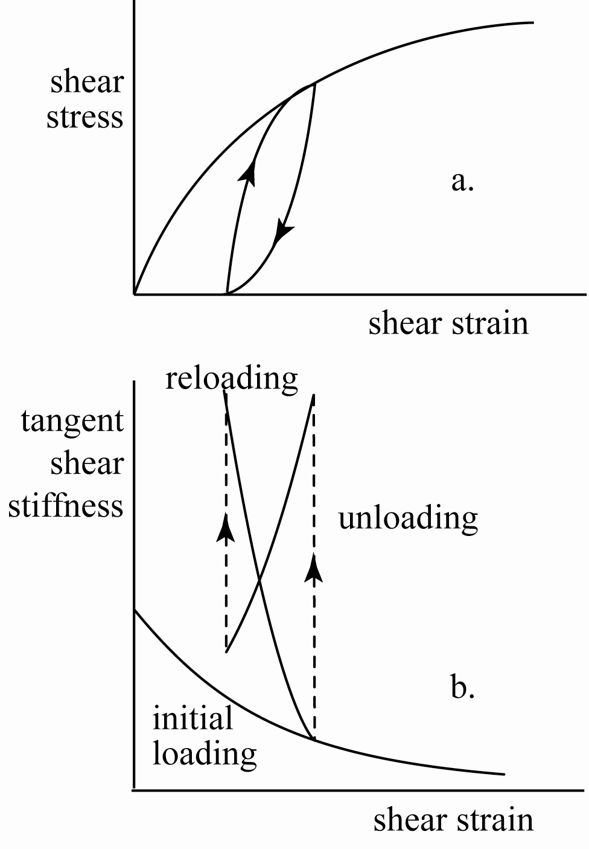
compare response of soil on nonmonotonic loading with capability of single yield surface model
elastic-hardening plastic model expects elastic behaviour on reversal, sudden drop in stiffness at yield
soils typically show hysteretic behaviour on unload-reload cycles, steady change in incremental stiffness

Slide 22
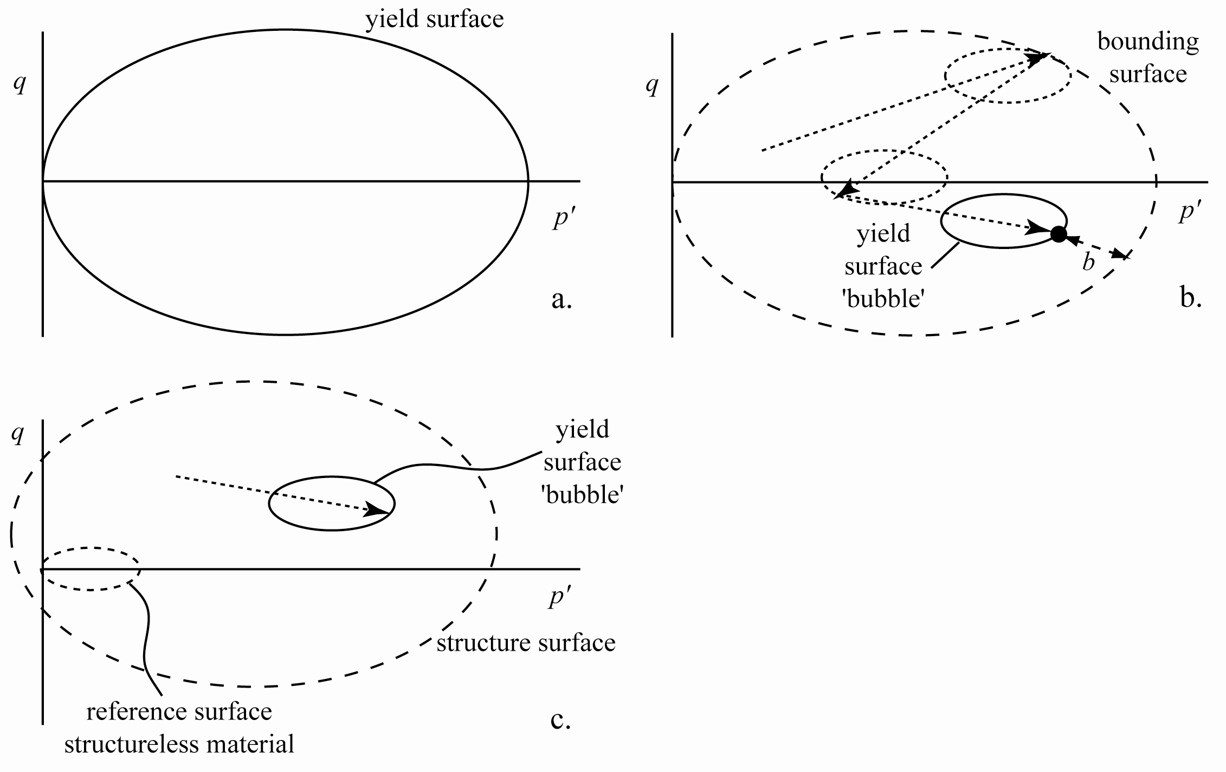
kinematic hardening extension
yield locus carried around with stress state – 'bubble' – strongly influenced by recent history
stiffness falls as yield 'bubble' approaches bounding surface – controlled by distance b
when loading with 'bubble' in contact with bounding surface model is identical to Cam clay

Slide 23
assume relative size R of 'bubble'
assume rule for translation of 'bubble'
assume interpolation rule linking plastic stiffness with b
…otherwise identical to Cam clay

Slide 24
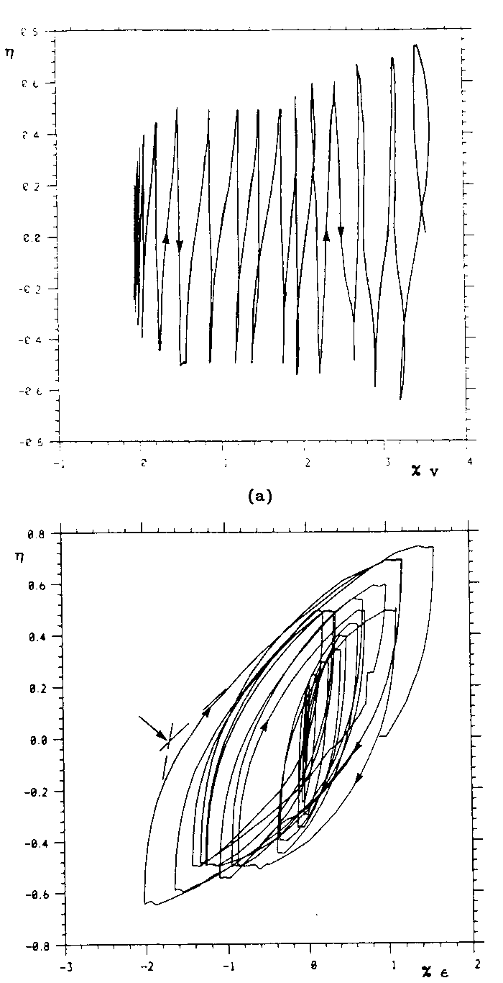
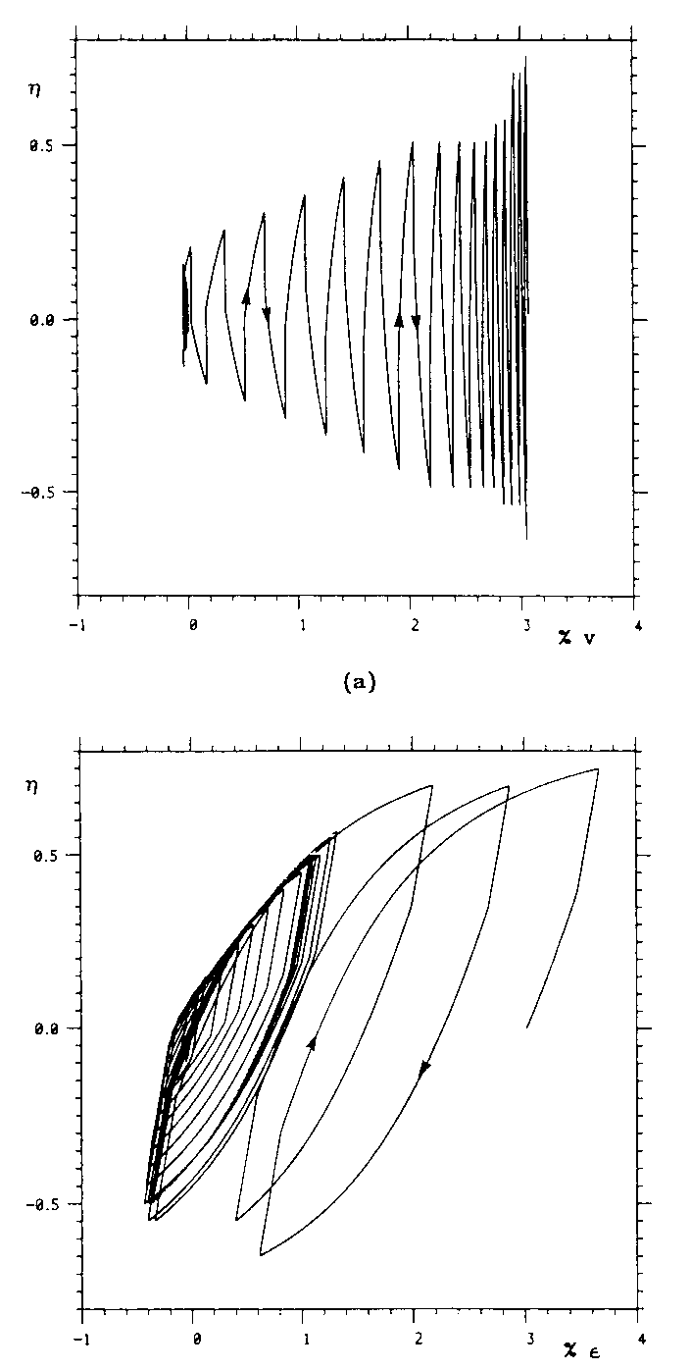
volumetric strain
η
η
kaolin
constant p' cycles
hysteresis
build up of volumetric strain
experiment
simulation
η
η
distortional strain

Slide 25
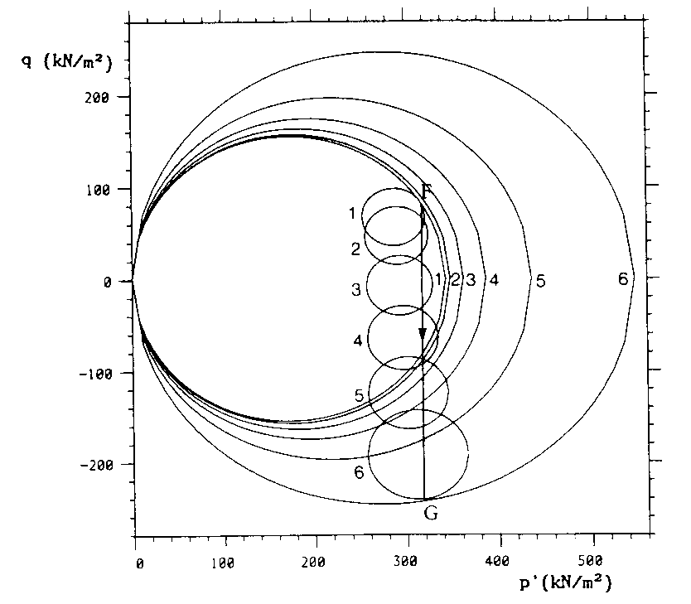
q kPa
p' kPa
migration of 'bubble' during constant p' unloading after one-dimensional normal compression
hardening of 'bubble' and bounding surface

Slide 26
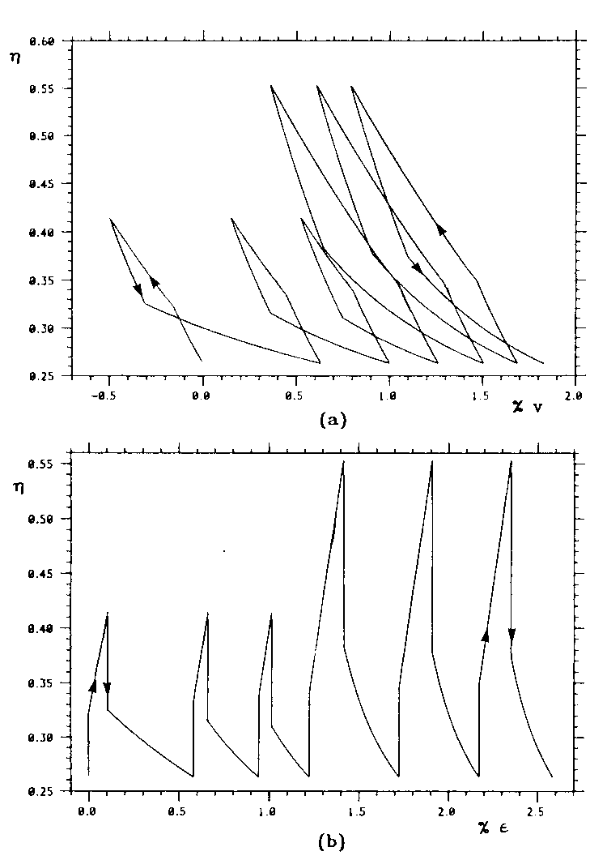
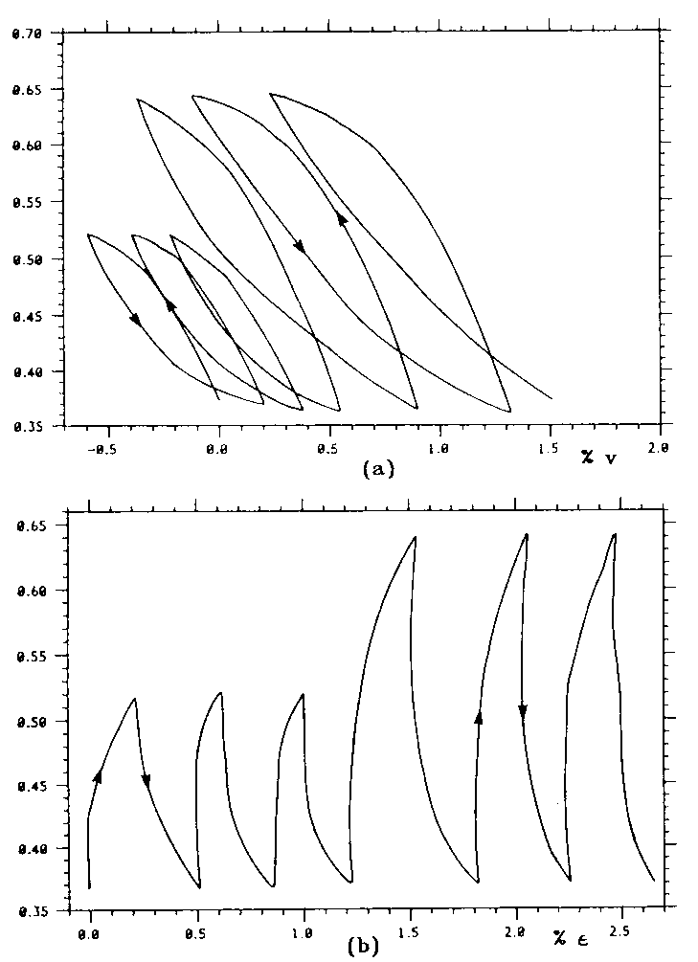
experiment
simulation
constant q cycles after one-dimensional normal compression

Slide 27
add further effects in a similarly hierarchical way
cementation and structure: extension to 'bubble' model
natural soils often contain structure: bonding between particles: destroyed with mechanical or chemical damage

Slide 28
ratio of sizes of structure surface and reference surface gives indication of current degree of structure
design model in which yield surface has increased size as a result of the bonding
with plastic straining (or chemical weathering) the yield surface gradually shrinks to the yield surface, for remoulded, structureless material
extension of 'bubble' kinematic extension of Cam clay
all features of 'bubble' model retained

Slide 29
add measure of structure or bonding: single scalar parameter r
'bounding' surface now called 'structure' surface: size r times larger than a reference surface
structure lost whenever plastic strains occur
damage law:
damage plastic strain increment δε_{d}^{p} combines plastic volumetric and plastic distortional strain increments:
– additional parameter to control their relative importance
structure progressively disappears:
r → 1 as plastic deformation increases

Slide 30
logical: structureless soil is one which has been so mechanically pummelled that it has no remaining bonds between particles
particular forms of laboratory testing (triaxial testing, for example) may not be able to provide sufficient damage
evolution law and definition of damage strain may need to include some more subtle reference to the nature of the strain path
shearing with rotation of principal axes is likely to be especially damaging
feasible to introduce other evolution laws which relate change (increase or decrease) of scalar measure of structure r to chemical environment or time or temperature effects
Cam clay can be regained by setting r = 1, R = 1

Slide 31
hierarchical extension of 'bubble' model to include effects of structure
other evolution laws: relate change (increase or decrease) of scalar measure of structure r to chemical environment or time or temperature effects
Cam clay can be regained by setting r = 1, R = 1

Slide 32
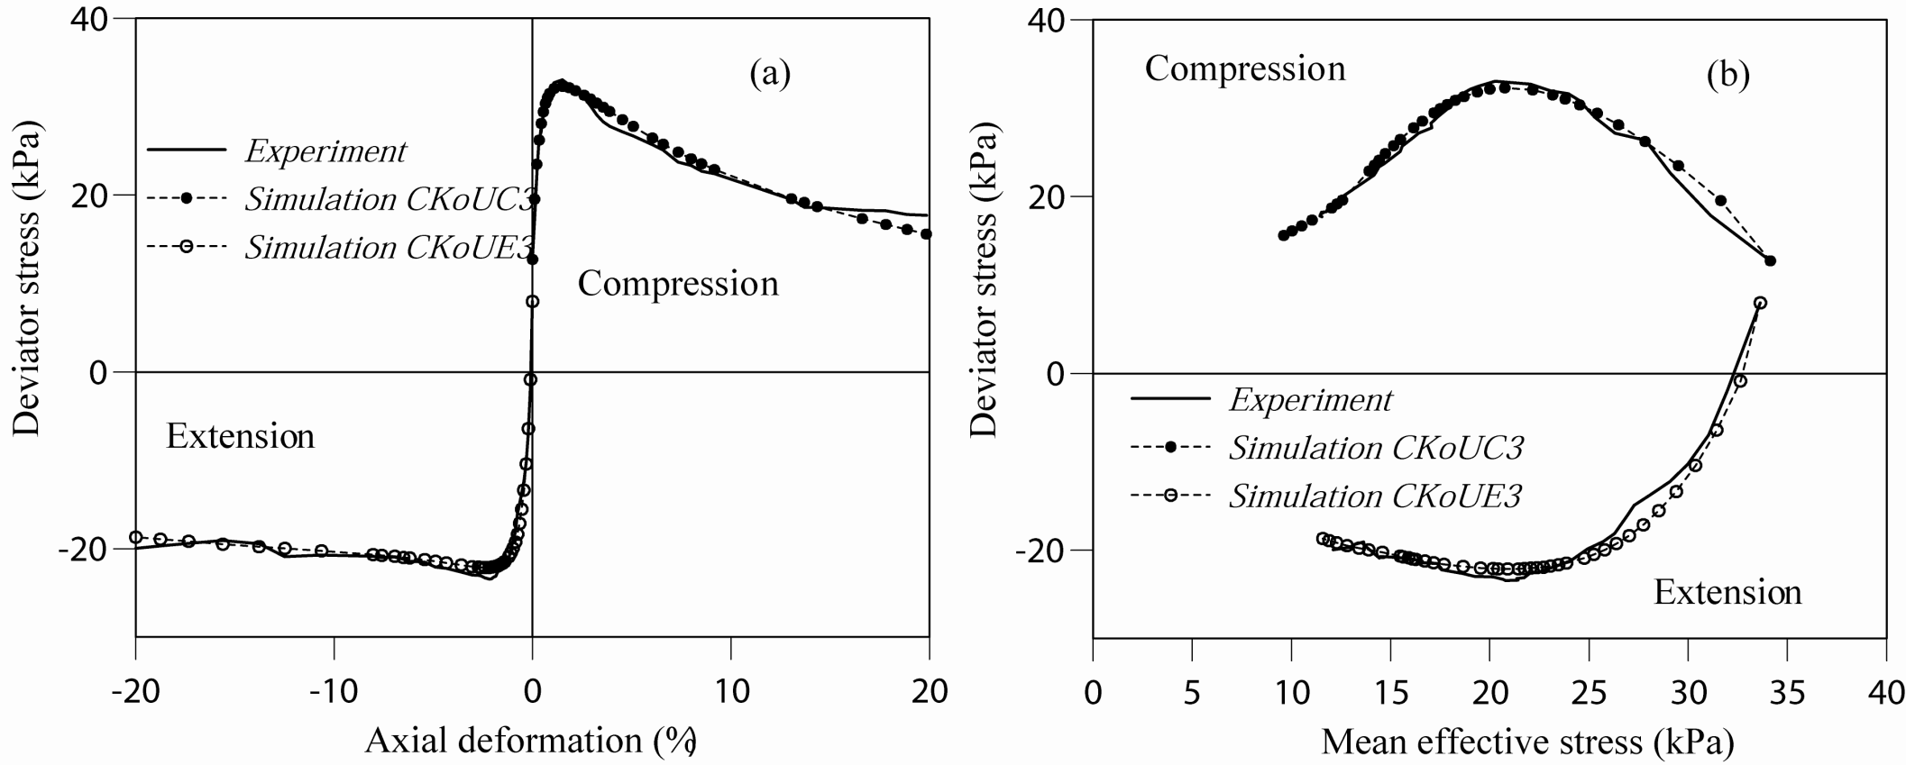
Norrköping clay – calibration tests
Rouainia & Muir Wood (2000)

Slide 33
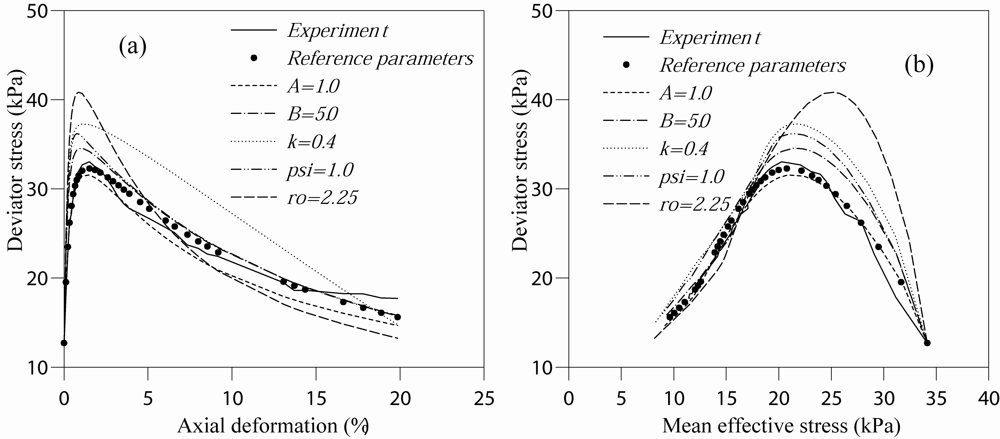
Norrköping clay – parametric variation
Rouainia & Muir Wood (2000)

Slide 34
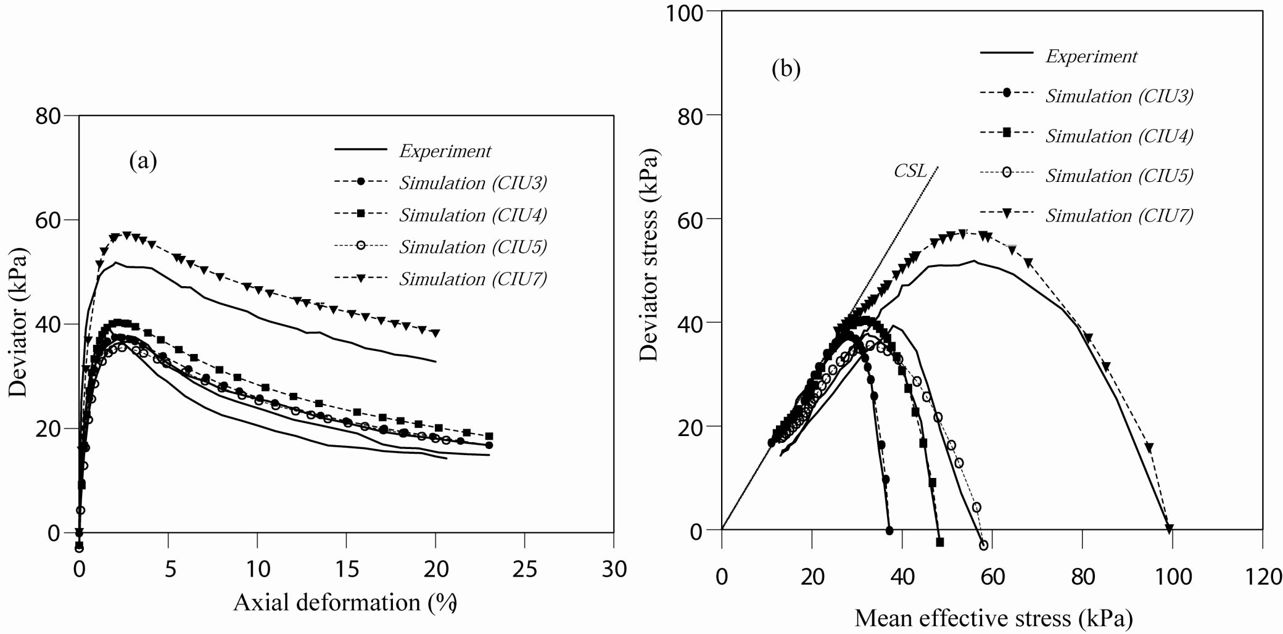
Norrköping clay – undrained – isotropic consolidation
Rouainia & Muir Wood (2000)

Slide 35
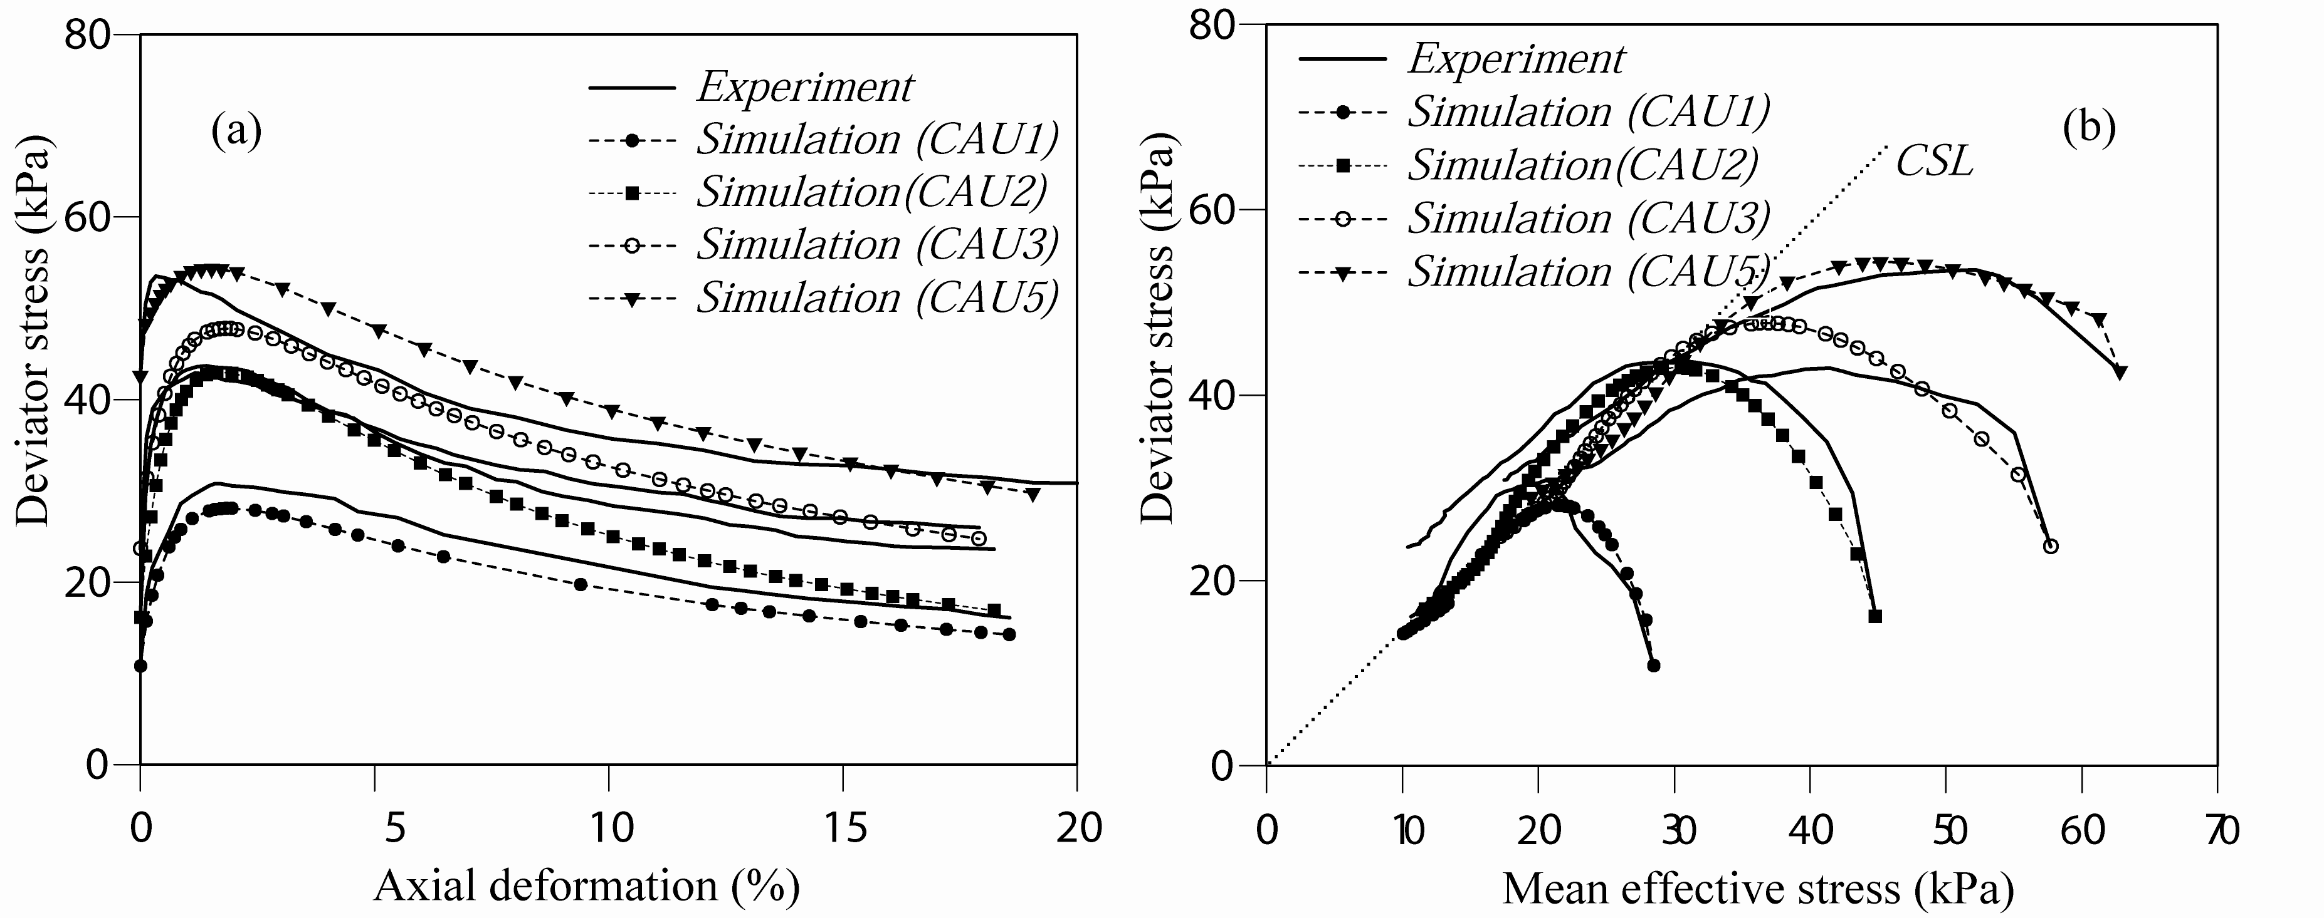
Norrköping clay – undrained – anisotropic consolidation
Rouainia & Muir Wood (2000)

Slide 36
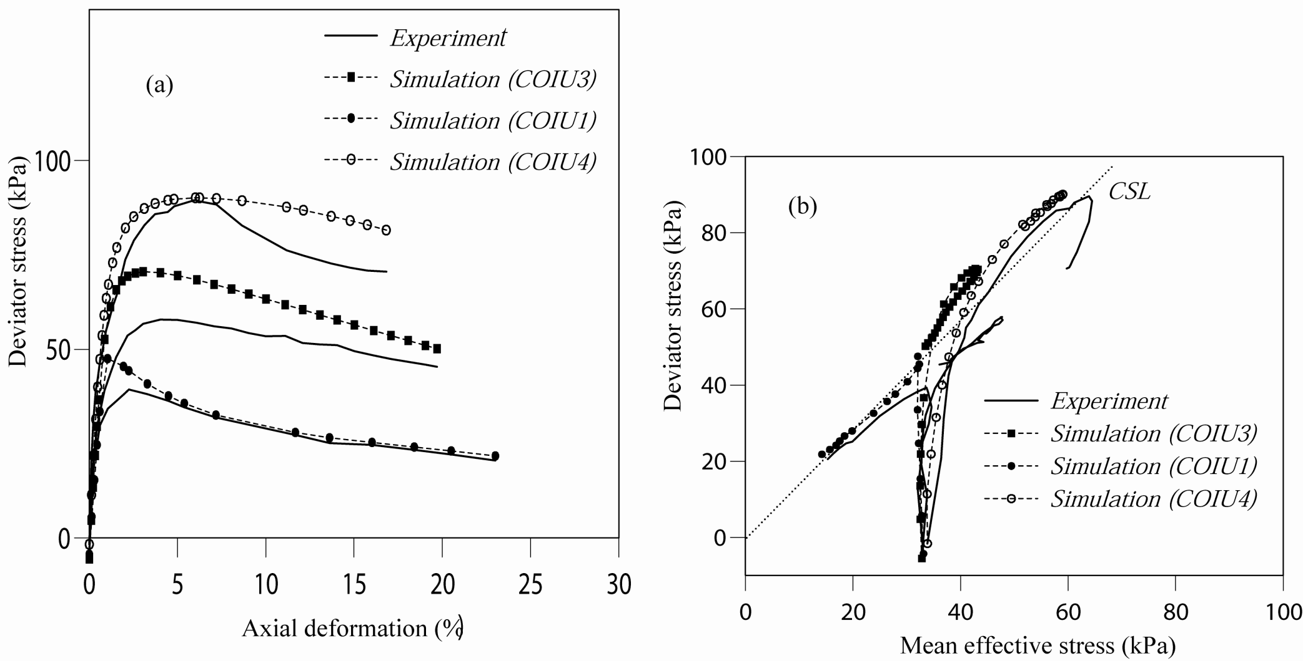
Norrköping clay – undrained – isotropic overconsolidation
Rouainia & Muir Wood (2000)

Slide 37
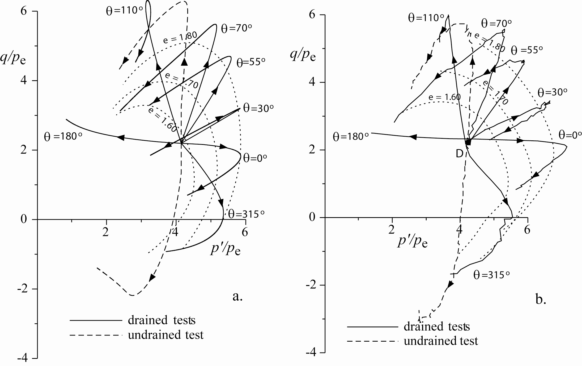
simulation experiment
Bothkennar clay
Gajo & Muir Wood, 2001
results normalised by Hvorslev equivalent consolidation pressure p'_{e} for structureless soil

Slide 38
Hierarchical extensions of Cam clay
it is relatively straightforward to add extra features to a soil model
advantage in using well known model as basis – check implementation – acceptability
extra features imply additional soil parameters and additional calibration tests
seek adequate complexity in modelling – match complexity of model to availability of data and needs of application

