Slide 1

Saturated soil modelling: Griffith University: February 2010
Hardening plasticity models: Cam clay II
David Muir Wood
d.muirwood@dundee.ac.uk

Slide 2
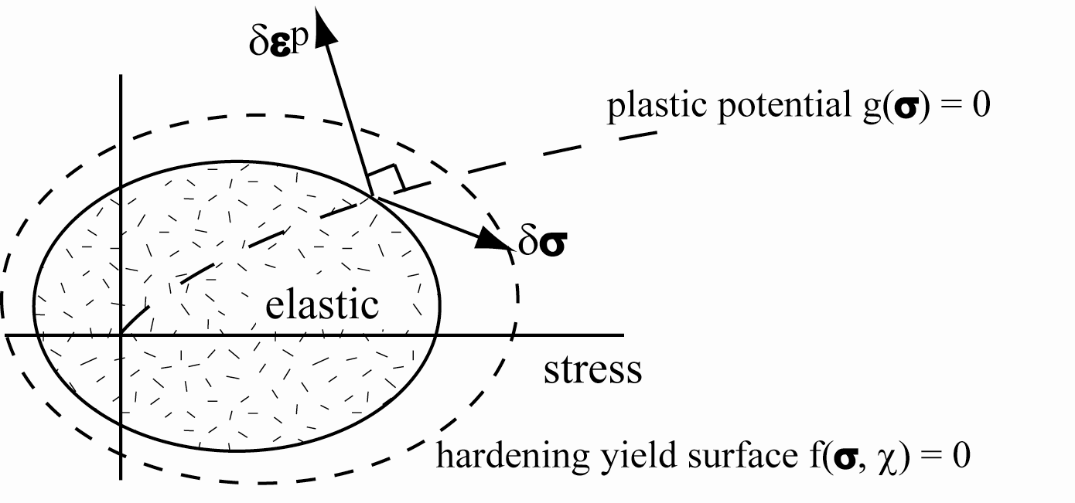
General elastic-hardening plastic model
natural extension of perfectly plastic model
yield surface now function not only of stresses but also of hardening parameter(s) χ: f(σ, χ) = 0
consistency condition becomes (stress state must remain on expanding yield surface):

Slide 3
General elastic-hardening plastic model
assume strain increment divided into elastic and plastic components δε = δε^{e} + δε^{p}
elastic strain accompanies any change in stress
elastic model δσ = Dδε^{e}
propose plastic potential g(σ) such that plastic strain increments given by flow rule:
then:

Slide 4
General elastic-hardening plastic model
combine consistency condition with flow rule:
write: (hardening function)
and deduce in the same way as before:
and:

Slide 5
Application
having established the general framework we can generate any model we wish by choosing appropriate functions for yield surface, plastic potential and hardening rule
demonstrate for Cam clay model

Slide 6
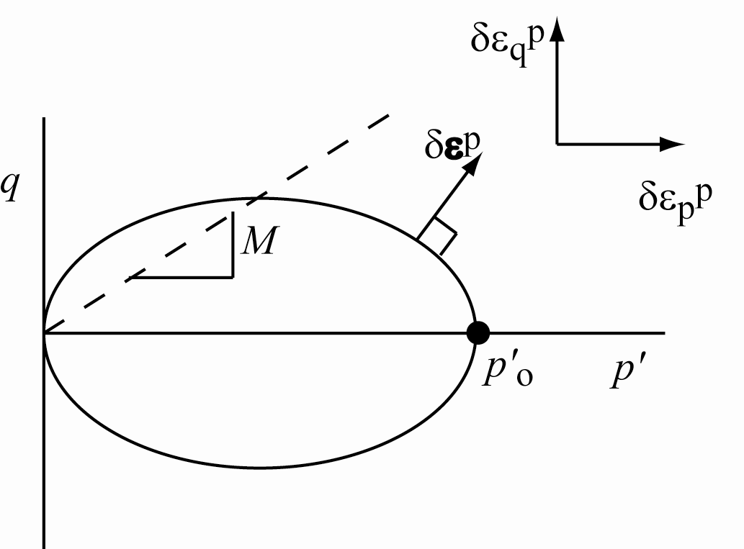
Cam clay
yield function and plastic potential assumed identical
plastic strain increments given by:
single hardening parameter p'_{o}

Slide 7
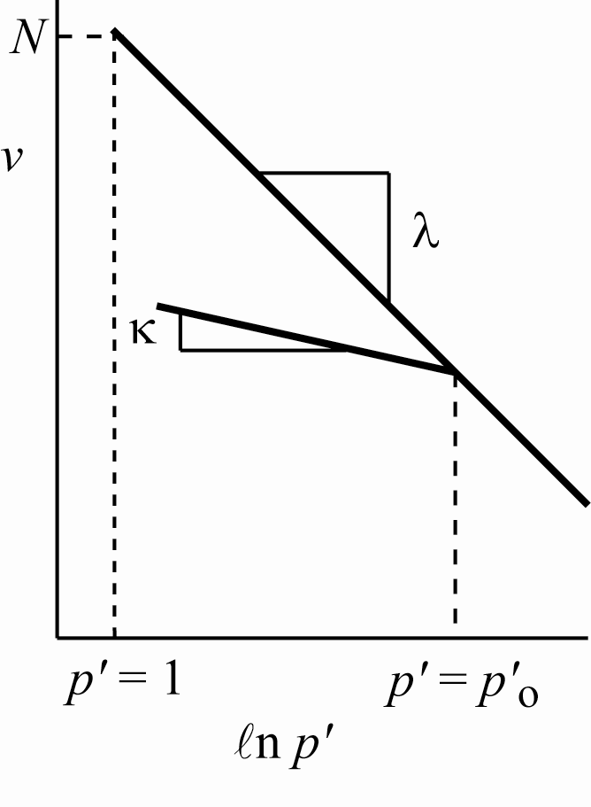
Cam clay
hardening rule linked with linear relationships in semi-logarithmic compression plane
pure volumetric hardening

Slide 8
Cam clay
compute hardening function H
and hence calculate full elastic-plastic stiffness relationship:
with: K=vp'/κ

Slide 9
Cam clay
compute hardening function H
and hence calculate full elastic-plastic stiffness relationship
elastic predictor
plastic corrector

Slide 10
Cam clay
stiffness formulation always works: strain increment → stress increment
elastic prediction – followed by plastic correction if predicted elastic stress state violates the yield condition
however, compliance formulation may be less cumbersome: stress increment → strain increment
but note that this breaks down if soil wants to soften – and is unsure whether to unload plastically or elastically

Slide 11
Cam clay: compliance formulation
decomposition of strain increment into elastic and plastic components δε = δε^{e} + δε^{p}
elastic strains:
yield locus:
differential form:

Slide 12
Cam clay: compliance formulation
plastic strain increments given by:
implying flow rule (ratio of plastic strain increments):
often convenient to work with yield locus described using stress ratio η = q/p'

Slide 13
Cam clay: compliance formulation
hardening rule links change in size p'_{o} of yield locus with plastic volumetric strain ε_{p}^{p} (magnitude of plastic strain increments)
so that plastic compliance relationship is:

Slide 14
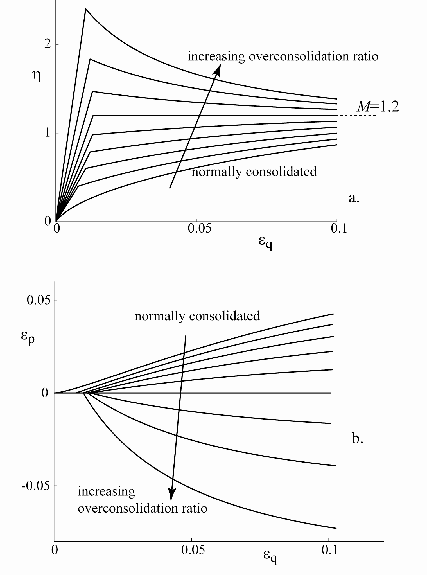
Cam clay integration
drained triaxial compression δp = 0
κ = 0.05, G = 1500kPa, λ = 0.25, M=1.2
p'_{o} = 100kPa
overconsolidation ratio p'_{o}/p'_{i} in range 1-5

Slide 15
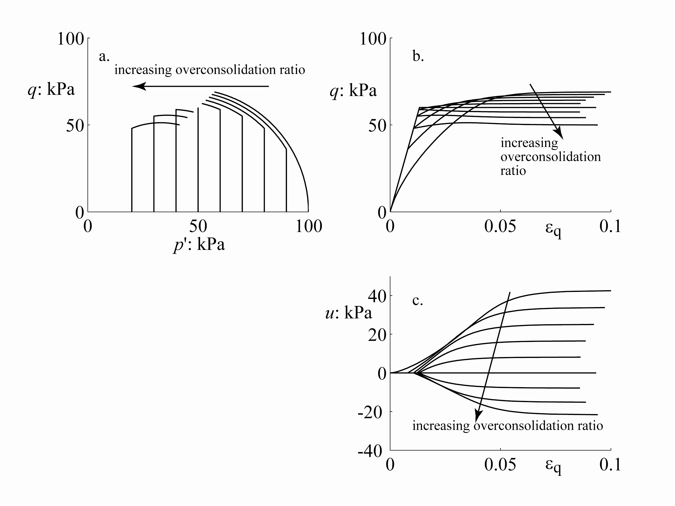
Cam clay integration
undrained triaxial compression δp = 0
κ = 0.05, G = 1500kPa, λ = 0.25, M=1.2
p'_{o} = 100kPa
overconsolidation ratio p'_{o}/p'_{i} in range 1-5
pore pressure entirely due to dilatancy

Slide 16
Cam clay – summary
pioneering elastic-plastic model
associated flow – normality – yield locus=plastic potential
volumetric hardening – change in size of yield locus linked with plastic volumetric strain
link between stress plane and compression plane – each yield locus has a corresponding unloading-reloading line
critical states
contrasting response for η < M and η > M
possibility of softening –localisation?

