Slide 1

Saturated soil modelling: Griffith University: February 2010
Practical exercise: choice of soil parameters
David Muir Wood
d.muirwood@dundee.ac.uk

Slide 2
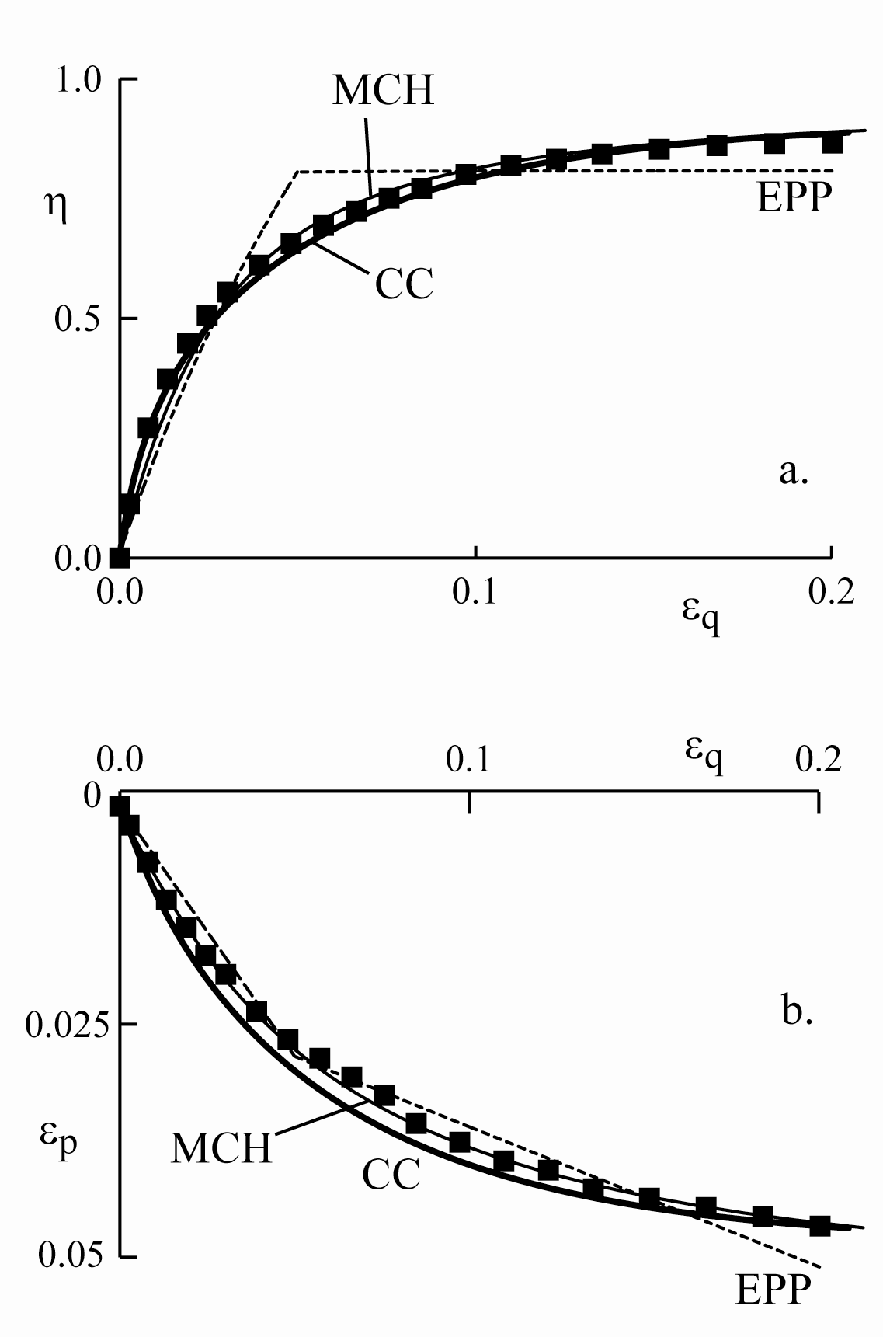
triaxial compression of normally compressed Weald clay
elastic-perfectly plastic (EPP) Mohr-Coulomb model is very widely available – but requires judgement for selection of stiffness and strength
Cam clay (CC) is quite widely available and provides more control over nonlinearity
hardening Mohr-Coulomb (MCH) is non-standard but demonstrates that there may be several routes to fitting available data

Slide 3
triaxial compression of Hostun sand
use spreadsheet to find optimum sets of parameters for [elastic-perfectly plastic Mohr-Coulomb,] Cam clay and elastic-hardening plastic Mohr-Coulomb models
there should be many right answers – there are many ways of obtaining matches of similar quality
it would be more realistic – and more challenging – to try to match several sets of data simultaneously

Slide 4
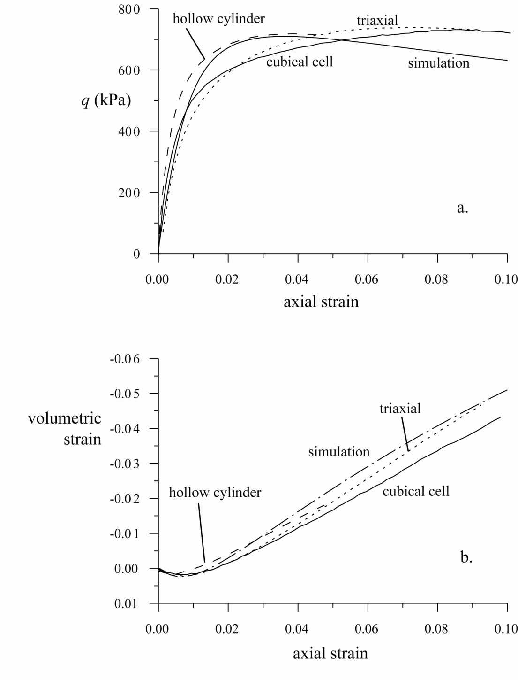
data from supposedly the same test in different apparatus are not the same
what accuracy should be expected in comparing simulation and observation?

Slide 5
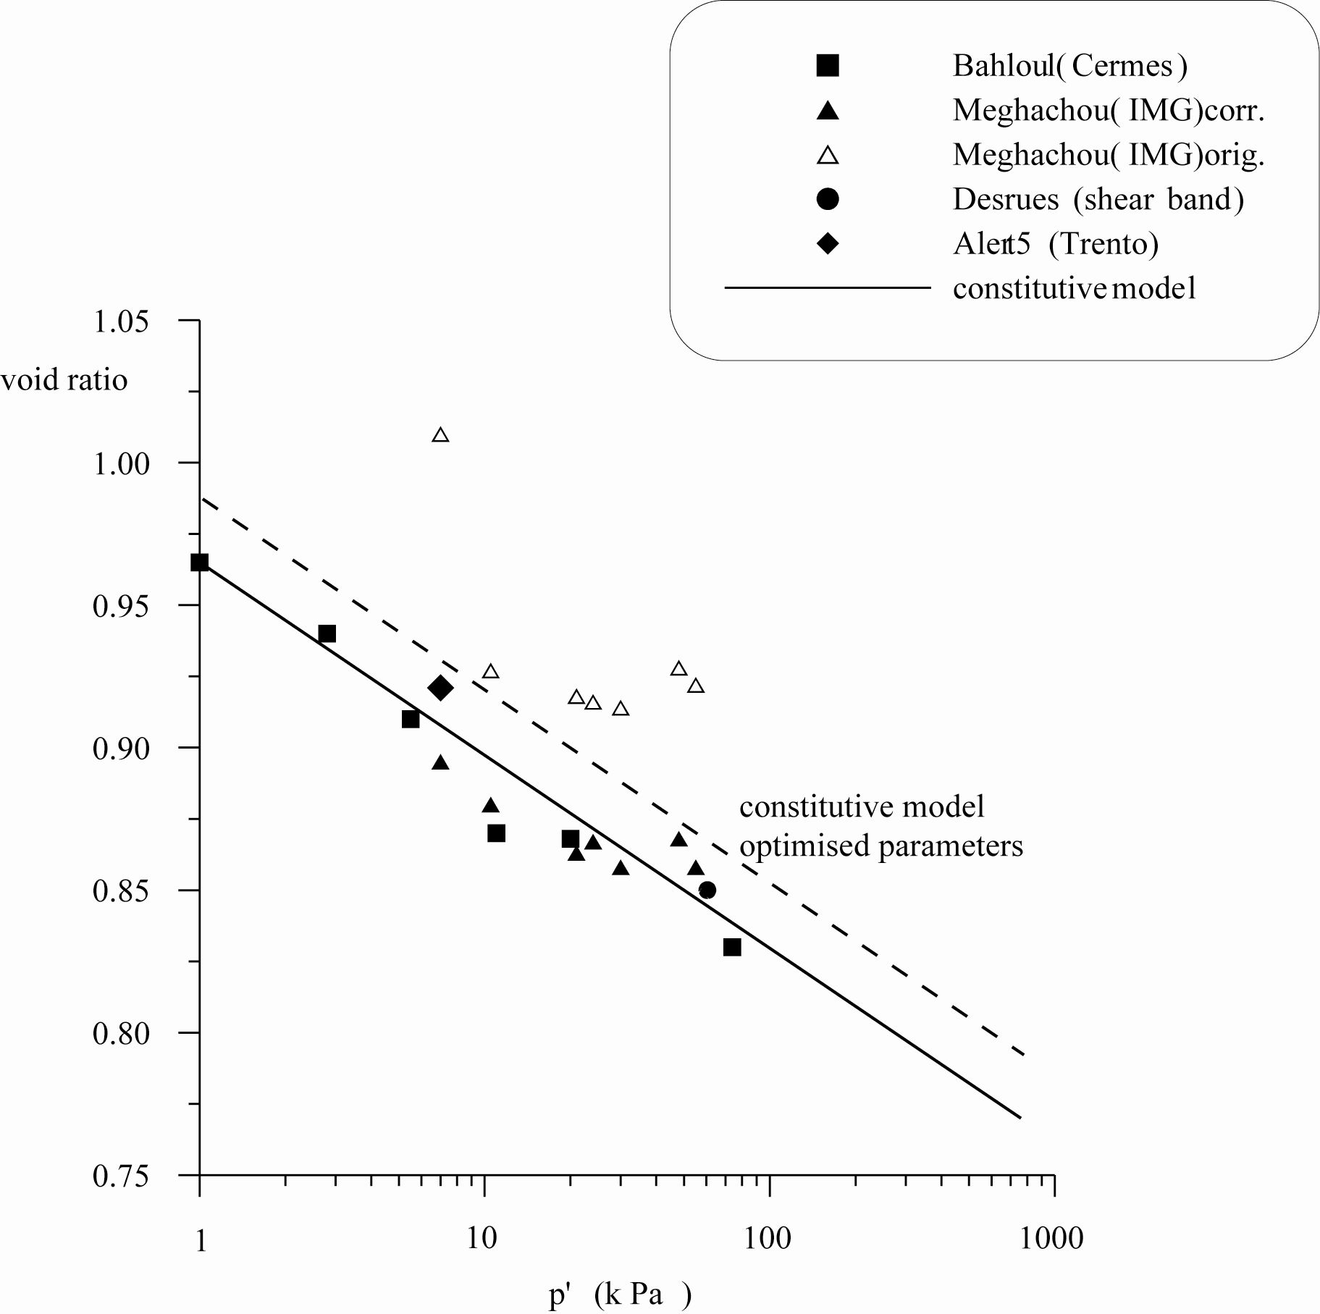
advanced soil model requires critical state data
difficulty in obtaining reliable void ratio information
model prefers a slightly higher critical state line to optimise fit

Slide 6
Summary
Mohr-Coulomb model is widely available but unsuitable to describe prefailure nonlinearity
elastic-hardening plastic models are more useful – but one simulated test is insufficient for decision on optimum model
desirable to match range of data for stress paths relevant to application
experimental data are not infallible

