Slide 1

Saturated soil modelling: Griffith University: February 2010
Cam clay I
David Muir Wood
d.muirwood@dundee.ac.uk

Slide 2
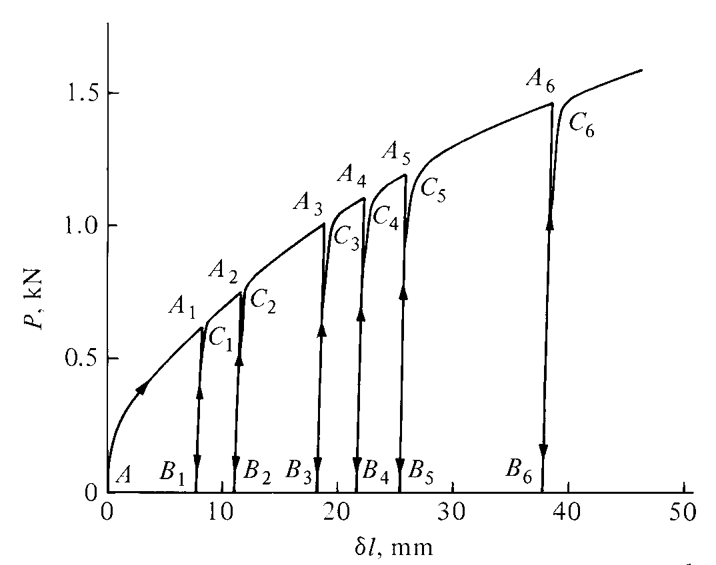
Yielding and plastic hardening
uniaxial tension of annealed copper wire – cycles of loading
δ
P
elastic – recoverable – response on unloading/reloading provided load remains below previous maximum: yield load
permanent extension – plasticity – if load exceeds yield load
increase in elastic region – penalty in permanent extension
plastic hardening rule

Slide 3
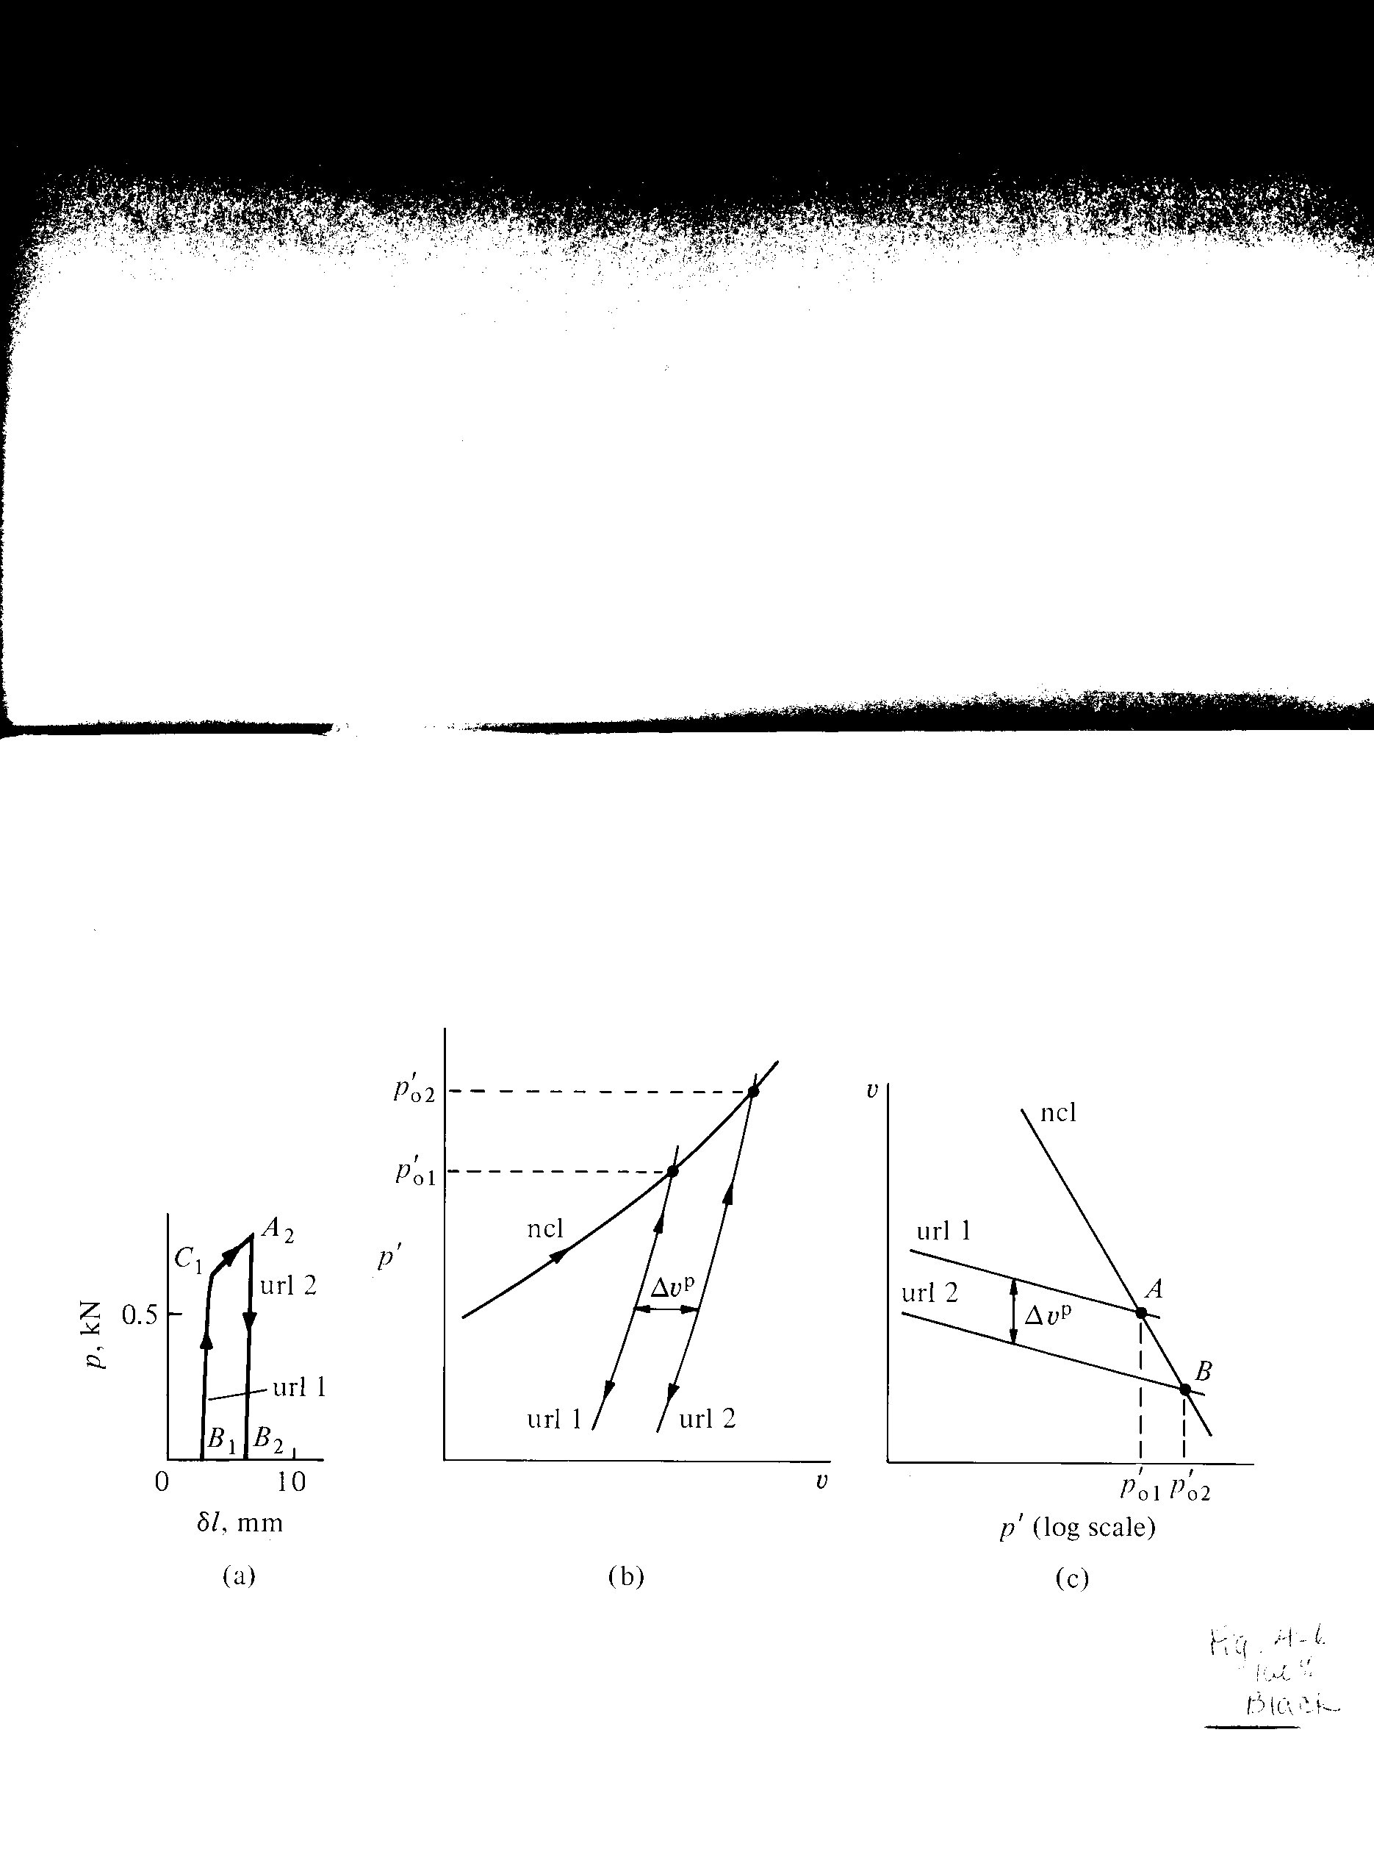
Plastic strains and hardening of yield loci
annealed copper – loading from C₁ (yield) to A₂ produces elastic and plastic deformation
separation of url1 and url2 is increase of plastic deformation

Slide 4
Plastic strains and hardening of yield loci
annealed copper – loading from C₁ (yield) to A₂ produces elastic and plastic deformation
separation of url1 and url2 is increase of plastic deformation
by analogy, for clay, separation Δv^{p} of url1 and url2 is increment of irrecoverable (plastic) volume

Slide 5
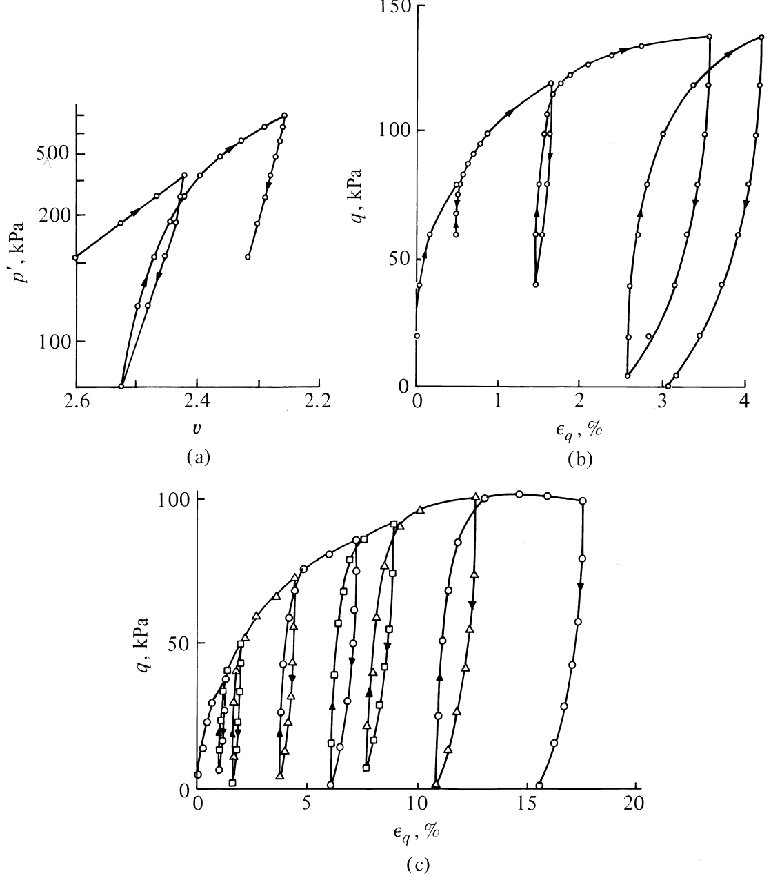
Yielding of clays
isotropic compression
undrained compression
drained compression
kaolin

Slide 6
Cam clay
volumetric hardening model: penalty for increased size of elastic region is permanent change in volumetric packing
adopt a graphical approach to explanation of the way in which the model operates in p':q stress plane and in p':v compression plane
behaviour bounded in these two planes: stresses and volume cannot change indefinitely (failure, limits to packing)
compute stress:strain response: distortional strain is unbounded and can increase indefinitely

Slide 7
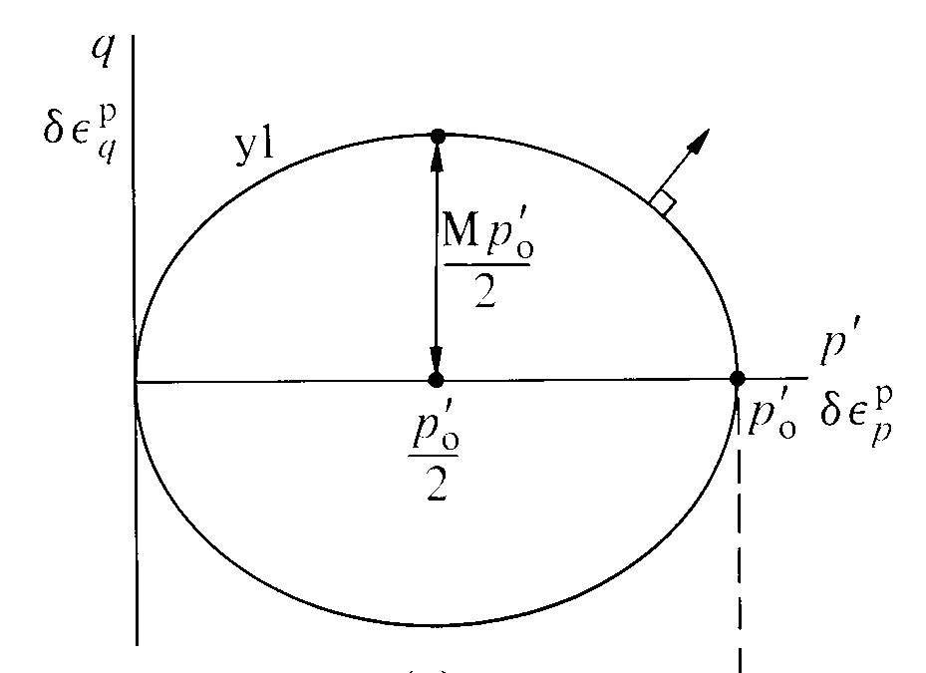
Volumetric hardening model: Cam clay
assume simple shape for yield locus: ellipse
shape M
size p'_{o}
plastic volumetric strains linked with change in p'_{o}
η = q/p'
assume normality of plastic strain increment at current stress state

Slide 8
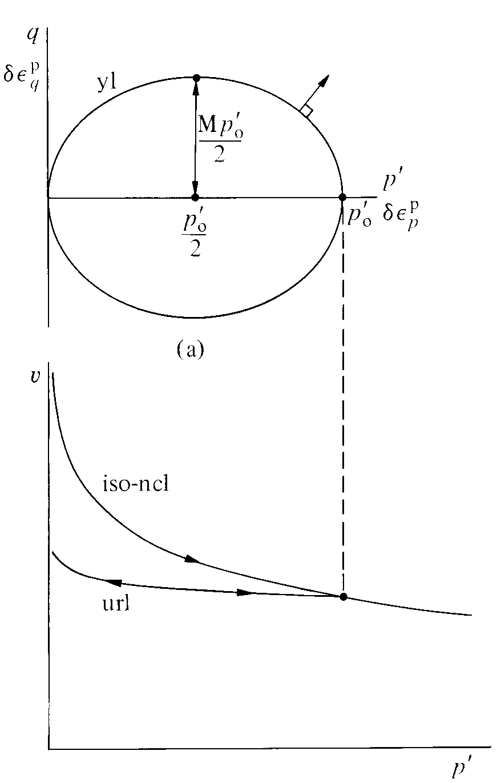
direct link between effective stress plane (p':q) and compression plane (p':v)
all stress states inside current yield locus of size p'_{o} map onto the unloading-reloading line (url) of 'length' p'_{o}
any stress path within the yield locus produces elastic changes in volume
plastic strains begin as soon as the boundary of the yield locus is reached
p'_{o}

Slide 9
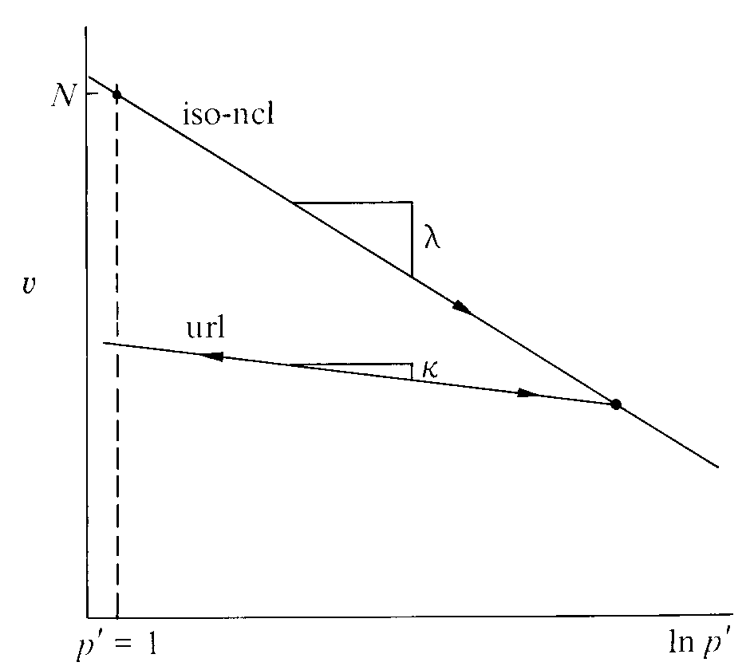
assume linear semilogarithmic compression plane plotting
κ slope of unloading reloading line
λ slope of normal compression line
N intercept on normal compression line
N
isotropic normal compression line (iso-ncl):

Slide 10
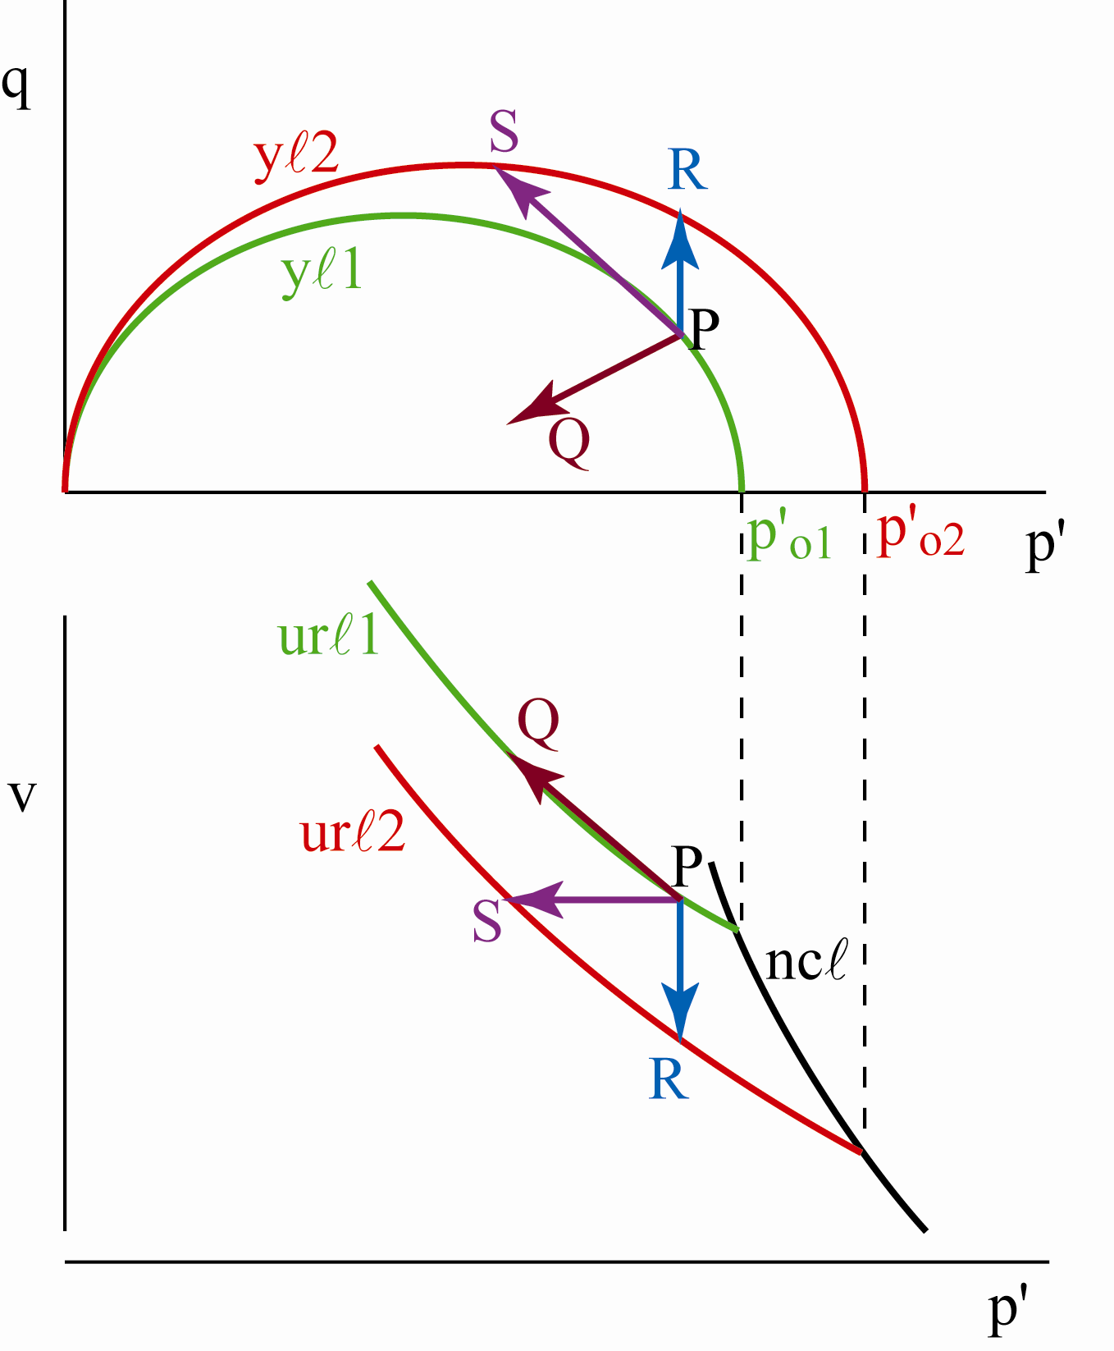
Plastic strains and hardening of yield loci
consider 3 probes from P
PQ: inside yield locus yl1, elastic, δp'_{o} = 0, volumetric strain
PR: constant p', purely plastic, yl1→yl2, volumetric strain
PS: same δp' as PQ, same δp'_{o} as PR, zero volumetric strain

Slide 11
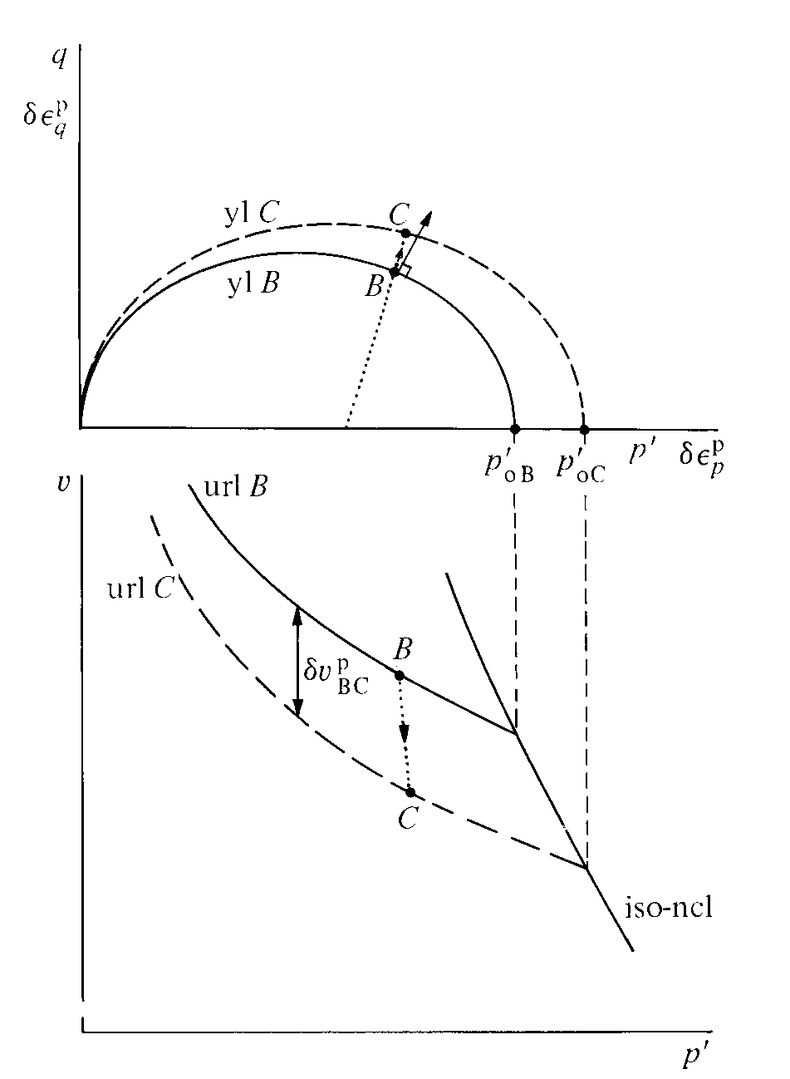
Cam clay – graphical presentation of strain calculation
conventional drained triaxial δq/δp' = 3
stress increment BC causes expansion of yield locus from p'_{oB} to p'_{oC}
state in compression plane changes from urlB to urlC because of change in p'_{o}
irrecoverable volume change δv^{p}_{BC} from change in p'_{o}
recoverable volume change from change in p'
irrecoverable distortional strain increment from normal to yield locus
recoverable distortional strain increment from elasticity

Slide 12
Cam clay
volumetric hardening model
adopt a graphical approach to explanation of the way in which the model operates in p':q stress plane and in p':v compression plane
behaviour bounded in these two planes: stresses and volume cannot change indefinitely (failure, limits to packing)
compute stress:strain response: distortional strain is unbounded and can increase indefinitely

Slide 13
Cam clay
break path into stress increments
estimate required change in size of yield locus p'_{o} for each increment
plastic volumetric strain from change in p'_{o}
plastic distortional strain from flow rule
elastic volumetric strain from change in p'
elastic distortional strain from change in q
basis of numerical (hand) calculations and computational implementation

Slide 14
yield locus
flow rule
δp', δq → δp'_{o} → δε_{p}^{p} → δε_{q}^{p}
→δε_{p}, δε_{q}
δp', δq → δε_{p}^{e}, δε_{q}^{e}
hardening rule
elastic properties
Cam clay calculation process

Slide 15
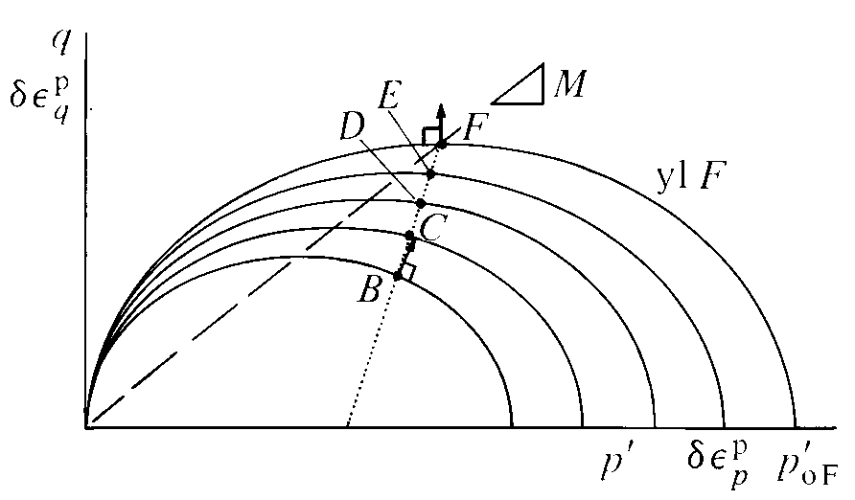
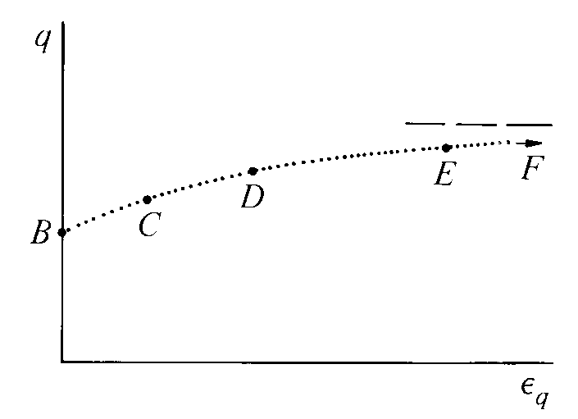
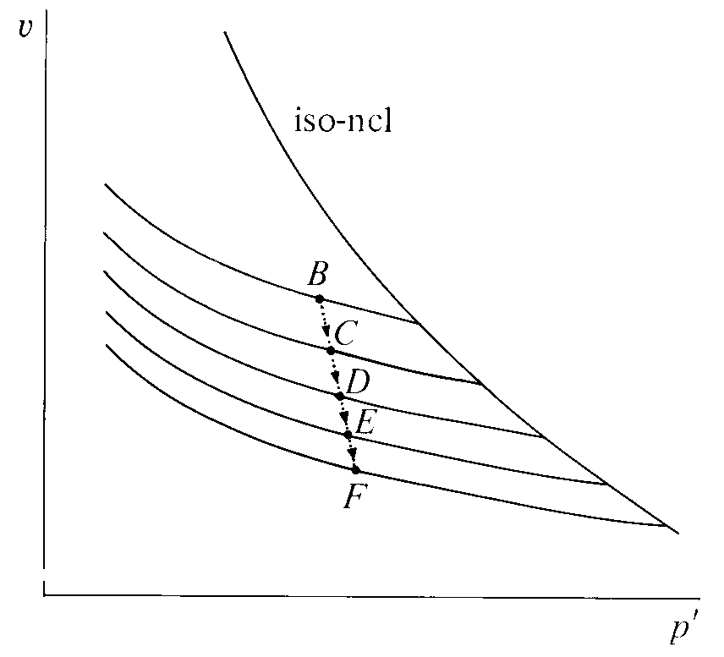
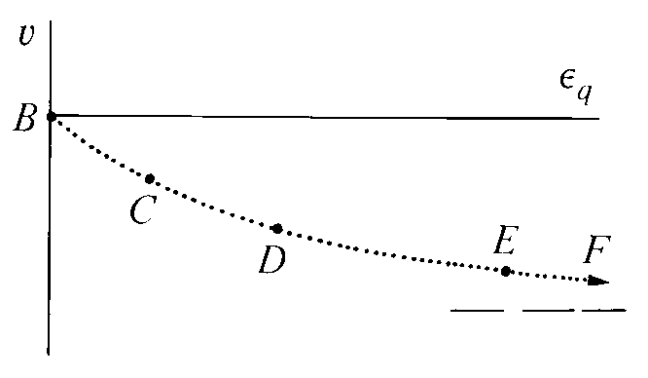
Cam clay – drained compression test (1)
B-C-D-E-F: slope of yield locus becomes flatter
ratio distortional/volumetric strain becomes larger
F: no plastic volumetric strain (normality)
ε_{q} → ∞: end of test!

Slide 16
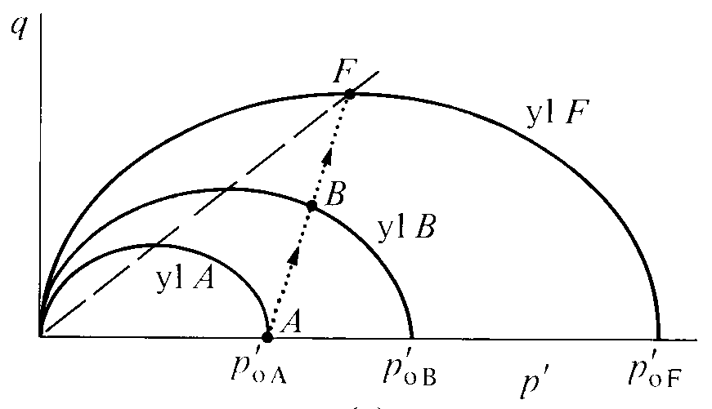
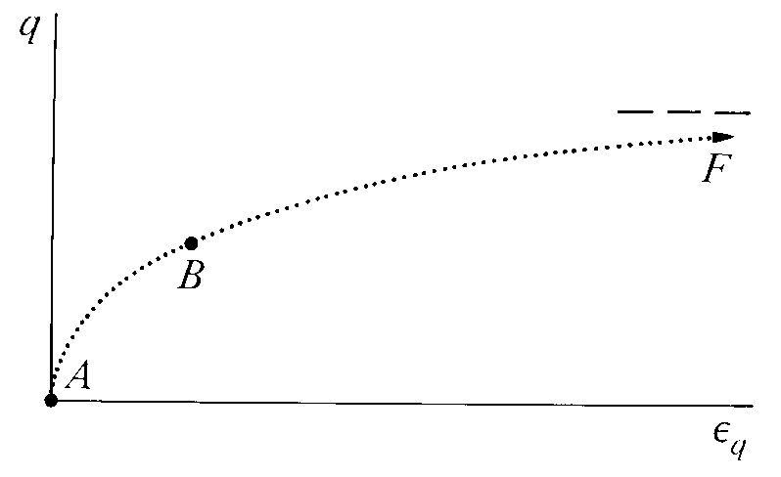
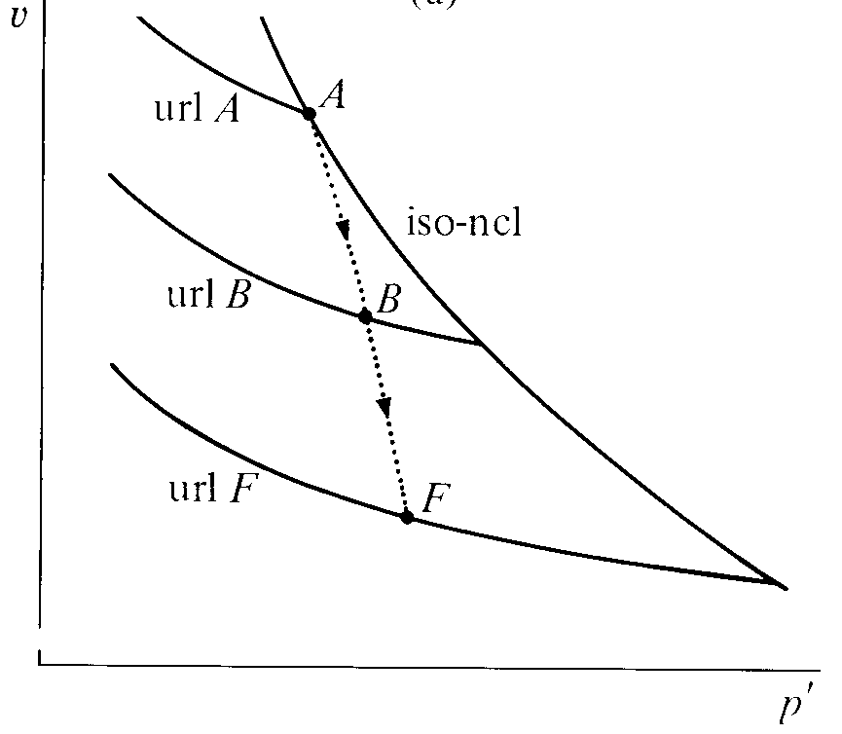
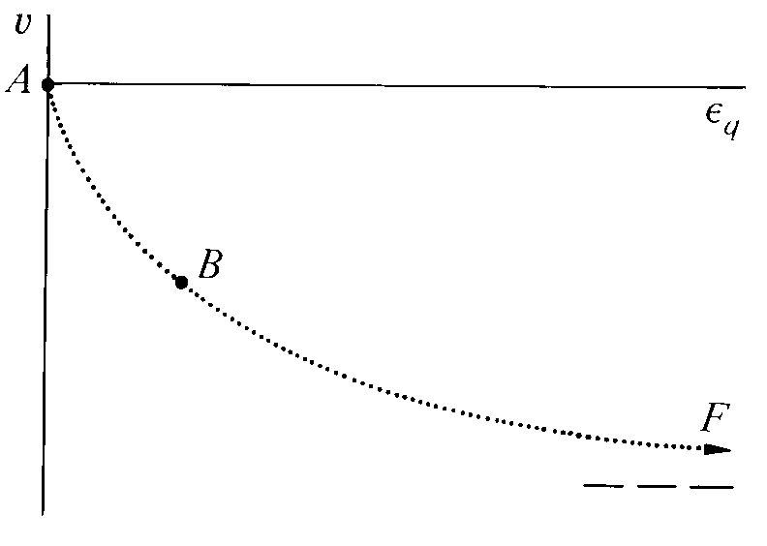
Cam clay – drained compression test (2)
how did we reach B? normal compression to A? behaviour beyond B not affected by previous history

Slide 17
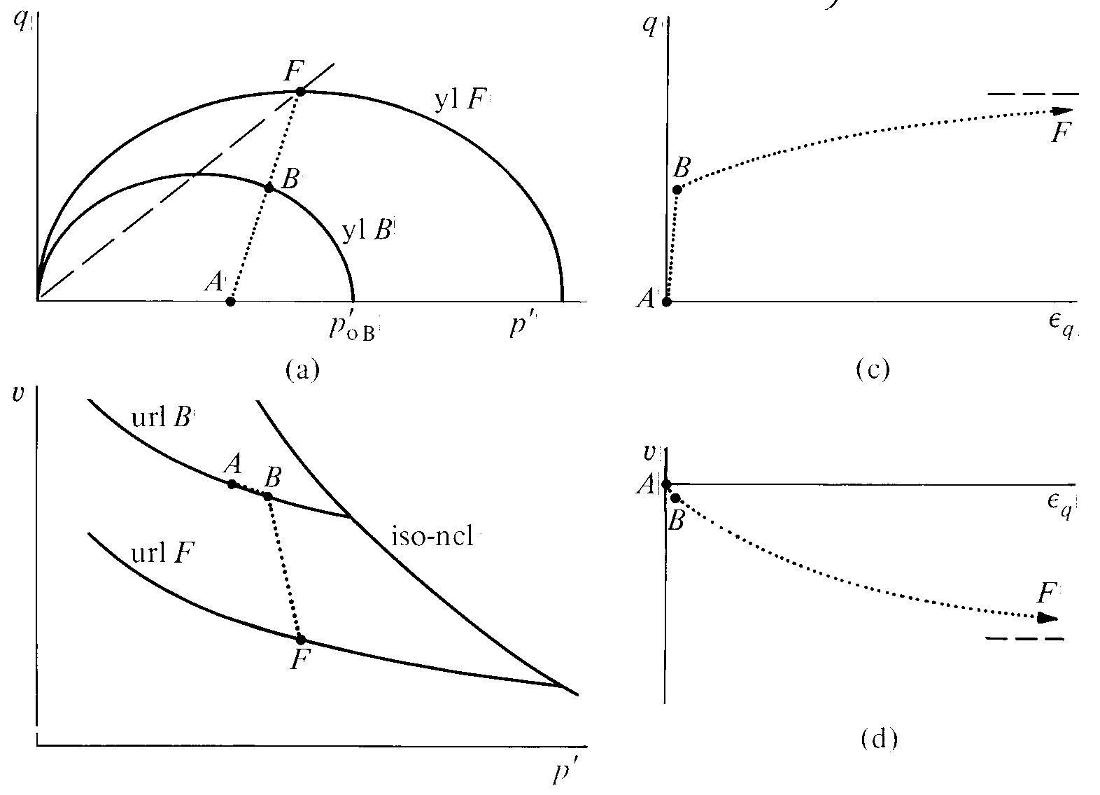
Cam clay – drained compression test (3)
how did we reach B? overconsolidation to A? behaviour beyond B not affected by previous history

Slide 18
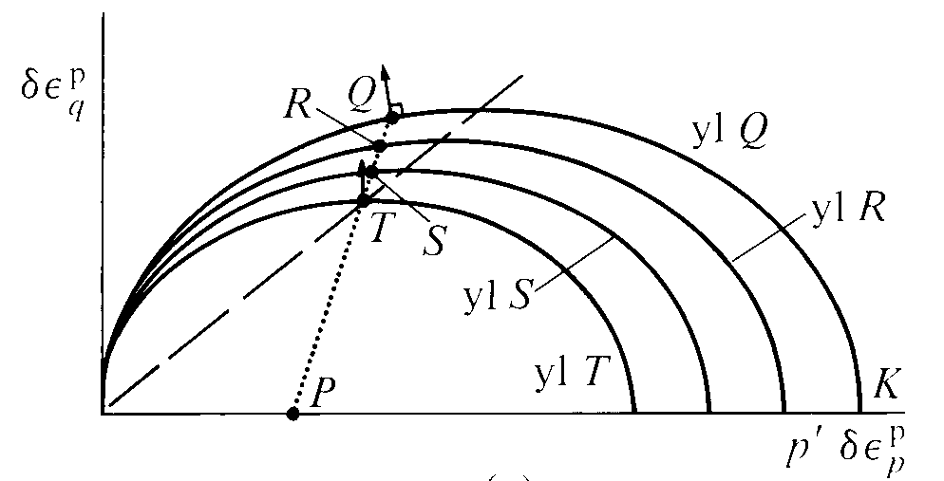
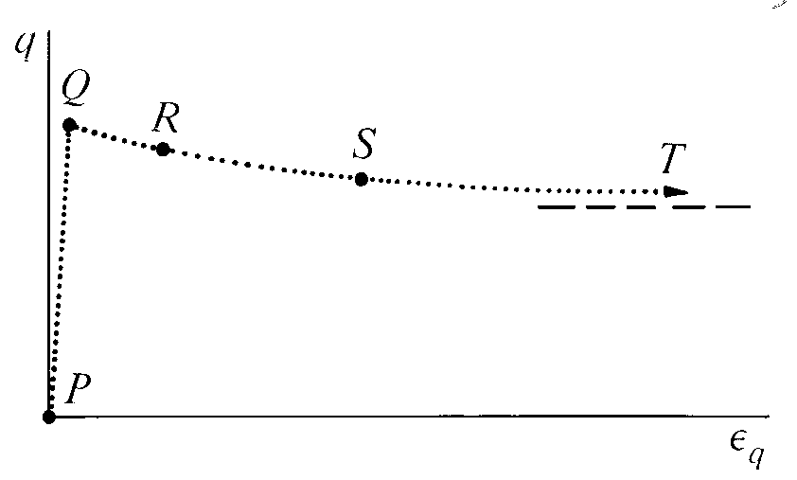
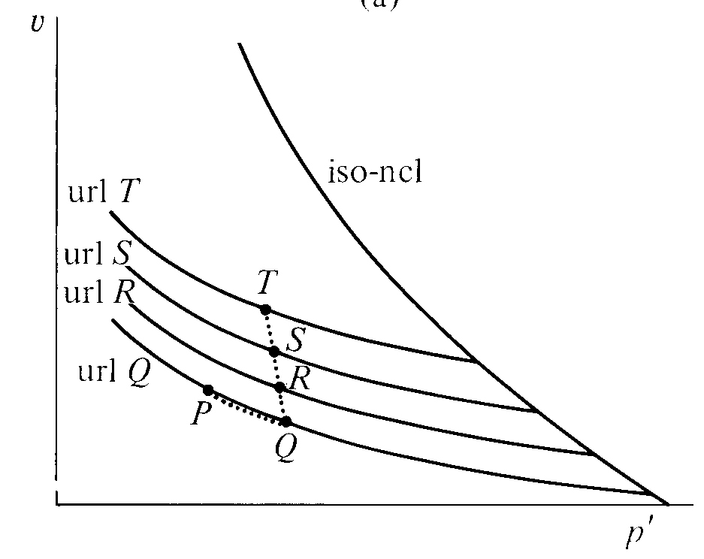
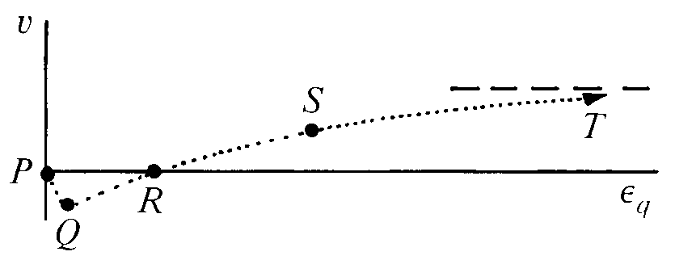
Cam clay – drained compression test (4)
heavily overconsolidated KP: yielding at Q with δε_{p}^{p} < 0
yield locus shrinks: softening stress:strain response
q
elastic: δq > 0
Q-R-S-T: slope of yield locus becomes flatter: ratio distortional/volumetric strain becomes larger: T: no plastic volumetric strain (normality)
ε_{q} → ∞: end of test!
elastic: δp' > 0

Slide 19
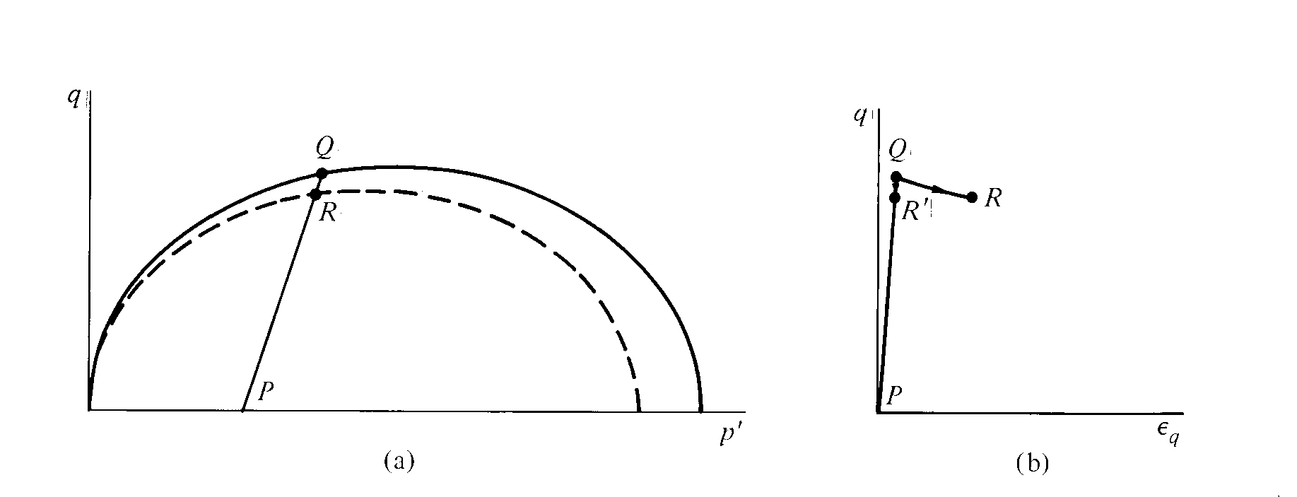
Cam clay – ambiguity of response
softening regime: yielding with η > M
same stress change associated either with plastic (QR) or elastic (QR') strain
bifurcation of response
numerical ambiguity

Slide 20
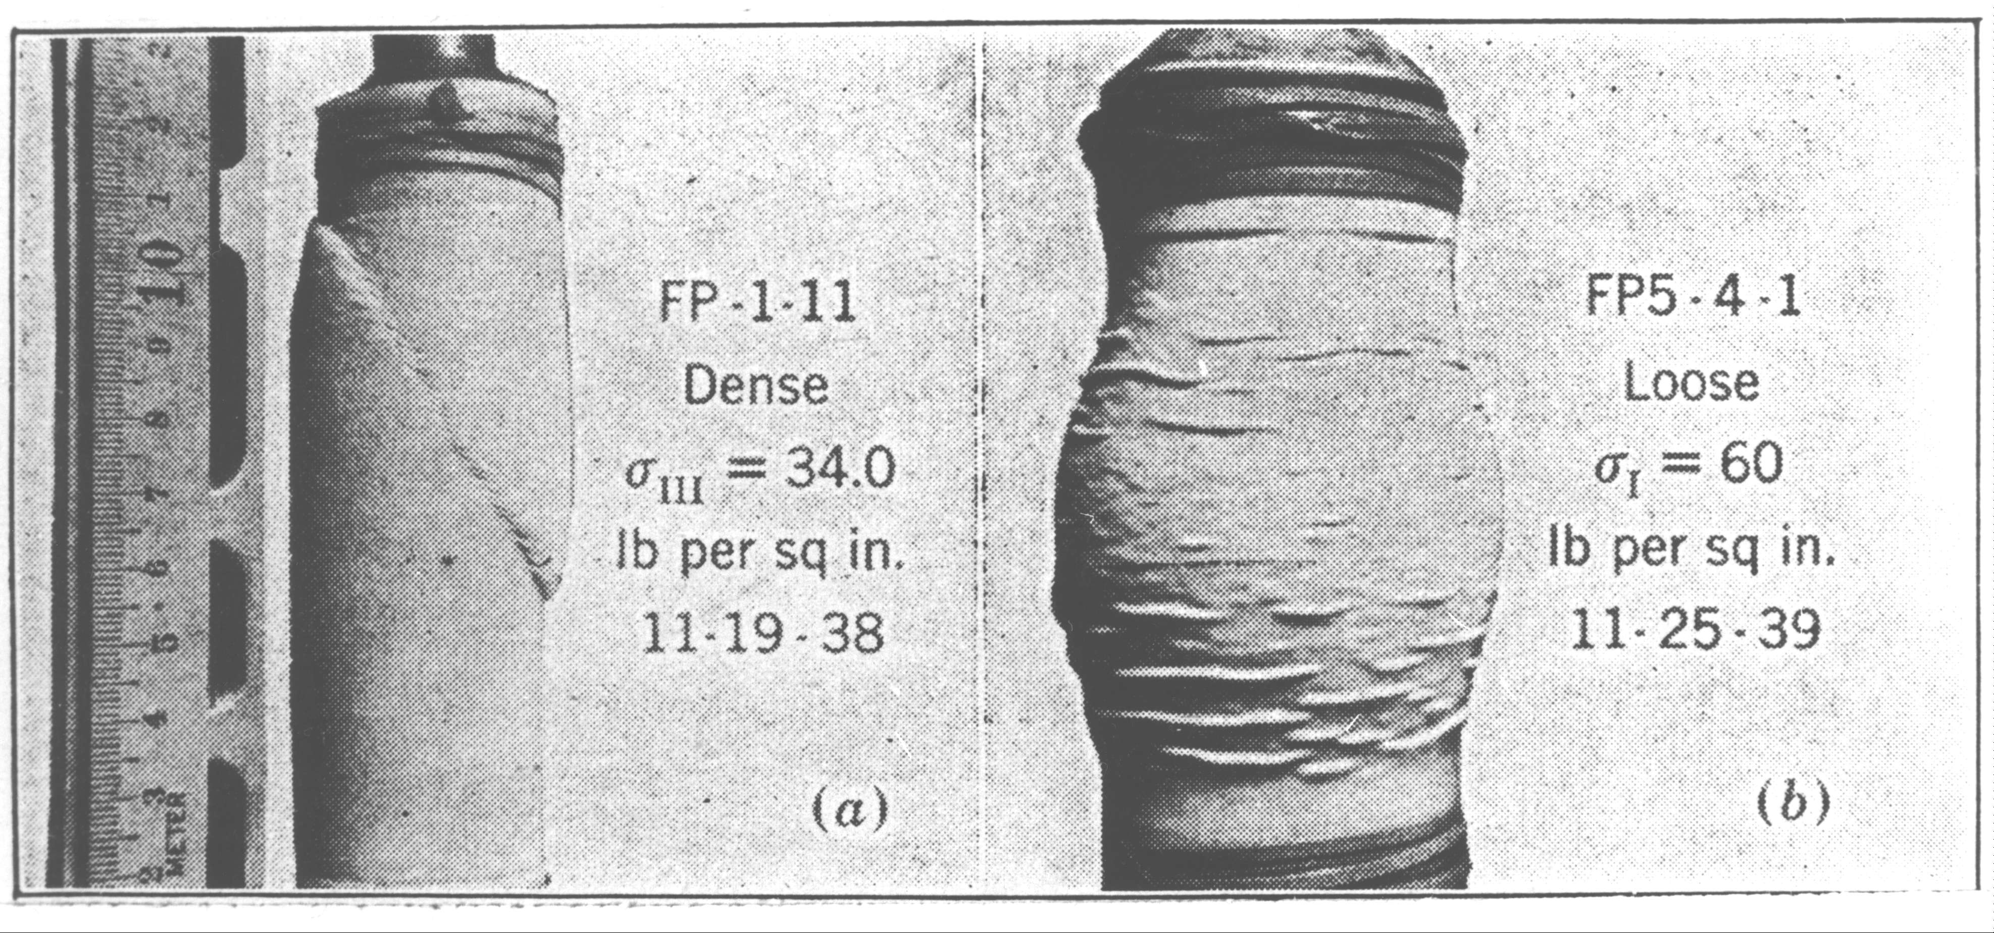
Physical consequence of uncertainty of response
elastic unloading
plastic softening confined to thin localised region
Taylor, 1948

Slide 21
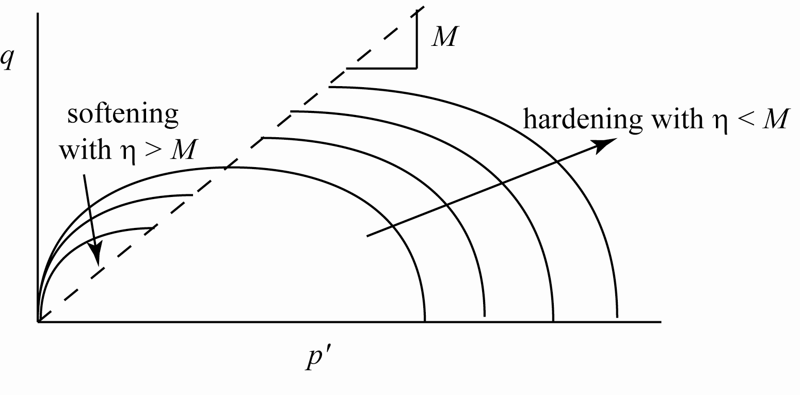
Cam clay – hardening and softening response

Slide 22
Plastic strains and hardening of yield loci
consider 3 probes from P
PQ: inside yield locus yl1, elastic, δp'_{o} = 0, volumetric strain
PR: constant p', purely plastic, yl1→yl2, volumetric strain
PS: same δp' as PQ, same δp'_{o} as PR, zero volumetric strain

Slide 23
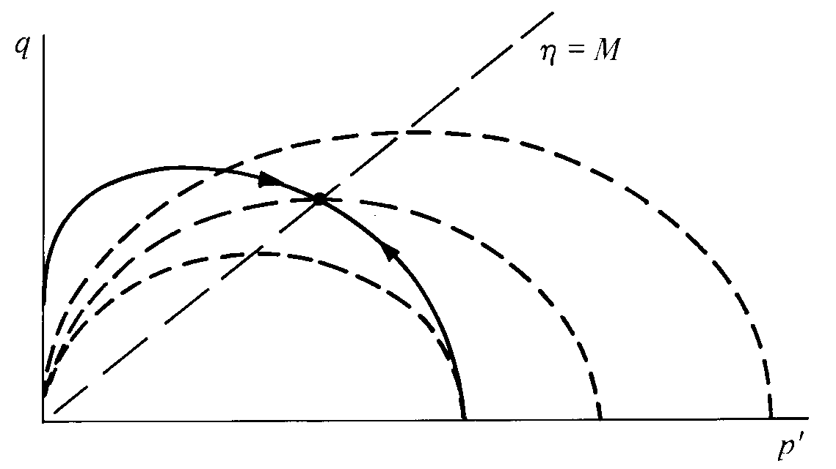
Cam clay – undrained compression
η > M, δp' > 0 η < M, δp' < 0
undrained stress path cannot be the same as the yield locus
balance of elastic expansion/plastic compression: η < M
balance of elastic compression/plastic expansion: η > M

Slide 24
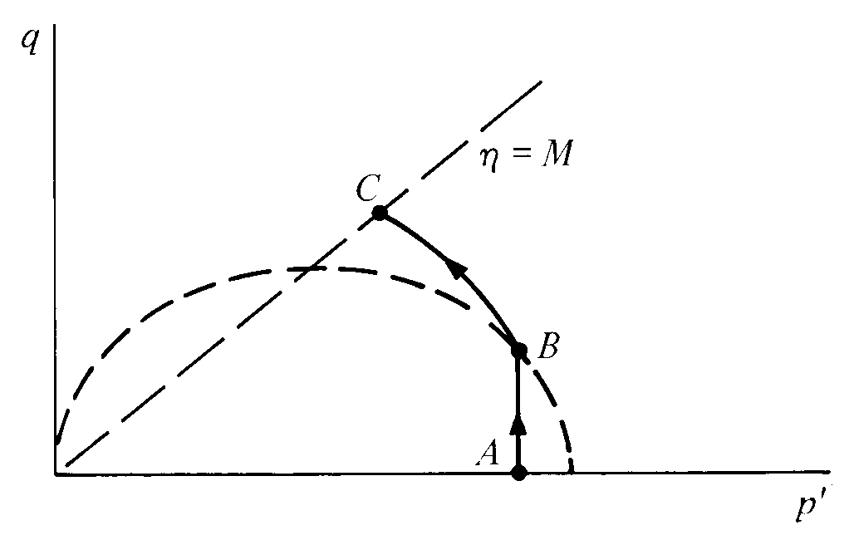
Cam clay – undrained compression
initial stress A inside current yield locus
elastic response: δp'_{o} = 0
hence: δp' = 0: constant p'
until yield at B
(isotropic elastic model)

Slide 25
direct link between effective stress plane (p':q) and compression plane (p':v)
all stress states inside current yield locus of size p'_{o} map onto the unloading-reloading line (url) of 'length' p'_{o}
any stress path within the yield locus produces elastic changes in volume
plastic strains begin as soon as the boundary of the yield locus is reached
p'_{o}

Slide 26
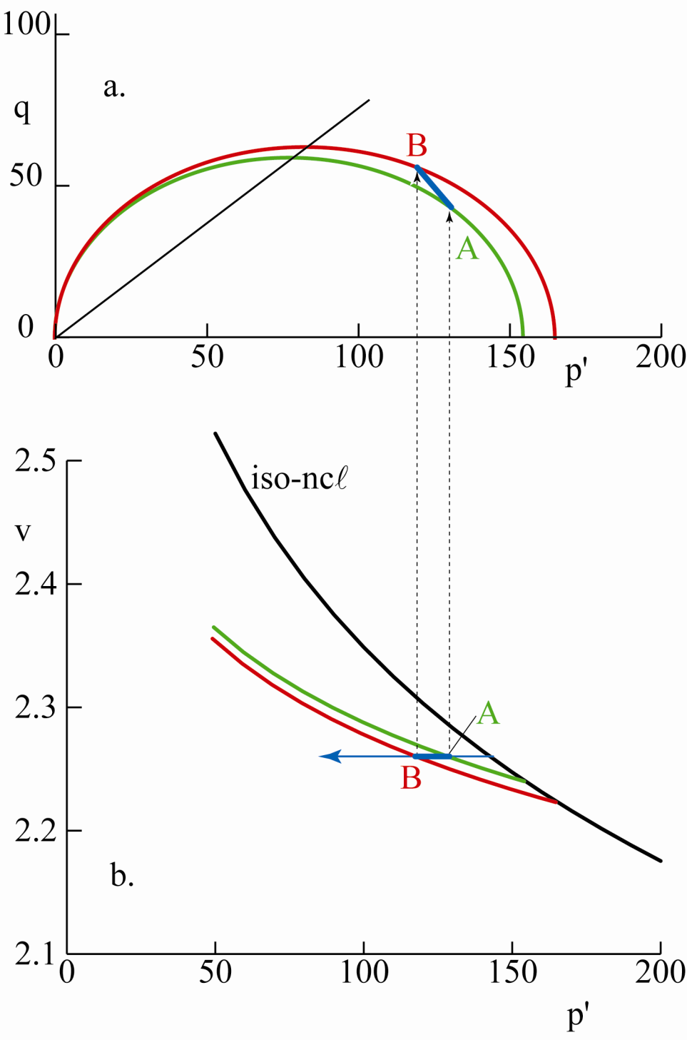
Cam clay – undrained compression
undrained stress increment in effective stress plane and compression plane
A on url A and yl A
B on url B and yl B
plastic hardening AB:
η < M, δp' < 0, δp'_{o} > 0

Slide 27
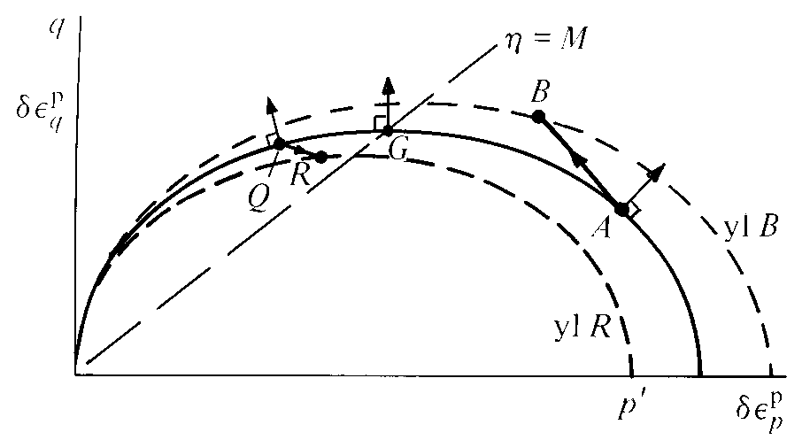
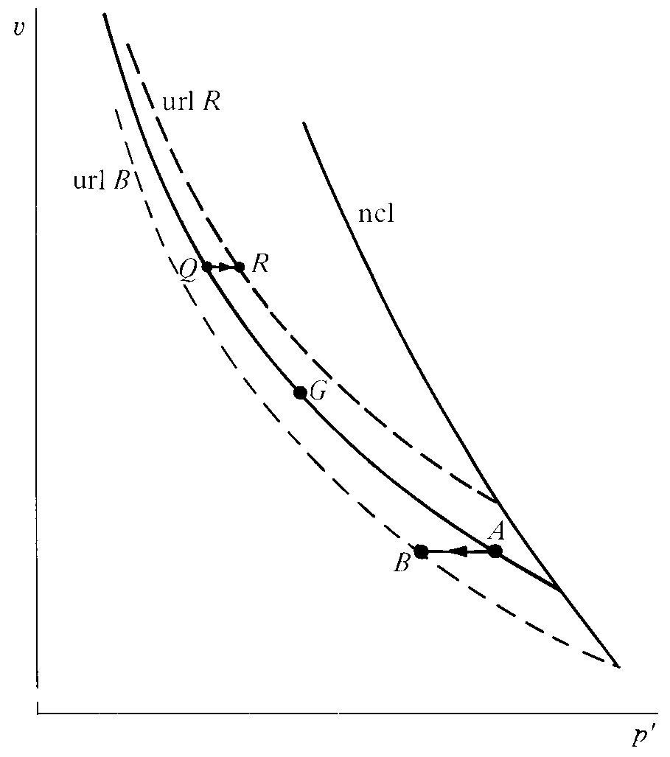
Cam clay – undrained compression
undrained stress increments in effective stress plane and compression plane
plastic hardening AB: η < M, δp' < 0, δp'_{o} > 0
plastic softening QR: η > M, δp' > 0, δp'_{o} < 0
perfect plasticity G: η = M, δp' = δp'_{o} = 0

Slide 28
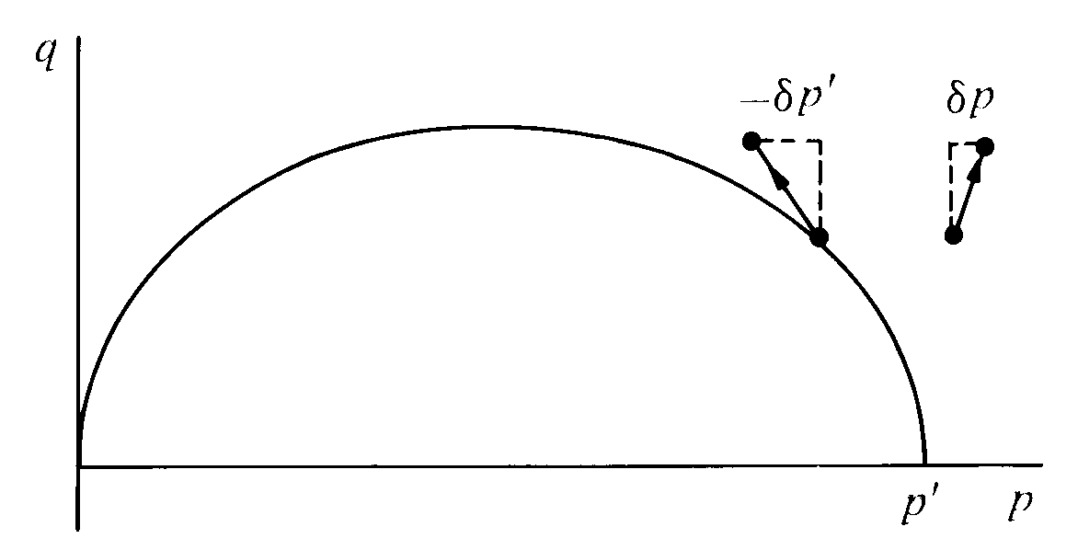
Cam clay – undrained compression
reminder: pore pressure has external and internal components
δu = δp – δp' = δp + aδq (pore pressure parameter a)
a is not a soil constant – depends on history

Slide 29
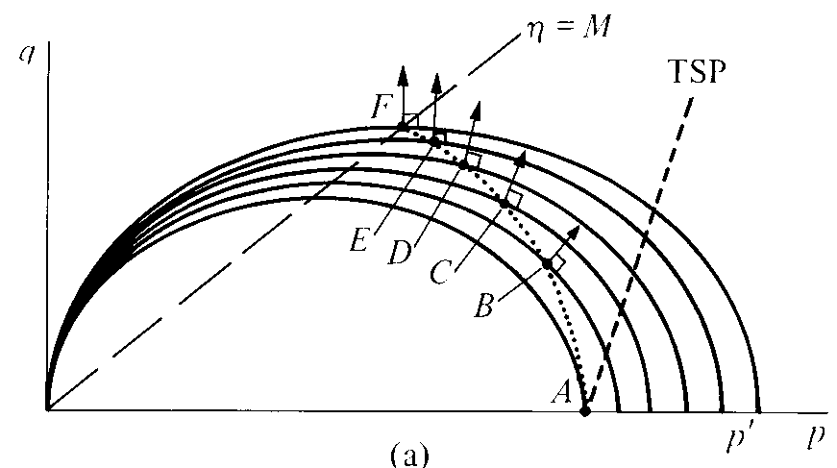
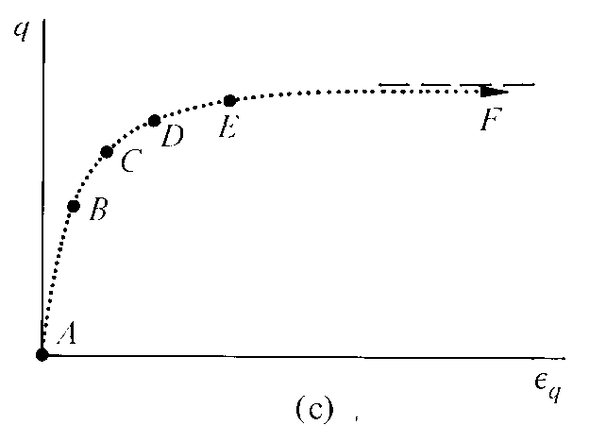
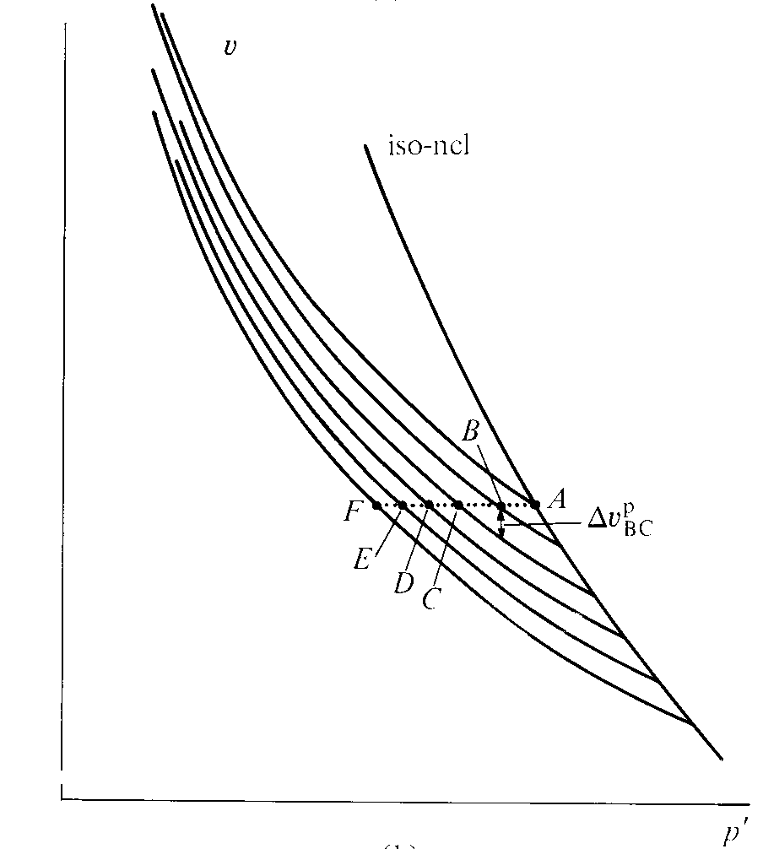
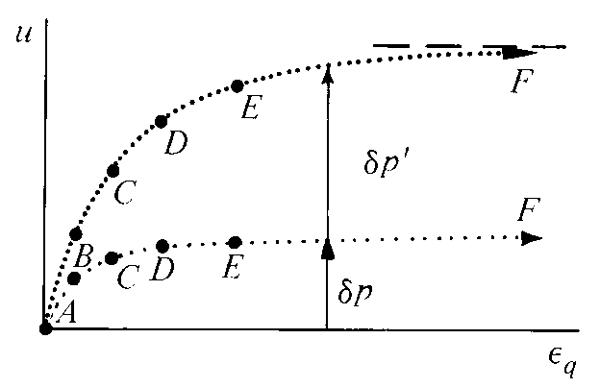
Cam clay – undrained compression
v
step through undrained test on normally compressed soil
conventional compression δq = 3δp

Slide 30
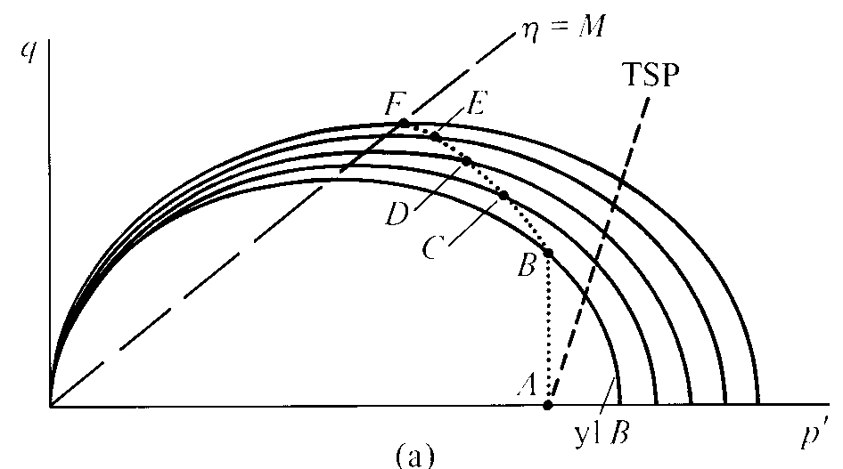
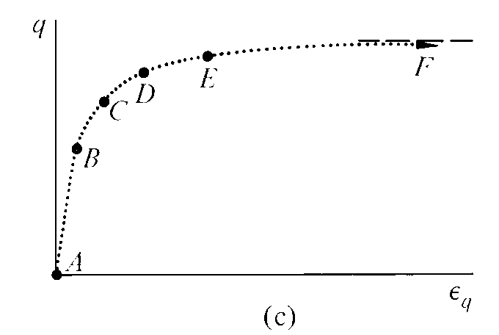
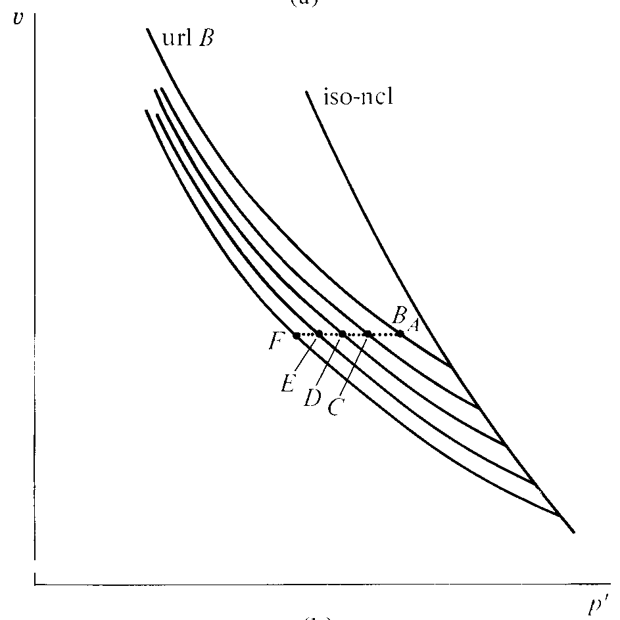
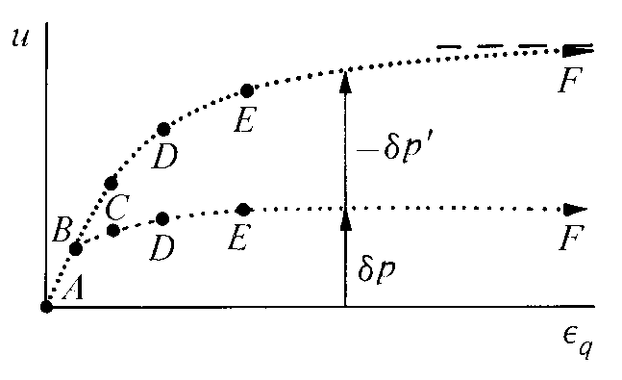
Cam clay – undrained compression
step through undrained test on lightly overconsolidated soil
conventional compression δq = 3δp

Slide 31
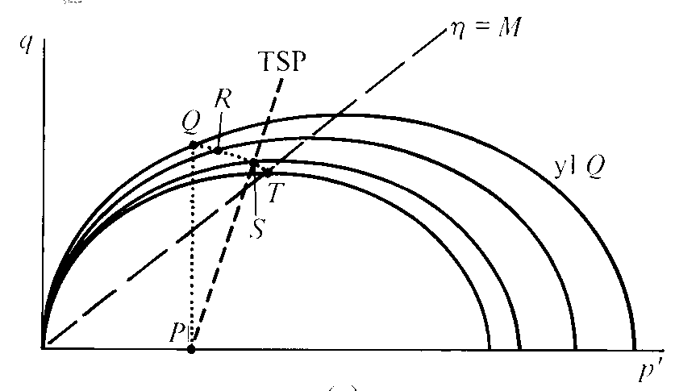
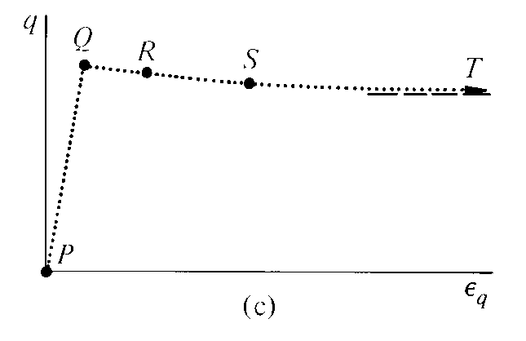
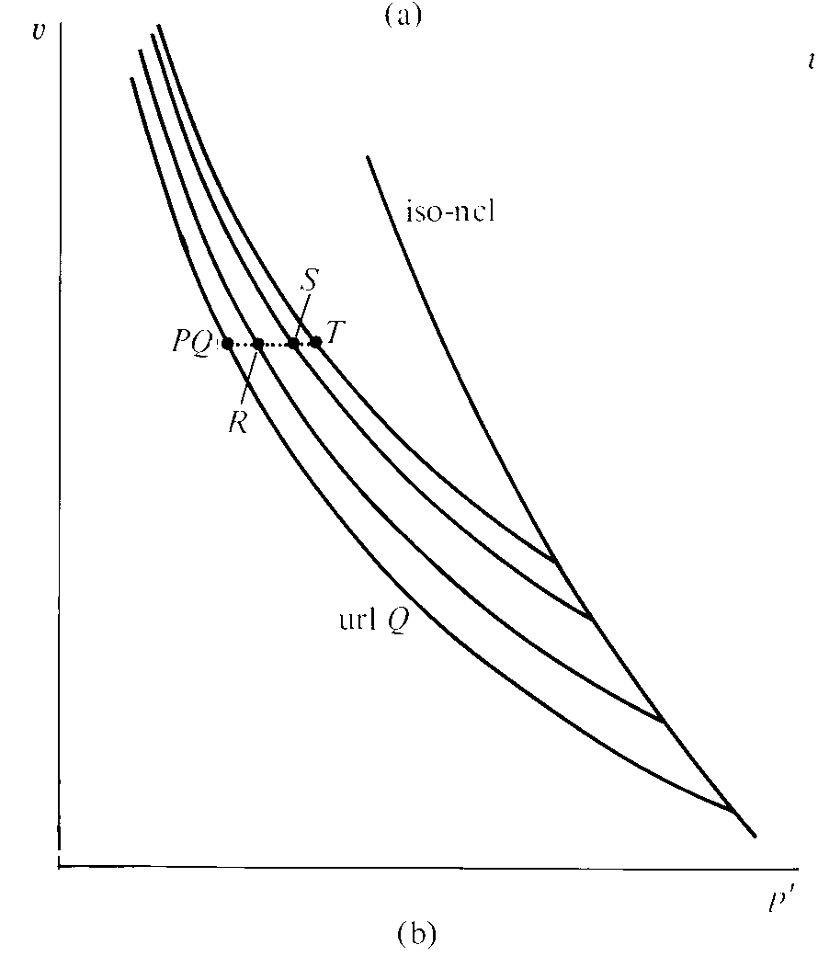
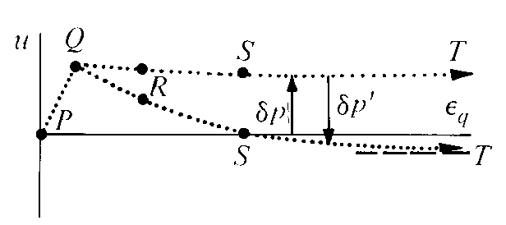
Cam clay – undrained compression
step through undrained test on heavily overconsolidated soil
conventional compression δq = 3δp

Slide 32
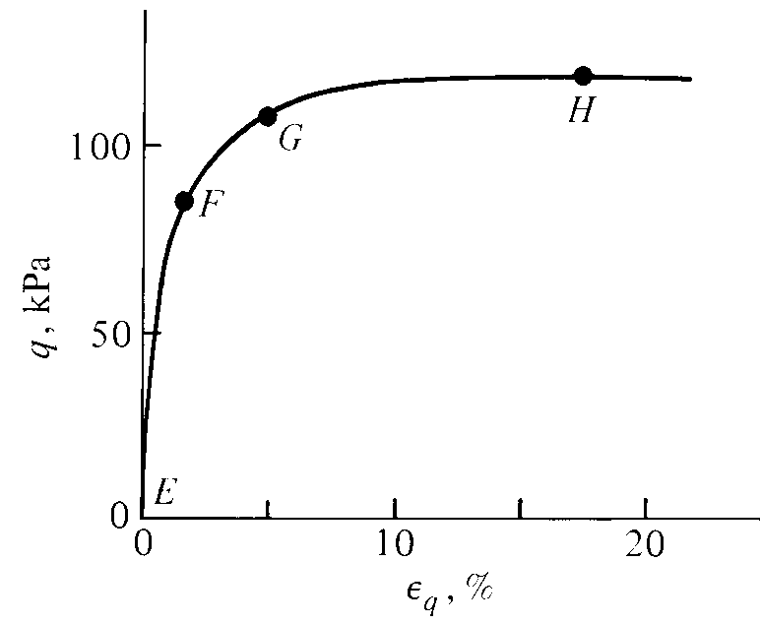
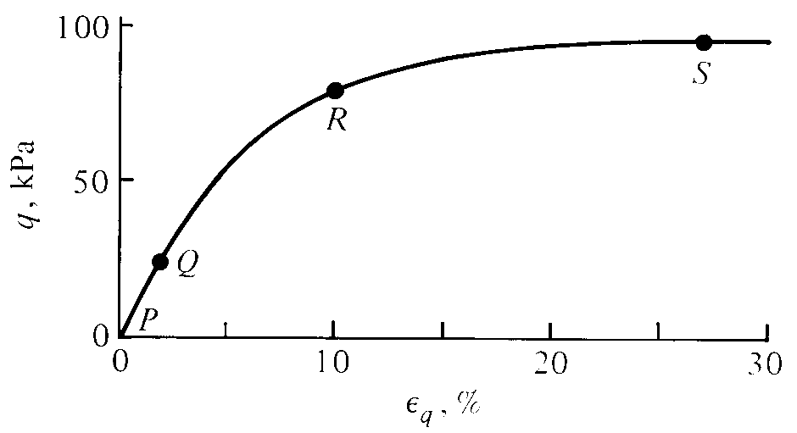
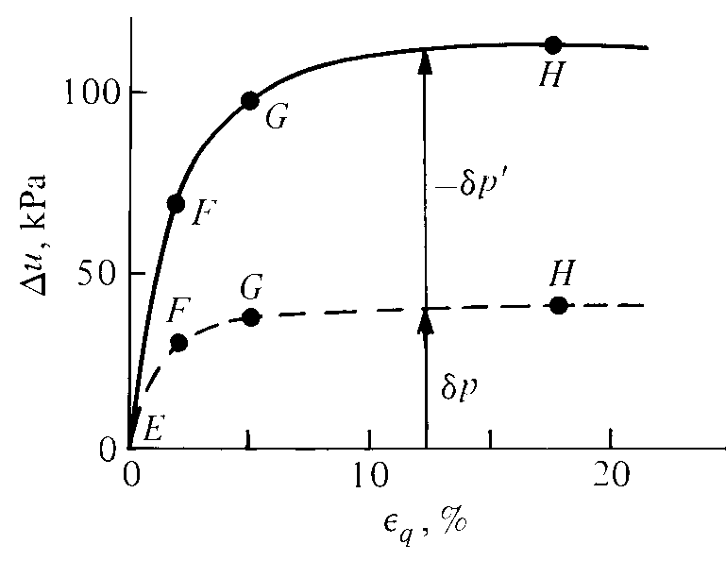
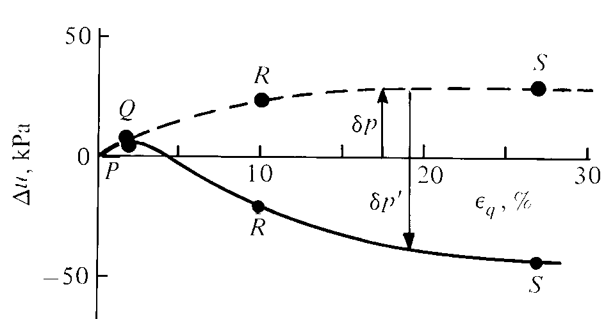
Weald clay – undrained response – division of pore pressure

