Slide 1

Saturated soil modelling: Griffith University: February 2010
The most widely used soil model: Mohr-Coulomb
David Muir Wood
d.muirwood@dundee.ac.uk

Slide 2
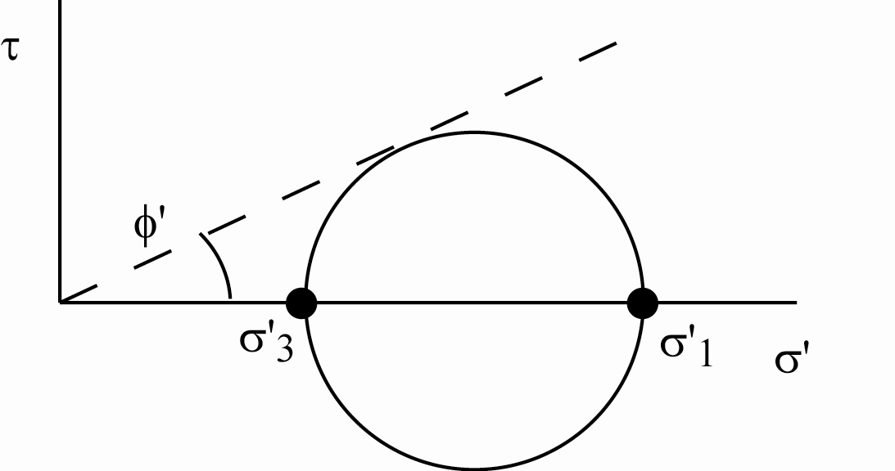
Elastic-perfectly plastic Mohr-Coulomb model
Mohr-Coulomb familiar as a strength/failure model
limiting stress ratio characterised by frictional strength φ
convert to stress ratio M
combine with isotropic elastic stiffness model
aim: to produce elastic-plastic stiffness matrix
strain increment ⇨ stress increment

Slide 3
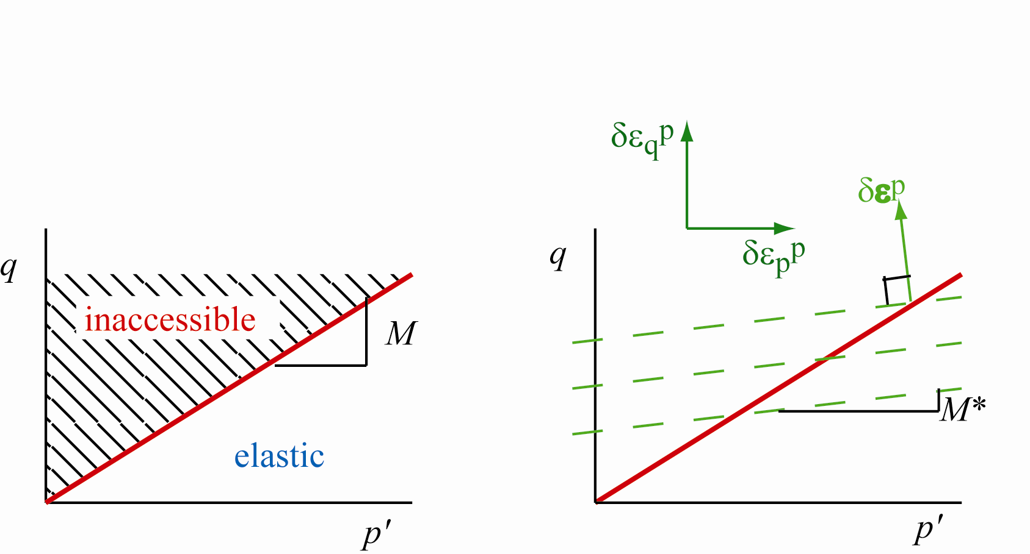
Mohr-Coulomb failure; elastic strains
failure locus divides stress plane into elastic and inaccessible regions
plasticity only occurs for stress states on failure locus: q/p'=M
stress increments implying q/p'>M not possible
assume strain increment divided into elastic and plastic components δε = δε^{e} + δε^{p}
elastic strain accompanies any change in stress
stiffness compliance

Slide 4
What are the deformations at yield/failure?
work conjugate strain increments plotted on local axes parallel to corresponding stress axes
assume that yielding mobilises a plastic mechanism
mechanism defines ratio (not magnitude) of plastic strain increments
where μ is an arbitrary scalar multiplier

Slide 5
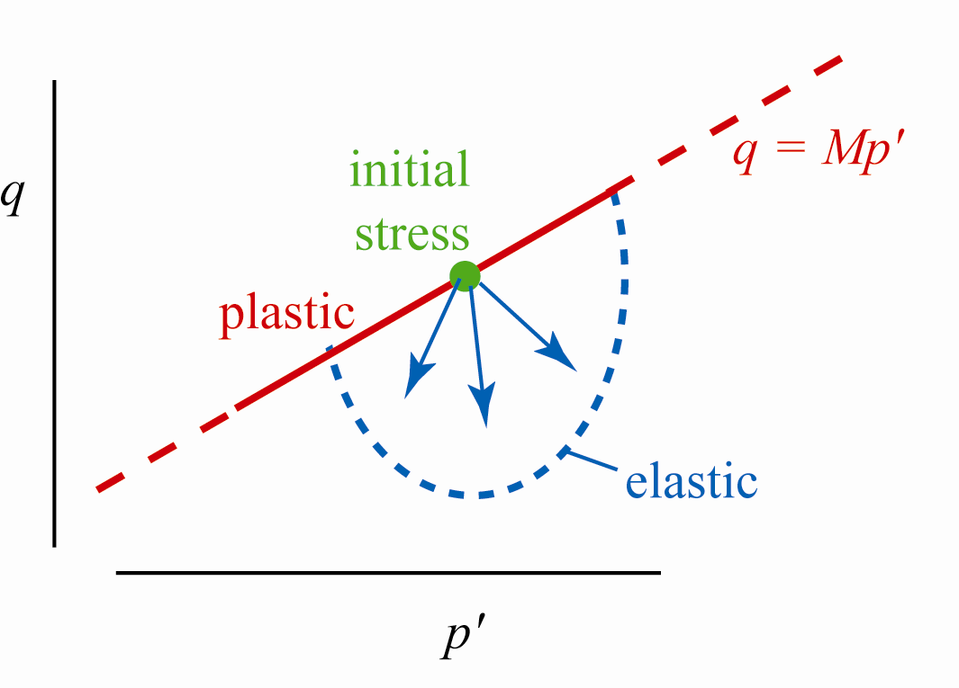
Stiffness matrix: consistency condition
for plastic strains, stress change lies along failure locus
– Mδp' + δq = 0
combine and rearrange

Slide 6
Stiffness matrix … which stiffness? elastic/plastic?
stiffness formulation: calculate stress increments from total strain increments
elastic predictor and plastic corrector
implementation: if elastic prediction produces a stress state lying in inaccessible region beyond failure locus, plastic correction required to bring stress state back to failure locus
if plastic:

Slide 7
Plastic dissipation? Associated flow?
if plastic:
confirm that δq = Mδp'
asymmetric unless M = M* (associated flow)
plastic work δW^{p} = p'δε_{p}^{p} + qδε_{q}^{p} =(M – M*)p'δε_{q}^{p}
plastic work δW^{p} = 0 for M = M* (associated flow)
physically unreasonable
(but basis of bearing capacity calculations etc)

Slide 8
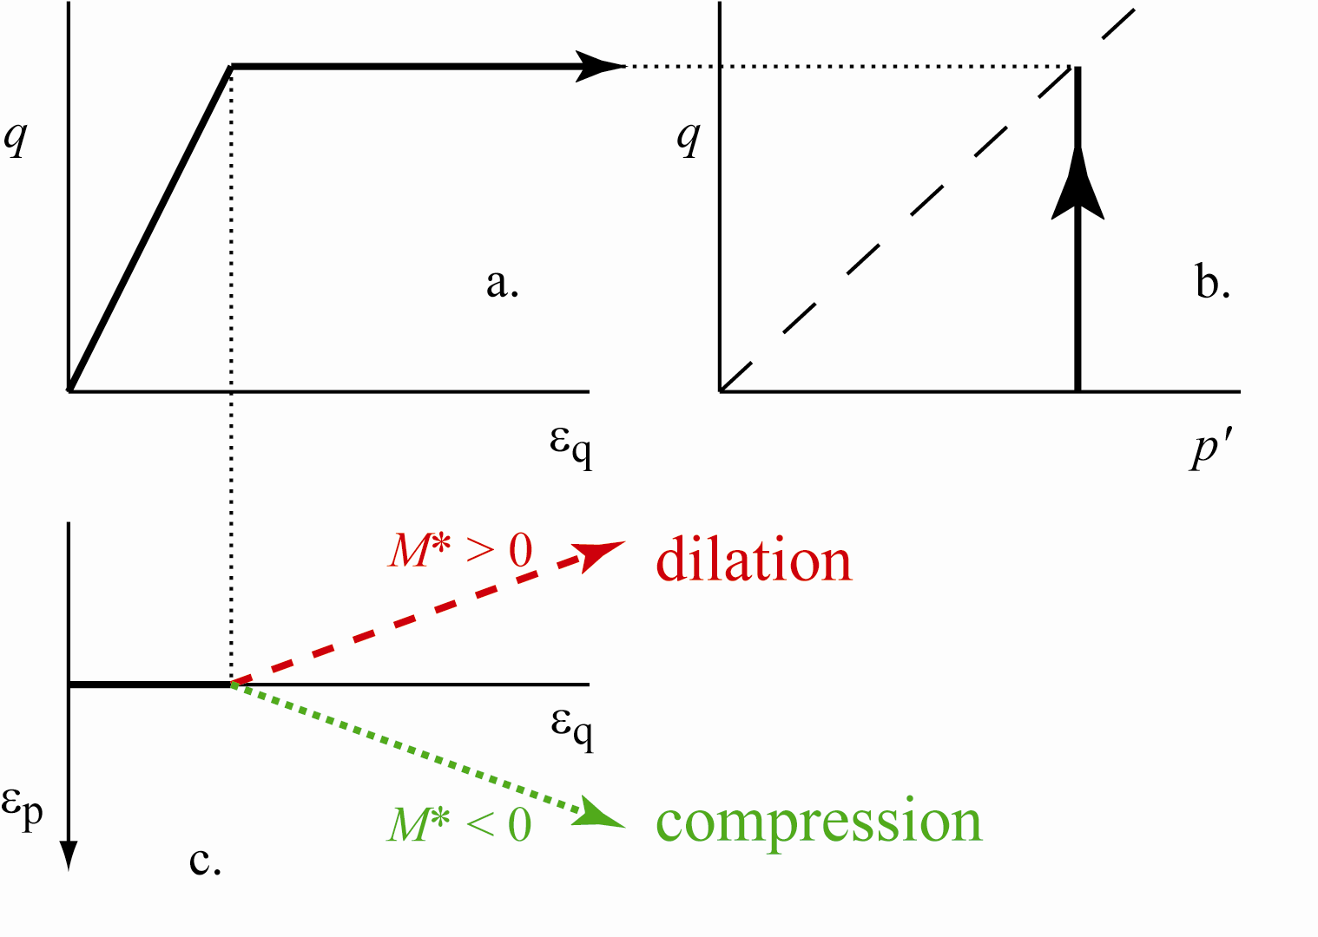
Mohr-Coulomb model: typical response
typical response in constant p' test
dilation/compression depends on sign of M*

Slide 9
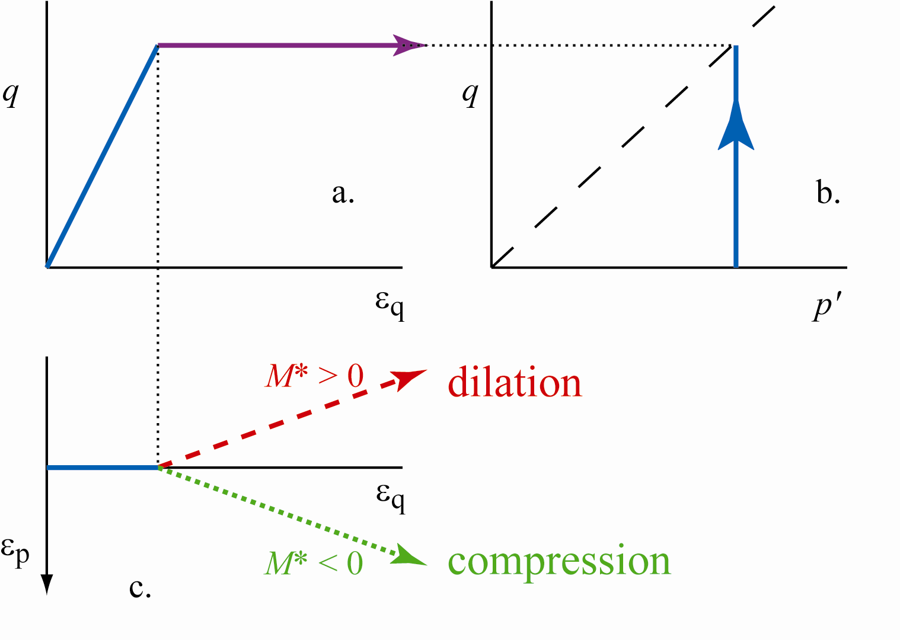
standard elastic-perfectly plastic Mohr-Coulomb model
non-associated plastic flow
M* ≠ M
simplicity
sharp stiffness changes
tangent stiffness either elastic or zero
continuing volume change

Slide 10
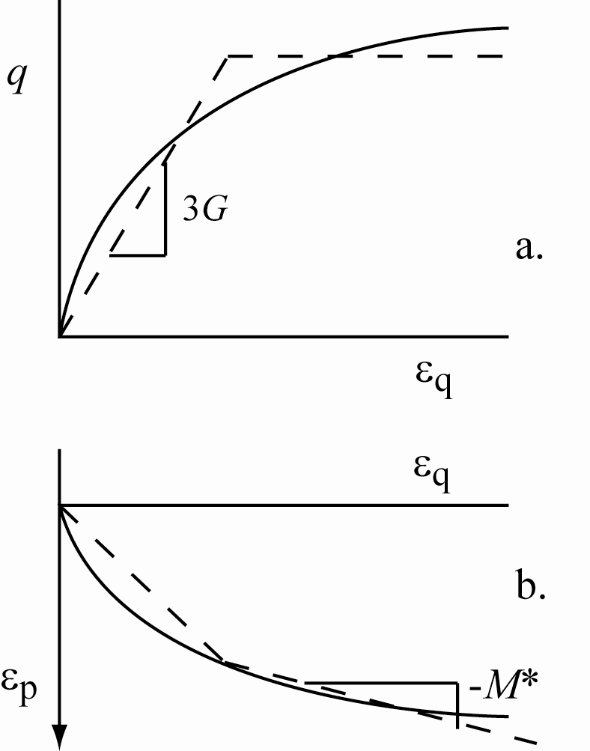
Mohr-Coulomb model: fitting to data?
standard model available in all geotechnical finite element programs
subjectivity in choice of parameters: G, K, M, M*
exercise

Slide 11
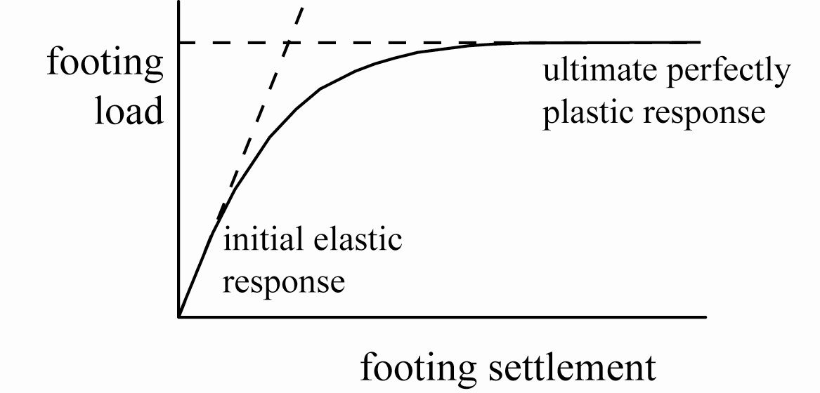
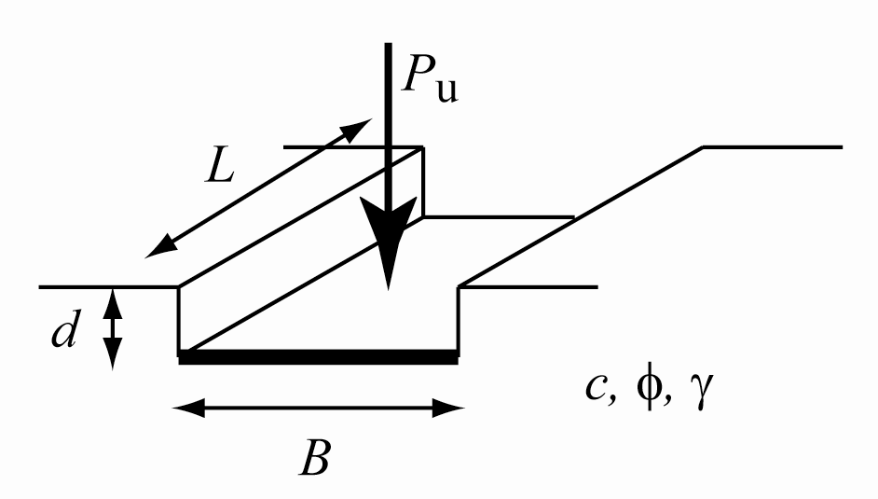
Mohr-Coulomb model: system/element response
system response – for example, footing – shows progressive yielding even though model for individual soil elements is elastic-perfectly plastic

Slide 12
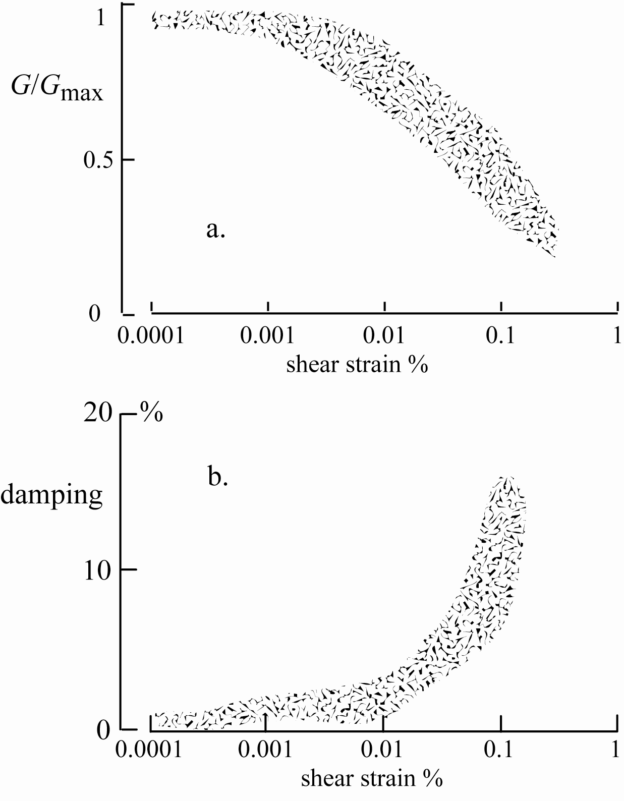
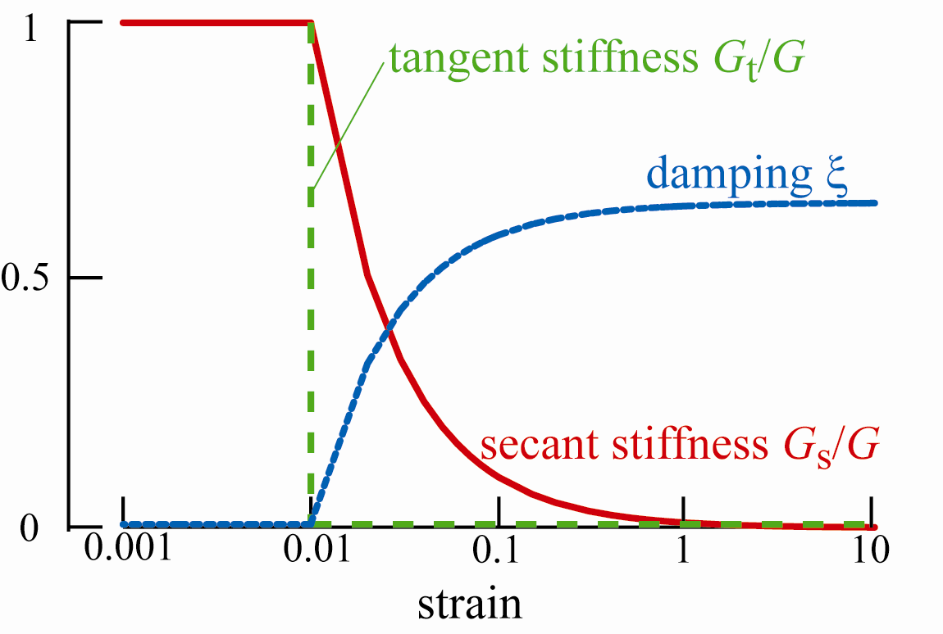
Cyclic loading: stiffness and damping
Quiou sand
variation of stiffness and damping in cyclic loading
tangent stiffness = 0 on yielding

Slide 13
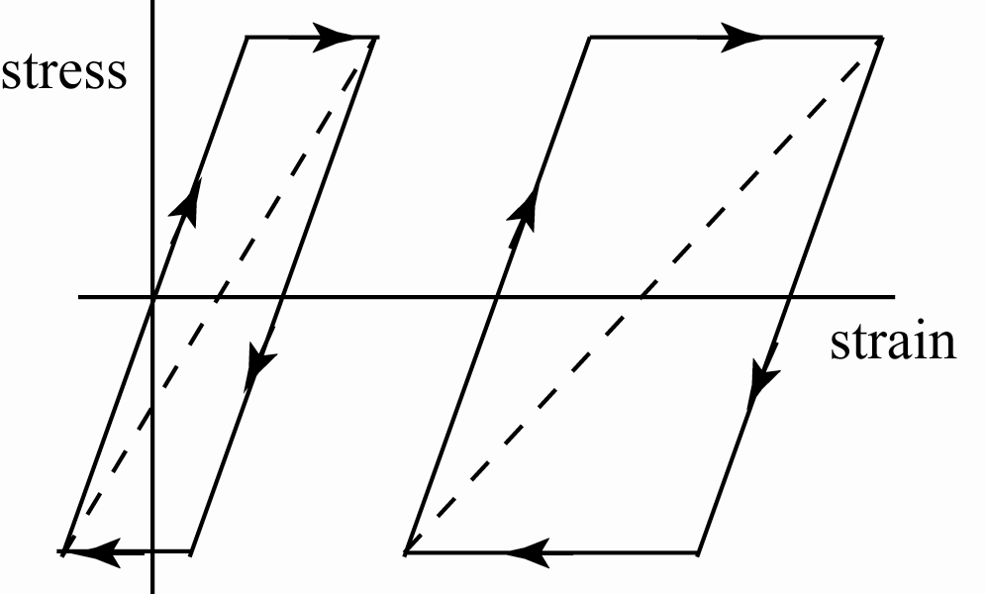
Tangent and secant stiffnesses
secant stiffness falls
damping rises
as amplitude increases

Slide 14
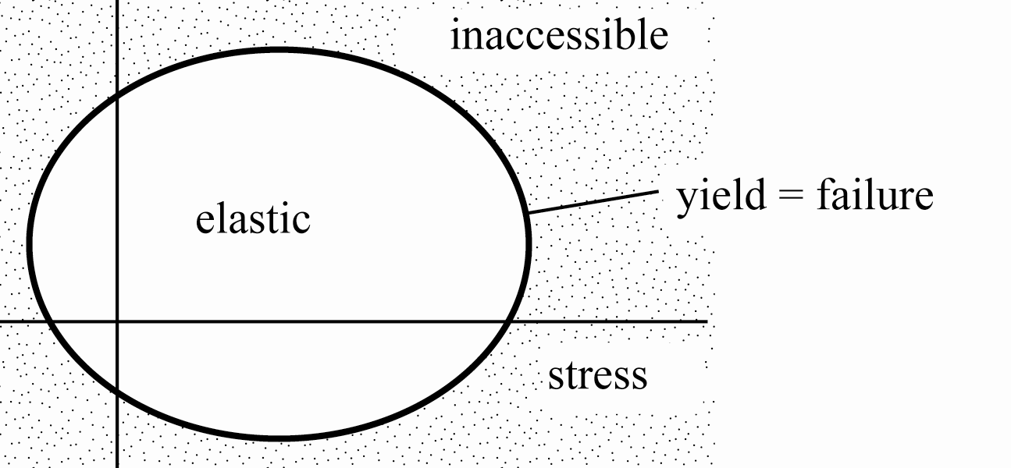
General elastic-perfectly plastic model
yield surface f(σ) = 0
during yield f(σ) = 0 and
(consistency)
elastic model δσ = Dδε^{e}

Slide 15
General elastic-perfectly plastic model
propose plastic potential g(σ) such that plastic strain increments given by:
then:
combine with consistency condition to deduce:
and

Slide 16
Summary
elastic-perfectly plastic Mohr-Coulomb model is most widely available constitutive model for soils
associated plastic flow is not physically reasonable
choice of soil parameters requires engineering judgement (exercise)
elastic-plastic stiffness matrix demonstrated for general perfectly plastic model

