Slide 1

Saturated soil modelling: Griffith University: February 2010
Elastic modelling
David Muir Wood
d.muirwood@dundee.ac.uk

Slide 2
Elasticity
Hooke's law
elastic behaviour in triaxial compression: drained/undrained
measurement of elastic properties with different devices
elastic anisotropy
elastic nonlinearity - hyperelasticity

Slide 3

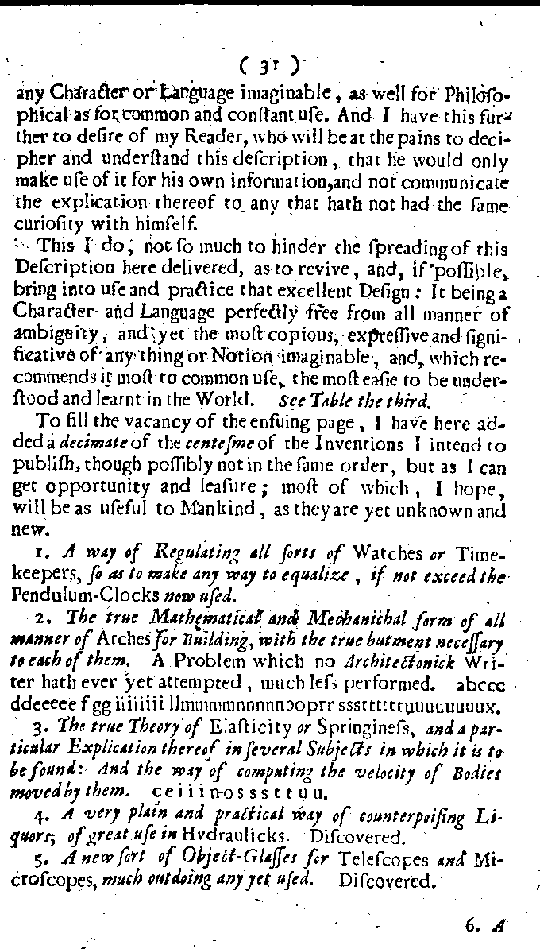

Slide 4
Hooke’s law
A description of helioscopes and some other instruments. London 1676.
To fill the vacancy of the ensuing page, I have here added a decimate of the centesme of the Inventions I intend to publish, though possibly not in the same order, but as I can get opportunity and leasure; most of which, I hope, will be as useful to Mankind as they are yet unknown and new.
2. The true Mathematical and Mechanichal form of all manner of Arches for Building, with the true butment necessary to each of them. A Problem which no Architectonick Writer hath ever yet attempted, much less performed.
abcccddeeeeefggiiiiiiiillmmmmnnnnnooprrsssttttttuuuuuuuux.
3. The true Theory of Elasticity or Springiness, and a particular Explication thereof in several Subjects in which it is to be found: And the way of computing the velocity of Bodies moved by them.
ceiiinosssttuu

Slide 5
Hooke’s law
To fill the vacancy of the ensuing page, I have here added a decimate of the centesme of the Inventions I intend to publish, though possibly not in the same order, but as I can get opportunity and leasure; most of which, I hope, will be as useful to Mankind as they are yet unknown and new.
2. The true Mathematical and Mechanichal form of all manner of Arches for Building, with the true butment necessary to each of them. A Problem which no Architectonick Writer hath ever yet attempted, much less performed.
abcccddeeeeefggiiiiiiiillmmmmnnnnnooprrsssttttttuuuuuuuux.
Ut pendet continuum flexile, sic stabit contiguum rigidum inversum.
(As hangs the flexible chain, so, inverted, stands the rigid arch.)

Slide 6
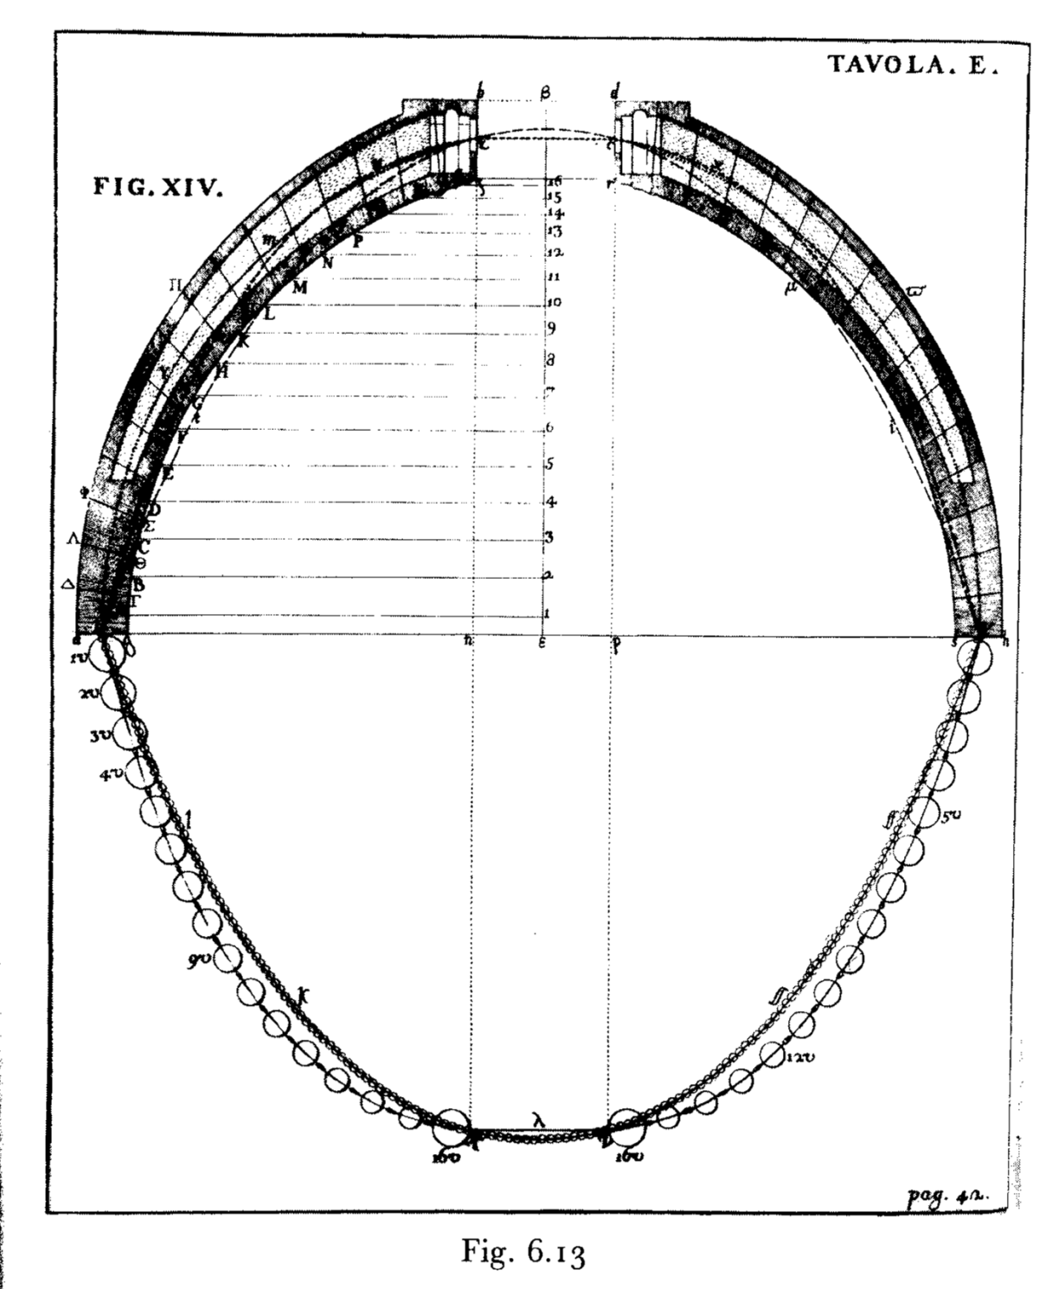
Ut pendet continuum flexile, sic stabit contiguum rigidum inversum.
(As hangs the flexible chain, so, inverted, stands the rigid arch.)
St Peter’s: Poleni: 1748

Slide 7
Hooke’s law
To fill the vacancy of the ensuing page, I have here added a decimate of the centesme of the Inventions I intend to publish, though possibly not in the same order, but as I can get opportunity and leasure; most of which, I hope, will be as useful to Mankind as they are yet unknown and new.
3. The true Theory of Elasticity or Springiness, and a particular Explication thereof in several Subjects in which it is to be found: And the way of computing the velocity of Bodies moved by them.
ceiiinosssttuu
Ut tensio sic vis. (As the extension so the force.)

Slide 8
Hooke’s law
principal stresses and strain increments:
symmetric

Slide 9
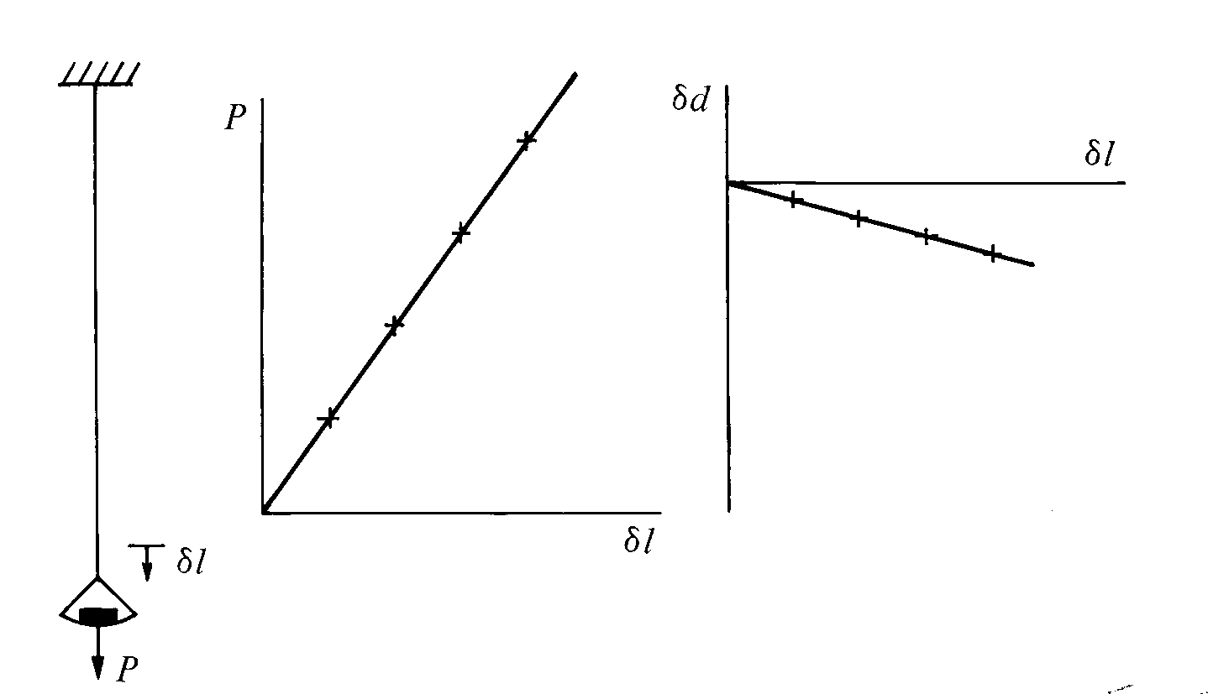
Hooke’s law
uniaxial tension
Young’s modulus E = (P/A)/(δ/)
Poisson’s ratio ν = – (δd/d)/(δ/)
direct observation of elastic constants

Slide 10
Hooke’s law
axial symmetry:
compliance/stiffness matrices not symmetric because stress and strain variables not work conjugate

Slide 11
Hooke’s law
separate change of size and change of shape
work conjugate stress and strain variables
bulk modulus:
shear modulus:
change of size and change of shape uncoupled
(off-diagonal zeros)

Slide 12
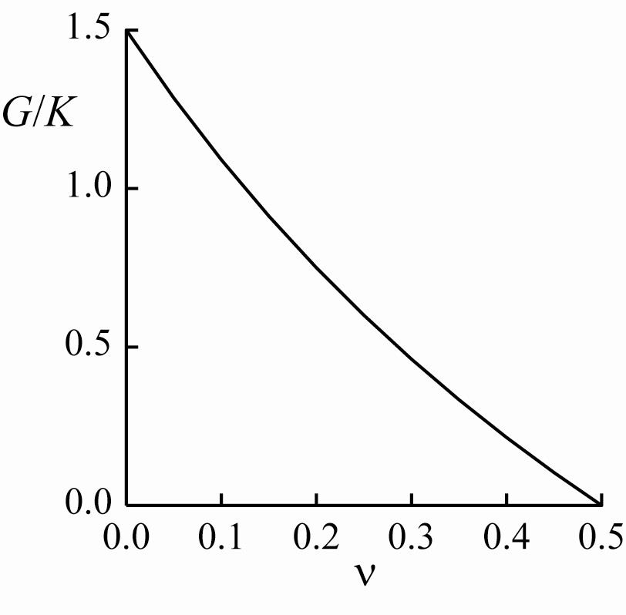
Hooke’s law
only 2 independent elastic properties for isotropic material

Slide 13
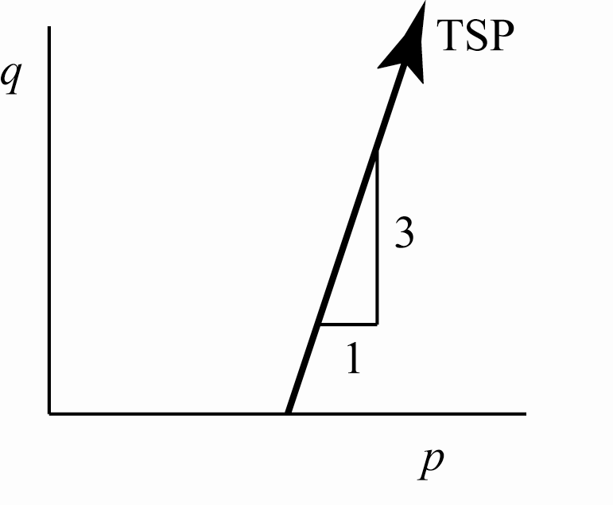
Stiffness in conventional drained triaxial compression
total stress path in conventional compression
(constant cell pressure):

Slide 14
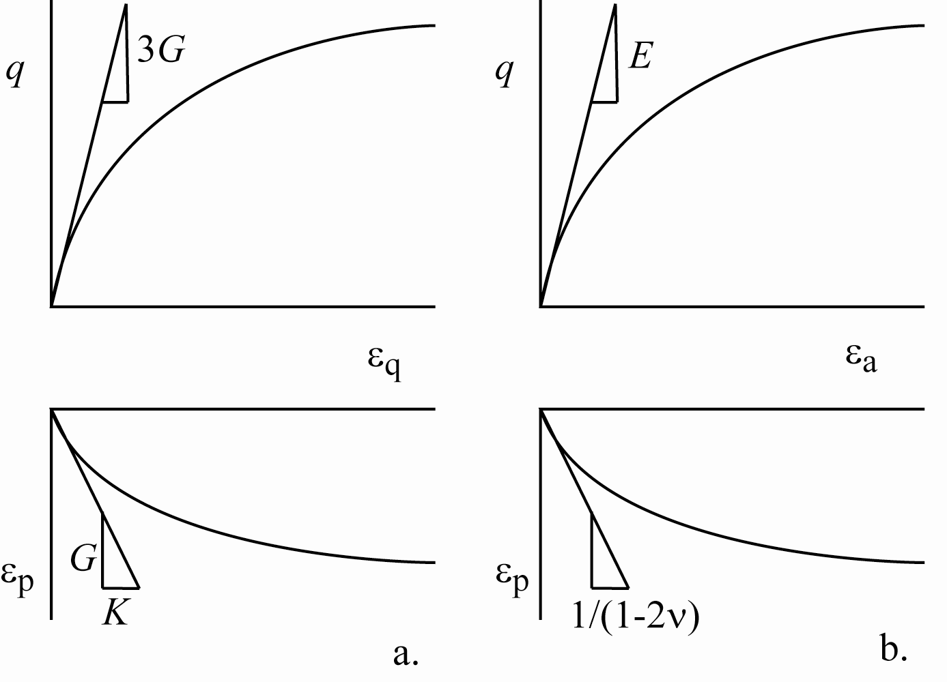
Stiffness in drained triaxial compression

Slide 15
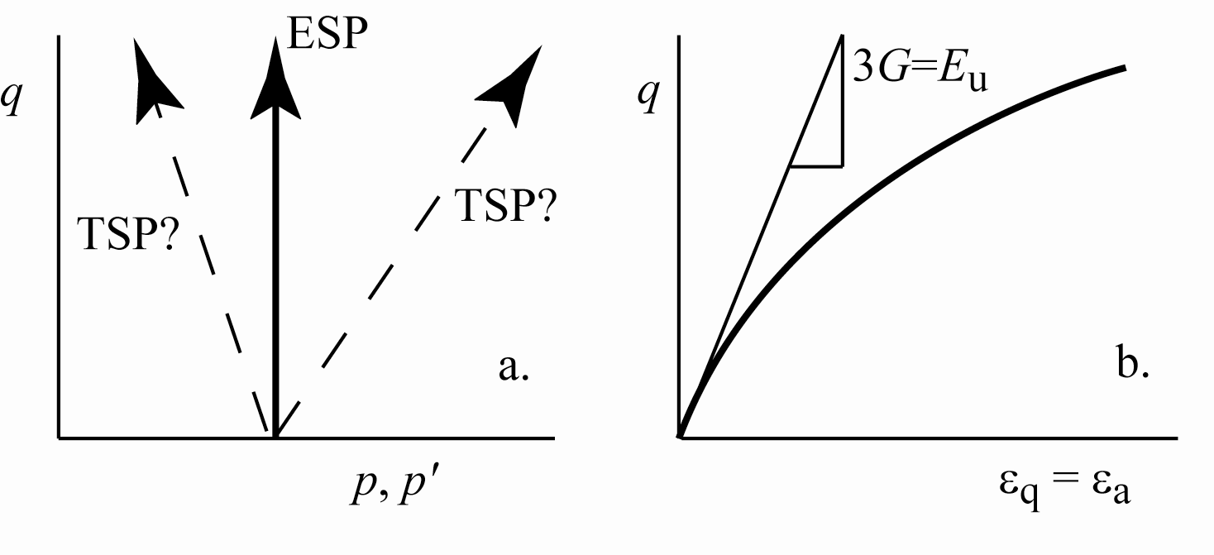
Stiffness in undrained triaxial compression
no coupling between change of size and change of shape – compression and distortion – for isotropic elastic soil
hence, in undrained test – pure distortion – δp'=0 and pore pressure parameter a = 0 for isotropic elastic soil
conventional triaxial compression δq/δp = 3 and δu = δp = δq/3
pore pressure from total mean stress alone
effective stress path independent of total stress path

Slide 16
Stiffness in undrained triaxial compression
in undrained test
external view of undrained stiffness in terms of total stress increments:
distortional stress q = σ_{a} – σ_{r} = σ'_{a} – σ'_{r} and hence G_{u} = G

Slide 17
Stiffness in undrained triaxial compression
δε_{p} = 0 (undrained)
δp arbitrary (external change of total stress)
hence K_{u} = ∞

Slide 18
Stiffness in undrained triaxial compression
ν_{u} = 1/2
drained and undrained elastic properties cannot be chosen independently

Slide 19
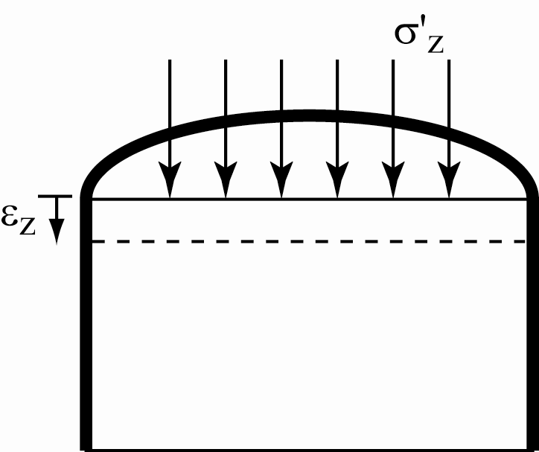
Elastic stiffness from different devices
oedometer
one dimensional compression
and K_{o} = ν/(1-ν)

Slide 20
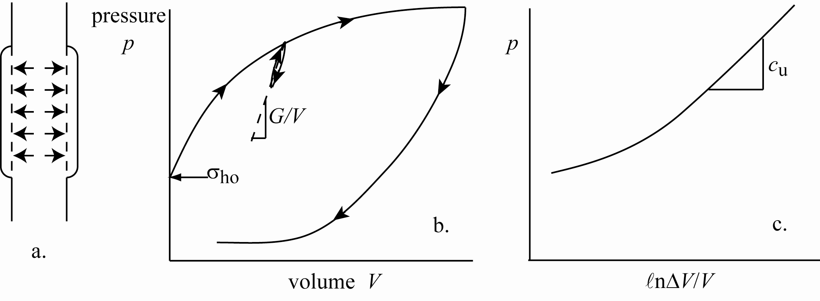
Elastic stiffness from different devices
pressuremeter
direct measurement of shear modulus G

Slide 21
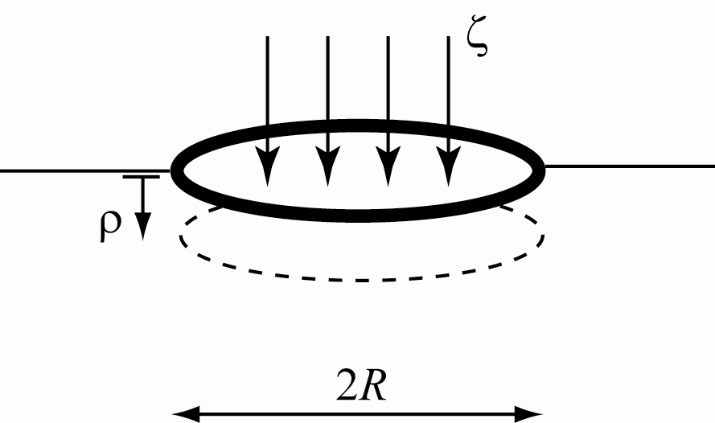
Elastic stiffness from different devices
plate loading test
composite stiffnesses do not reveal individual elastic properties

Slide 22
elasticity
simple models assume isotropic linear elasticity
two parameters: E, ν or G, K
convenient but not necessary
explore possibility of anisotropy
and nonlinearity

Slide 23
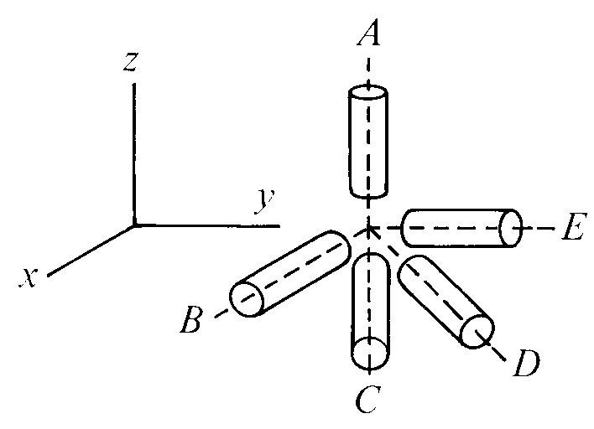
anisotropic elasticity
many soils deposited over areas of large lateral extent
implied symmetry: all horizontal directions equivalent: B, C, D, E
cross anisotropy – transverse isotropy
(anisotropy of real soils, after real stress/strain histories will be more complex)

Slide 24
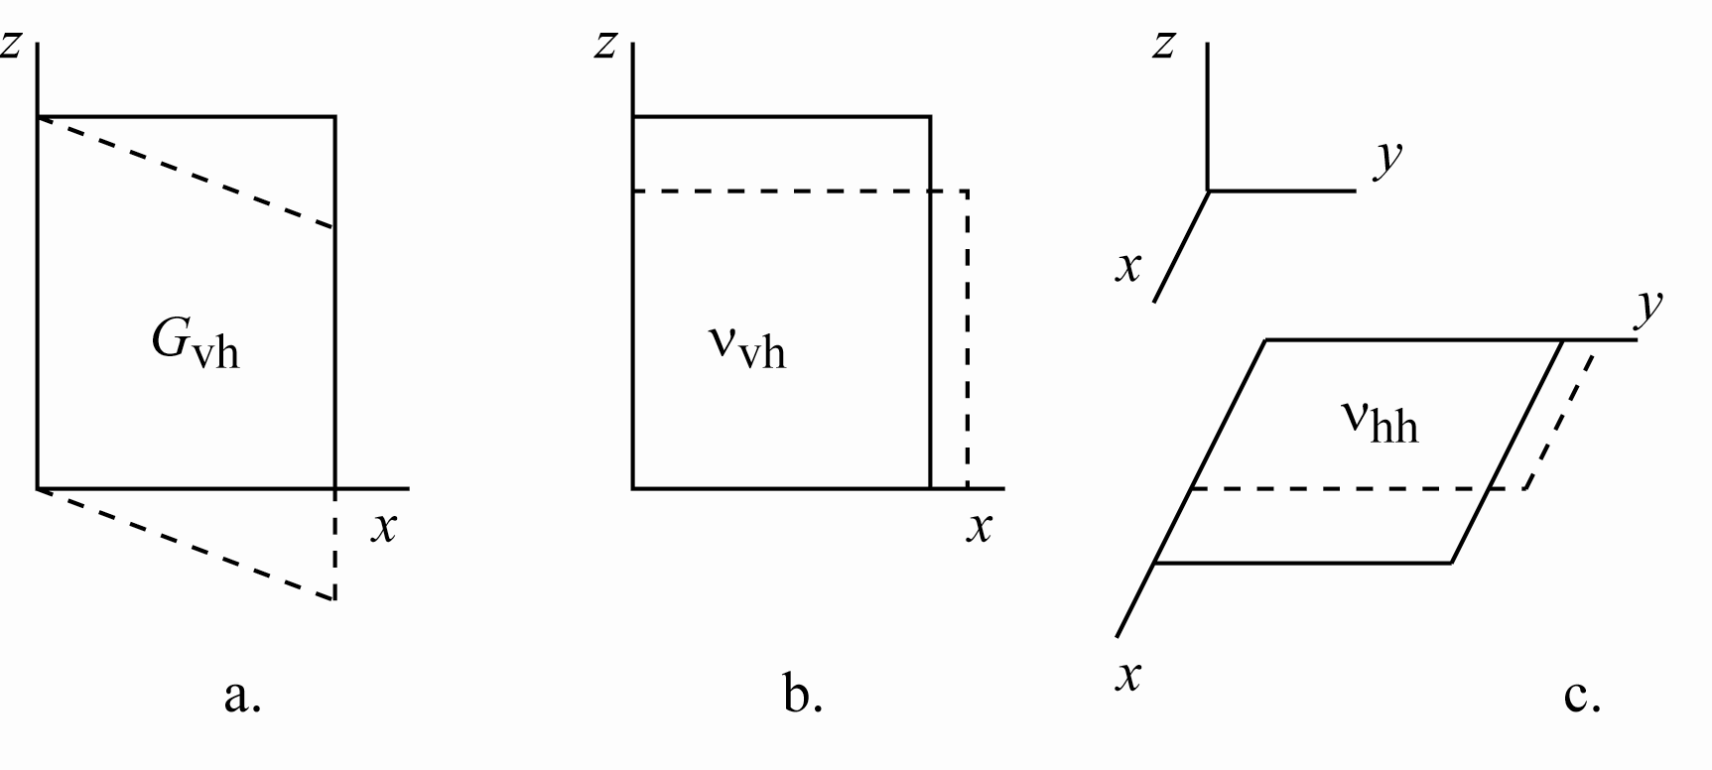
different modes of shearing
cross anisotropy
5 elastic properties
triaxial can only find 3: E_{v}, ν_{vh}, E_{h}/(1-ν_{hh})
ν_{hh}? G_{vh}? could use bender elements

Slide 25
Graham & Houlsby 3 parameter cross anisotropy
axisymmetric triaxial conditions
coupling of compression and distortion

Slide 26
Graham & Houlsby 3 parameter cross anisotropy
axisymmetric triaxial conditions
forcing particular link between cross anisotropic elastic parameters
coupling of compression and distortion

Slide 27
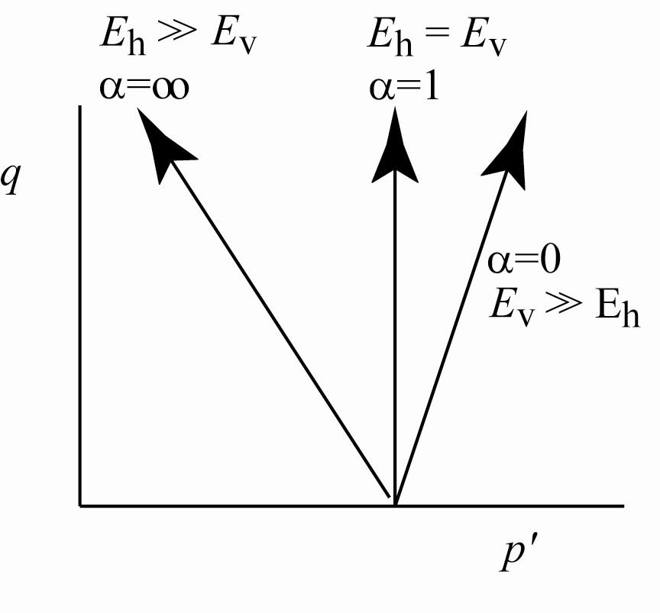
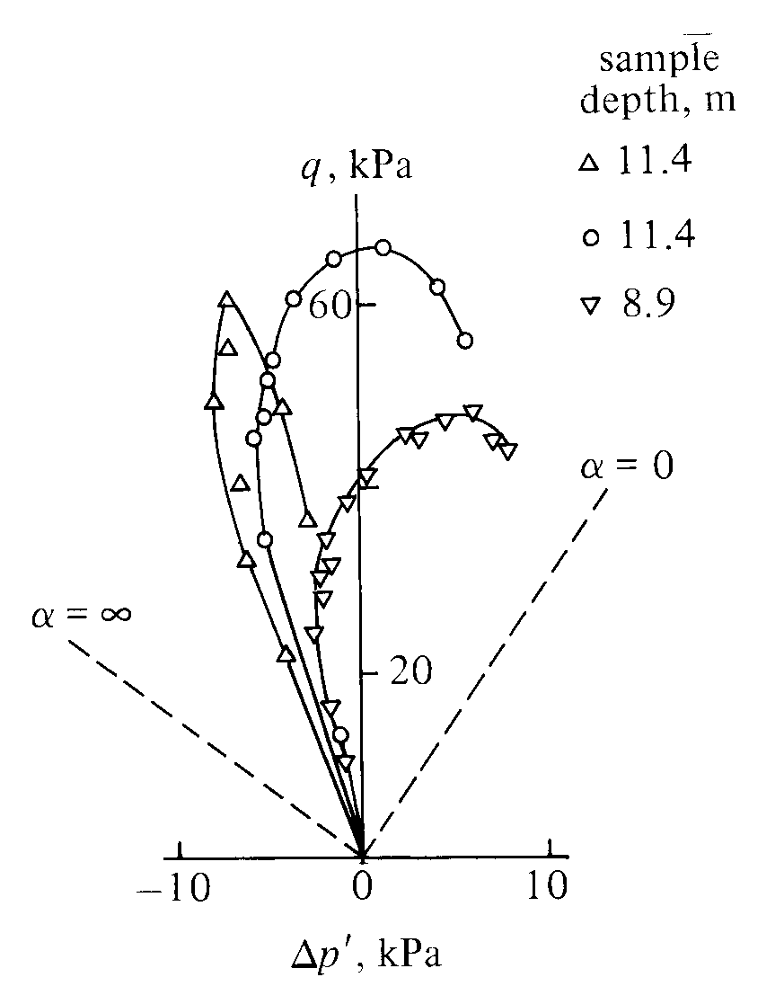
effective stress path in undrained triaxial compression
α² = 1.52 = E_{h}/E_{v}
Winnipeg clay (Graham & Houlsby)

Slide 28
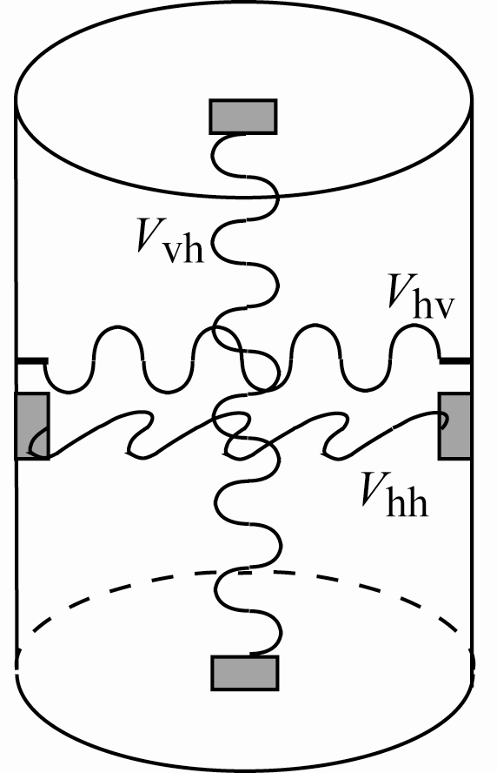
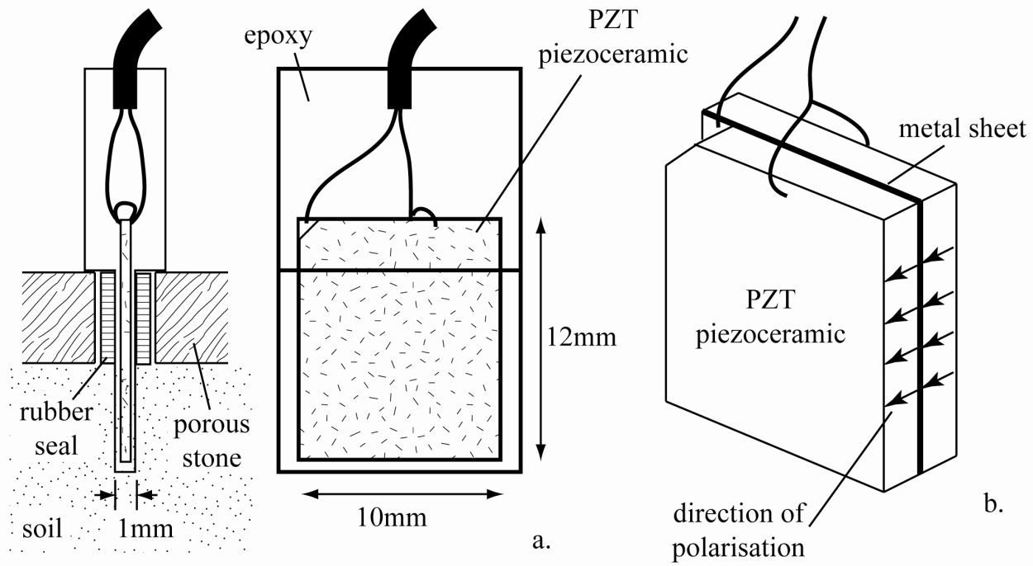
experimental techniques
laboratory geophysics
bender elements
shear wave velocities: time, distance
V_{vh} = V_{hv} ? (elastic, symmetry)

Slide 29
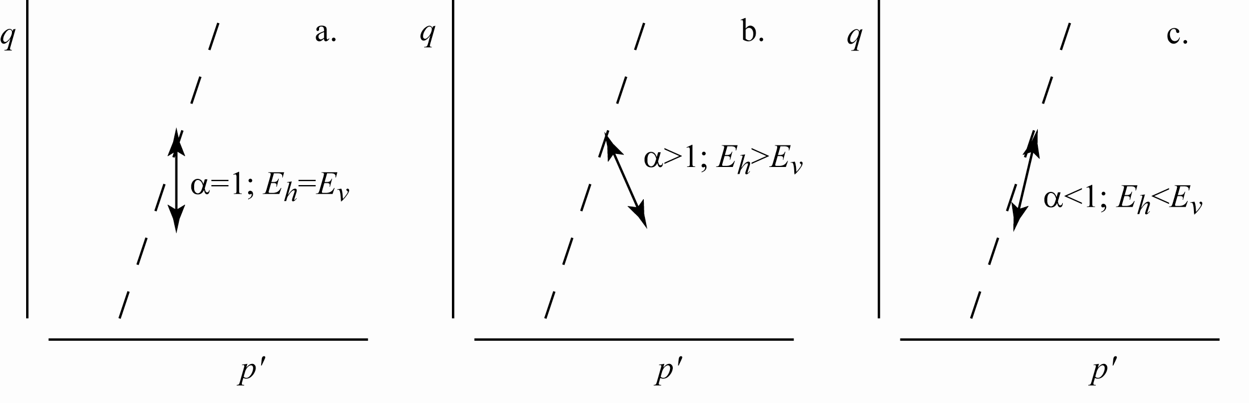
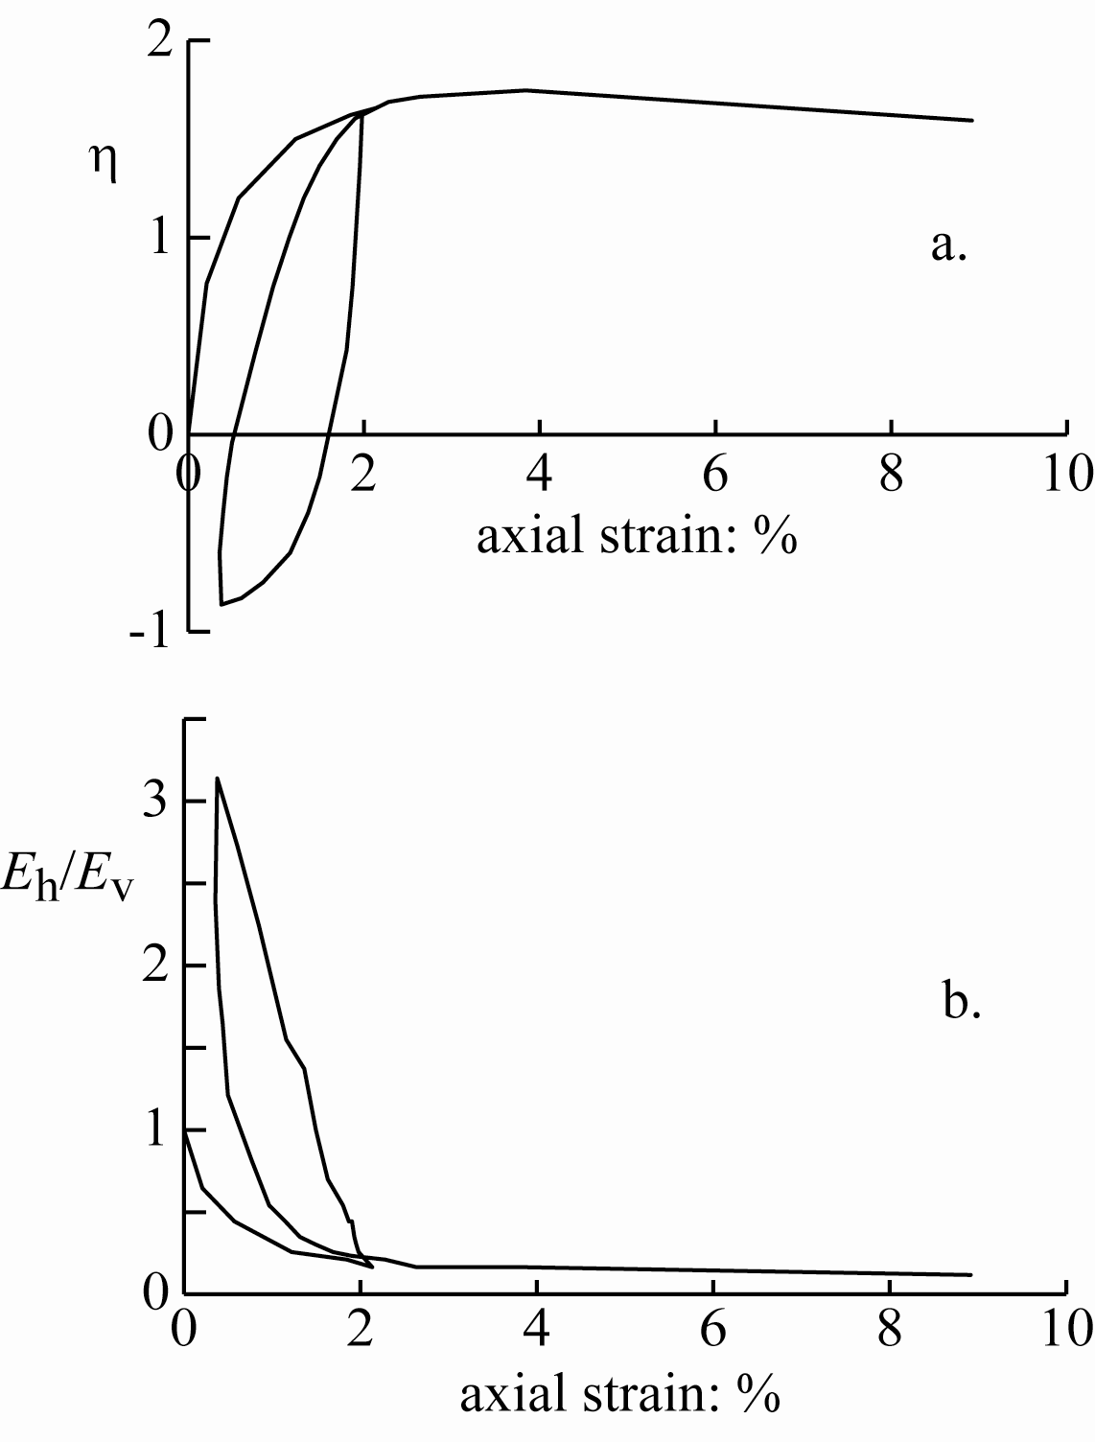
alternatively:
small undrained unload-reload cycles during drained test
slope of effective stress path indicates elastic anisotropy
vertical E_{h} = E_{v}, α = 1
anisotropy evolves with stress ratio
E_{h} → 0 at critical state
Hostun sand (Gajo)

Slide 30
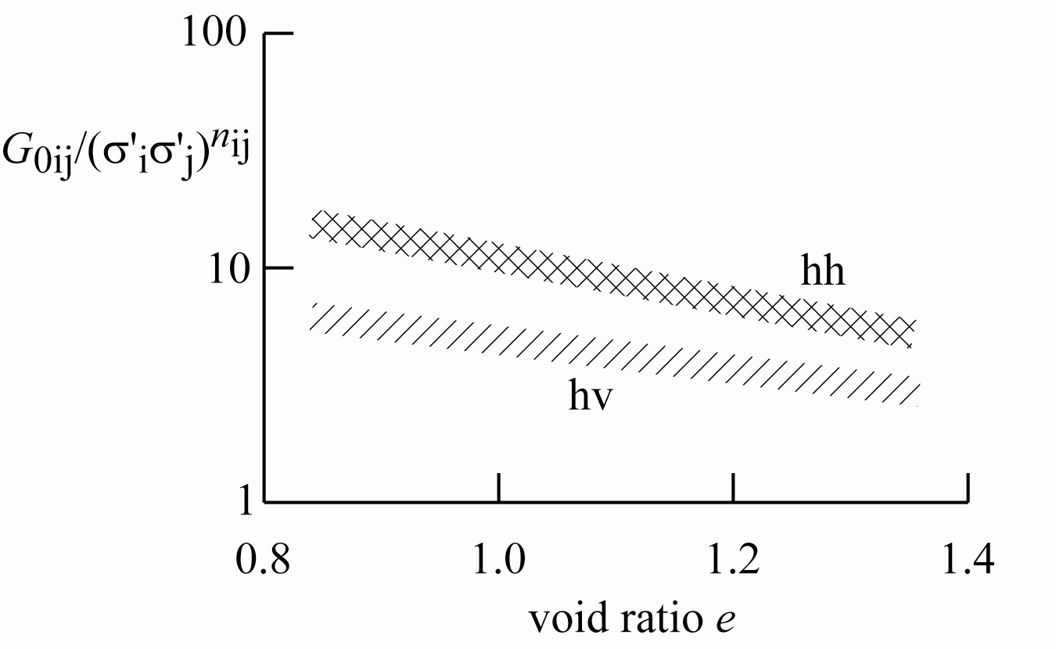
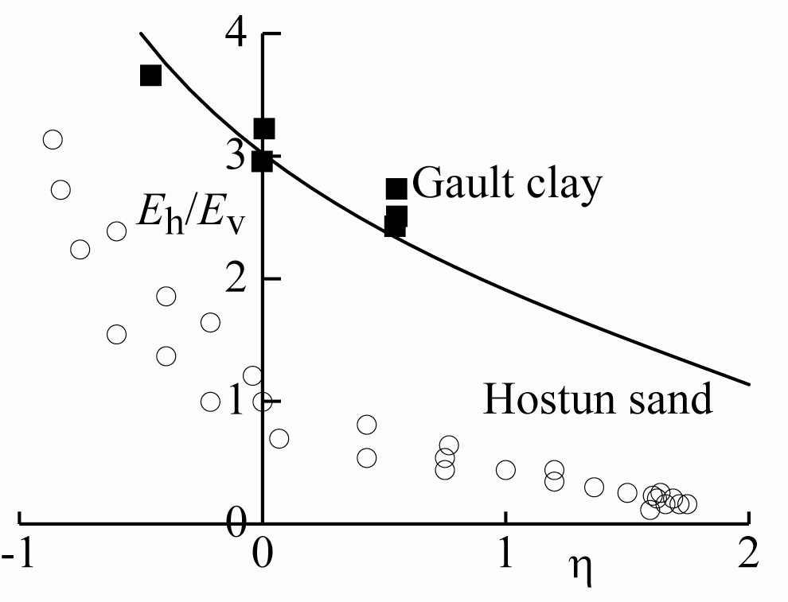
Gault clay
evidence of stiffness anisotropy from bender elements
Gault clay and Hostun sand
evolution of elastic anisotropy with stress ratio

Slide 31
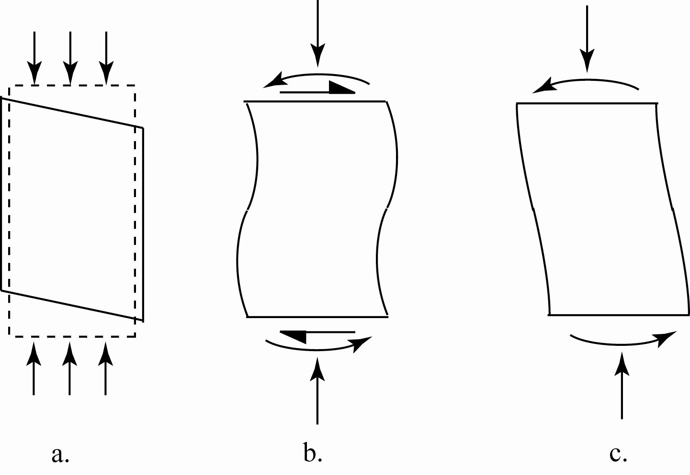
cross anisotropy – axis of symmetry of anisotropy coincides with vertical axis of sample
more general anisotropy – misalignment of axes – sample distressed – boundary measurements may be unrepresentative
it is tempting to assume that things that you choose not to observe do not exist

Slide 32
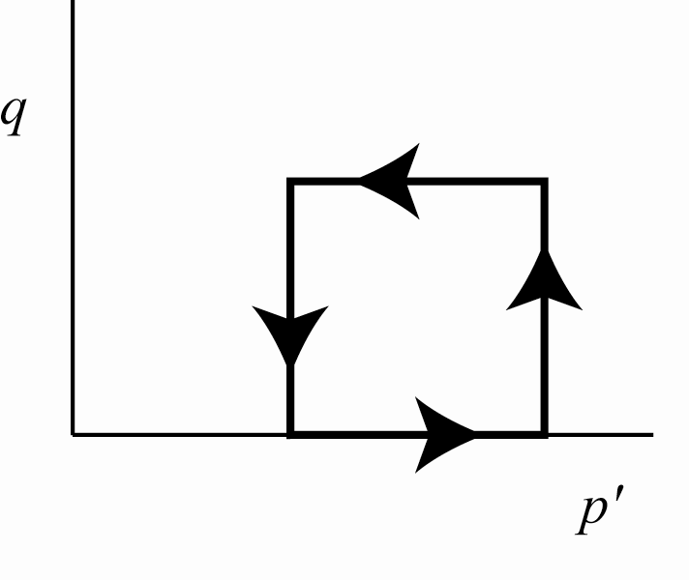
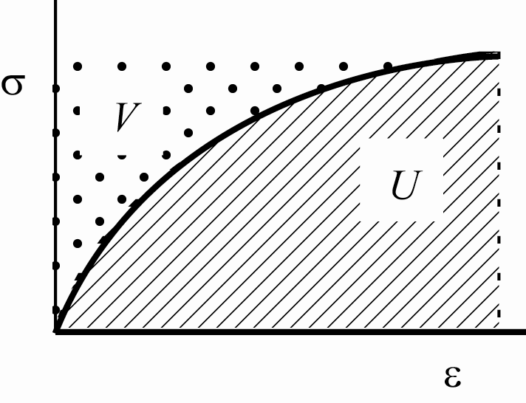
empirical description of elastic nonlinearity or evolution of anisotropy
hypoelasticity
not necessarily conservative – energy production/dissipation in closed cycles
for example, both G and K functions only of p'
hyperelasticity
thermodynamically consistent
define strain energy density function U
or complementary energy V
hence stiffnesses

Slide 33
complementary energy function (Boyce, 1980)
constant volume paths
constant distortional strain paths
road sub-base material: n = 0.2, ν = 0.3 (K₁/G₁ = 2.17)

Slide 34
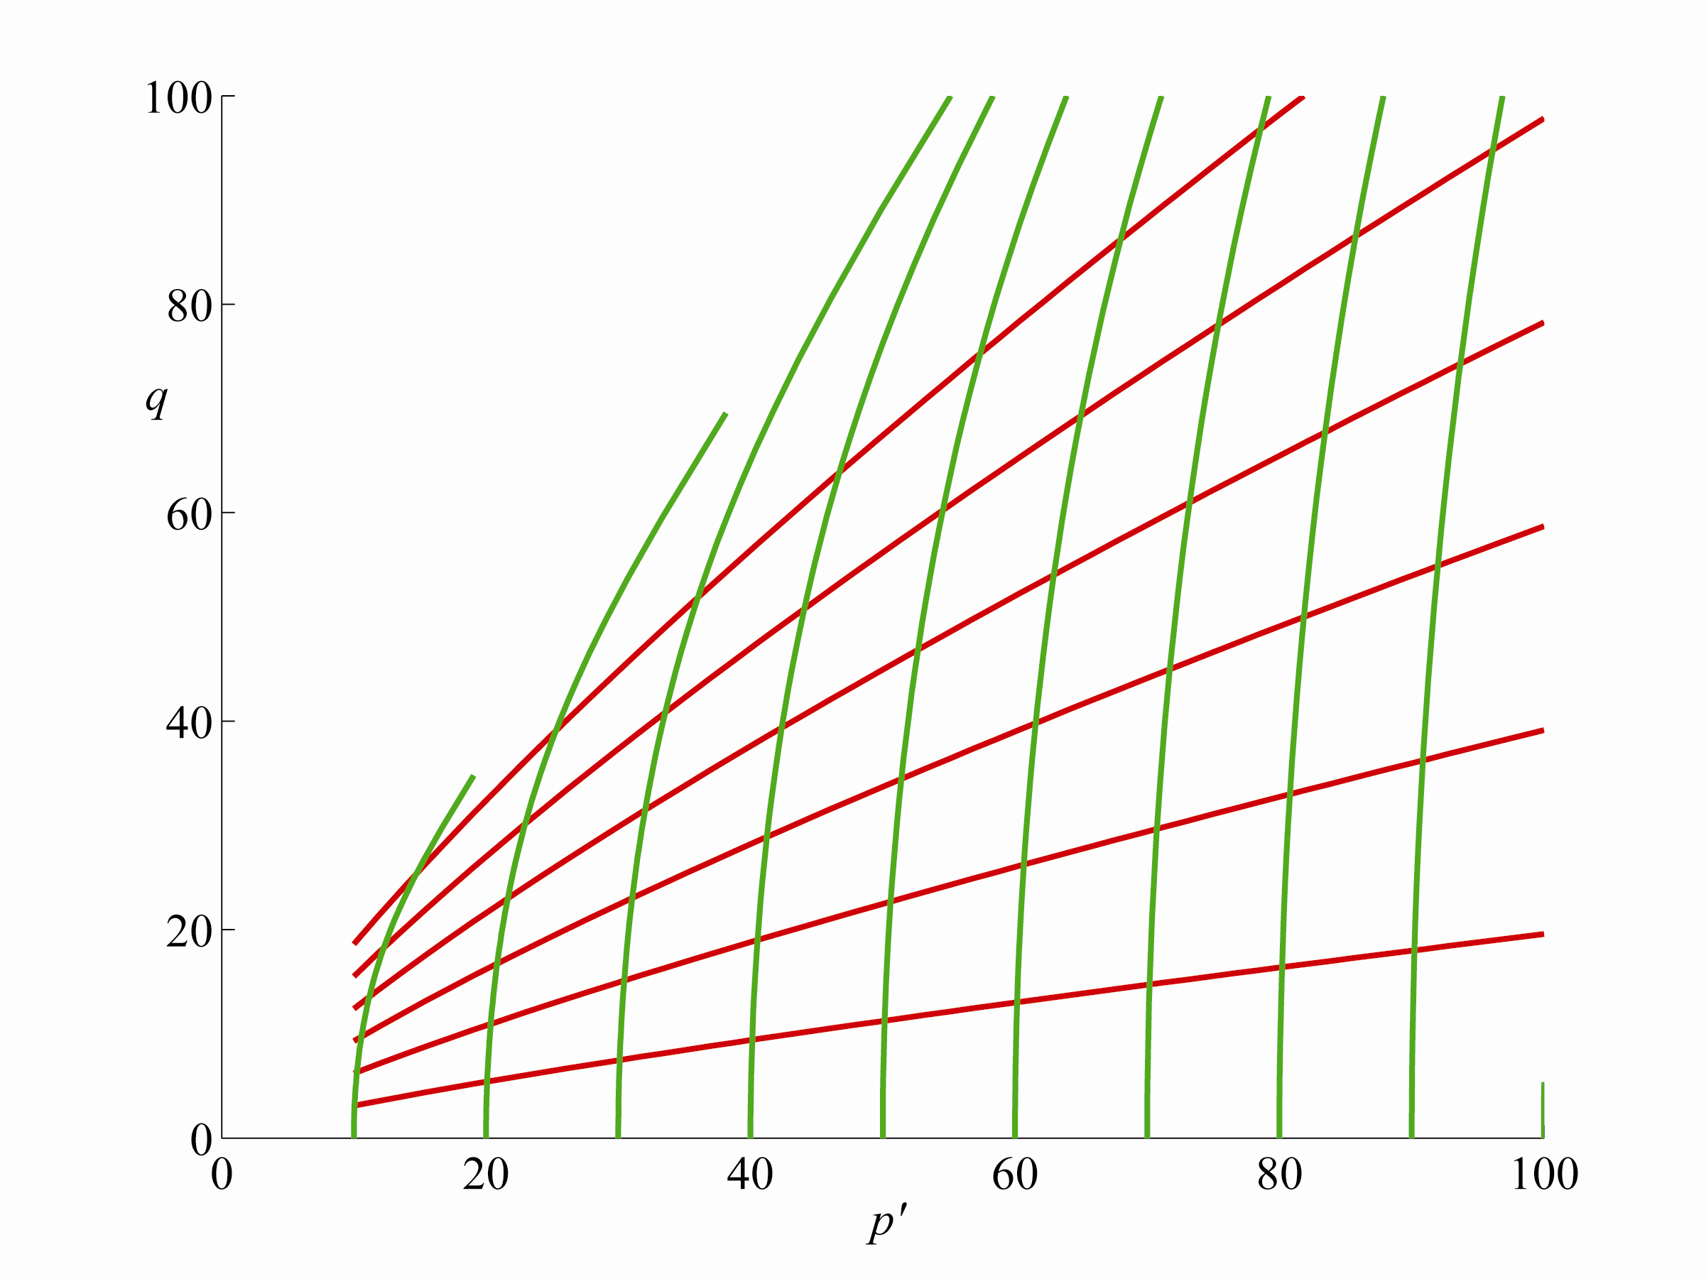
Boyce complementary energy function
contours of constant volumetric strain and constant distortional strain

Slide 35
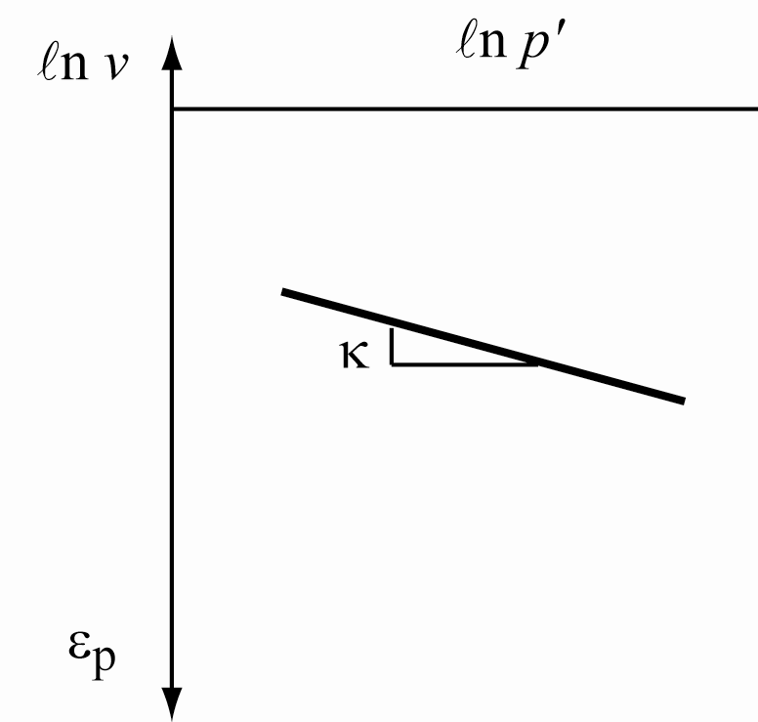
Cam clay has K dependent on p'
constant ν is thermodynamically unacceptable
Houlsby strain energy function
constant distortional strain paths: η = constant
constant volume paths
asymptotic to

Slide 36
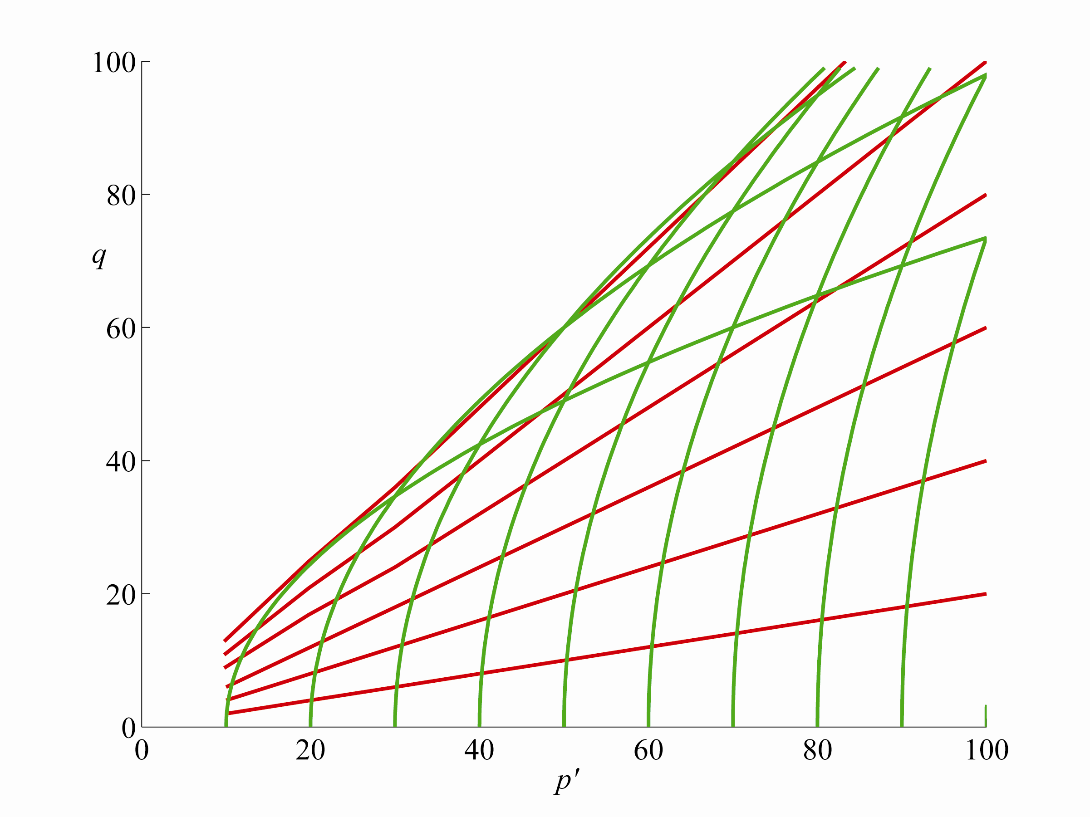
Houlsby strain energy function
contours of constant volumetric strain and constant distortional strain

Slide 37
art in choosing energy functions to give desirable properties when differentiated twice (stiffness or compliance)
varying slope of undrained path may come from nonlinearity or evolving anisotropy (or both)
subtle tests to distinguish
even more difficult to discover hyperelastic energy functions to describe evolving elastic anisotropy
nonlinear elasticity – or plasticity? (irrecoverable strains)

Slide 38
Summary
generalised Hooke’s law – one-to-one link between stress and strain
elastic matrices symmetric with work-conjugate variables
two independent elastic properties for isotropic material
deduction of elastic properties from standard tests
evolving anisotropy - nonlinearity

