Slide 1

Saturated soil modelling: Griffith University: February 2010
Introduction to modelling: soil behaviour
David Muir Wood
d.muirwood@dundee.ac.uk

Slide 2
Models:
‘Scientific understanding proceeds by way of constructing and analysing models of the segments or aspects of reality under study. The purpose of these models is not to give a mirror image of reality, not to include all its elements in their exact sizes and proportions, but rather to single out and make available for intensive investigation those elements which are decisive. We abstract from non-essentials, we blot out the unimportant to get an unobstructed view of the important, we magnify in order to improve the range and accuracy of our observation. A model is, and must be, unrealistic in the sense in which the word is most commonly used. Nevertheless, and in a sense, paradoxically, if it is a good model it provides the key to understanding reality.’
(Baran and Sweezy, 1968)

Slide 3
Everything engineers (and scientists) do is concerned with modelling!
You have been engaged in modelling for years – perhaps unconsciously!
examples of models in civil and geotechnical engineering

Slide 4
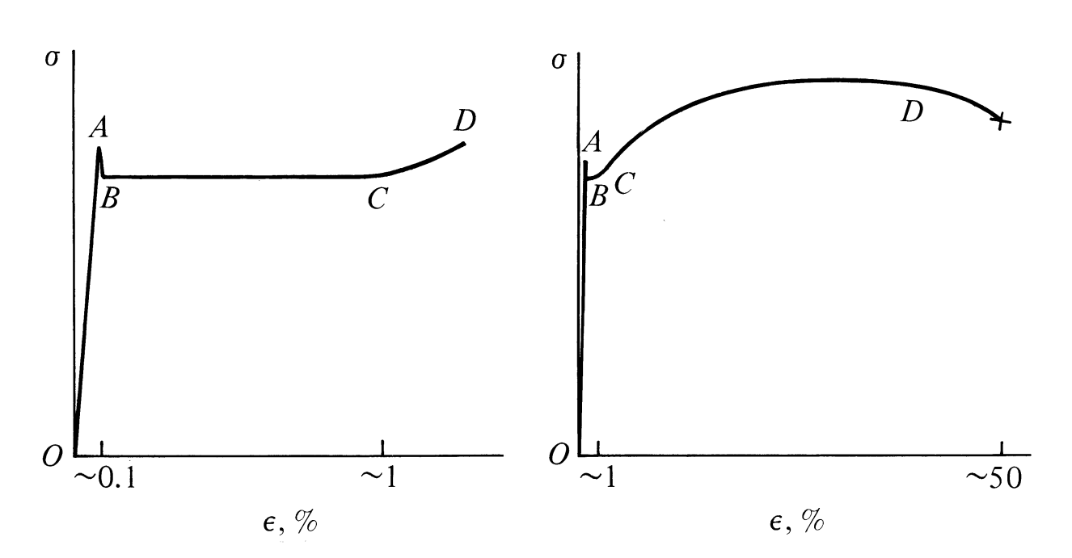
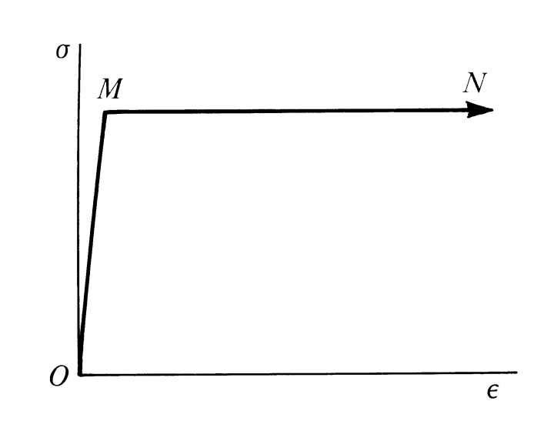
behaviour of mild steel in uniaxial tension
idealisation of behaviour of mild steel – forming basis for plastic design of steel structures
structural engineering

Slide 5
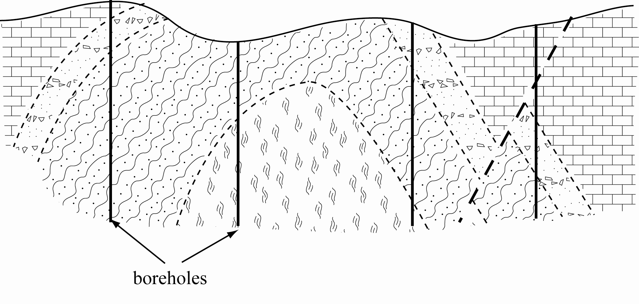
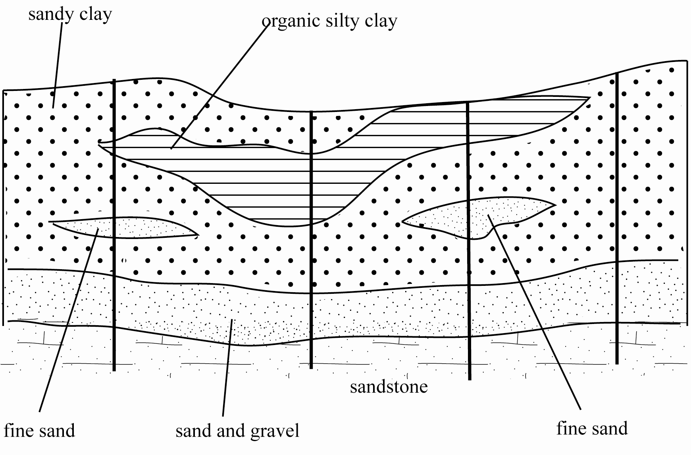
geological model

Slide 6
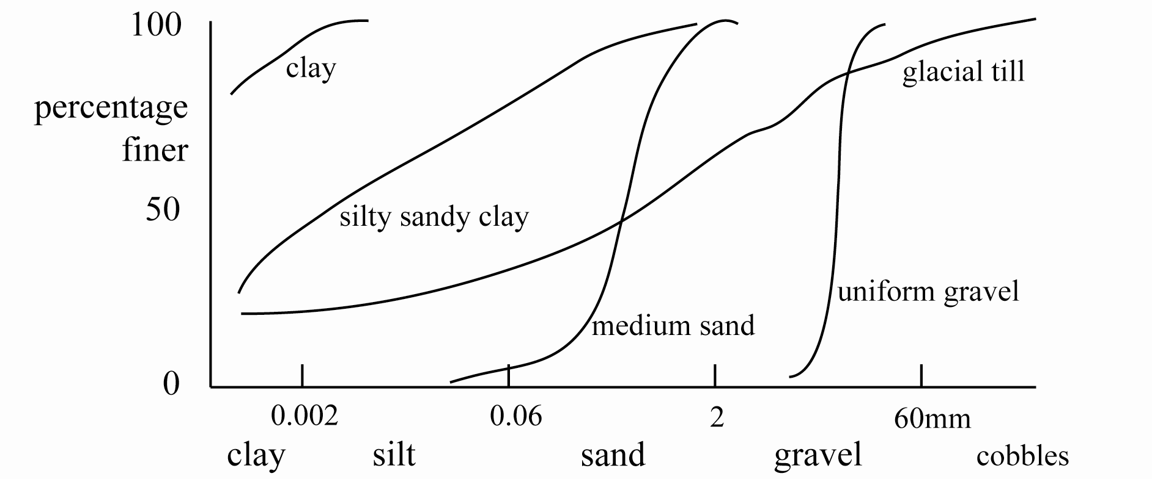
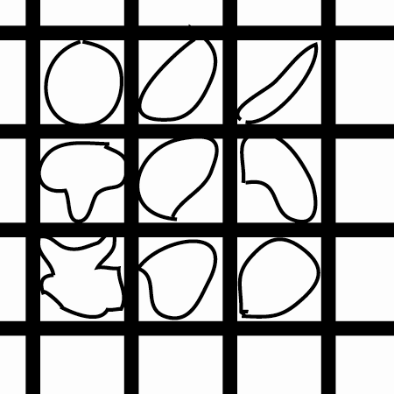
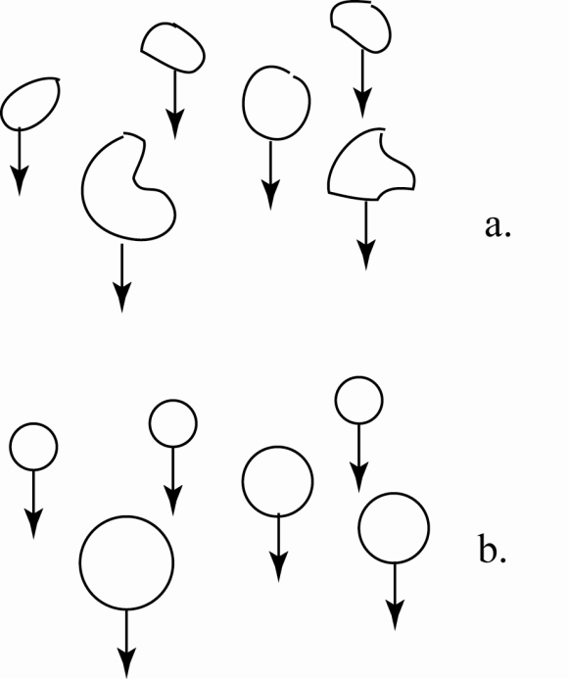
– particles modelled as equivalent spheres
– sieving – sedimentation
classification model - particle sizes

Slide 7
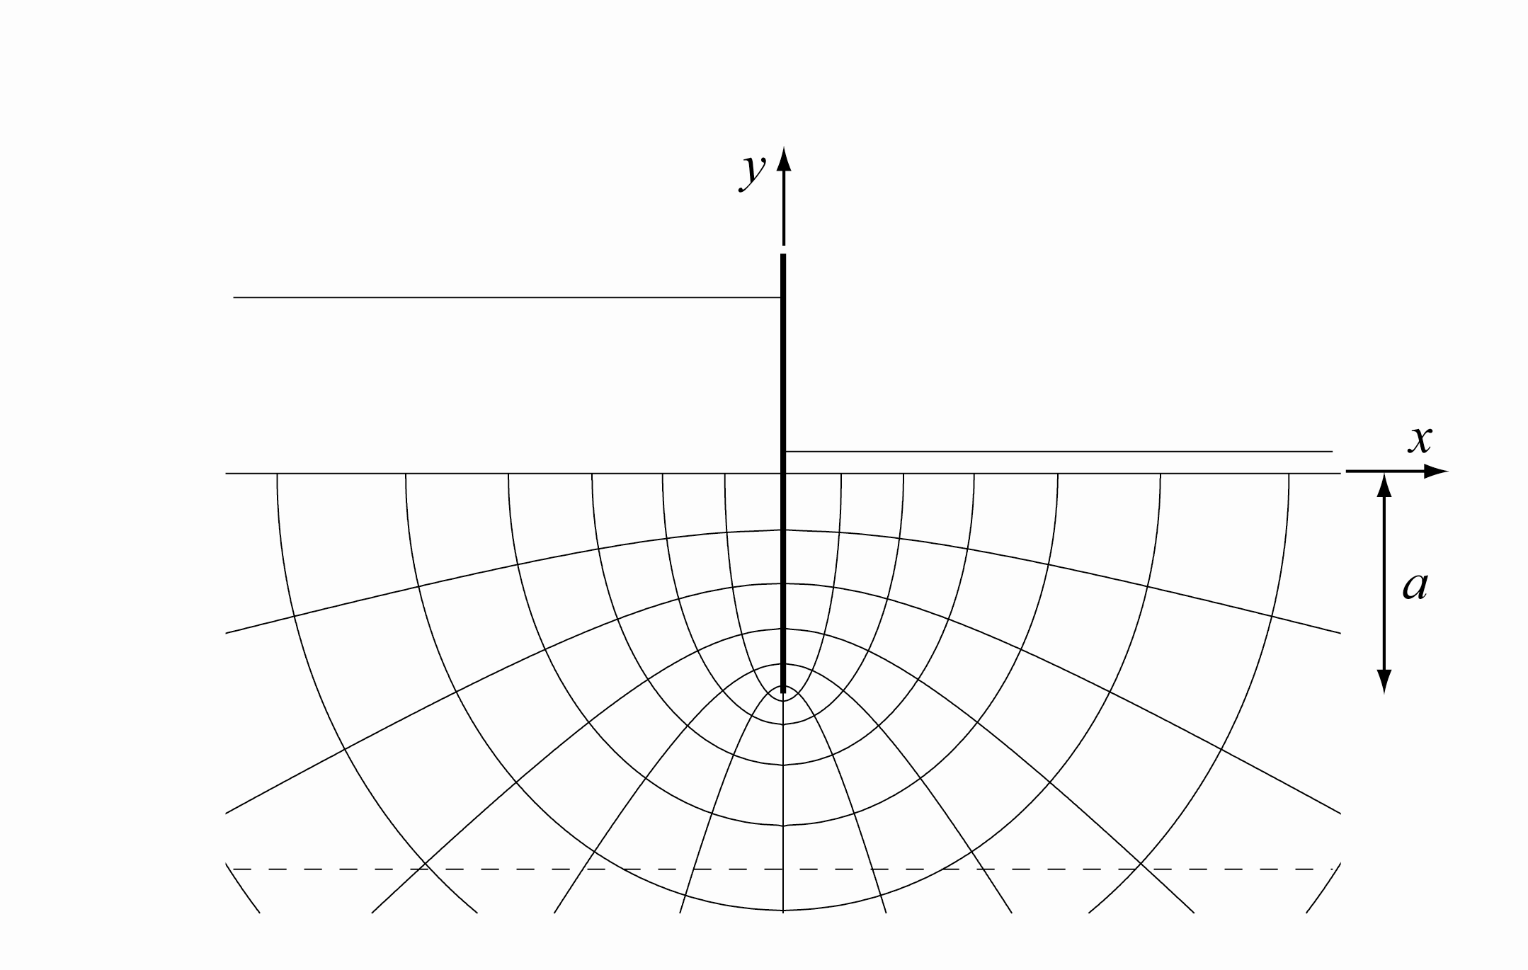
theoretical model
– useful for confirming results of other modelling
– if boundary conditions are somewhat similar

Slide 8
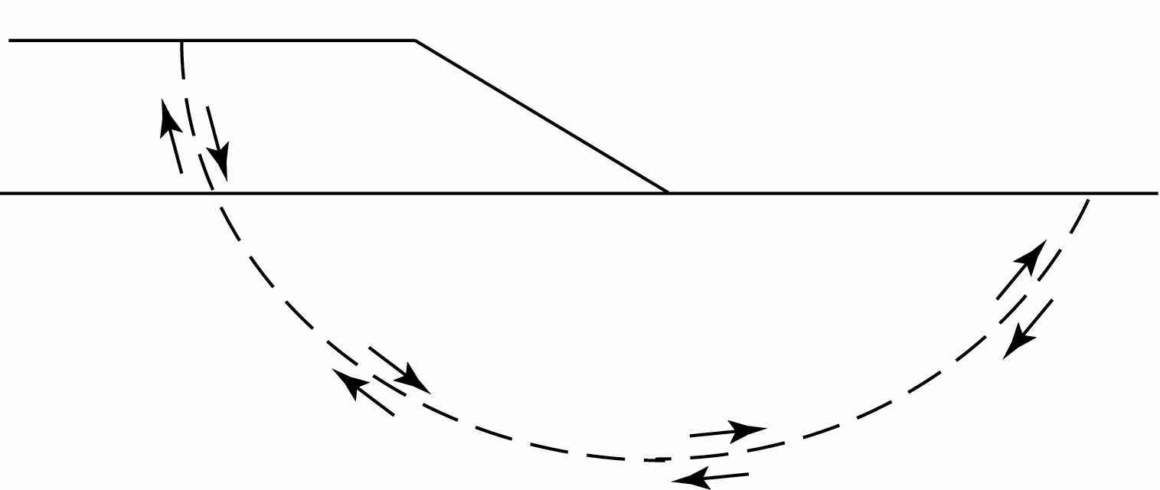
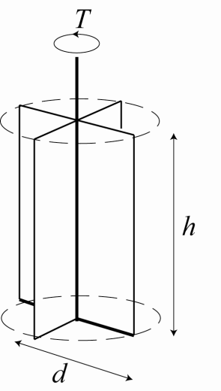
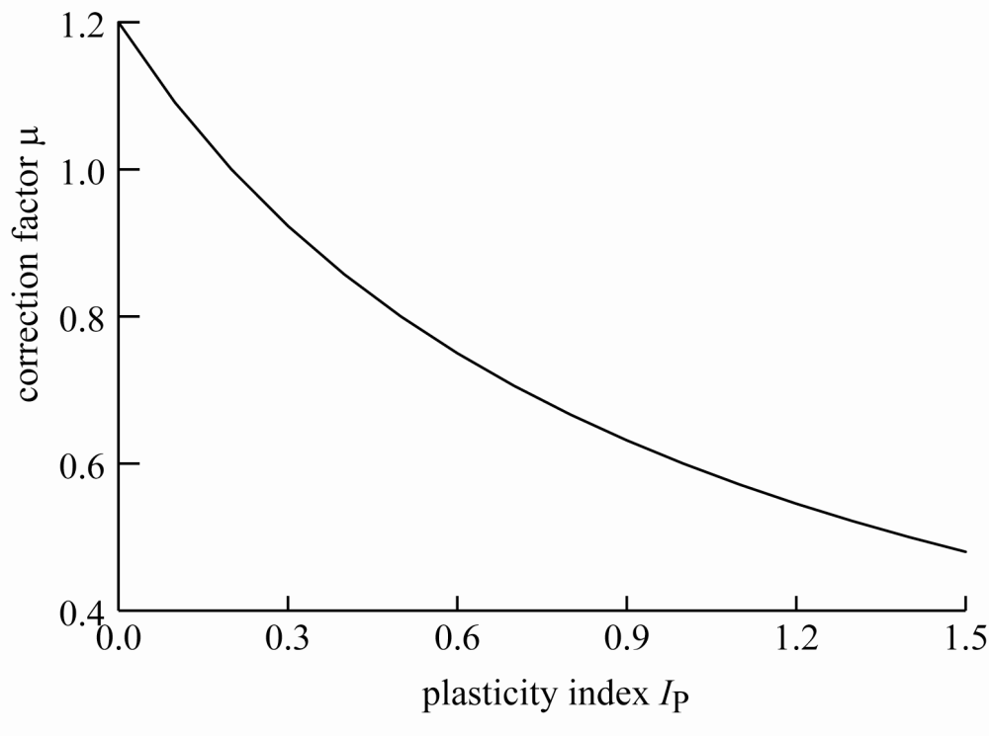
– Bjerrum vane correction factor
– effects of rate, anisotropy, …
empirical model

Slide 9
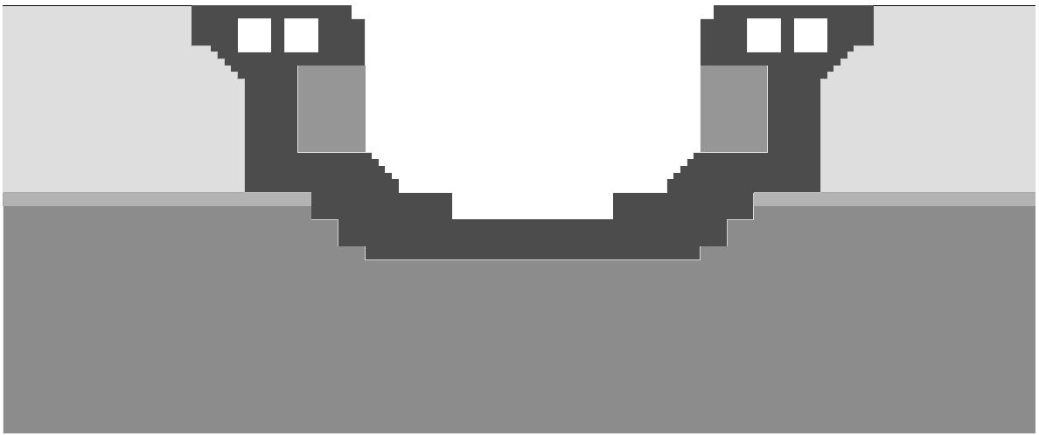
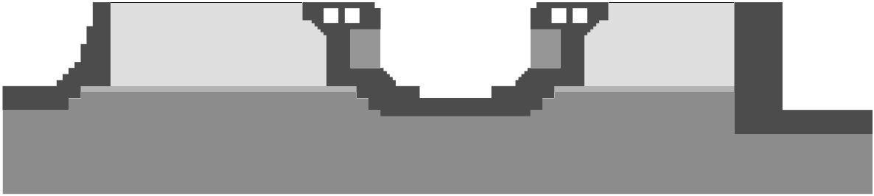
numerical model
model of dock with free field boundaries behind walls
dock structures under seismic loading
model of dock with adjacent docks included
Mair and Muir Wood (2001)

Slide 10
numerical modelling
for example, finite element, finite difference
equilibrium compatibility of deformations
stresses strains
stress:strain relationship
constitutive model
lectures primarily concerned with introduction to various aspects and possibilities of constitutive modelling

Slide 11
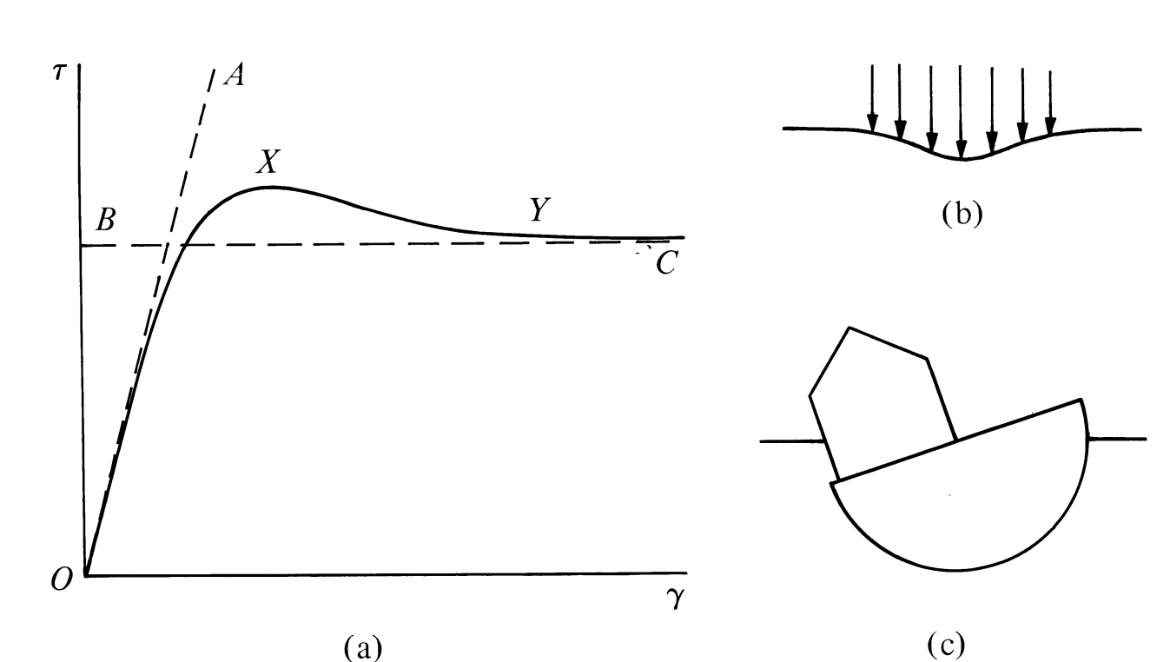
observed and idealised shearing behaviour of soil for settlement and bearing capacity calculations
constitutive models trying to reproduce more of the actual nonlinearity of pre-failure soil response

Slide 12
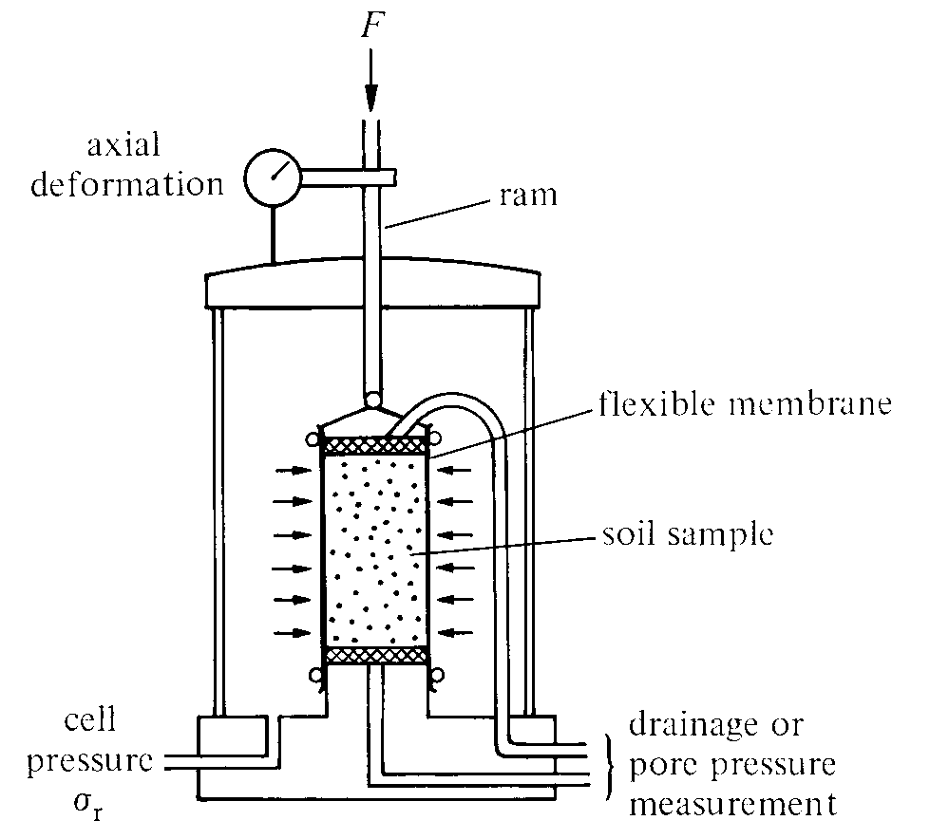
stress and strain variables (1)
concentrate on axisymmetric conditions of triaxial test
volume changes are important in soils
– and affect mechanical properties
choose volumetric strain increment:
axial strain increment
radial strain increment

Slide 13
stress and strain variables (2)
in developing constitutive models concept of work will be important
need to link strain increment and stress variables
– work conjugate pairs
choose volumetric stress variable: effective mean stress
volumetric work – work done in changing size – is:

Slide 14
stress and strain variables (3)
choice of second pair of variables to describe change of shape somewhat arbitrary
for convenience choose deviator stress from triaxial test
distortional stress variable: deviator stress
F
area A

Slide 15
stress and strain variables (4)
work conjugate pair for change in shape
distortional strain increment:
distortional work – work done in changing shape – is:
δε_{q} = δε_{a} for constant volume deformation δε_{p} = 0

Slide 16
stress and strain variables (5)
confirm that total work done in strain increment is:
convenient transformation matrices

Slide 17
stress and strain variables (6)
define stress ratio: η = q/p'
mobilised friction
for conditions of triaxial compression

Slide 18
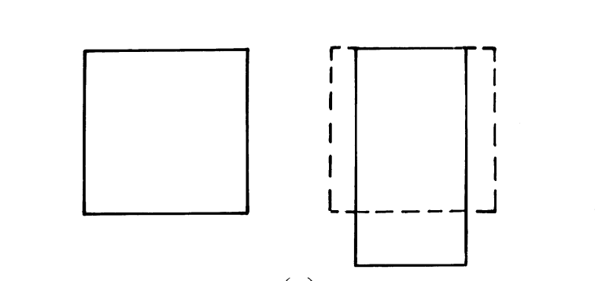
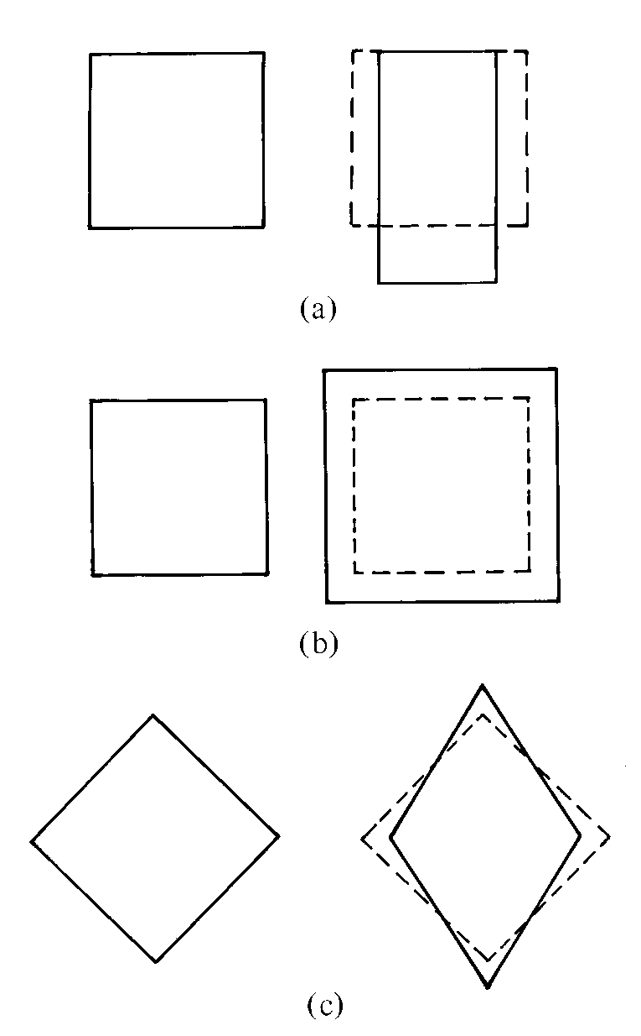
distortion: change in shape: q, δε_{q}
distortion: change in shape: q, δε_{q}
compression: change in size: p', δε_{p}

Slide 19
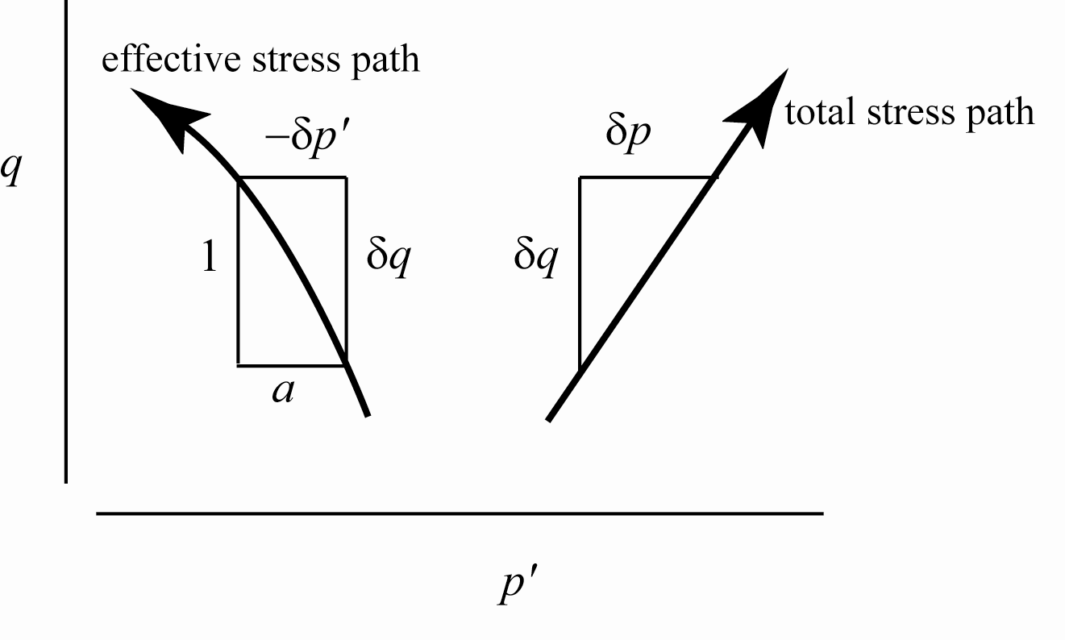
Pore pressure parameter
total and effective stresses
undrained deformation
total stress is external perturbation – arbitrary
effective stress is soil response – constrained by constitutive properties – δp' indicates desire of soil to change in volume when sheared (or not) – dilatancy

Slide 20

Pore pressure parameter
pore pressure increment: δu = δp – δp'
slope of effective stress path: a = –δp'/δq
then: δu = δp + aδq
logical definition of pore pressure parameter – linking pore pressure change with total stress change (compare Skempton…)
a is not a soil property – function of history etc.
subtraction of arbitrary total stress change δp helps in interpretation of pore pressure change

Slide 21
Soil behaviour
particle continuum duality
laboratory element testing
stiffness

Slide 22
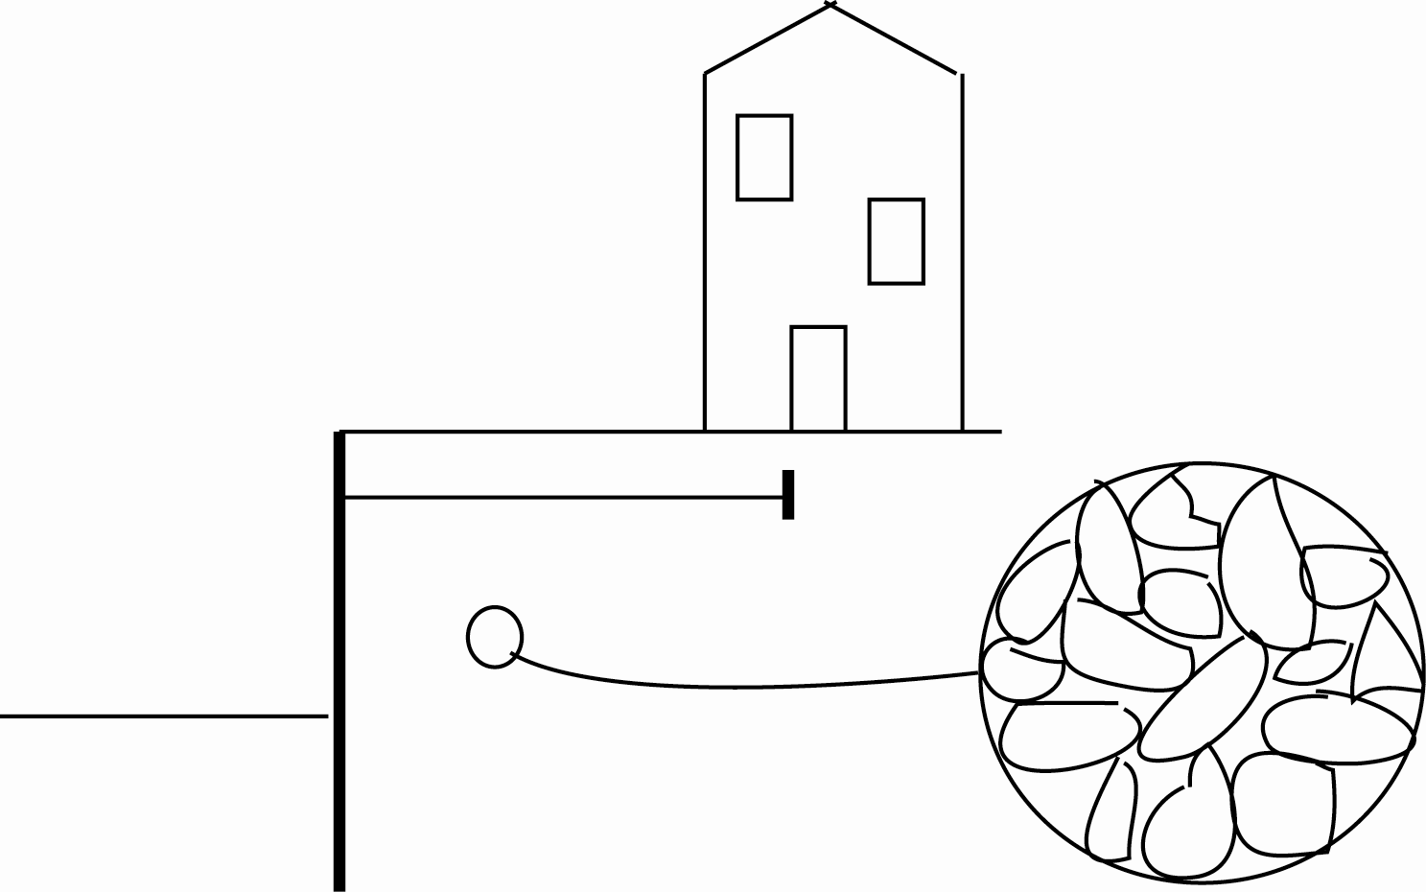
Particle-continuum duality
for analysis we need to treat soil as a continuum (stress, strain)
but its properties emerge from its particulate nature

Slide 23
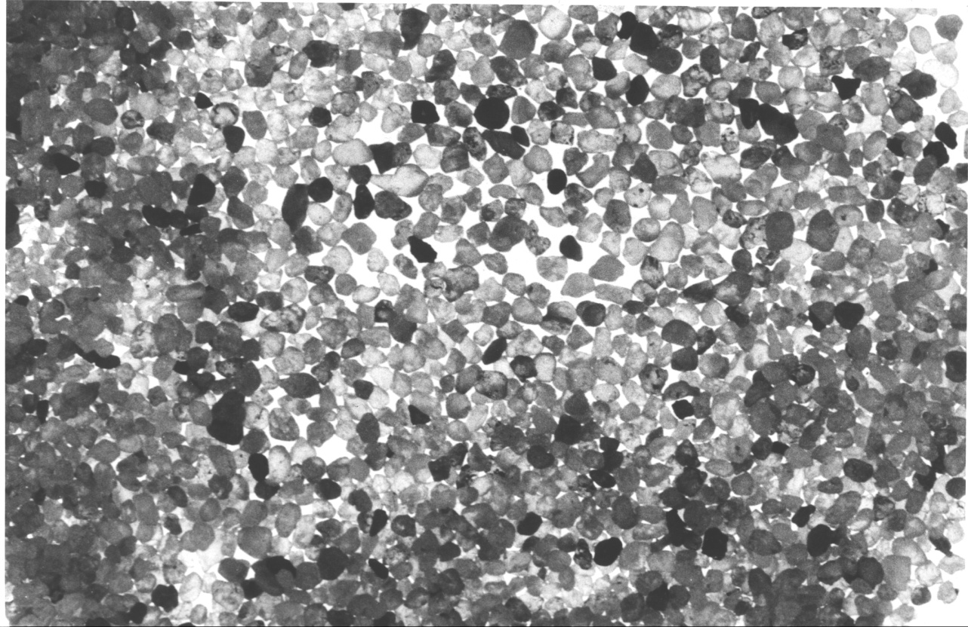
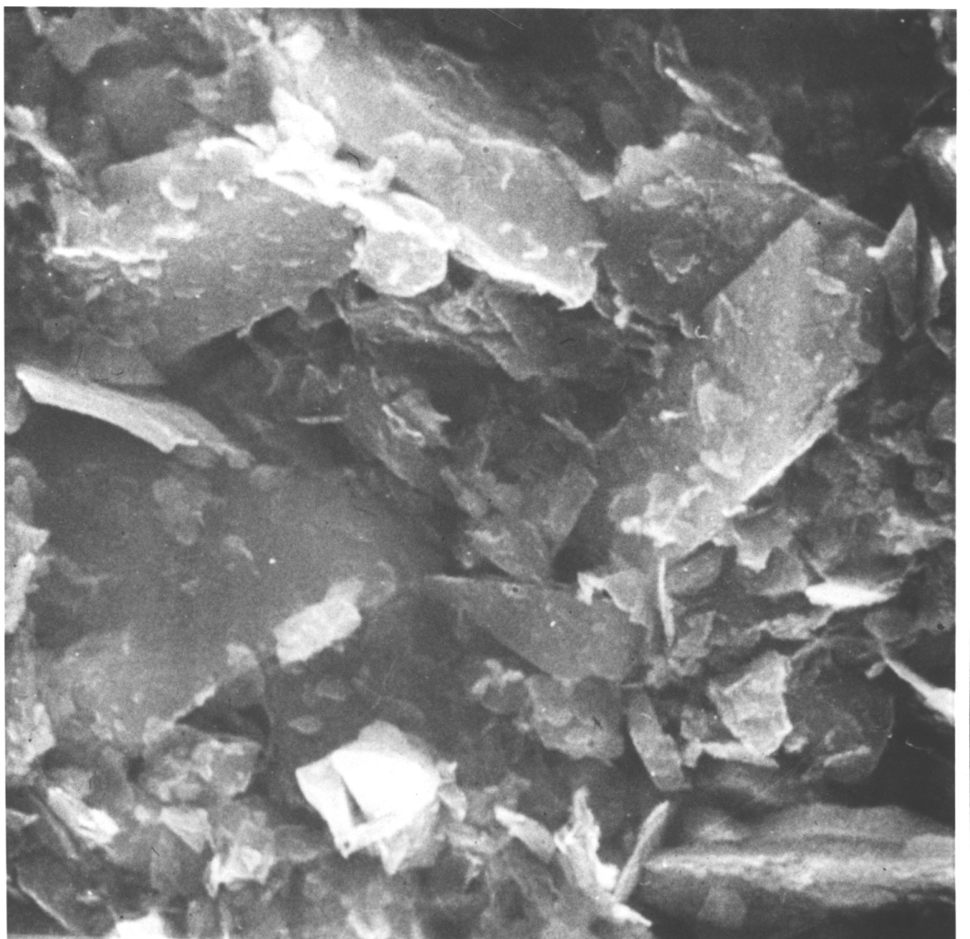
particle-continuum duality
Leighton Buzzard sand (picture width 37 mm)
Leda clay (picture width 13μm)

Slide 24
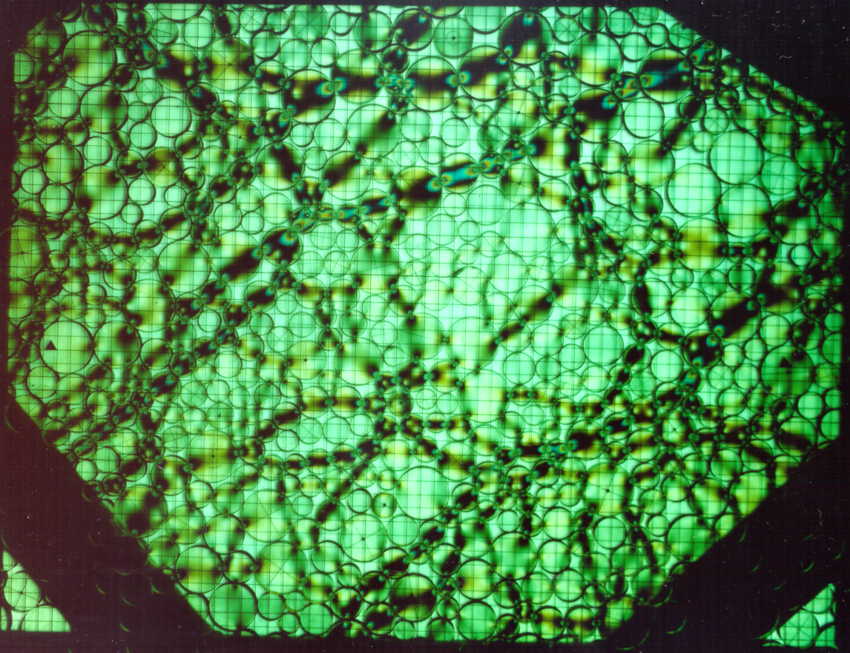
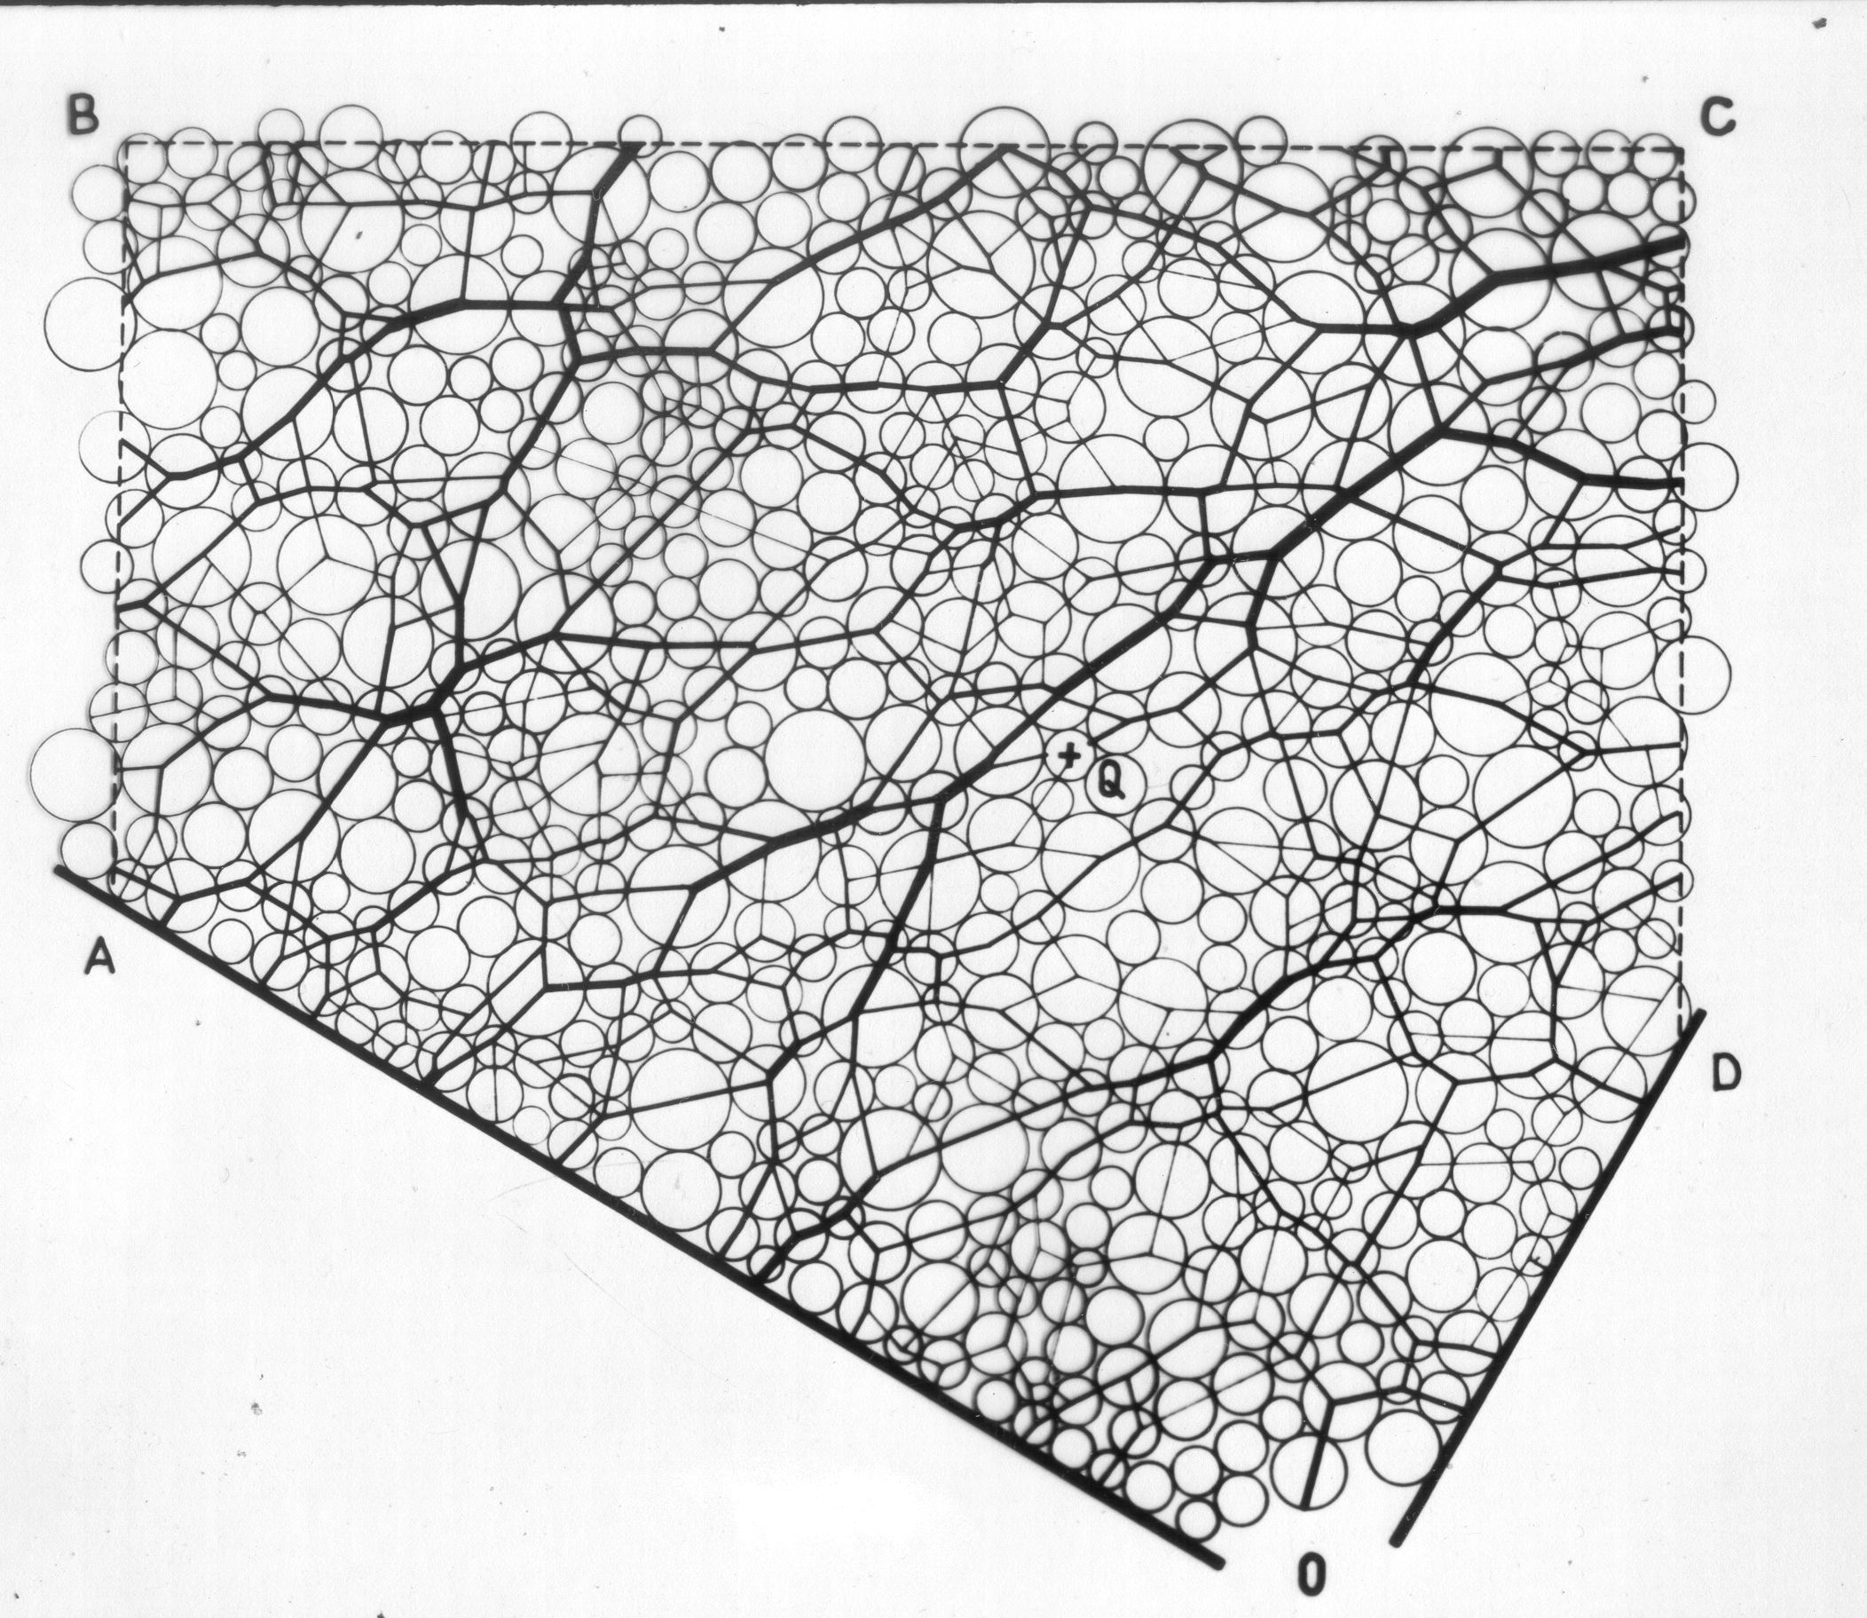
particle-continuum duality
photoelastic discs
force chains
fabric
Drescher and de Josselin de Jong (1972)

Slide 25
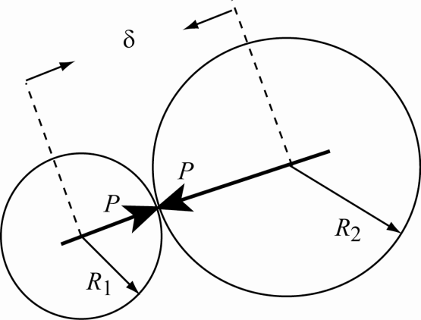
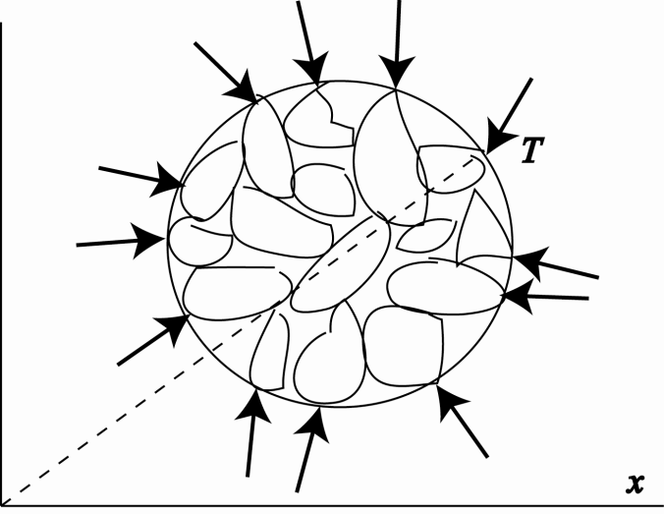
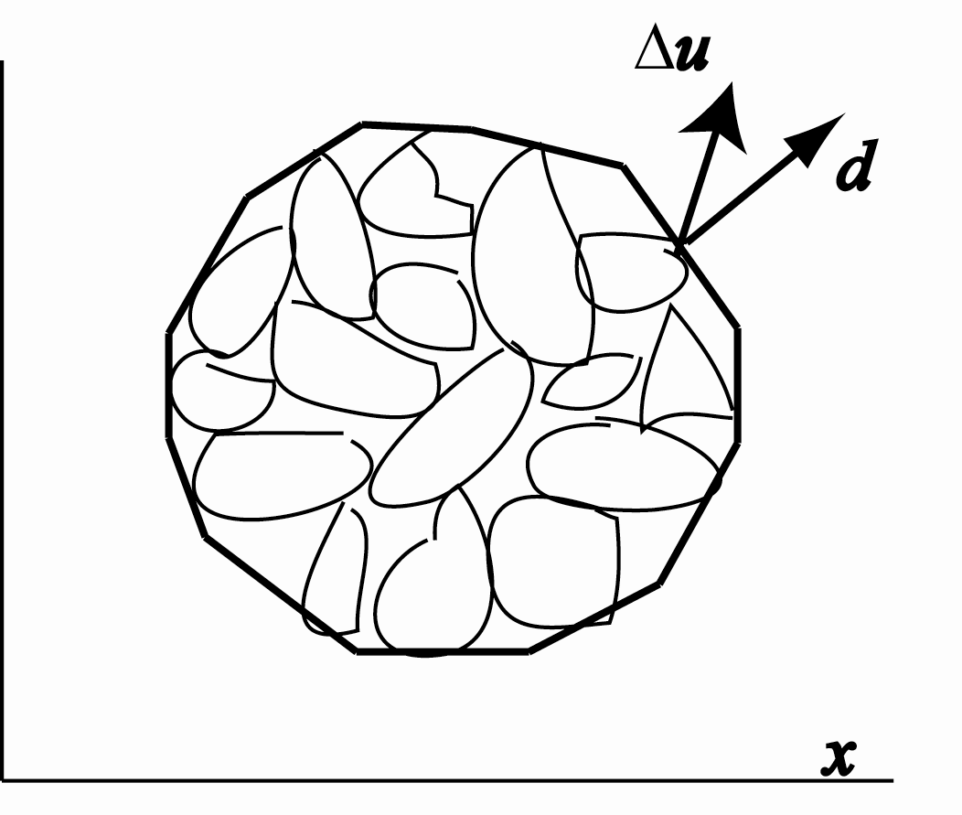
particle-continuum duality
Discrete Element Modelling of particle interactions
homogenisation procedure required to produce continuum quantities
stress
strain

Slide 26
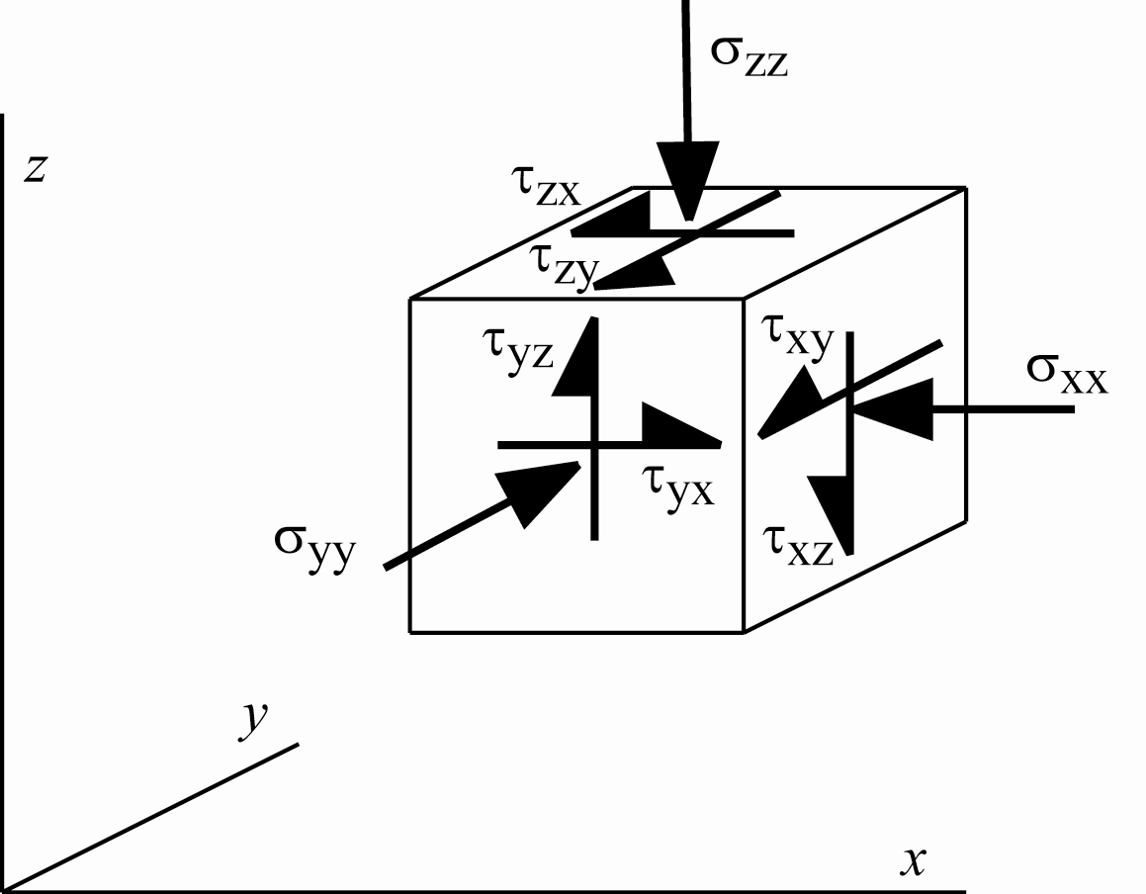
Laboratory element testing
general stress state has 6 degrees of freedom
we may calibrate models using triaxial test data but soil elements in the ground and in numerical modelling will certainly break away from axial symmetry
beware of unintended responses in uncalibrated regions of stress space

Slide 27
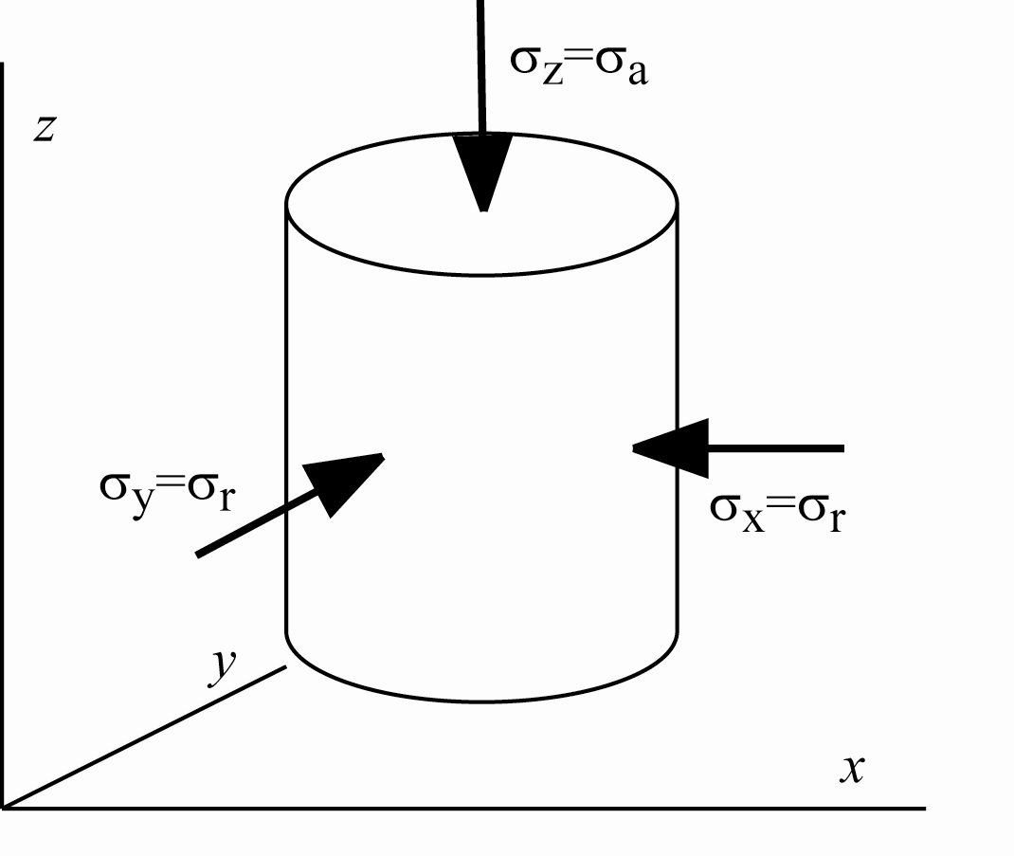
Laboratory element testing
axial symmetry
triaxial apparatus
centreline of circular loaded area
widely available source of data of stress:strain response

Slide 28
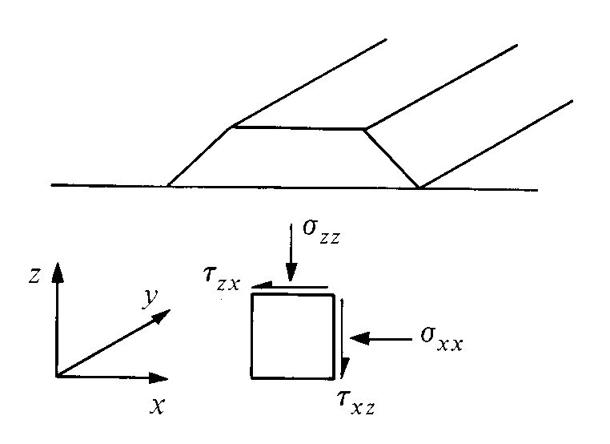
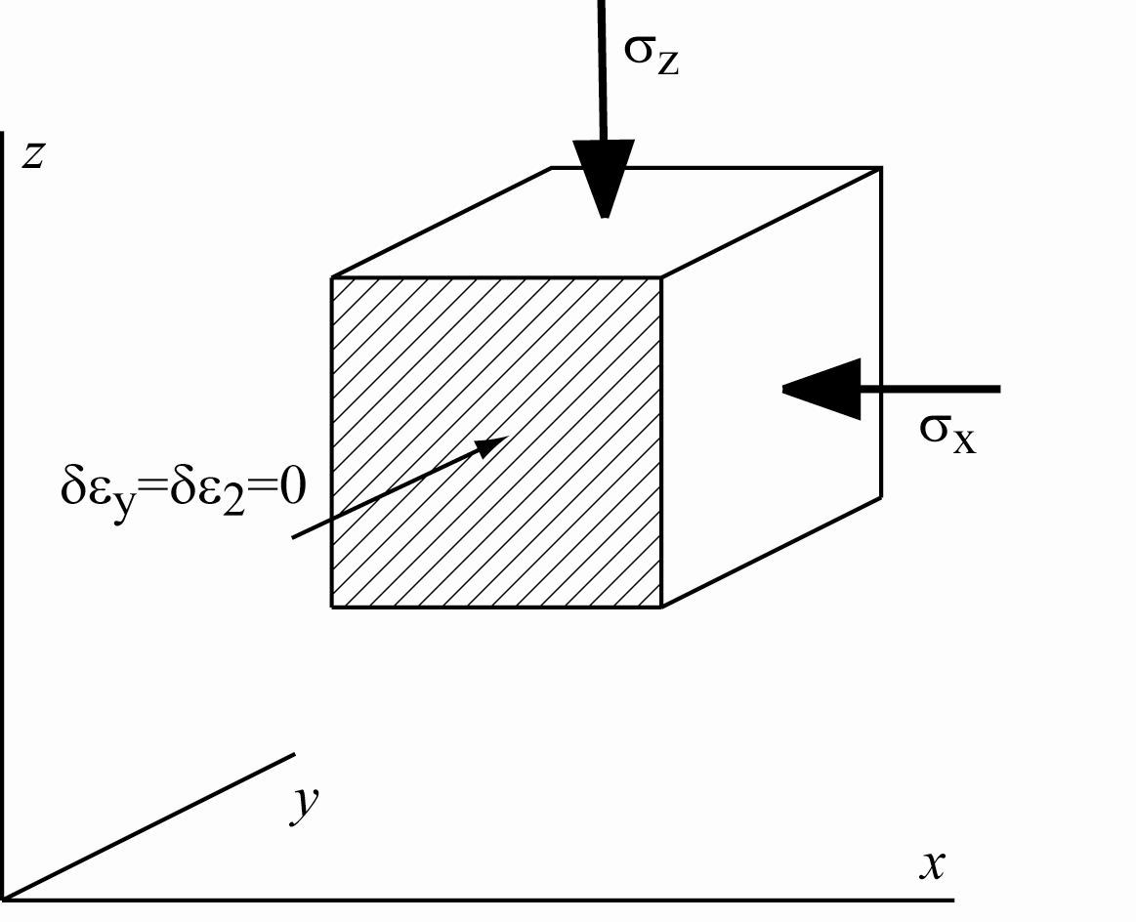
Laboratory element testing
plane strain occurs more frequently
no strain in long direction
plane strain with fixed principal axes fairly easy to apply in laboratory

Slide 29
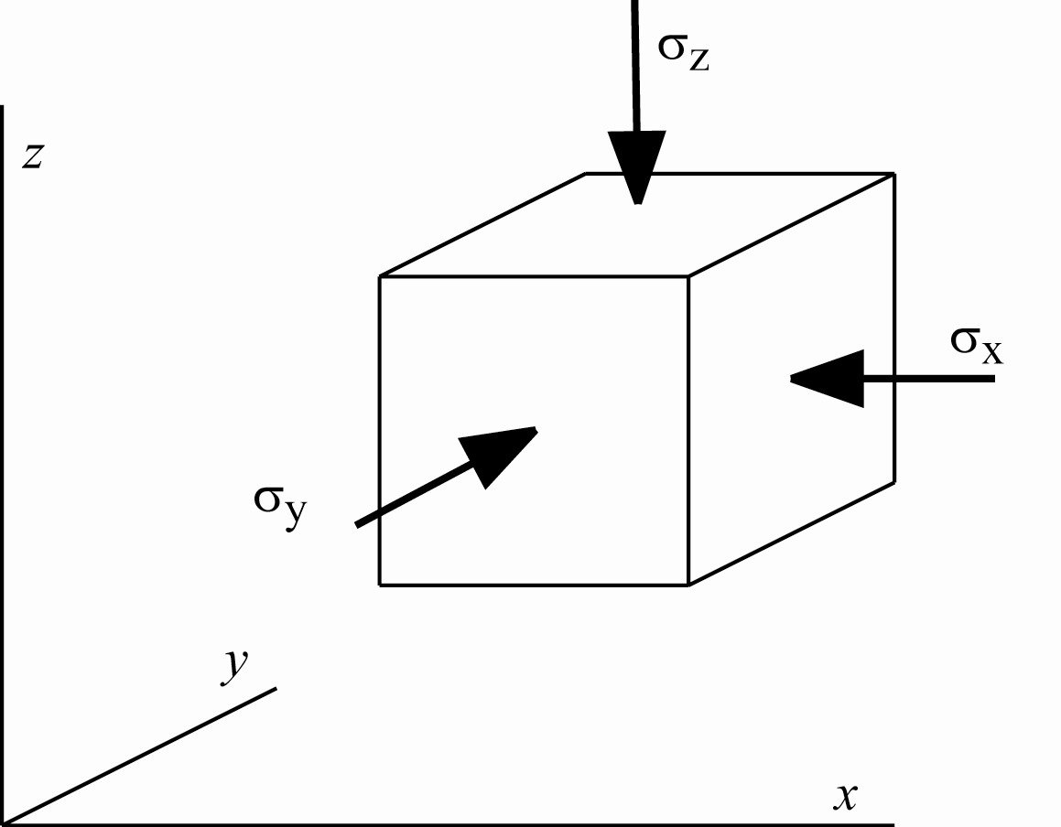
Laboratory element testing
true triaxial apparatus
3 degrees of freedom
no rotation of principal axes

Slide 30
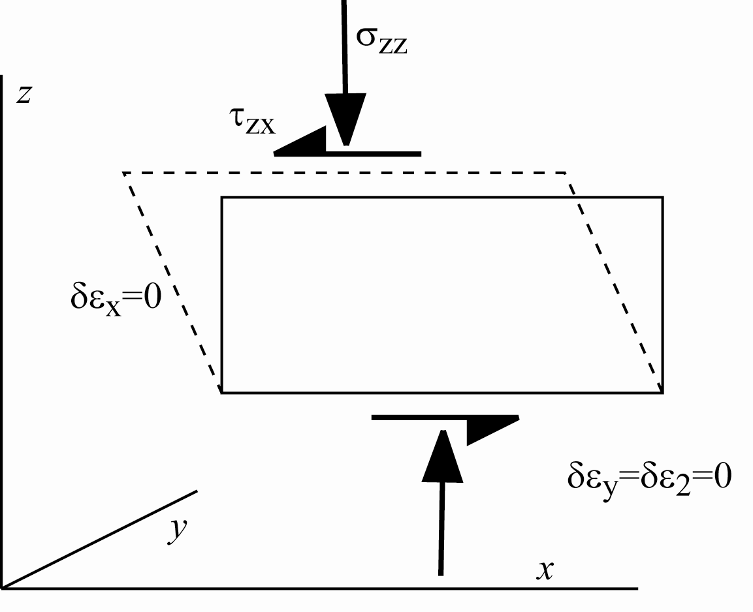
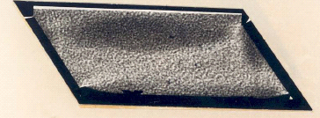
Laboratory element testing
Simple shear apparatus
plane strain with rotation of principal axes
no horizontal strain
development of shear stress on ends of sample?
questions of uniformity of stress state/strain state

Slide 31
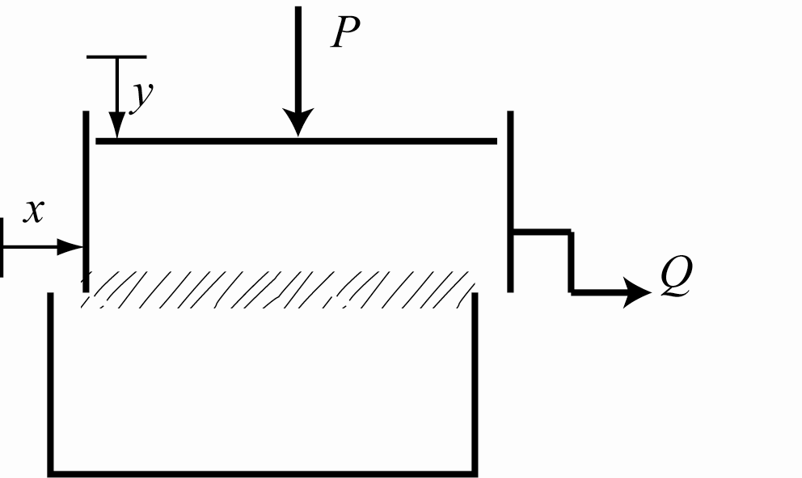
Laboratory element testing
direct shear box
inhomogeneous deformation
strength information
pedagogic illustration of dilatancy

Slide 32
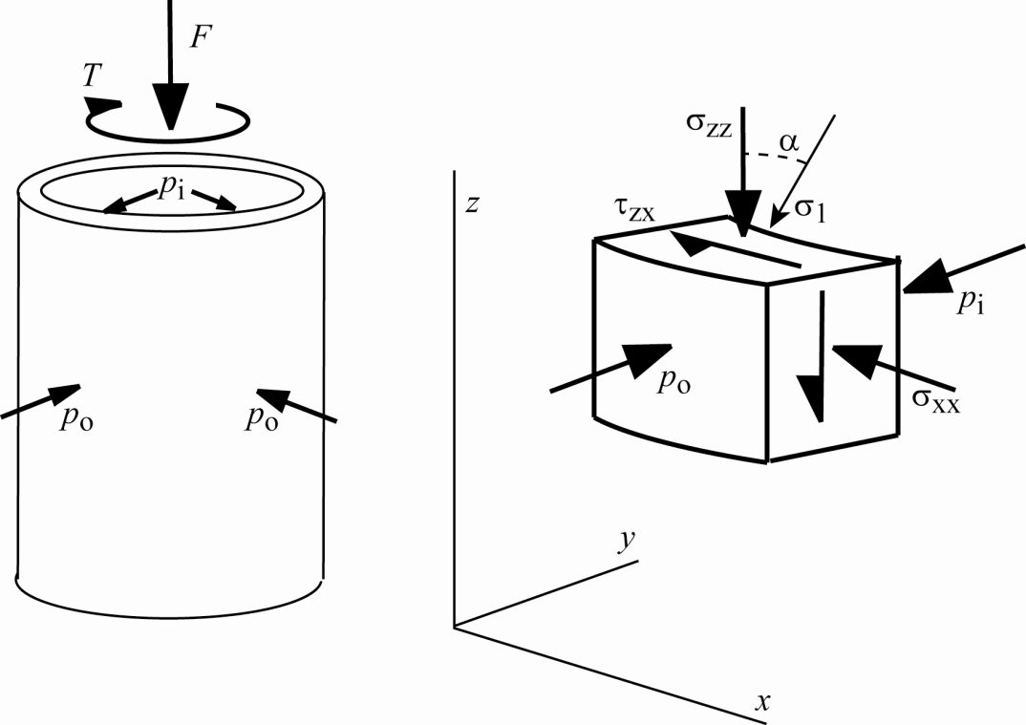
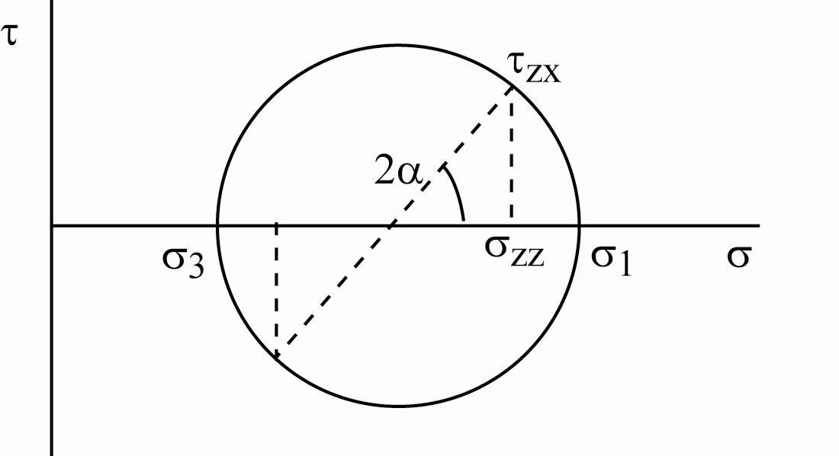
Laboratory element testing
torsional hollow cylinder apparatus
4 degrees of freedom
but radial non-uniformity
average stress quantities
with equal internal/external pressures
b = (σ₂-σ₃)/(σ₁-σ₃) = sin² α
constraint on stress space exploration

Slide 33
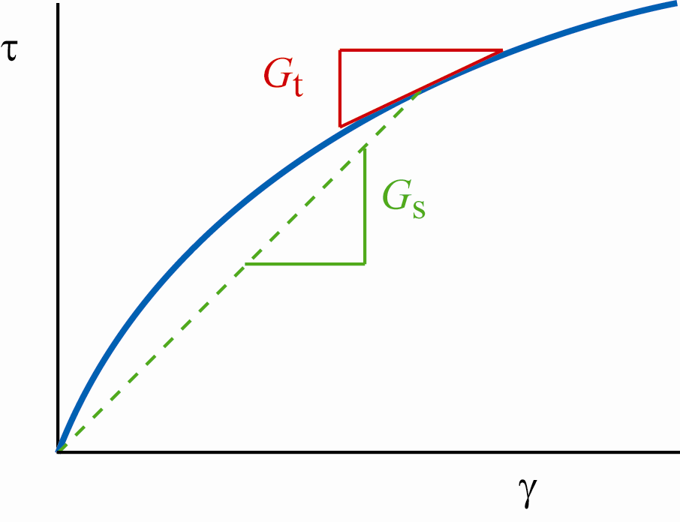
Stiffness
secant stiffness G_{s} tells us where we are now but gives no indication of how we got there
tangent stiffness G_{t} tells us about current incremental response
beware: use of term ‘stiffness’ does not imply elasticity

Slide 34
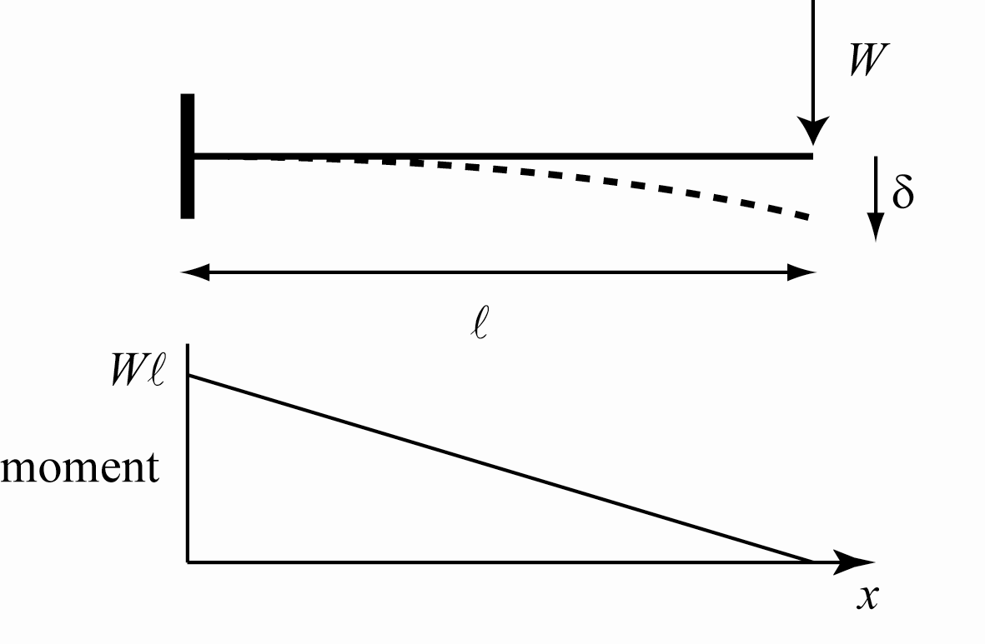
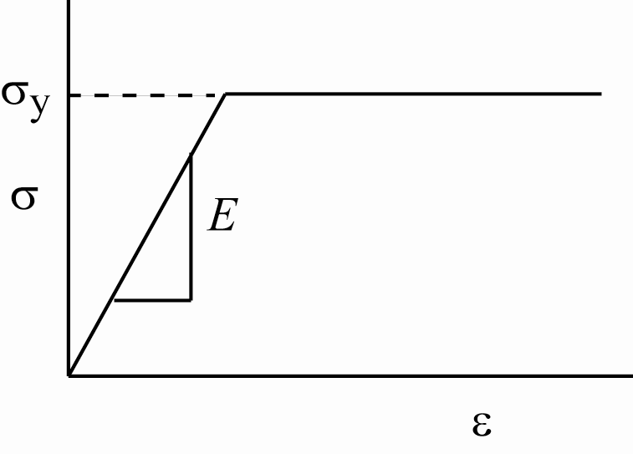
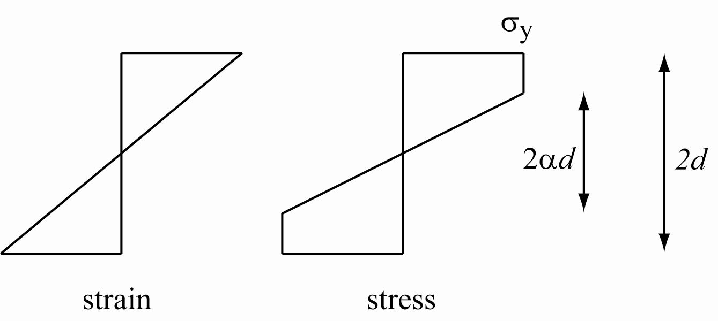
Stiffness
progressive yielding of steel cantilever as analytical illustration of distinction between tangent and secant stiffness
elastic-plastic model for steel
plastic region penetrates from edges towards centre of beam

Slide 35
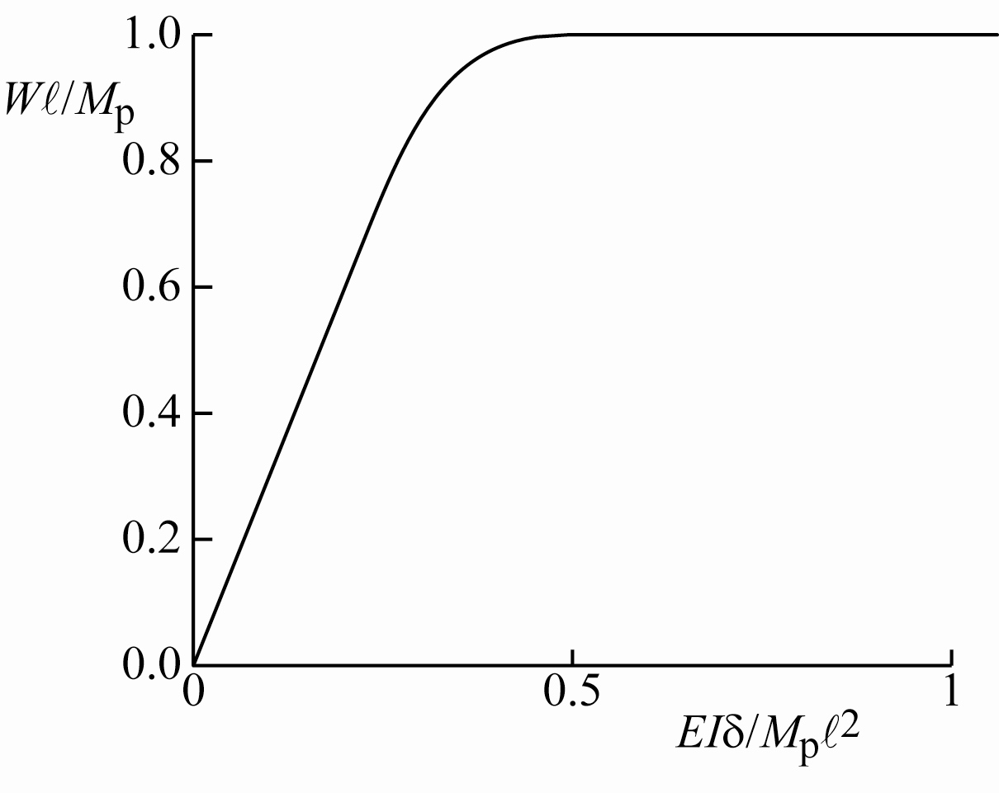
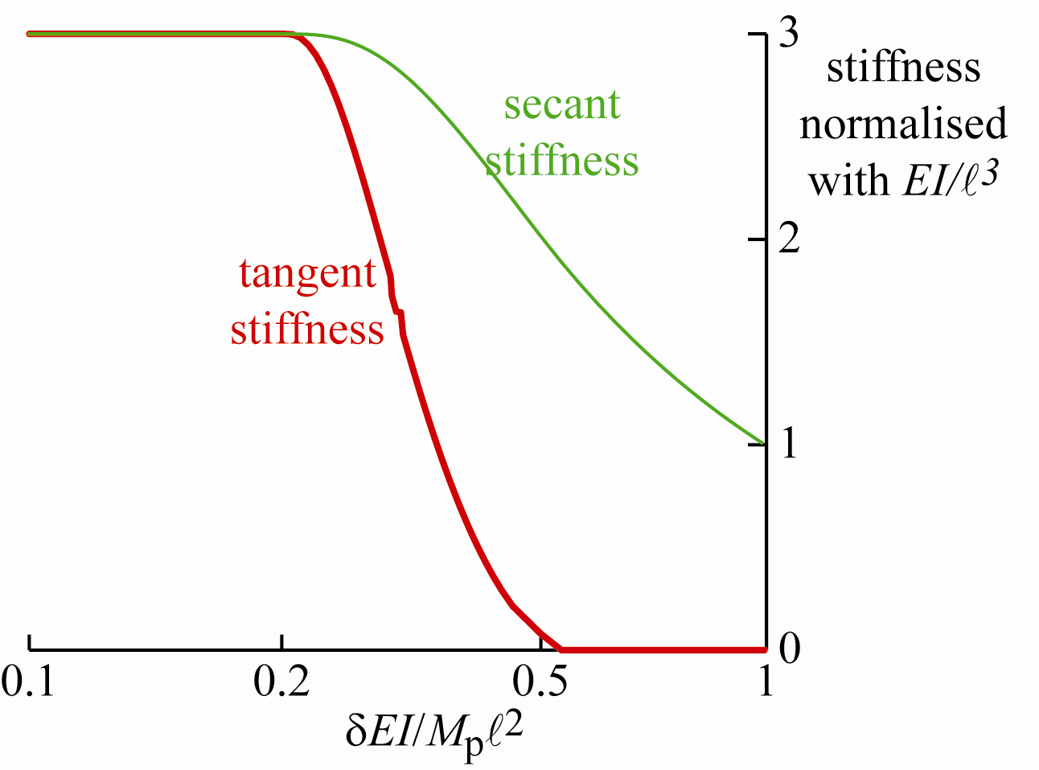
Stiffness: steel cantilever
tip displacement – log scale
tangent stiffness falls as yielding spreads
tangent stiffness zero when full plastic hinge has formed
secant stiffness remains positive and non-zero

Slide 36
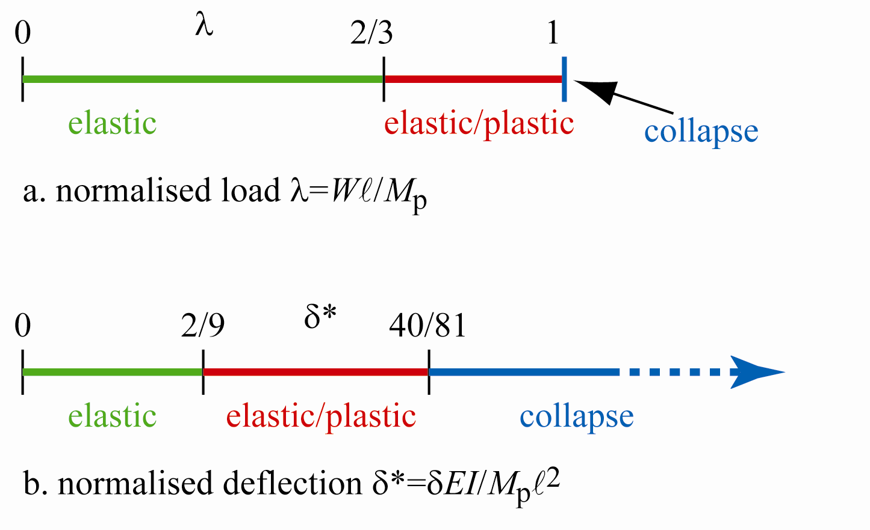
Stiffness: steel cantilever
load line
deflection line
stiffness good – compliance bad!
load line limited by collapse load of cantilever
deflection line unlimited (ignore geometry changes)
many to one mapping – we can always map from deflection to load but not always from load to deflection

Slide 37
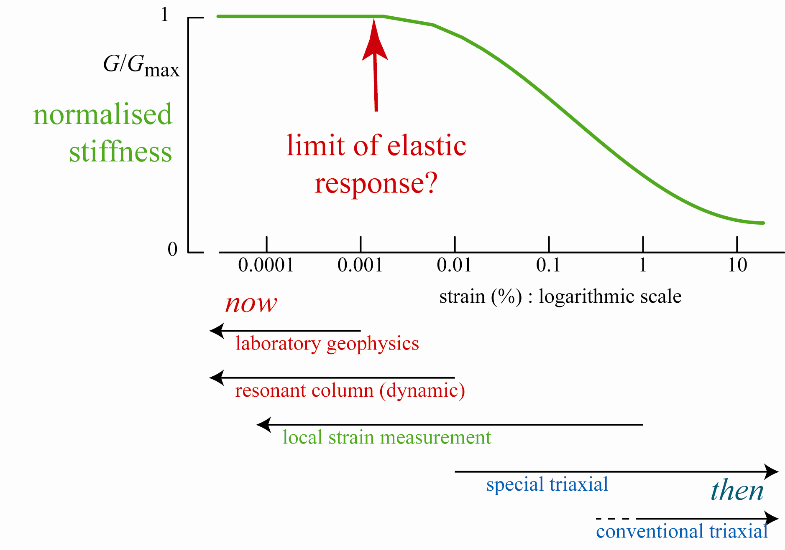
stiffness

Slide 38
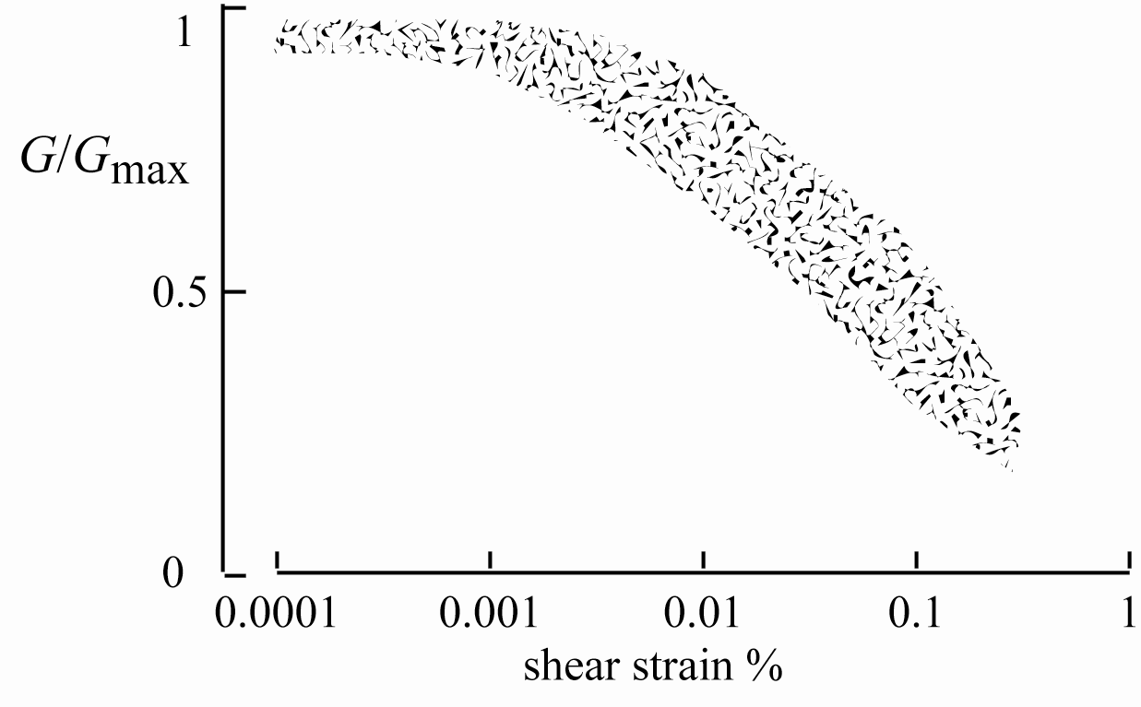
Stiffness
secant stiffness
variation of stiffness is due to plasticity
hence need for constitutive models
Quiou sand (LoPresti et al., 1997)

Slide 39
Summary
modelling is all around us
care in selection of strain increment and stress variables
pore pressure parameter as a variable
particle-continuum duality
laboratory element testing – not just axial symmetry – but more general stress states not easily accessible
tangent and secant stiffness
stiffness/compliance formulation?

