Slide 1

Saturated soil modelling
David Muir Wood
University of Dundee, Scotland
Griffith University, Brisbane
February 2010

Slide 2
Monday 15 February
0830–0900 Registration
0900–1000 Introduction to modelling: soil behaviour
1000–1100 Elastic modelling
1100–1115 Coffee break
1115–1215 One-dimensional model
1215–1300 Lunch
1315–1415 The most widely used soil model: Mohr-Coulomb
1415–1530 Cam clay I
1530–1545 Coffee break
1545–1715 Practical exercise : choice of soil parameters

Slide 3
Tuesday 16 February
0900–1000 Hardening plasticity models: Cam clay II
1000–1100 Cam clay improved: nonlinearity and structure
1100–1115 Coffee break
1115–1215 Mohr-Coulomb improved: nonlinearity and critical states
1215–1300 Lunch
1300–1430 Practical exercise: stress paths and laboratory testing
1430–1600 Modelling particle breakage and erosion of fine particles
1600–1615 Coffee break
1615–1715 Constitutive modelling: Concluding remarks

Slide 4
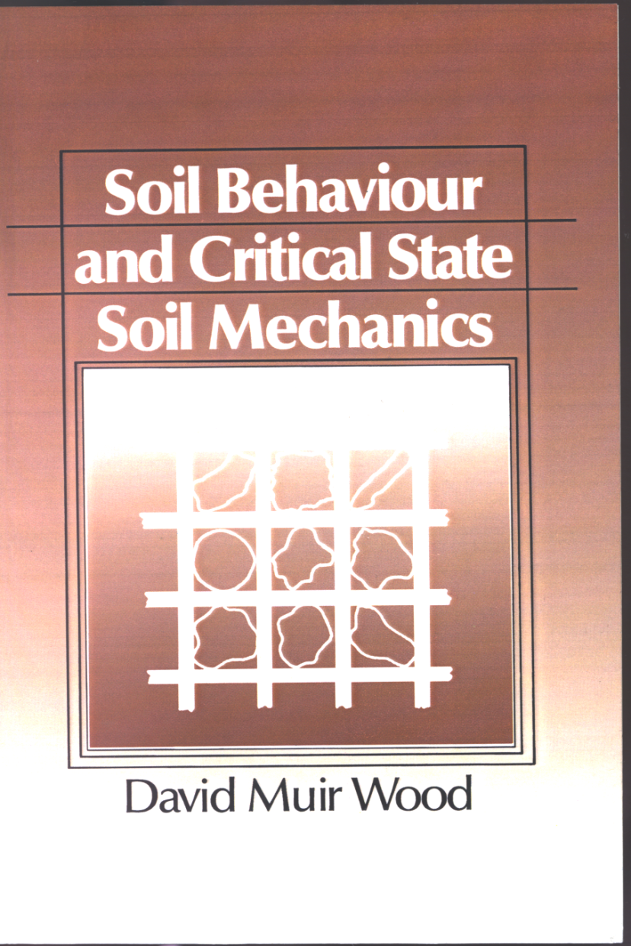
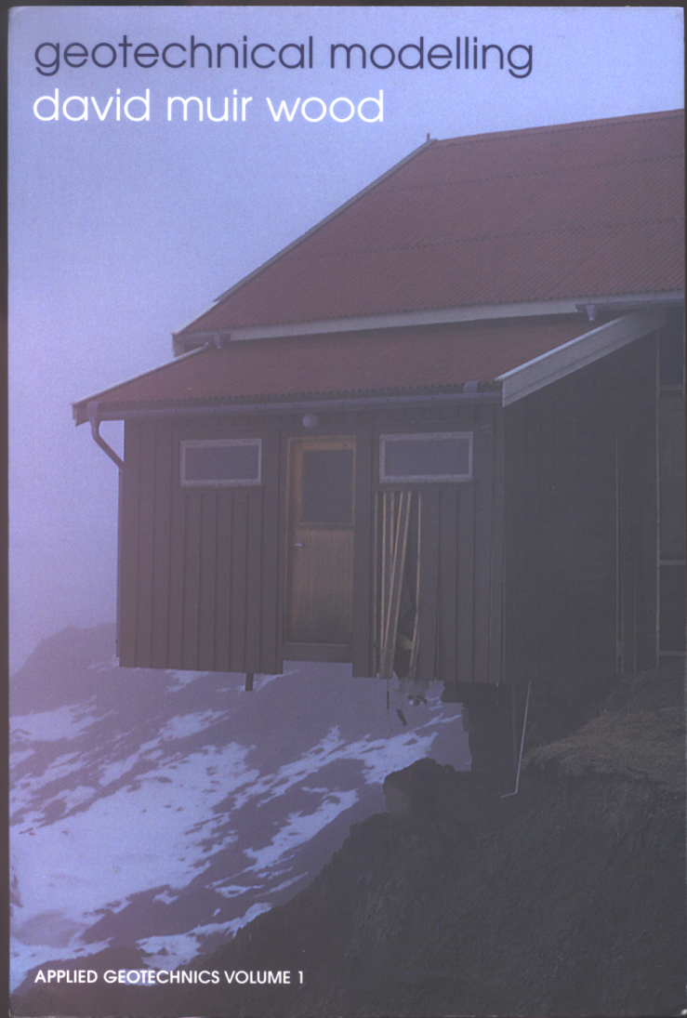
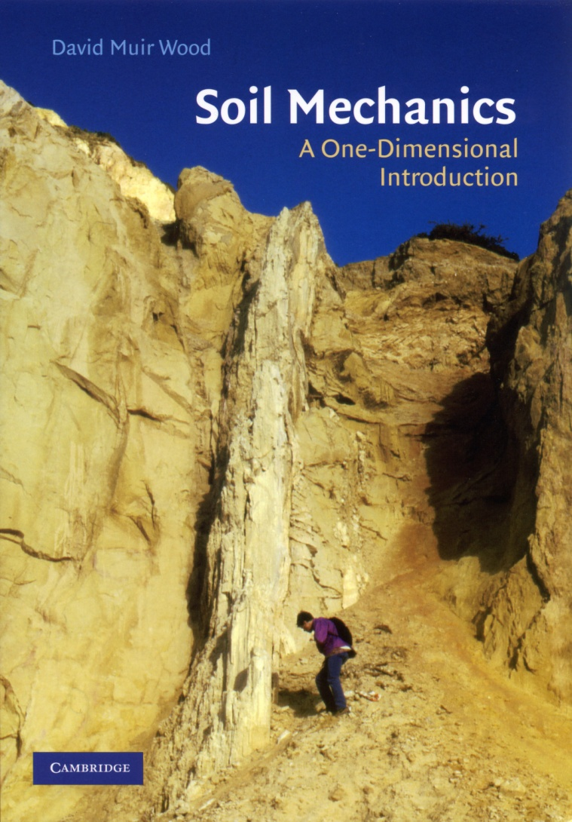
CUP (1990) Spon (2004) CUP (2009)

Slide 5
SBCSSM: Soil behaviour and critical state soil mechanics. Cambridge University Press 1990
GM: Geotechnical modelling. Spon Press 2004
1D: Soil mechanics: a one-dimensional introduction.
Cambridge University Press 2009

